Slide 1
Git Started on Windows with PowerShell
Keith Dahlby
http://solutionizing.net/
@dahlbyk

Slide 2
1. Download
msysgit
http://code.google.com/p/msysgit/downloads

Slide 3
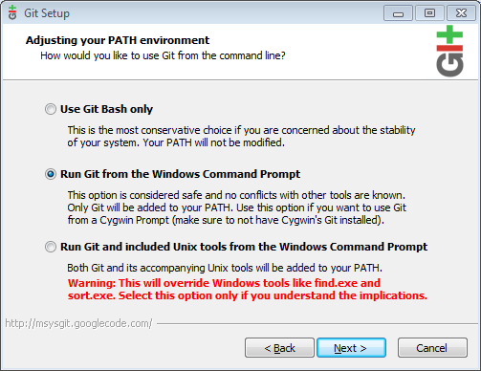
2. Install

Slide 4
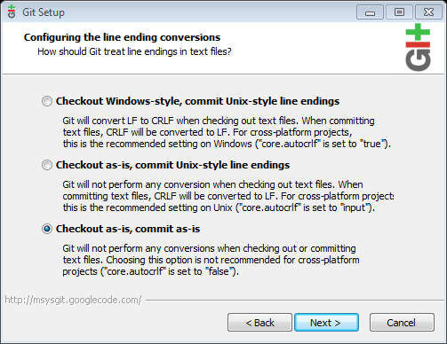
2. Install

Slide 5
3. Get posh-git
Clone from GitHub
http://github.com/dahlbyk/posh-git
./install.ps1

Slide 6
Resources
http://git-scm.com/
http://gitref.org/
http://gitready.com/
http://progit.org/
http://github.com/dahlbyk/posh-git
Me
http://solutionizing.net/
keith@ ---^
@dahlbyk

