Slide 1
What’s New in C# 4 & VB 10
Keith Dahlby
http://solutionizing.net/
@dahlbyk

Slide 2

Who am I?
Iowa Native
Iowa State University
Cedar Rapids
SharePoint → ASP.NET MVC
J&P Cycles
Language Geek

Slide 3
Agenda
Embedded Interop Types
Language Parity
Generic Variance
Dynamic Language Runtime

Slide 4
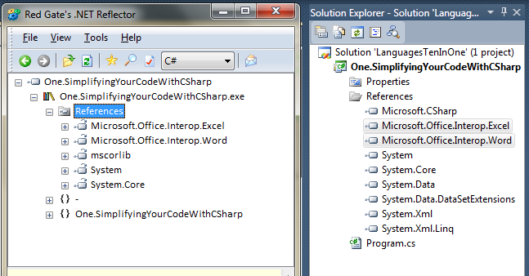
Embedded Interop Types

Slide 5
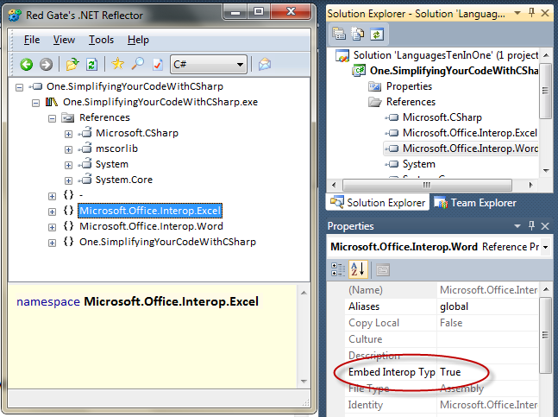
Embedded Interop Types

Slide 6
Language Parity
VB: Lambda Expressions
VB: Auto-implemented Properties
VB: Implicit Line Continuations
VB: Collection Initializers
VB: Array Literals
VB: Nullable Optional Parameters
C#: Named/Optional Parameters

Slide 7
Lambda Expressions
Visual Basic 9
Function (x) x+1
Visual Basic 10
Function (x) Return x + 1 End Function
Sub (x) Console.WriteLine(x) End Sub
Sub (x) Console.WriteLine(x)

Slide 8
Auto-Implemented Properties
Property ID() As Integer = -1
Compiles into… Private _ID As Integer = -1 Property ID() As Integer Get Return _ID End Get Set(ByVal value As Integer) _ID = value End Set End Property
Cannot be ReadOnly or WriteOnly

Slide 9
Implicit Line Continuations
After a comma
After a dot (member access)
After a binary operator (+, =, +=, &, And, etc)
After a LINQ query clause
After a (, {, or <%=
Before a (, }, or %>

Slide 10
Collection Initializers
Dim list = new List(Of String) From { "abc", "def", "ghi“ }
Dim dict = new Dictionary( Of Integer, String) From { {1, "abc"}, {2, "def"}, {3, "ghi"} }
Passed into Add() method or extension

Slide 11
Array Literals
Type is inferred if possible
Dim a = {1, 2, 3}
Dim b = {"1", "2", "3"}

Slide 12
Nullable Optional Parameters
Sub Add( x As Integer, y As Integer, Optional z As Integer? = 0) …

Slide 13
C# Named/Optional Params
void MyMethod( string myString = "", int myInt = 1, double myDub = 0.1) { … }
MyMethod( myDub: -0.1, myString: "neat" );
Caveat: default value is compiled as attribute

Slide 14
Generic Variance
Covariance
Interface IEnumerable(Of Out T)
IEnumerable<object> s = new[] { "" };
Contravariance
Interface IComparer(Of In T)
Both
delegate TResult Func<in TArg, out Tresult>(TArg arg)
Interfaces and delegates only; no classes or structs
Variance requires reference conversion

Slide 15
Dynamic vs. Static
Dynamic Languages
Static Languages
Robust
Simple and succinct
Intelligent tools
Implicitly typed
Meta-programming
No compilation
Performant
Better scaling

Slide 16
Diverse Object Models
C# and Visual Basic were designed to work great with .NET’s strongly-typed libraries.
However, there are many other object models out there that rely on specific features from their original target language!
C#
Visual Basic
HTML DOM
.NET BCL
COM
Python Libs

Slide 17
HTML DOM – J(ava)Script
J(ava)Script:
C# 3.0 (Silverlight):
var loc = new VELatLong(latitude, longitude);
var pin = map.AddPushpin(loc);
pin.SetTitle(title);
pin.SetDescription(description);
map.SetCenterAndZoom(loc, 7);
ScriptObject loc = win.CreateInstance(
"VELatLong", latitude, longitude)
ScriptObject pin =
(ScriptObject)map.Invoke("AddPushpin", loc);
pin.Invoke("SetTitle", title);
pin.Invoke("SetDescription", description);
map.Invoke("SetCenterAndZoom", loc, 7);

Slide 18
COM – VBA
VBA:
VB.NET:
C# 3.0:
Selection.PasteSpecial Link:=True
word.Selection.PasteSpecial(Link:=True)
object missing = Type.Missing;
object link = true;
word.Selection.PasteSpecial(
ref missing, ref link, ref missing,
ref missing, ref missing, ref missing,
ref missing);

Slide 19
Python Libraries
Python:
C# 3.0:
import random
random.shuffle(items)
var source = engine.
CreateScriptSourceFromFile(@"lib\random.py");
var scope = engine.CreateScope();
source.Execute(scope);
scope.SetVariable("items", items);
var source1 = engine.CreateScriptSourceFromString(
"random.shuffle(items)");
source1.Execute(scope);

Slide 20
Common Language Runtime
.NET 4.0
DLR
Dynamic
Dispatch
Expression
Trees v2
Call Site Caching
.NET 3.5
LINQ
Extension
Methods
Expression
Trees
Silverlight
.NET 2.0
Fast
Delegates
Generics
In Runtime
Dynamic
Methods
.NET 1.0
JIT
GC
Reflection
BCL
Verifier
Sandbox
Dynamic
Codegen

Slide 21





.NET Dynamic Programming
IronPython
IronRuby
C#
VB.NET
Others…
Dynamic Language Runtime
Dynamic Dispatch
Expression Trees
Call Site Caching
Object Binder
JavaScript Binder
Python Binder
Ruby Binder
COM Binder

Slide 22
Dynamically Typed Objects
Calculator calc = GetCalculator();
int sum = calc.Add(10, 20);
object calc = GetCalculator();
Type calcType = calc.GetType();
object res = calcType.InvokeMember("Add",
BindingFlags.InvokeMethod, null,
new object[] { 10, 20 });
int sum = Convert.ToInt32(res);
ScriptObject calc = GetCalculator();
object res = calc.Invoke("Add", 10, 20);
int sum = Convert.ToInt32(res);
Statically typed to be dynamic
dynamic calc = GetCalculator();
int sum = calc.Add(10, 20);
Dynamic conversion
Dynamic method invocation

Slide 23
Dynamically Typed Objects
public static class Math
{
public static decimal Abs(decimal value);
public static double Abs(double value);
public static float Abs(float value);
public static int Abs(int value);
public static long Abs(long value);
public static sbyte Abs(sbyte value);
public static short Abs(short value);
...
}
Method chosen at compile-time: double Abs(double x)
double x = 1.75;
double y = Math.Abs(x);
Method chosen at run-time: double Abs(double x)
dynamic x = 1.75;
dynamic y = Math.Abs(x);
Method chosen at run-time: int Abs(int x)
dynamic x = 2;
dynamic y = Math.Abs(x);

Slide 24
dynamic in a Nutshell
Implicit: CLR → dynamic
Implicit: dynamic → CLR
Any expression using dynamic is dynamically evaluated
Static type of dynamically-evaluated expression is dynamic*
* Unless it’s not

Slide 25
Dynamic in Visual Basic 10
Dynamic dispatch is not new:
Option Strict Off
VBx (10) Uses DLR

Slide 26
Creating Dynamic Objects
ExpandoObject
Key-Value Pairs
Accessed as properties
DynamicObject
Abstract Base Class
IDynamicMetaObjectProvider
DynamicMetaObject GetMetaObject( Expression parameter)

Slide 27
Creating Dynamic Objects

Slide 28
.NET Dynamic Programming
IronPython
IronRuby
C#
VB.NET
Others…
Dynamic Language Runtime
Dynamic Dispatch
Expression Trees
Call Site Caching
Object Binder
JavaScript Binder
Python Binder
Ruby Binder
COM Binder

Slide 29
Resources
PDC on Channel 9
http://channel9.msdn.com/tags/Languages/
C# in Depth, 2nd Edition by Jon Skeet (Manning EAP)
Bart De Smet – Microsoft Language Geek
http://community.bartdesmet.net/blogs/bart/
Me
http://solutionizing.net/
keith@ ---^
@dahlbyk

