Slide 1
Year in Preview: Advice From the 2013 Software Craftsmanship Calendar
Keith Dahlby
@dahlbyk

Slide 2



Who am I?
Iowa Native
Iowa State University
Cedar Rapids
ASP.NET MVC
Language Geek
Developer of posh-git (Git with PowerShell)

Slide 3
Who are you?

Slide 4
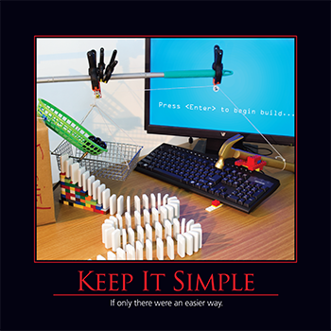
KISS: Keep It Simple (Stupid)
Debugging is twice as hard as writing the code in the first place. Therefore, if you write the code as cleverly as possible, you are, by definition, not smart enough to debug it.
― Brian Kernighan

Slide 5

Separation of Concerns
…even if not perfectly possible, [separation of concerns] is yet the only available technique for effective ordering of one’s thoughts.
― Edsger W. Dijkstra

Slide 6
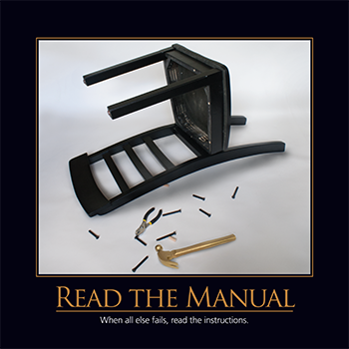
RTFM: Read the Manual, Please
Life is too short for man pages, but occasionally much too short without them.
― XDCD #293

Slide 7
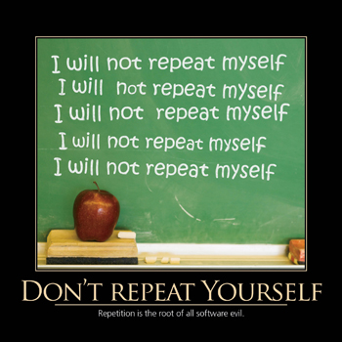
DRY: Don’t Repeat Yourself
The Don’t Repeat Yourself Principle is ‘There can be only one!’ (expression of any rule or functionality that could conceivably change)
― Jeremy Miller

Slide 8
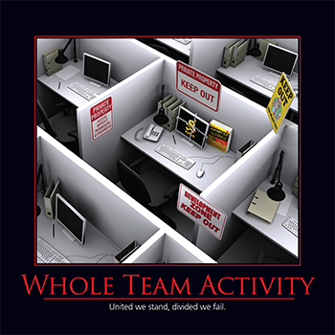
Whole Team Activity
Customers don’t want software; they want their problems solved. Complete solutions are built by complete teams.
― Mary & Tom Poppendieck

Slide 9

Hollywood Principle
We allow low-level components to hook themselves into a system, but the high-level components determine when they are needed, and how.
― Eric Freeman Head First Design Patterns

Slide 10

SOLID
If I had to write commandments, these would be candidates.
― Robert Martin

Slide 11
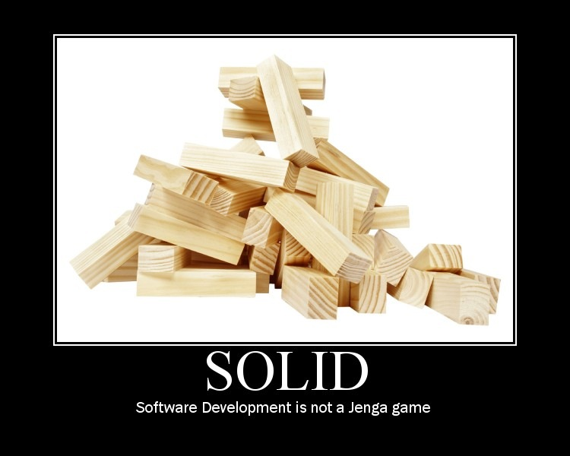

Slide 12
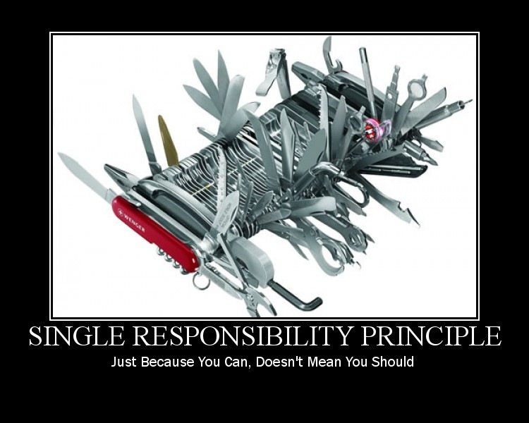

Slide 13


Slide 14
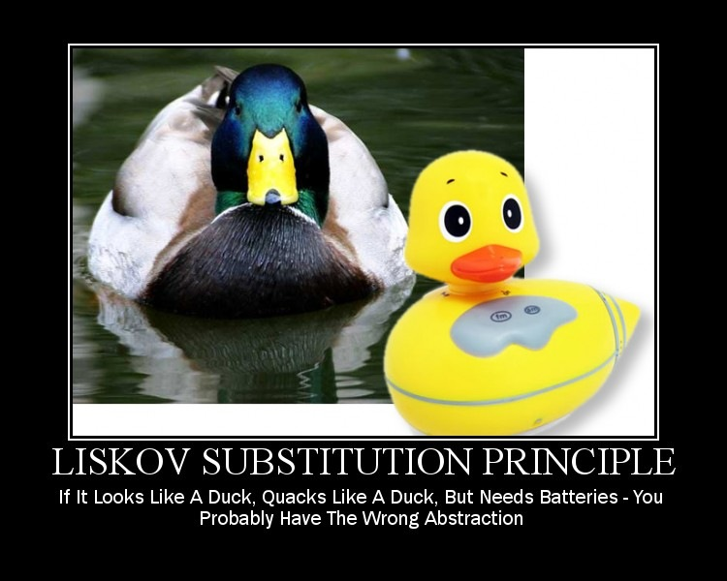

Slide 15
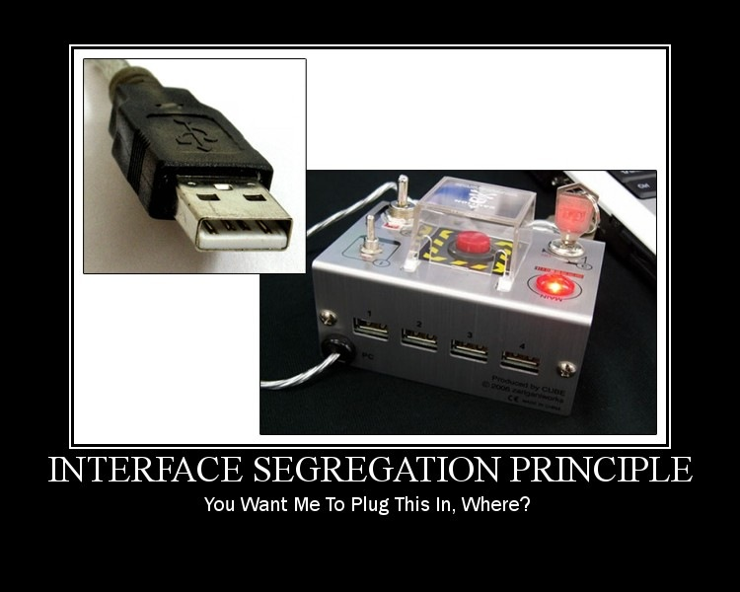

Slide 16


Slide 17
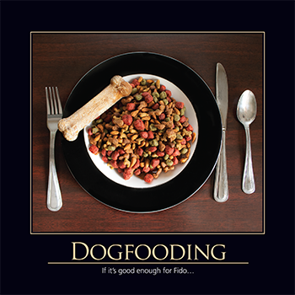
Dogfooding
… nothing exudes confidence like software developers who are willing to stick their own extremities into the spinning blades of software they’ve written.
― Jeff Atwood

Slide 18
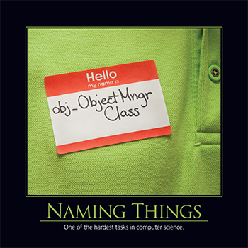
Naming Things
There are only two hard things in Computer Science: cache invalidation, naming things and off-by-one-errors.
― Phil Karlton (modified via Twitter)

Slide 19

YAGNI: You Ain’t Gonna Need It
The best way to have fewer bugs is to implement less code.
― Ron Jeffries

Slide 20

Know Where You’re Going
Without requirements or design, programming is the art of adding bugs to an empty text file.
― Louis Srygley

Slide 21
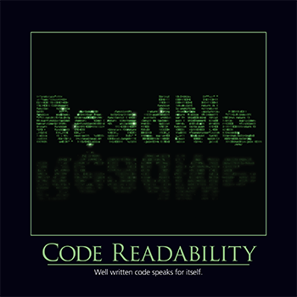
Code Readability
Any fool can write code that a computer can understand. Good programmers write code that humans can understand.
― Martin Fowler

Slide 22
Credits
2013 Software Craftsmanship Calendar
http://gear.telerik.com/
Images from http://deviq.com/
Derick Bailey’s SOLID Motivational Posters
http://bit.ly/solid-posters

