Slide 1
Git More Done
Keith Dahlby
http://solutionizing.net/
@dahlbyk

Slide 2




Who am I?
Iowa State University
Cedar Rapids, IA
ASP.NET MVC
jpcycles.com – we’re hiring!
Language Geek
Developer of posh-git (Git with PowerShell)

Slide 3
Who are you?

Slide 4
Git More Done
This talk is not about:
This talk is about:
Getting started
Remotes (push/pull)
Team workflow
Internals
Neat stuff I don’t use…
Hooks
Submodules
Subtree merging
Conserving keystrokes
Local workflow
Fixing “oops”
Finding bugs
Your questions

Slide 5
Conserving Keystrokes

Slide 6
git config
Hundreds of settings
git help config
Current config
git config -l
git config name
Set value
git config name value

Slide 7
git config
Scope | Switch | Location
Repository |  | .git/config
User | --global | ~/.gitconfig
System | --system | {install dir}/etc/gitconfig
File | --file config-file | config-file

Slide 8
git config
git config -e --global
# git config core.autocrlf false
[core]
autocrlf = false
# git config branch.master.rebase true
[branch "master"]
remote = origin
merge = refs/heads/master
rebase = true

Slide 9
git config
Setting | Values
core.editor | Path to editor
diff.renames | false = don’t detect renames (default) true = detect renames copies = detect renames & copies
help.autocorrect | 0 = show but don’t execute (default) N = execute correction after N tenths of a second -N = execute correction immediately
log.date | relative, local, default, iso, rfc short
merge.log | false = no merge log N = add up to N merged commit messages to log true = synonym for 20

Slide 10
git config
[difftool]
prompt = false
[mergetool]
prompt = false
keepBackup = false
[diff]
tool = p4
[merge]
tool = p4
[difftool "p4"]
cmd = \"c:/program files/Perforce/p4merge.exe\" \"$LOCAL\" \"$REMOTE\"
[mergetool "p4"]
cmd = \"c:/program files/Perforce/p4merge.exe\" \"$BASE\" \"$LOCAL\" \"$REMOTE\" \"$MERGED\"
trustExitCode = false

Slide 11
Aliases
Wrap git command + arguments
git config alias.ds "diff --stat"
git ds → git diff --stat
Wrap shell commands
alias.gitka = !gitk --all
alias.svn-up = !git svn fetch && git svn rebase -l

Slide 12
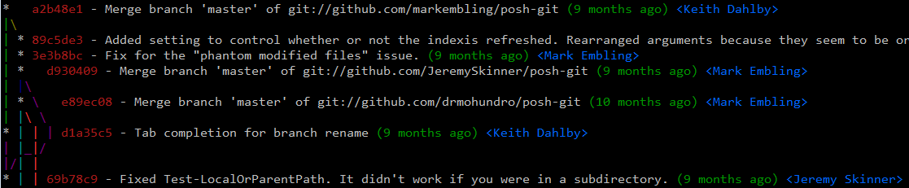
Aliases
alias.di = diff --staged
alias.new = log master.. --reverse
alias.rbc = rebase --continue
http://bit.ly/better-git-svn
http://bit.ly/git-lg

Slide 13
Naming Commits
SHA1 name
Or unique initial substring (6 often sufficient)
Symbolic references
Branch: refs/heads/dev = dev
Tag: refs/tags/v0.1 = v0.1
Remote references
refs/remotes/origin/dev = origin/dev

Slide 14
Naming Commits
HEAD = what’s checked out
Reference to branch
On commit, reference updates with HEAD
Arbitrary commit (detached HEAD)
ORIG_HEAD = “undo” for big HEAD changes
Saved before reset, merge, pull, etc
FETCH_HEAD = last fetched from remote
MERGE_HEAD = incoming merge commits

Slide 15
Naming Commits
Suffixes
^ = first parent; ^n = nth parent
~n = nth-generation grandparent (~1 = ^; ~3 = ^^^)
@{n} = nth prior value for that ref
HEAD@{1}
@{date} = value at past point in time
master@{1 week ago}
git help revisions

Slide 16
Local Workflow

Slide 17
Git Knows Developers
We have many responsibilities
We switch contexts often
We make mistakes
We love to refactor

Slide 18
Branching
Keep master clean!
Create branch but stay where you are
git branch <name> <commit>
Switch to new branch
git checkout <commit> -b <name>
Branches to clean up
git branch --merged

Slide 19
git stash
Stash away work in progress
Preserves working directory & index
Typical workflow
Working on topic branch
git stash
Switch to other branch, hack away, switch back
git stash pop

Slide 20
git stash
Other useful operations
git stash list
git stash show -p
git stash drop stash@{1}
git stash save --keep-index
git stash branch <name>

Slide 21
Temporary Commits
Stays with branch
Works well with rebase
Typical workflow
Working on topic branch
git commit -m "WIP: Need impl"
Switch to other branch, hack away, switch back
git reset HEAD~
Pretend WIP commit never happened

Slide 22
git reset
Two distinct operations…confusing!
Reset paths in index to match commit:
git reset commit -- <paths>…
git reset -- staged-file.txt
Reset HEAD reference to commit:
git reset [--<mode>] commit
git reset --hard HEAD^

Slide 23
git reset
Reset Modes
hard = reset index and working tree
Undo changes (ignores untracked files)
mixed = reset index but not working tree (default)
Unstage everything
soft = only move HEAD ref
merge & keep = special purpose

Slide 24
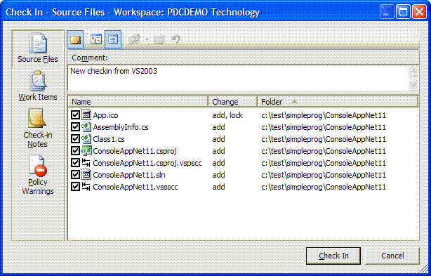
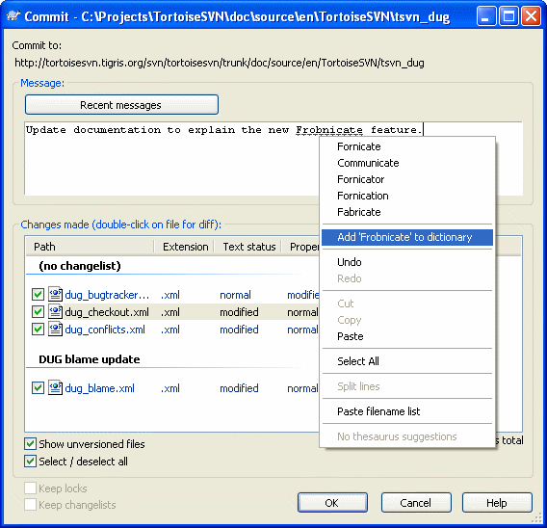
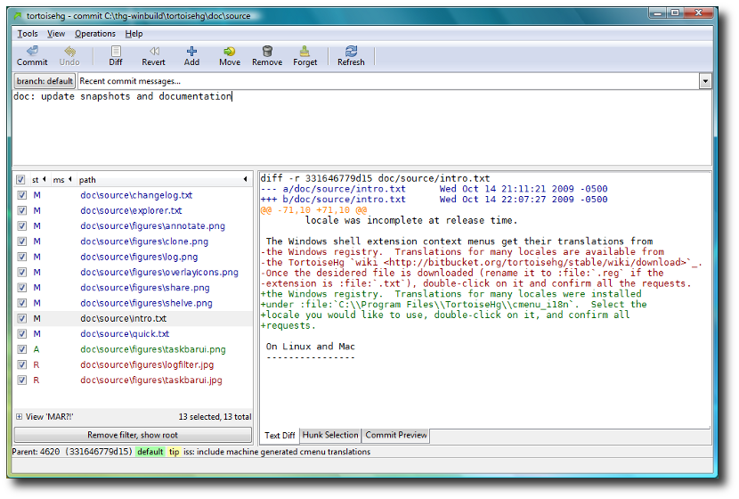
Review: Staging Area

Slide 25
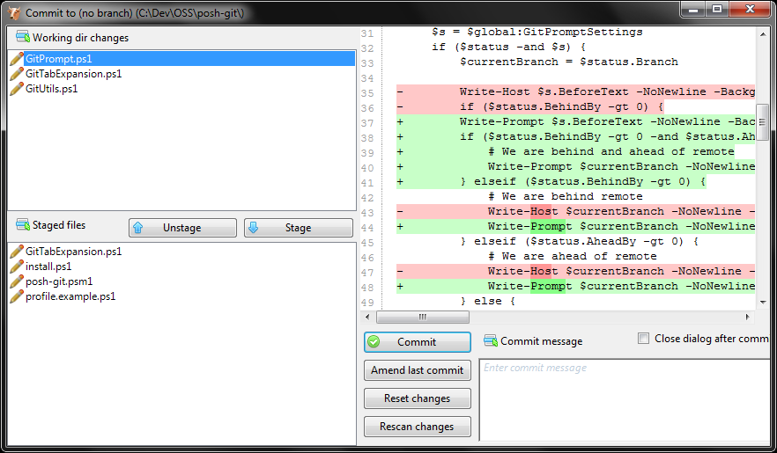
Git Staging Area (Index)
reset
add
add -p

Slide 26
git add --patch
Overlapping logical changes to one file
Reformatting
Refactoring
Changing functionality
Pick “hunks” (sections of diff) to stage
Key operations: y/n, a/d, s (split), e (edit)
Also:
git reset -p commit -- files
git checkout -p commit -- files

Slide 27
Demo
Patchwise Add

Slide 28
Rewriting History
Permanent when pushed
Until then, pretend you were perfect
Simple case: messed up last commit
git add -A
git commit --amend
alias.cia = commit --amend -C HEAD
git cia -a --reset-author

Slide 29
git cherry-pick
Applies changeset(s) elsewhere
Commit to wrong branch?
… working on wrong-branch…
git checkout correct-branch
git cherry-pick wrong-branch
git checkout wrong-branch
git reset --hard HEAD~

Slide 30

merge vs rebase

Slide 31
merge vs rebase
Merge without rebase
A---B---C topic
/ \
D---E---F---B'--M master, HEAD
Merge after rebase
D---E---F---B'--A'--C' master, topic, HEAD
Deck of cards: shuffle vs cut

Slide 32
git rebase
Replay commits
A---B---C topic
/
D---E---F---B' master, HEAD
git rebase master topic
A'--C' topic, HEAD
/
D---E---F---B' master

Slide 33
git rebase --interactive
Replay history with modifications
A---B---C topic, HEAD
/
D---E master
git rebase -i master
C'---(A+B)' topic, HEAD
/
D---E master

Slide 34
git rebase -i --autosquash
git commit -m "Do something"
… work, another commit …
… stage work to fix "Do something" …
git commit -m "fixup! Do something"
git rebase -i --autosquash HEAD~3
Updates todo list for us
Moves fixup! after first commit; marks as fixup
rebase.autosquash = true

Slide 35
Demo
Interactive Rebase

Slide 36
Fixing “Oops”

Slide 37
git reflog
Uh oh…where did my commit go?
ls -r .git/logs
HEAD, heads, remotes
> git reflog --all
c66d5f9 refs/heads/dev2@{0}: branch: Created from origin/dev2
1df4b7e refs/heads/master@{0}: push
b6e3739 refs/remotes/origin/dev1@{0}: update by push
2c2c892 refs/remotes/origin/dev1@{1}: fetch origin: forced-update
69dcefd refs/remotes/origin/dev1@{2}: update by push
954fa68 refs/remotes/origin/dev1@{3}: pull : fast-forward
0234a69 refs/remotes/origin/dev1@{4}: pull origin: storing head
8de4df0 refs/heads/master@{1}: pull origin: Fast-forward
66e2e5f refs/heads/tiny74@{0}: commit: WIP

Slide 38
Finding Bugs

Slide 39
git bisect
Binary search through commit space
Good
Good/Bad?
Bad
Good
Good/Bad?
Bad
Good
Good/Bad?
Bad
Good
Oldest Bad!

Slide 40
git bisect
> git bisect start
> git bisect bad new-commit
> git bisect good old-commit
Bisecting: 4 revisions left to test after this
> git bisect bad
Bisecting: 2 revisions left to test after this
> git bisect good
Bisecting: 0 revisions left to test after this
> git bisect bad
5087d6… is the first bad commit
> git bisect reset

Slide 41
git bisect
Other useful operations
visualize = view = overview in gitk/log
skip = current version cannot be tested
run my_script = automated bisect

Slide 42
Review
Config for your preferences
Aliases to avoid typing
Commit naming shortcuts
Stashes and WIP commits
Patchwise add/reset/checkout
Rewriting history
Opps? reflog
Bugs? bisect

Slide 43
Resources
http://git-scm.com/
http://gitref.org/
http://gitready.com/
http://progit.org/
http://github.com/dahlbyk/posh-git
This deck: http://github.com/dahlbyk/Presentations
Evals: http://nebraskacodecamp.com/evals
keith@solutionizing.net
@dahlbyk

