Slide 1
CO² Emissions and its relation to Economic Growth
Aydin Jalilov
Georgia Leigh
Jackie Kamprath
Robert Cox Jr.
Seung min Yoo

Slide 2
Our Hypothesis
To see if environmental quality (looking at CO² emissions) is related to economic growth.

Slide 3
Our Motivation
There is Emerging Global concern about the Climate due to the amount of greenhouse gases in the atmosphere, particularly CO2, which has been challenged by some countries claiming that the environmental degradation is directly related to Economic Growth and is inevitable.
Here we work to analyze Global CO2 emissions within the context of Economic Growth.
The analysis conducted on different group of countries based on their GDP per capita to find out whether this claim holds true.

Slide 4
OUR research questions
How does the US CO² emissions per capita volumes compare against those in other developed nations, focusing on EU nations.
How are GDP and CO² emissions per capita correlated in Least developed nations.
How are total amount of the CO² in kt and total GDP (inflation included) correlated – US only
What are the main sources of CO² emissions and how are they correlated.
Why are there fluctuations in CO² emission over time? Insights
Statistical Tests – Ttest, Anova, Kruskal-

Slide 5
World Development Indicators
World Bank’s premier compilation of cross-country comparable data on development
Is a compilation of relevant, high-quality, and internationally comparable statistics about global development and the fight against poverty.
The database contains thousands of indicators for 217 economies and more than 40 country groups, with data for many indicators going back more than 50 years.
Notes:
This was our main data set – some of the indicators varied from military expenditure, imports of goods and services and arms exports, etc.
We also used data from https://fred.stlouisfed.org/series/DCOILWTICO for oil prices and https://www.eia.gov/electricity/data/browser/#/topic/7?agg=0,1&geo=g&endsec=vg&linechart=ELEC.PRICE.US-ALL.A~ELEC.PRICE.US-RES.A~ELEC.PRICE.US-COM.A~ELEC.PRICE.US-IND.A&columnchart=ELEC.PRICE.US-ALL.A~ELEC.PRICE.US-RES.A~ELEC.PRICE.US-COM.A~ELEC.PRICE.US-IND.A&map=ELEC.PRICE.US-ALL.A&freq=A&ctype=linechart&ltype=pin&rtype=s&pin=&rse=0&maptype=0 for the cost of electricity in the US.

Slide 6
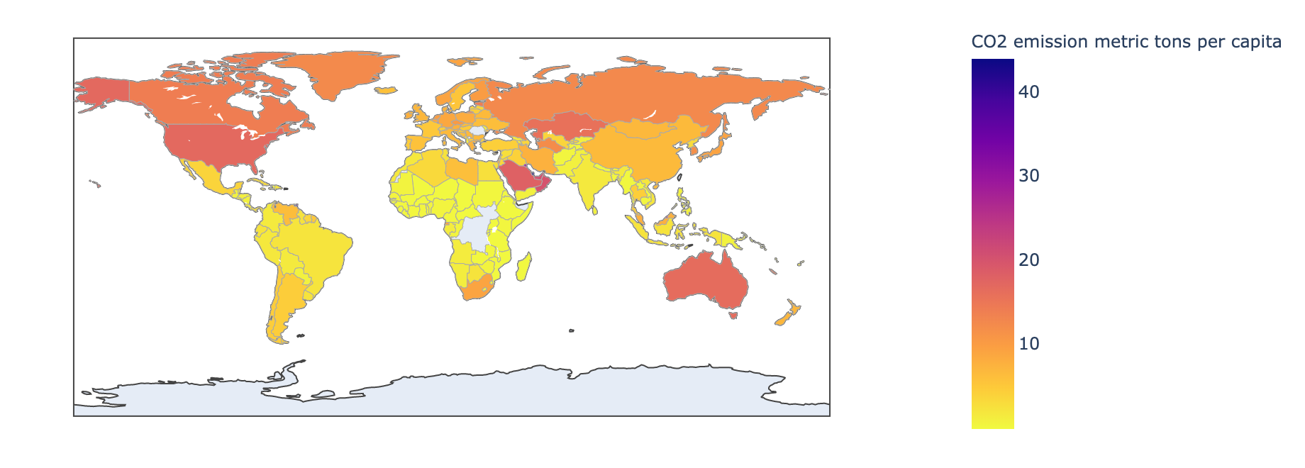
CO² Emissions around the world
The US is an outlier and is only exceeded by nations in the Middle East and Trinidad and Tobago (South Amierica) in CO² per capita.

Slide 7
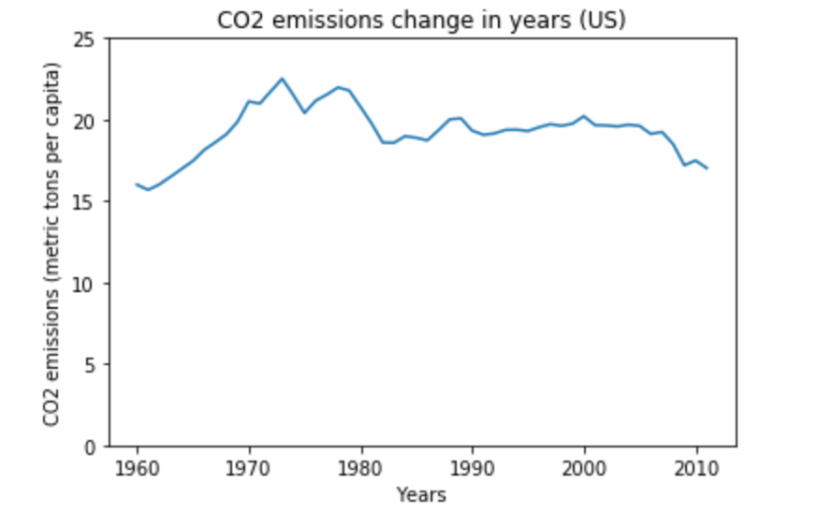
The Change in The United States’ CO² Emissions from 1960-2015
CO² dramatically increased between 1960-1970
CO² levels began to decrease prior to 1980 and remain trending lower

Slide 8
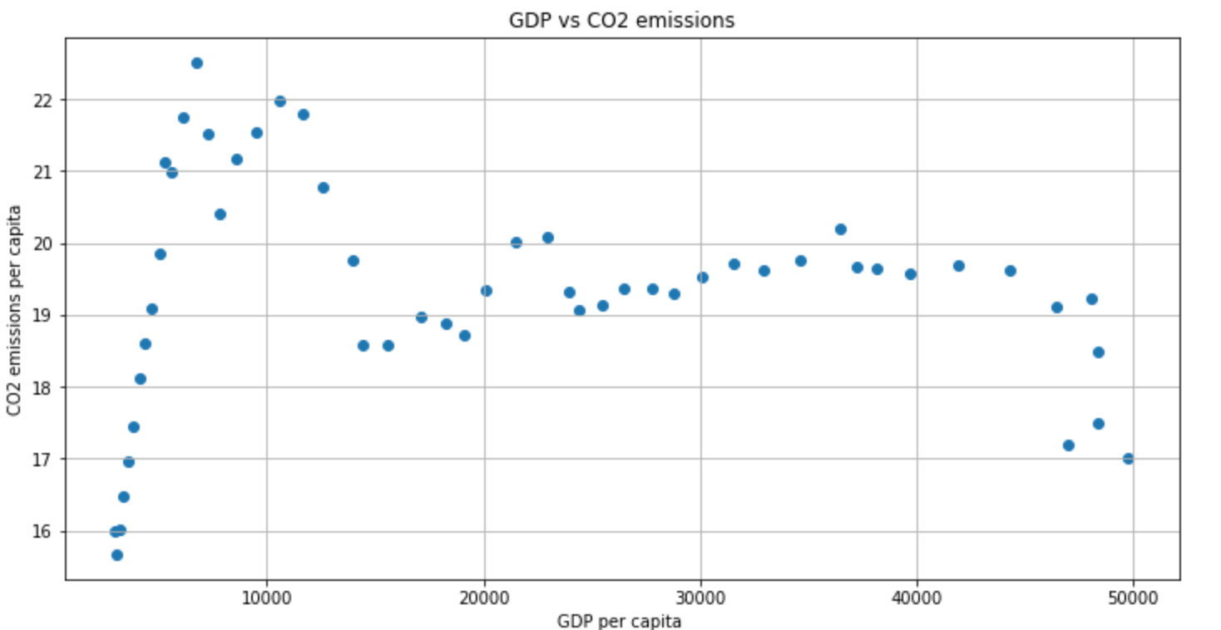
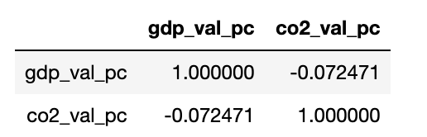
…looking to see if there’s a correlation between GDP and CO² in the US

Slide 9
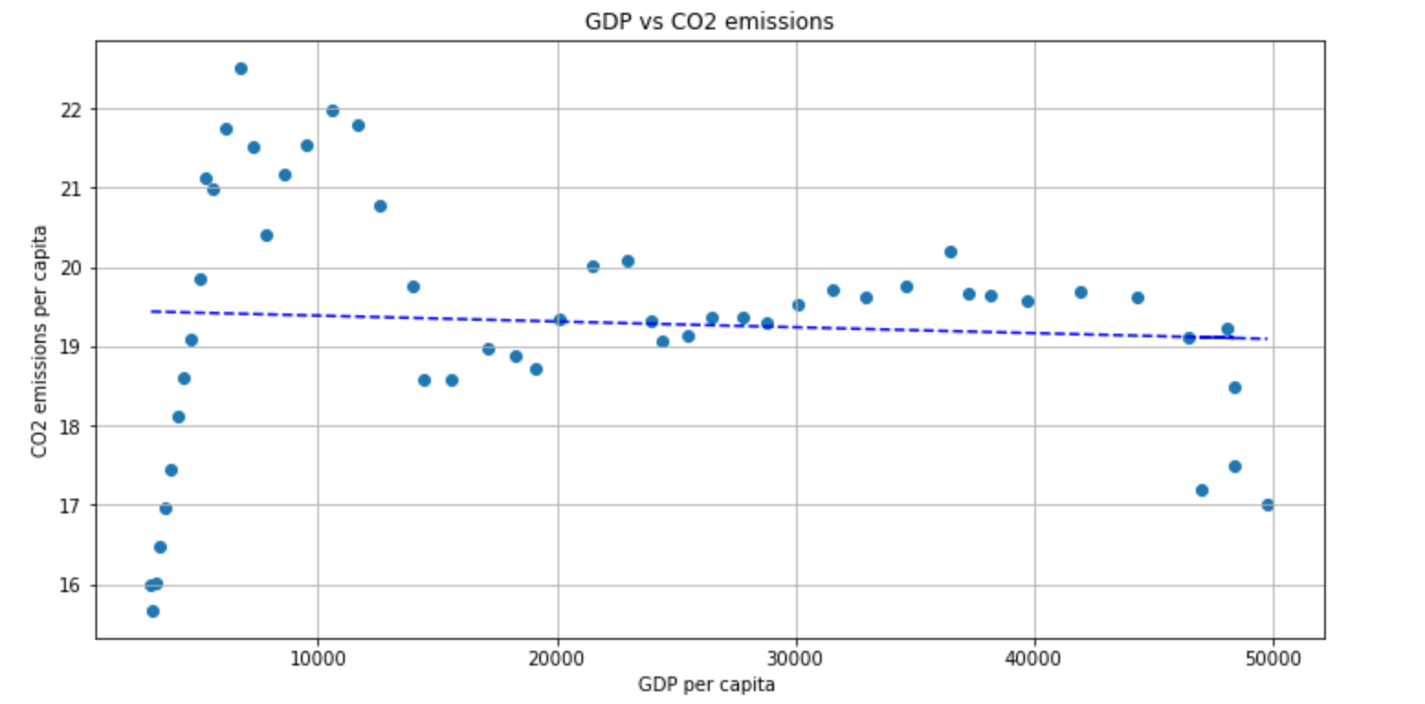
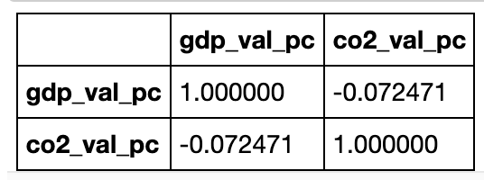
Here Shows that the CO² emissions and gdp had positive relationship in the 1960’s years in THE US, however then there seems to be no relation in the years proceeding.
CO2 emissions in relation to the GDP per capita in the US
The correlation statistic shows that CO² emissions are not related to economic growth and vice versa.

Slide 10
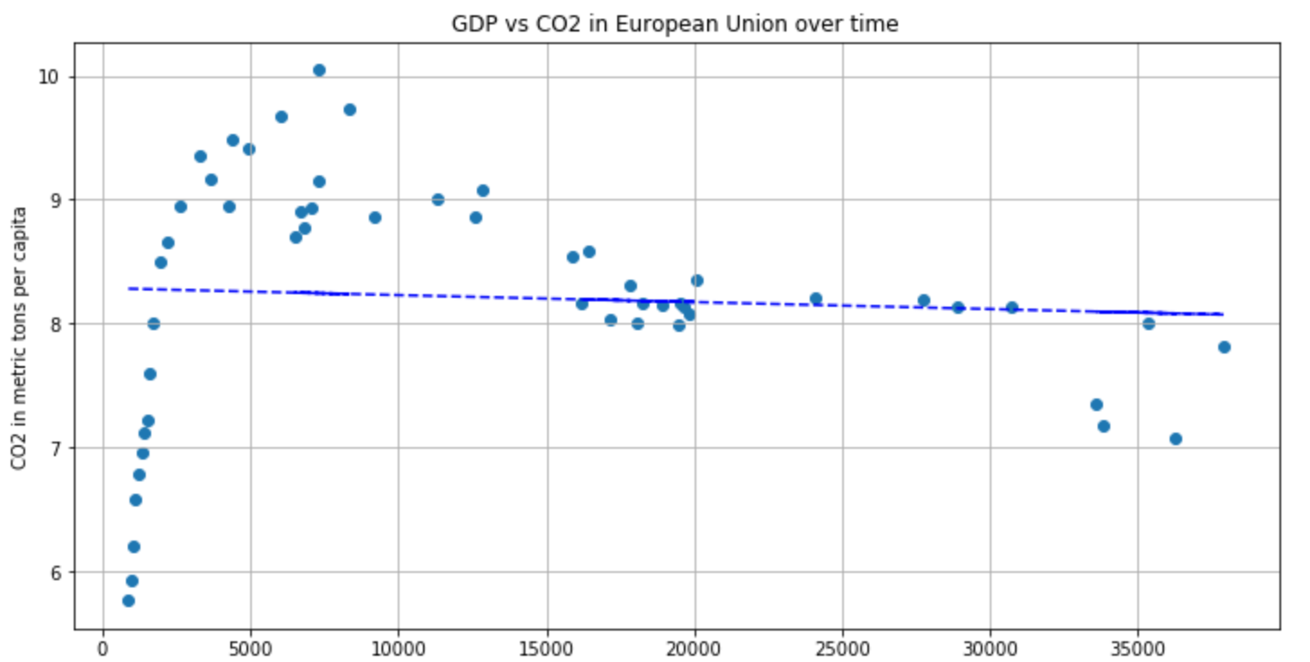
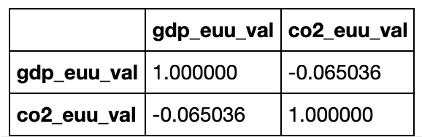
This is very Similar to the relationship we saw in the US
CO² emissions in relation to the GDP per capita in the EU (developed countries)
The correlation statistic shows that CO² emissions are not related to economic growth and vice versa.

Slide 11
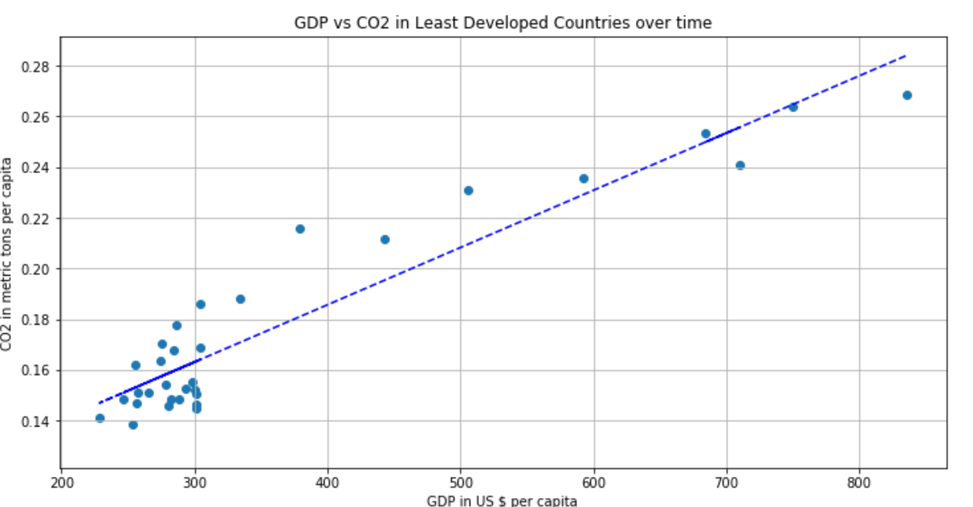
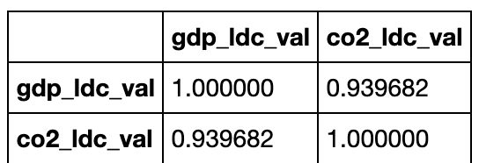
CO² emissions in relation to the GDP per capita for Less Developed Countries
For the least developed countries we see a positive correlation statistic and a linear graph, which is the complete opposite of what we saw for the US and the EU.
Notes:
Correlation between GDP per capita and CO2
per capita values is very strong.
It is antithetical to what we have observed in
developed Nations meaning their economy is
more dependent on technology that produces
CO².

Slide 12
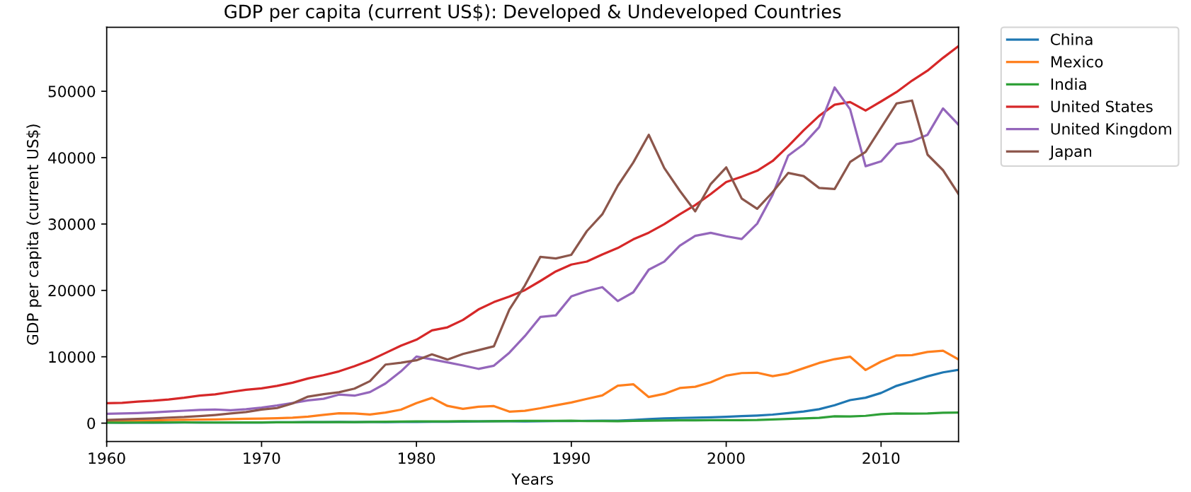
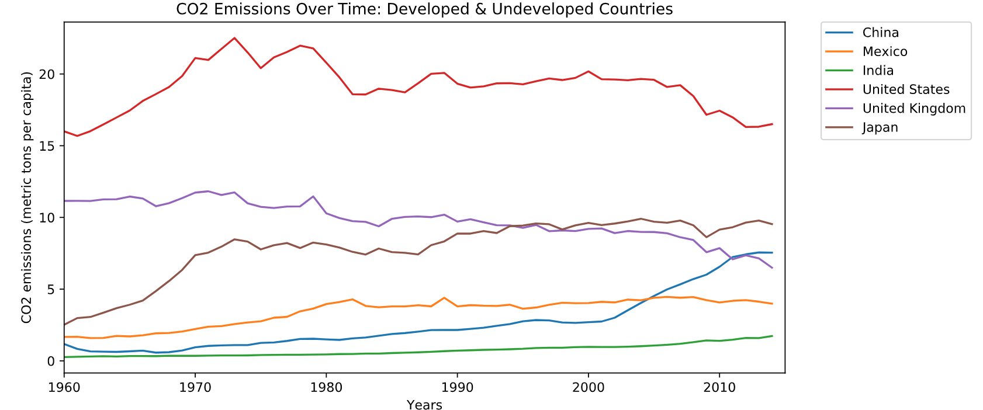

Slide 13
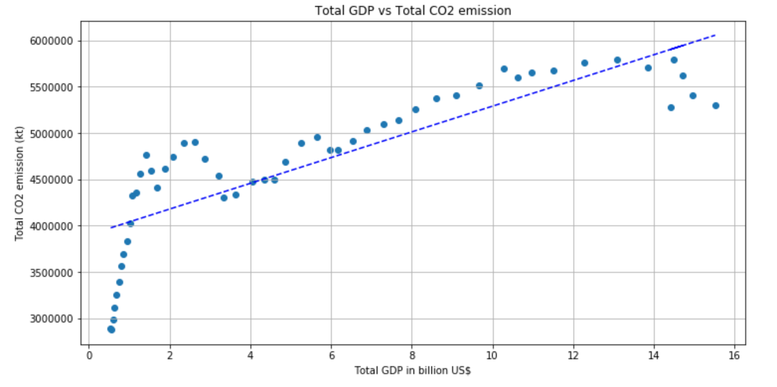

CO² EMISSIONS IN RELATION TO THE TOTAL GDP IN THE US
This is now showing a different relationship when looking at total GDP instead of GDP per capita. Now we have very strong correlation between the total CO2 emission and the total GDP in the US.
This includes GDP values with inflation so it may distort the results of the analysis.
Population also may be a limiting factor – which will need more analysis.
Notes:
Findings
3. Remarkable Finding. Total GDP
and total CO2 in US are linearly
correlated. This unfortunately this are the
GDP values with inflation included which
may distort the results of the analysis.
Also the population might be a big
factor. This finding needs more analysis.

Slide 14
Sources of CO²
There are 3 main sources of CO² emissions
CO² emissions from Gaseous fuel
CO² emission from Liquid Fuel
CO² emission from Solid Fuel

Slide 15
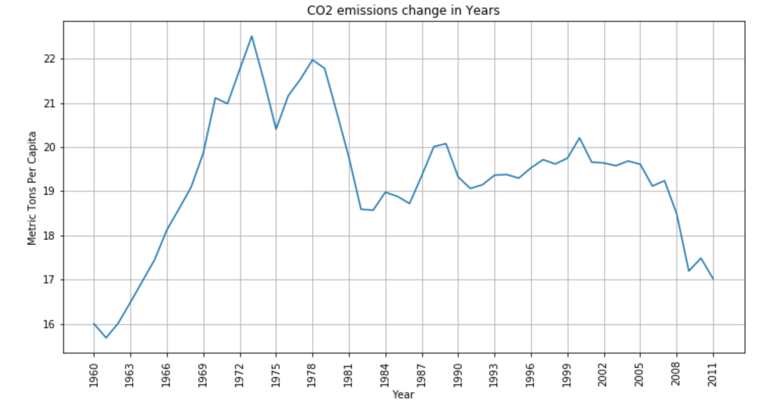
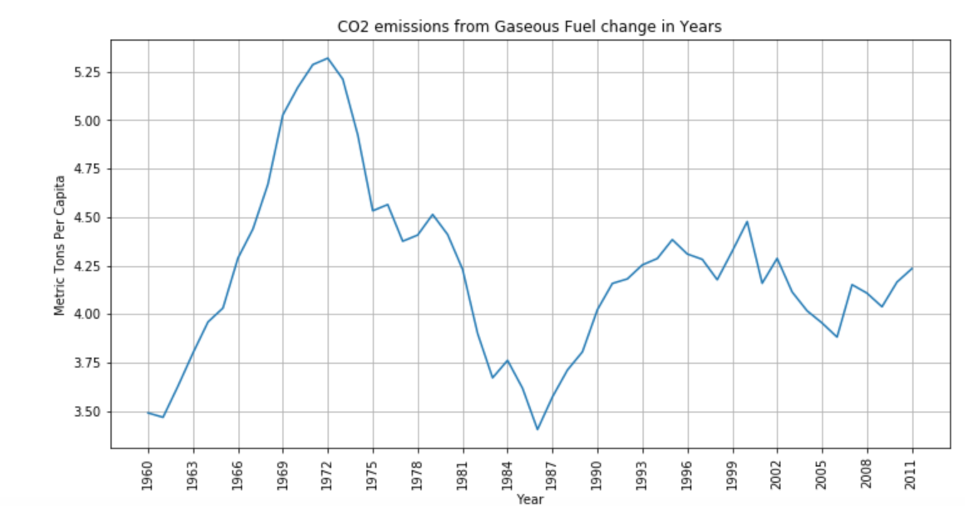
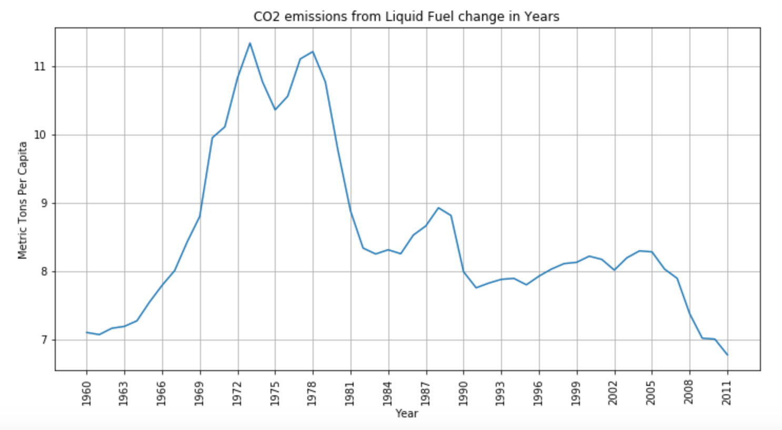
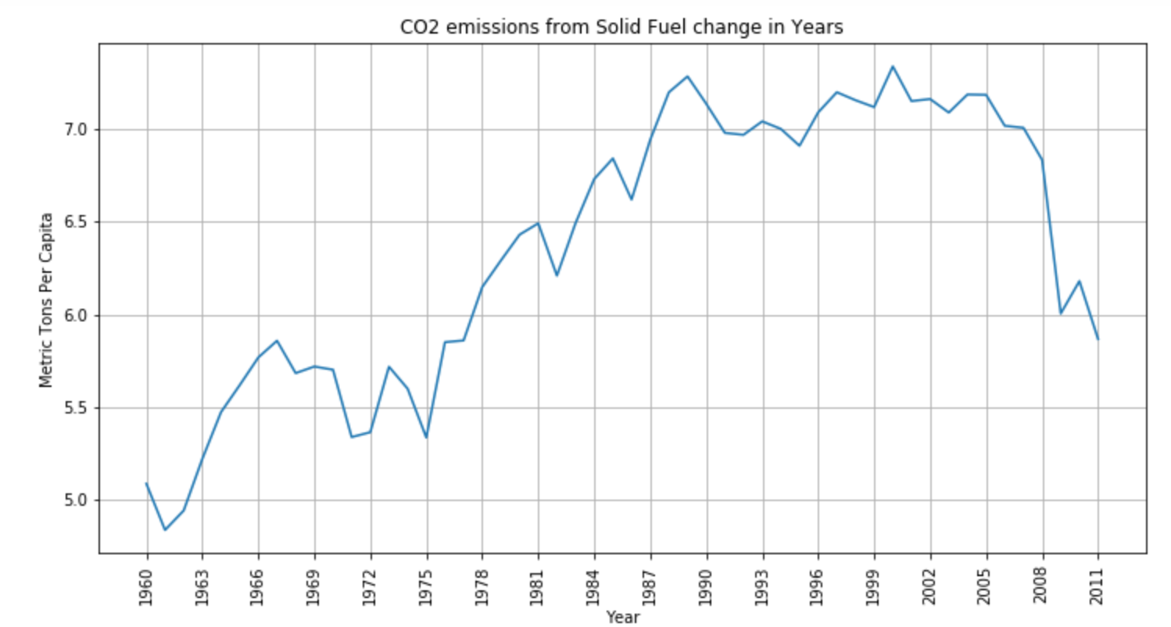
Sources of CO²
*all data for the US
Notes:
Total CO² emission per capita and CO² from liquid fuel behave similarly and are strongly correlated, after the Recession we can see that the total CO² emissions and CO2 from Solid fuel start to behave similarly.
Does this mean that the main users for liquid fuel are switching to alternative forms of energy?

Slide 16
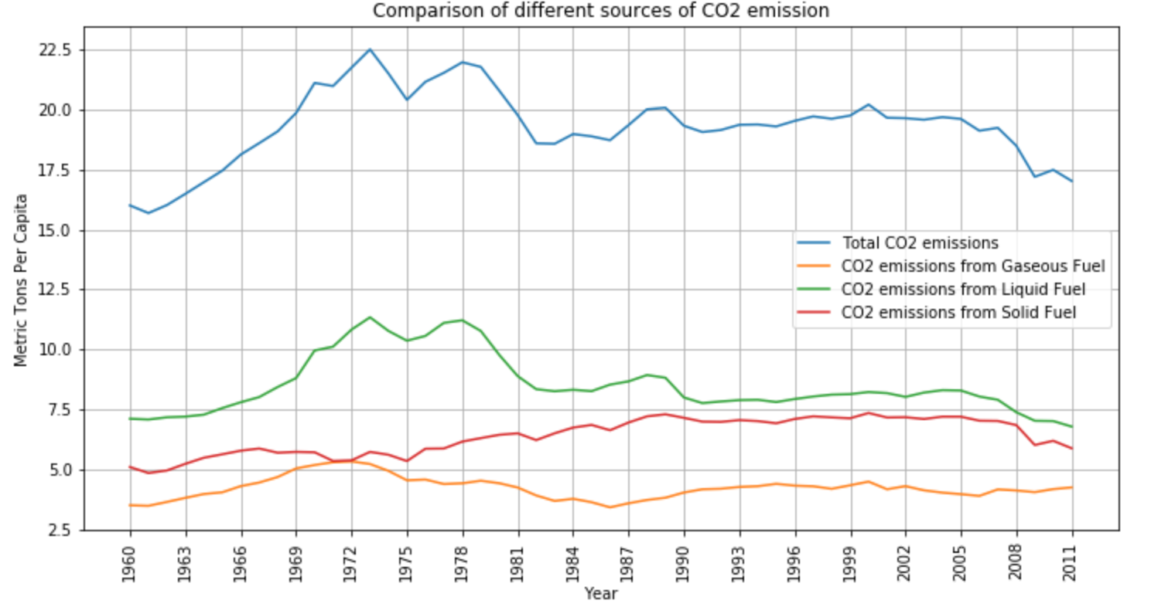
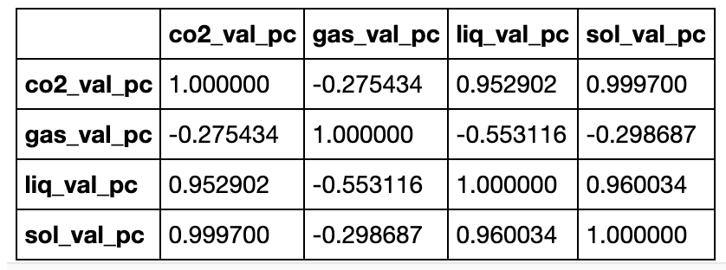
Notes:
Because CO2 emission behaves linearly in the beginning and then changes in irregular fashion it would be better to divide the CO2 emission to different timeframes.
Fun Facts: The dip in CO2 emission in starting from 1973 to 1975 is related to the Oil Crisis caused by Arab Petroleum Exporting Countries proclaiming an oil embargo at nations perceived as supporting Israel.
Right after the cease of embargo CO2 emissions increased again but from 1978 to 1982 there is a huge dip in CO2 emission. This could mean either nations started to use Liquid Fuel more economically and/or switched to alternative energy
The correlation statistic between the Solid Fuel CO2 emission values and Liquid Fuel CO2 emission values is very strong and positive. This means that both are not alternative to each other but rather the industries that use Liquid Fuel also use Solid Fuel or the the industries that use either of these fuel types are dependent on each other.
The correlation statistic between the Gaseous Fuel and other types of fuel shows as always negative meaning that the Gaseous fuel is a true alternative. It also means that the increase in usage of Gaseous fuel decrease the amount of CO2 by through lesser usage of Liquid and Solid Fuels
CO2 per capita values have very strong relation with Solid Fuel with a correlation statistic of 0.9997

Slide 17
FINDINGS
After 2008 the correlation between different sources
Of CO² emissions reveal important facts.
Correlation between the Solid Fuel CO2 emission values and Liquid Fuel CO2 emission values is very strong and positive. This means that both are not alternative to each other but rather the industries that use Liquid Fuel also use Solid Fuel or the industries that use either of these fuel types are dependent on each other.
Correlation between the Gaseous Fuel and other types of fuel is always negative meaning that the Gaseous fuel is a true alternative. It also means that the increase in usage of Gaseous fuel decrease the amount of CO2 by through lesser usage of Liquid and Solid Fuels
CO2 per capita values have a very strong correlation to Solid Fuel.

Slide 18
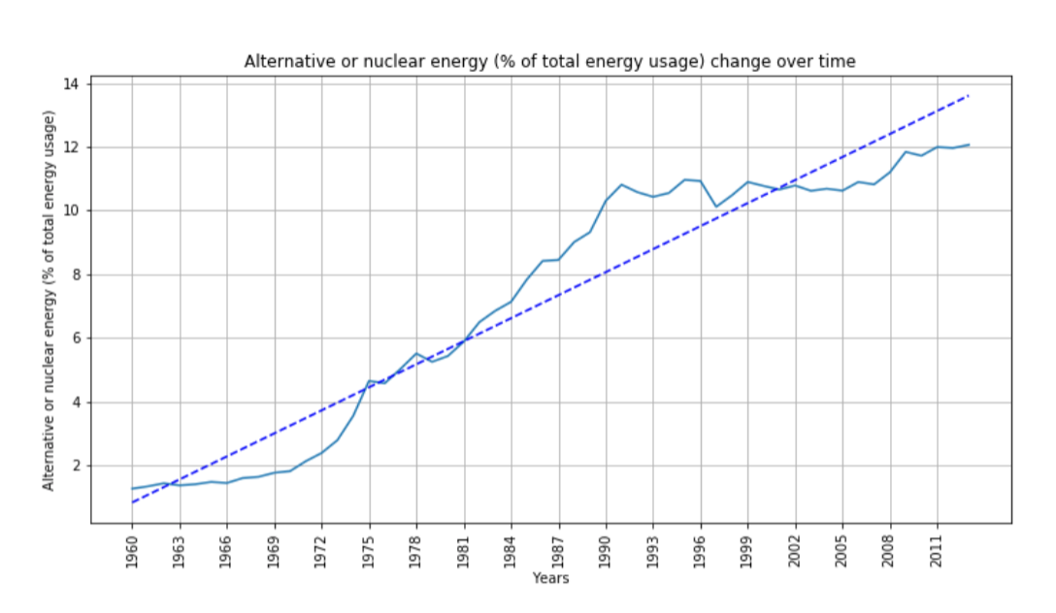
FINDINGS
The irregularities in CO² emission values per capita may be related to emerging technologies, as well as the usage of nuclear and alternative energy.
Also, more efficient usage of the liquid fuel may result in lesser CO² emissions. If there is new technology introduced then the electricity retail price also should increase to cover the expenses.

Slide 19
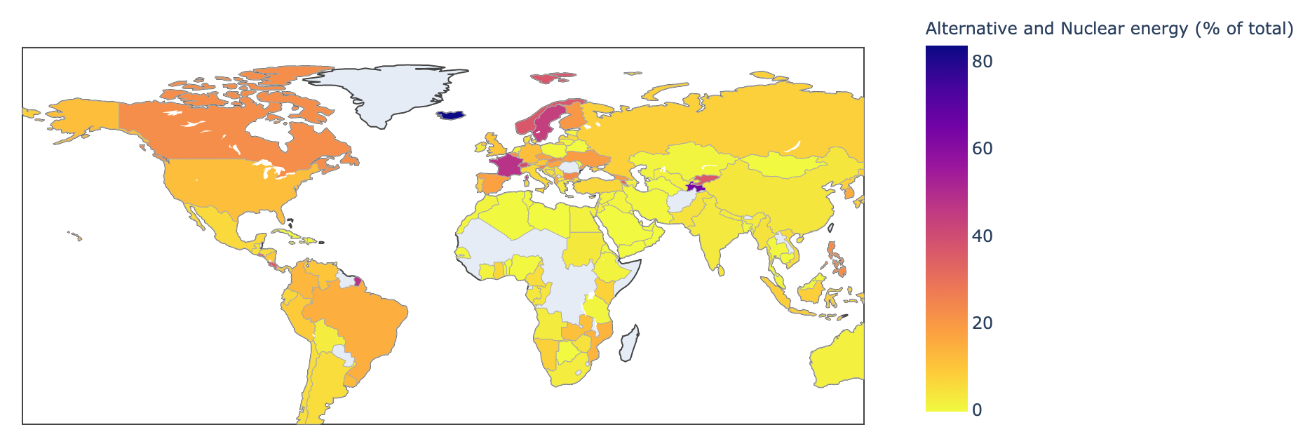
ALTERNATIVE AND NUCLEAR ENERGY ACROSS THE GLOBE
Alternative and nuclear energy usage in US in 2011 was 12%
While other developed countries were at…
Canada was at 23%,
France at 47%,
Iceland at 84%.
(Go Iceland!)

Slide 20
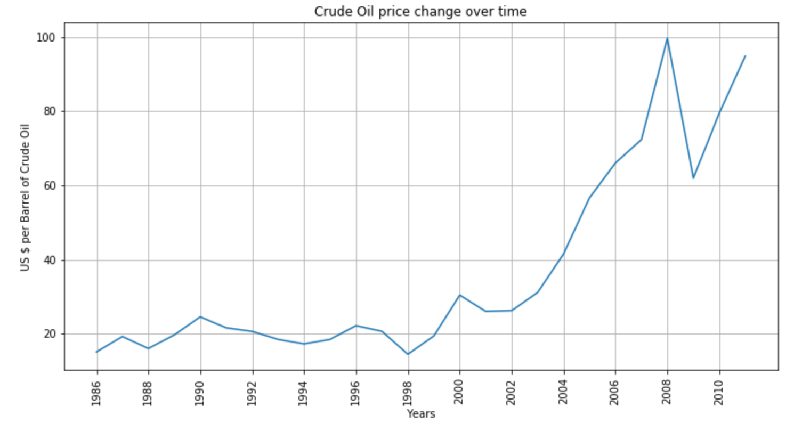
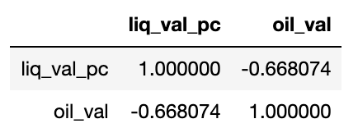
Next we looked at if there’s a correlation between CO² emissions and the price of Oil…
Notes:
There is a spike in Oil prices right before the 2008 recession and during this recessions the prices drop. Is this because people start to look for and use alternate forms of energy?

Slide 21
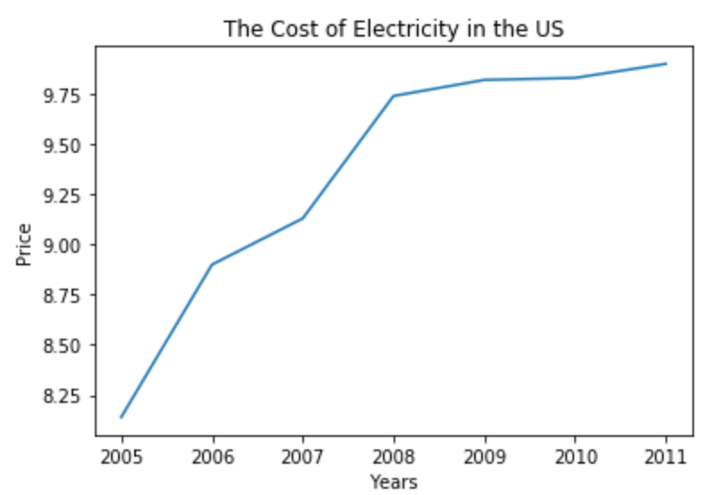
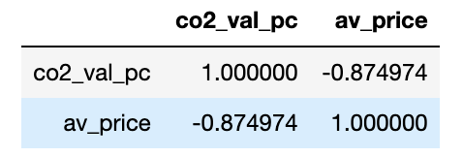
Next we looked electricity prices in the US to see if a decrease in CO² emissions lead to a increase in retail prices…
The data here shows there is a correlation between the two…as the price of electricity increases the usages of CO² goes down.

Slide 22
Statistical Tests Results
Here we divided the countries into groups based on their GDP per capita.
lowGDP = dataCountries[dataCountries["Value"].values < 2500]
mediumGDP = dataCountries[(dataCountries["Value"].values >= 2500) & (dataCountries["Value"].values < 12000)]
highGDP = dataCountries[dataCountries["Value"].values >= 12000]

Slide 23
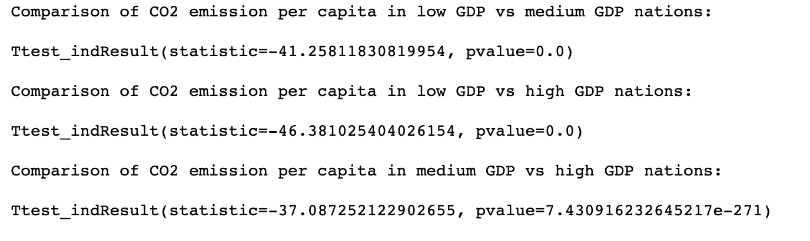
Statistical Tests Results – T-TEST
We are checking whether each group of countries has comparable CO2 mean values. Null hypothesis is that the Mean values are not comparable

Slide 24
Statistical Tests Results – ANOVA TEst
We are checking whether all three groups of countries has comparable CO2 mean values. Null hypothesis is Mean values are not comparable

Slide 25
Statistical Tests Results – Kruskal-wallis h-test
Kruskal-Wallis H-test AKA a One-Way Anova test. We are checking whether all three groups of countries has comparable CO2 mean values. Null hypothesis is Mean values are not comparable

Slide 26
Our Conclusion
As the production increases the amount of CO² emission increases as well. CO² emission is directly related to the energy production and energy production uses CO² producing technology.
Although CO² emission increase every year almost linearly since 1960 the GDP value of CO² emission reduce thanks to implementation of new technology, more efficient fuel burning mechanisms, alternative and nuclear energy.
Gaseous Fuel is a true alternative to Liquid and Solid Fuel types to reduce the CO² amount.
CO² per capita may be misleading since the primary goal is to harness the total CO² but the total CO² volumes keep increasing as does population.
Least developed nations do not use advanced technology and cheap but less efficient usage of the Fuel result in increased CO² per capita.

