Slide 1

Wind error analysis used in the inversion framework
Aydin Uzun
Technical University of Munich
TUM Department of Electrical and Computer Engineering
Professorship of Environmental Sensing and Modeling
[Munich, 20.05.2022]

Slide 2
Forschungspraxis Final Presentation
Aydin Uzun
München, 20. Mai 2022

Slide 3
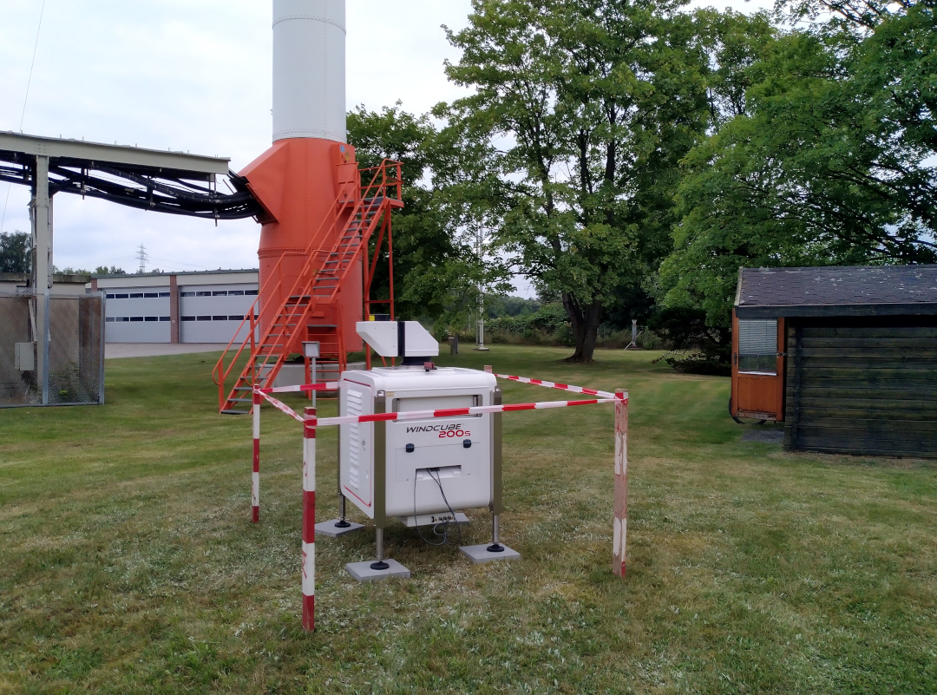
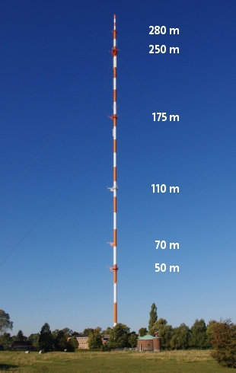
LiDAR observations, Wettermast, Hamburg
Leosphere Windcube 200S
latitude = 53.5193
longitude = 10.1028
altitude = 0
Variables
Z: Measurement height above ground level in m
Size: 149x1
Horizontal wind speed in m/s
Size: 149x1
Horizontal wind direction in deg
Size: 149x1

Slide 4
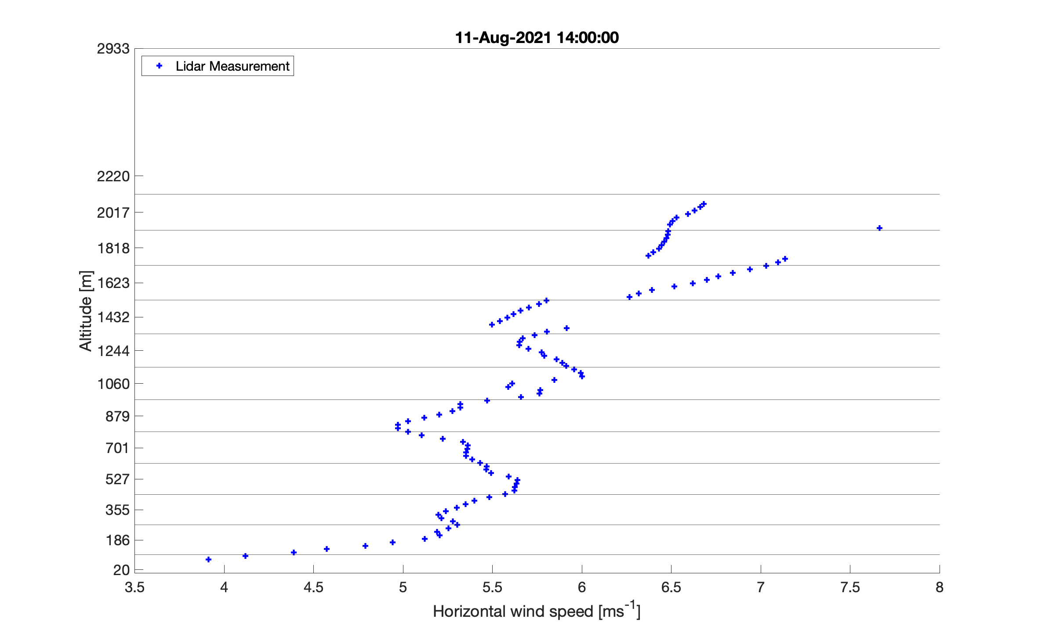
LiDAR observations, preprocessing
Temporal resolution : per 10 mins [xx:55, xx:05, xx:15, xx:25, xx:35, xx:45 etc.]
Temporal coverage : from 27 Jul 21 to 15 Sep 21
7170 measurements
Vertical resolution and coverage : Z goes from ~25 m to ~2900 m, approximately one sample per 15-25 m, 149 altitude values -> good resolution
!!!WSPD and WDIR not available at all of these 149 altitudes
1st task: Convert LiDAR observations to hourly data
Boundary between atmospheric layers
Particle release heights
Aydin Uzun (TUM)

Slide 5
Combine
ERA5 hourly data on pressure levels
Temporal resolution : hourly
Gridded data - Regular latitude-longitude grid
Horizontal resolution – 0.25° x 0.25°
Vertical coverage : 1000 hPa to 1 hPa
Vertical resolution : 37 pressure levels
Variables of interest:
U-component of wind
V-component of wind
Geopotential
ERA5 hourly data on single levels
Temporal resolution : hourly
Gridded data - Regular latitude-longitude grid
Horizontal resolution – 0.25° x 0.25°
Variables of interest:
100m u-component of wind
100m v-component of wind
10m u-component of wind
10m v-component of wind
Geopotential : The (surface) geopotential height can be calculated by dividing the (surface) geopotential by the Earth's gravitational acceleration.

Slide 6
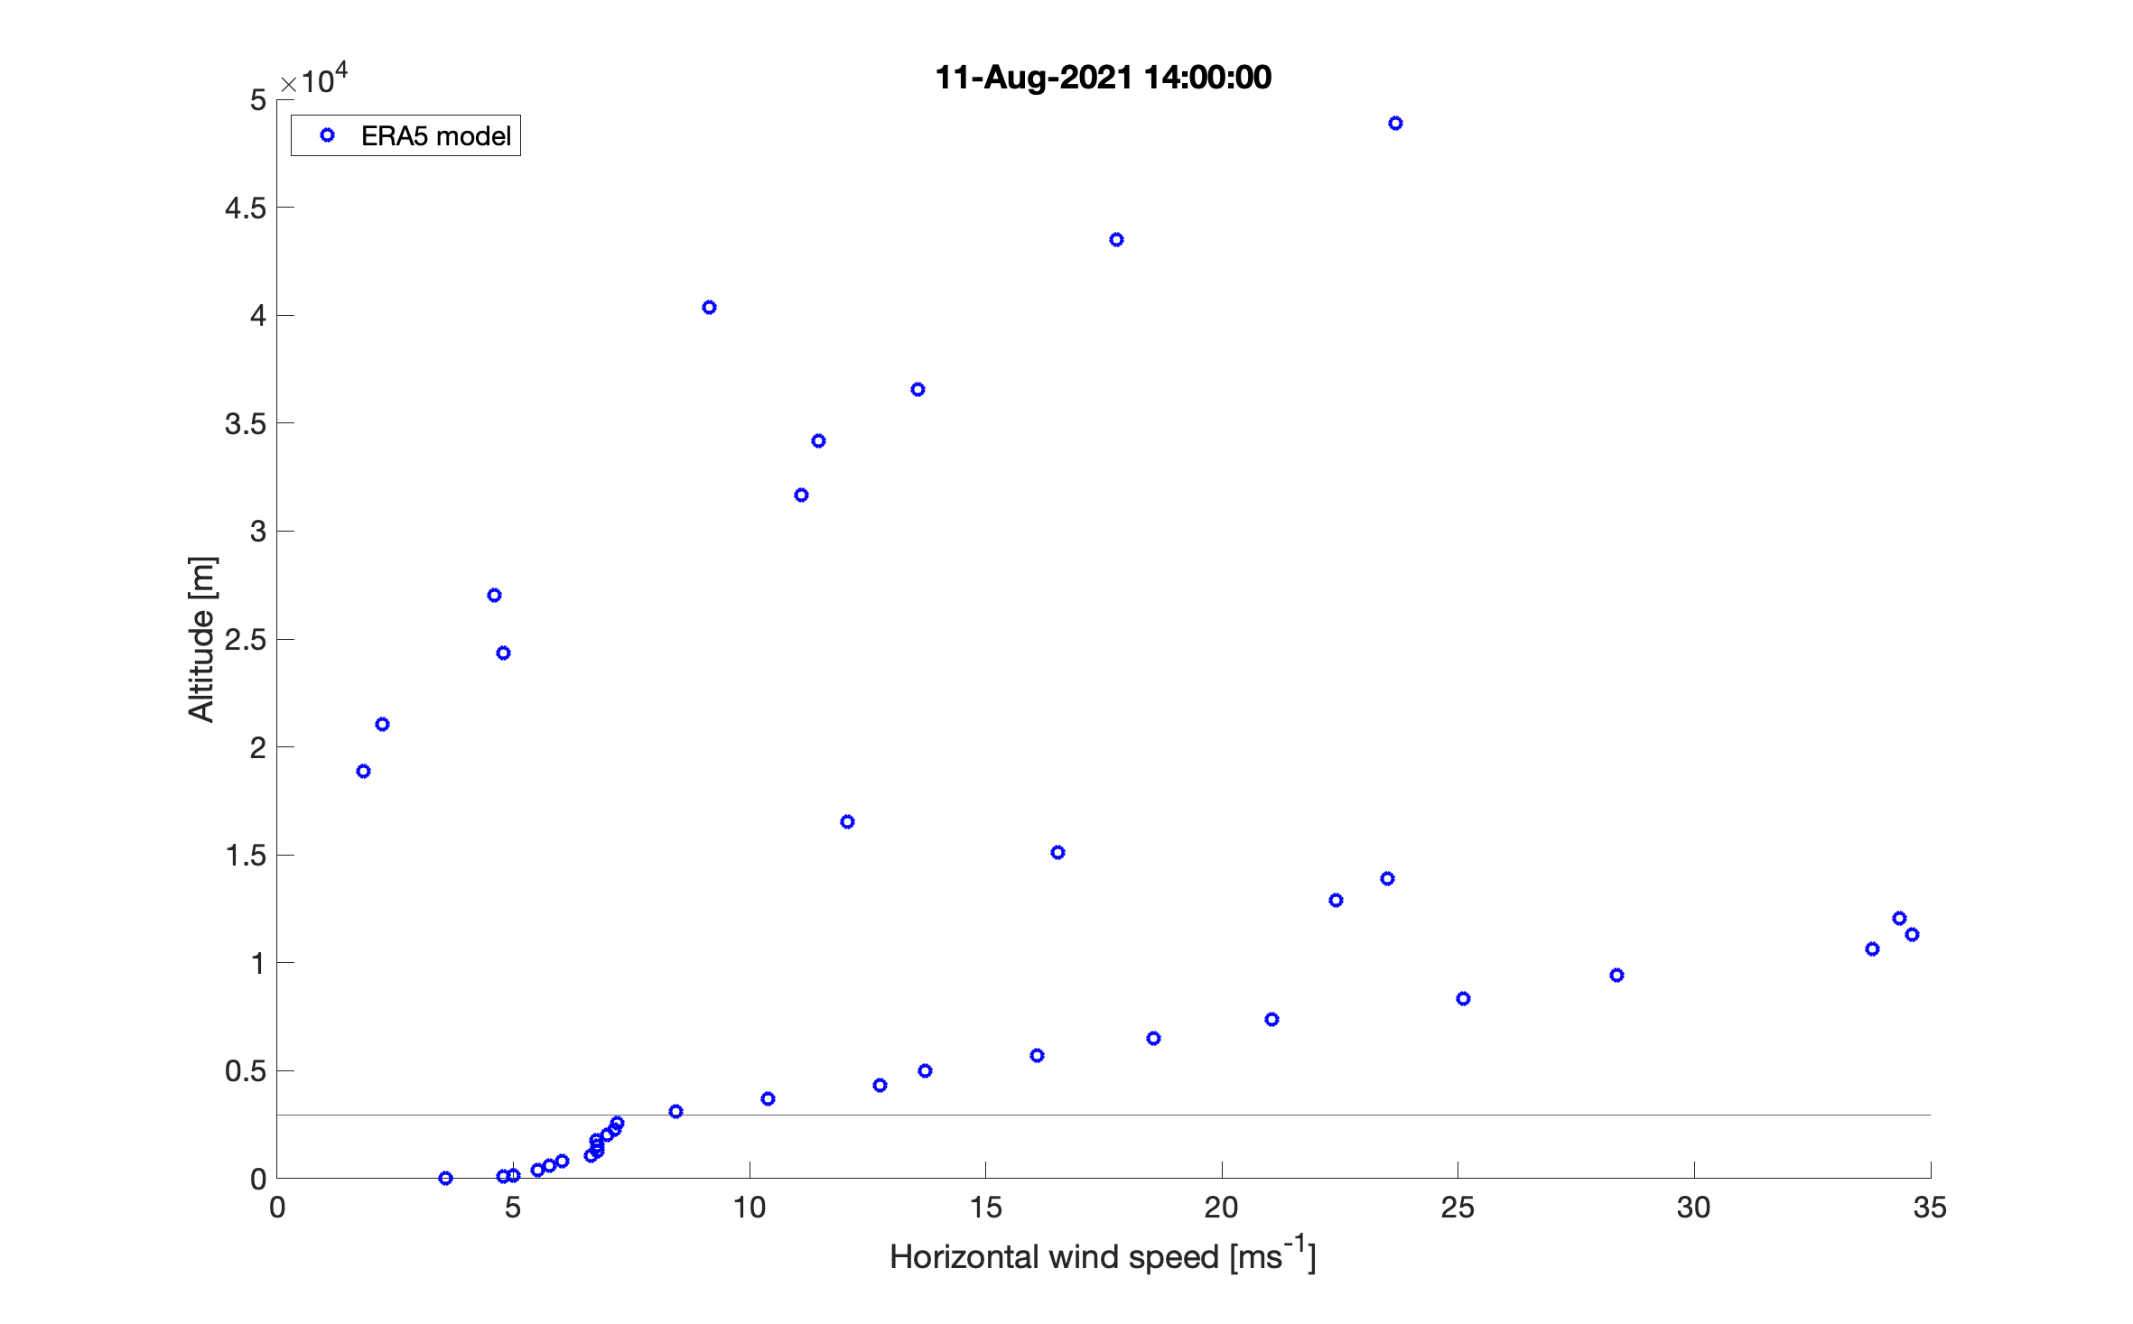
Wind Speed ERA5 model

Slide 7
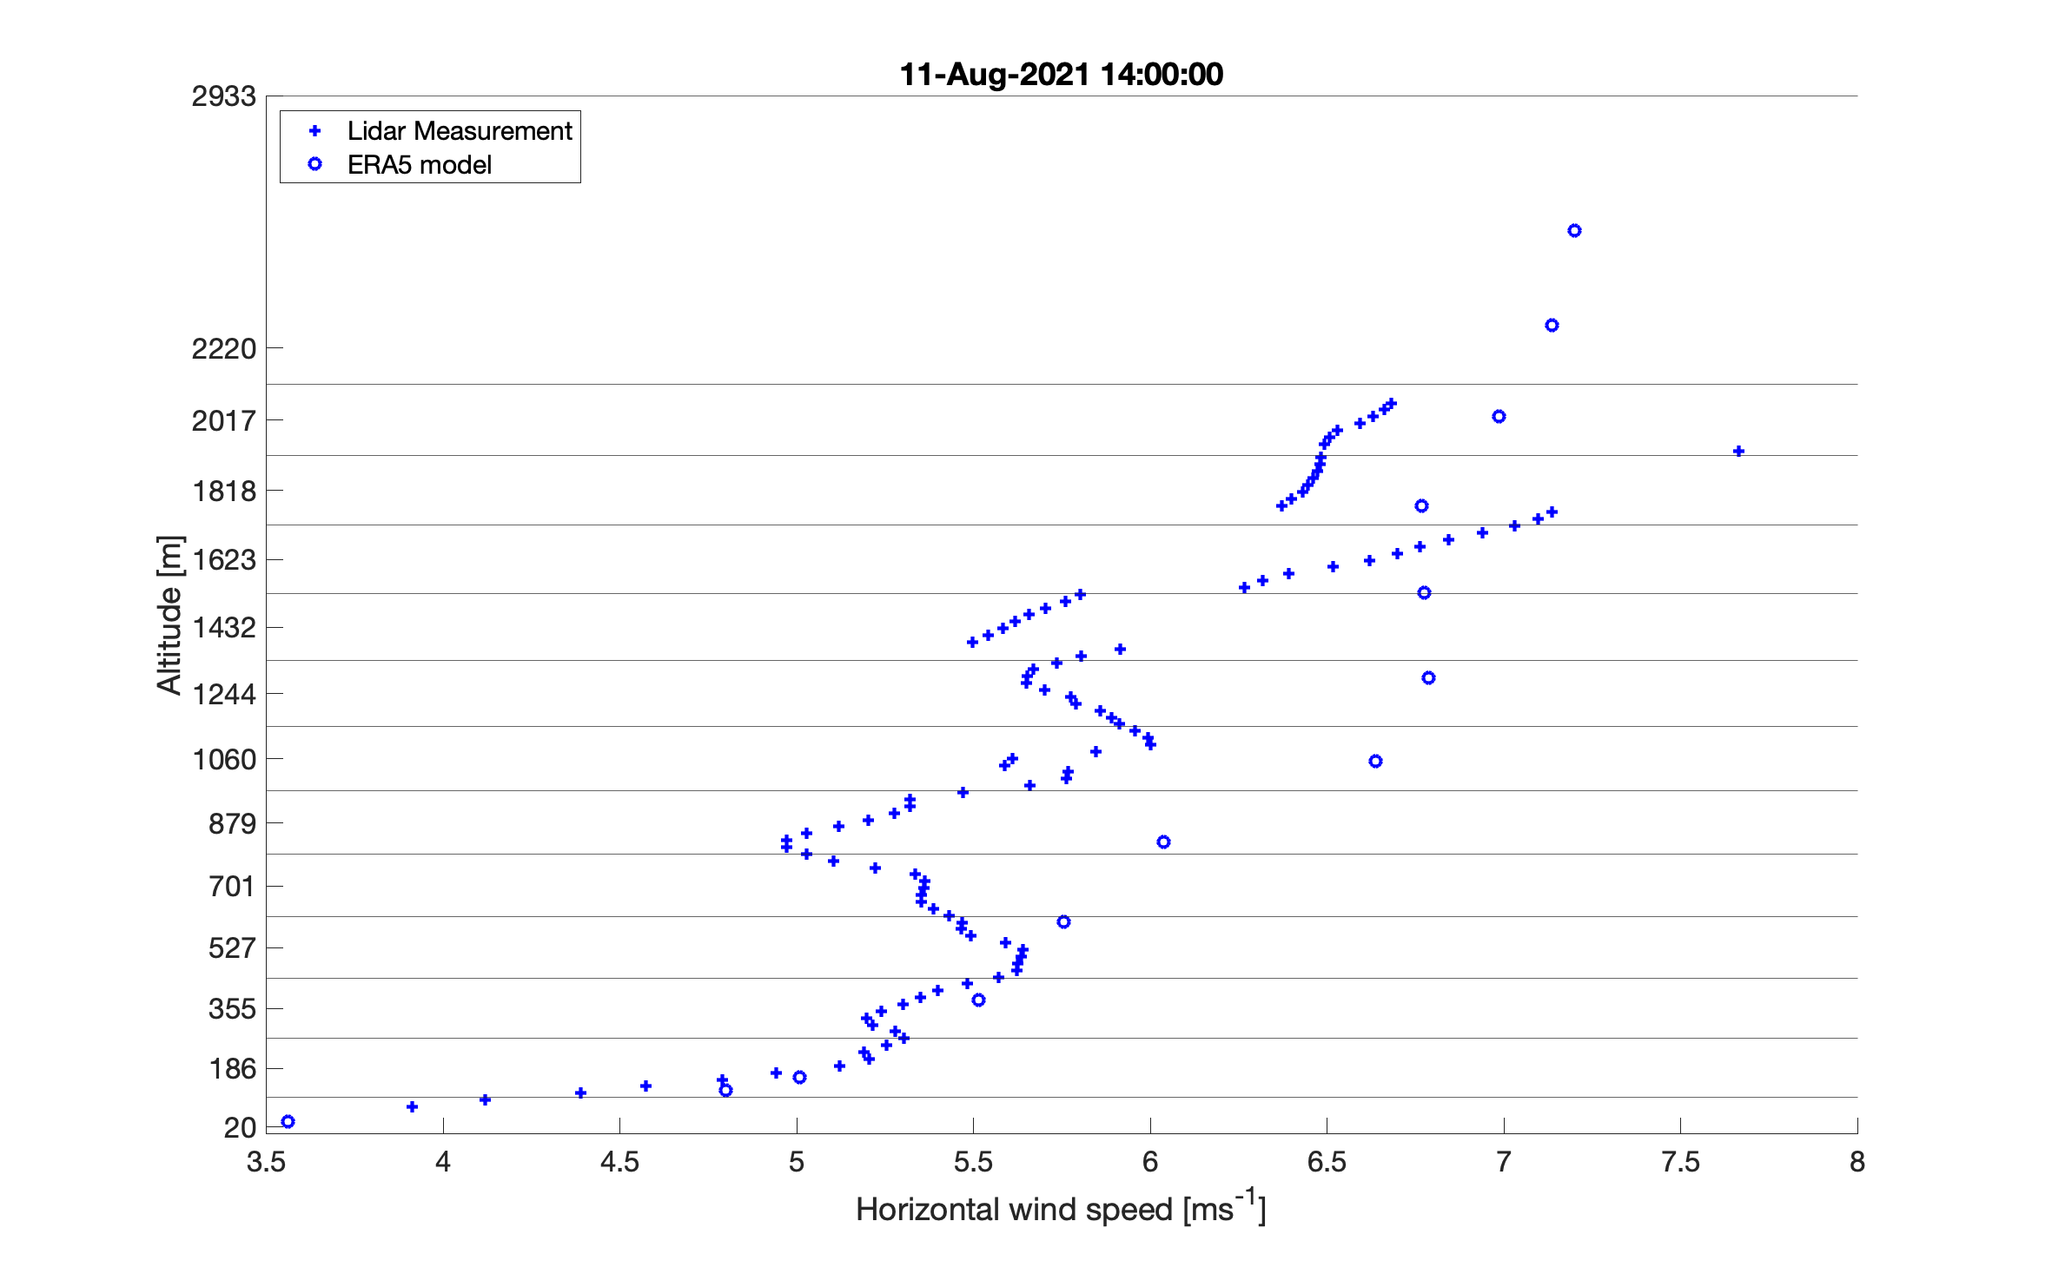
LiDAR and ERA5 WSPD, region of interest

Slide 8
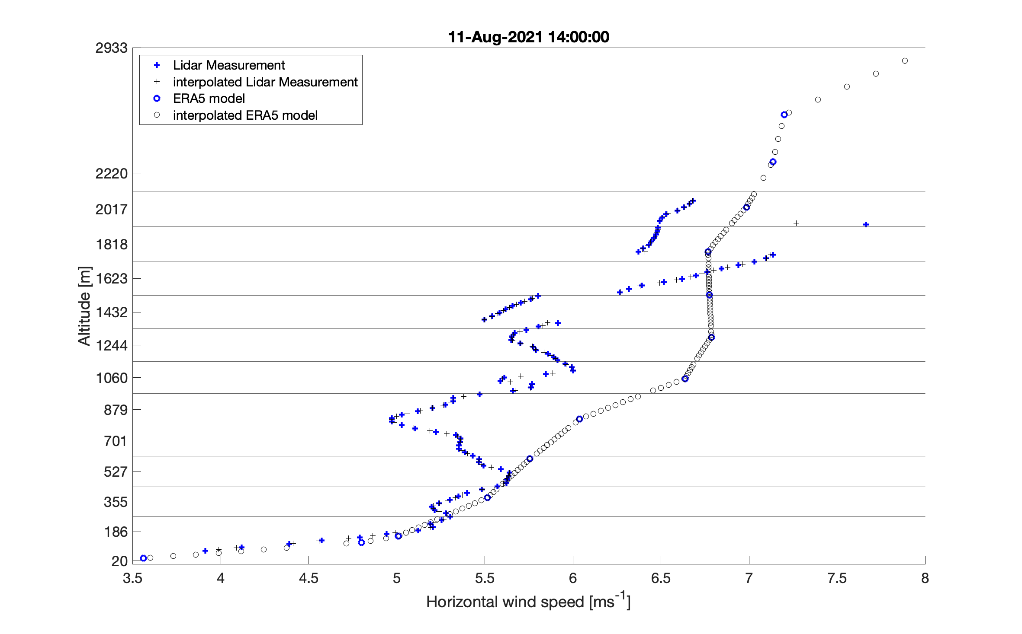
LiDAR and ERA5 WSPD -> interpolation

Slide 9
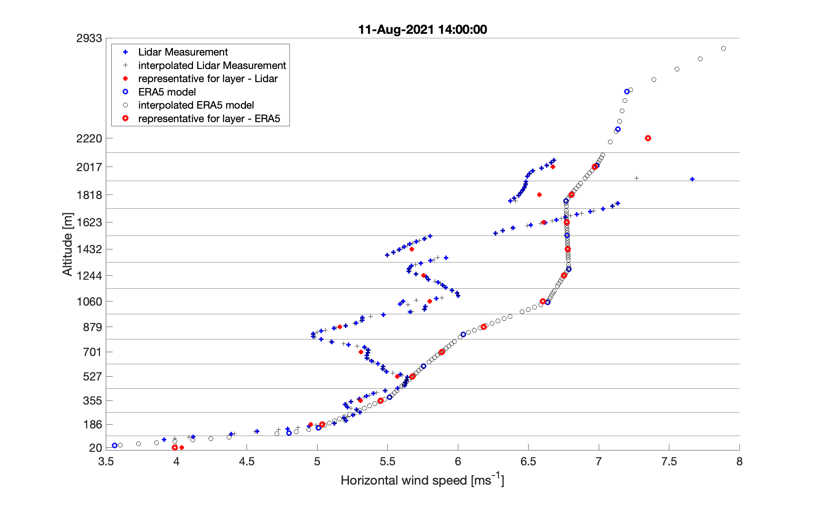
LiDAR and ERA5 WSPD -> mean of interpolated points

Slide 10
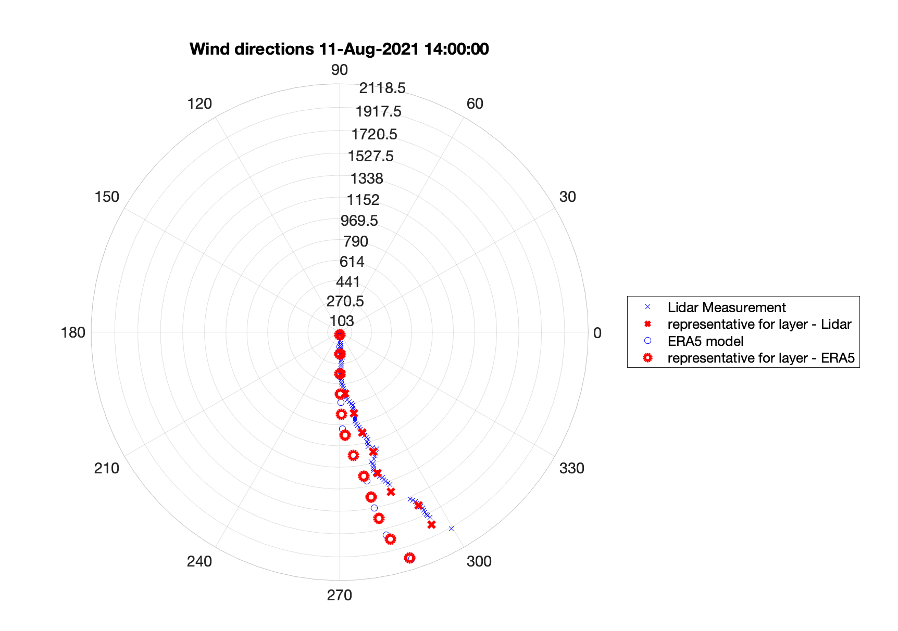
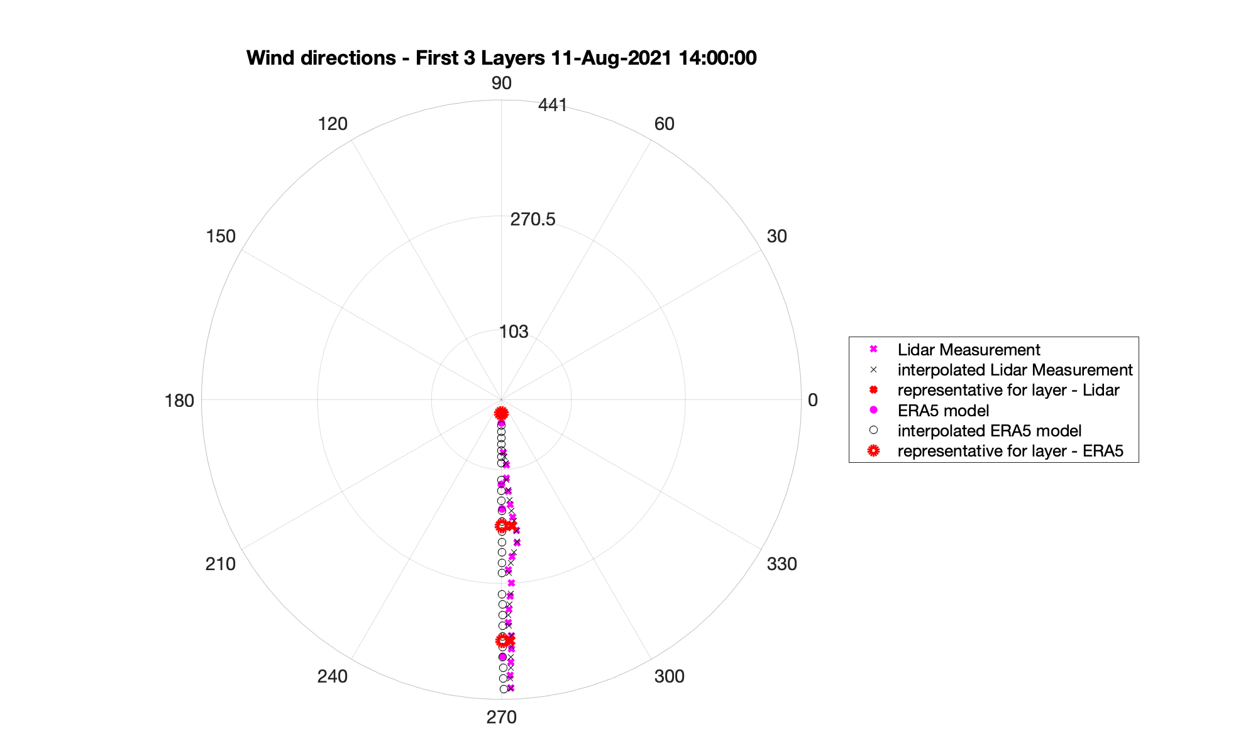
Comparison of LiDAR wind data and ERA5 model - Wind rose plot

Slide 11
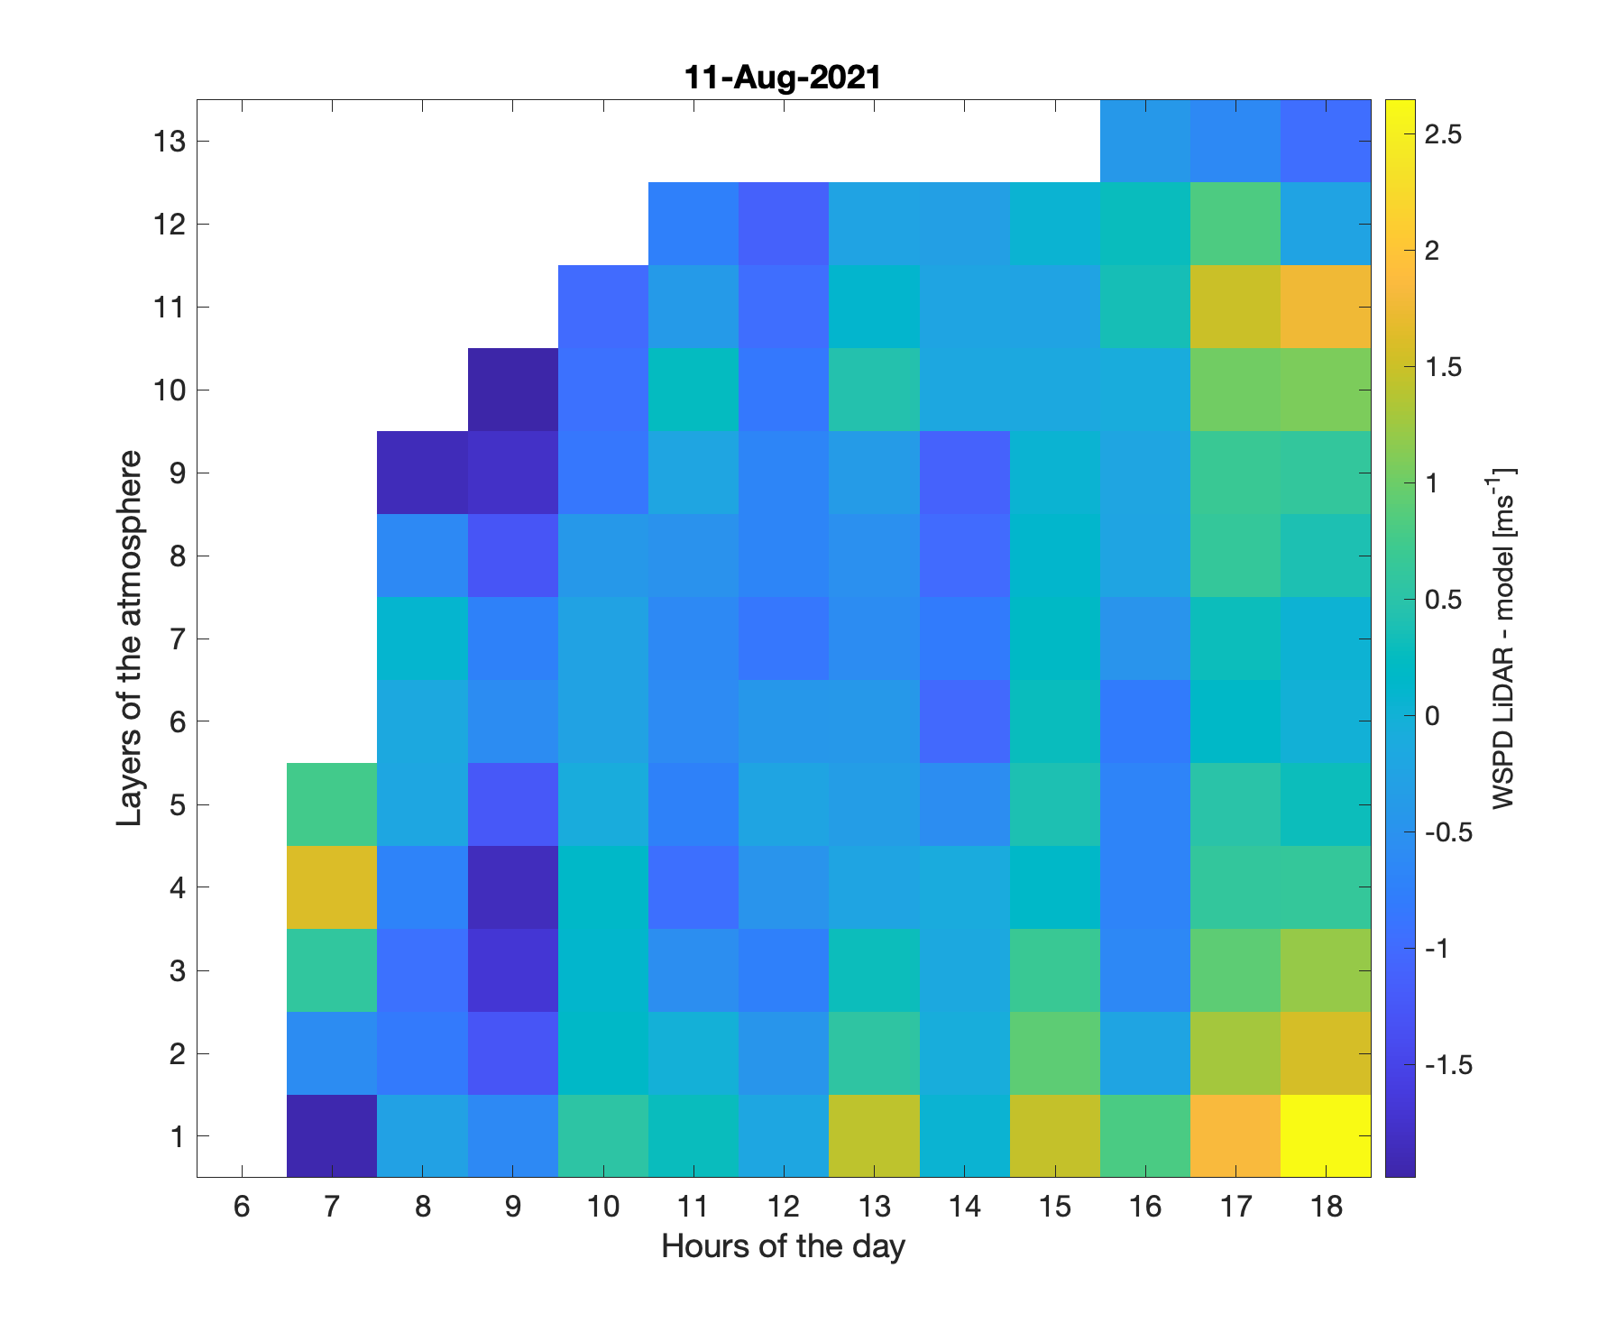
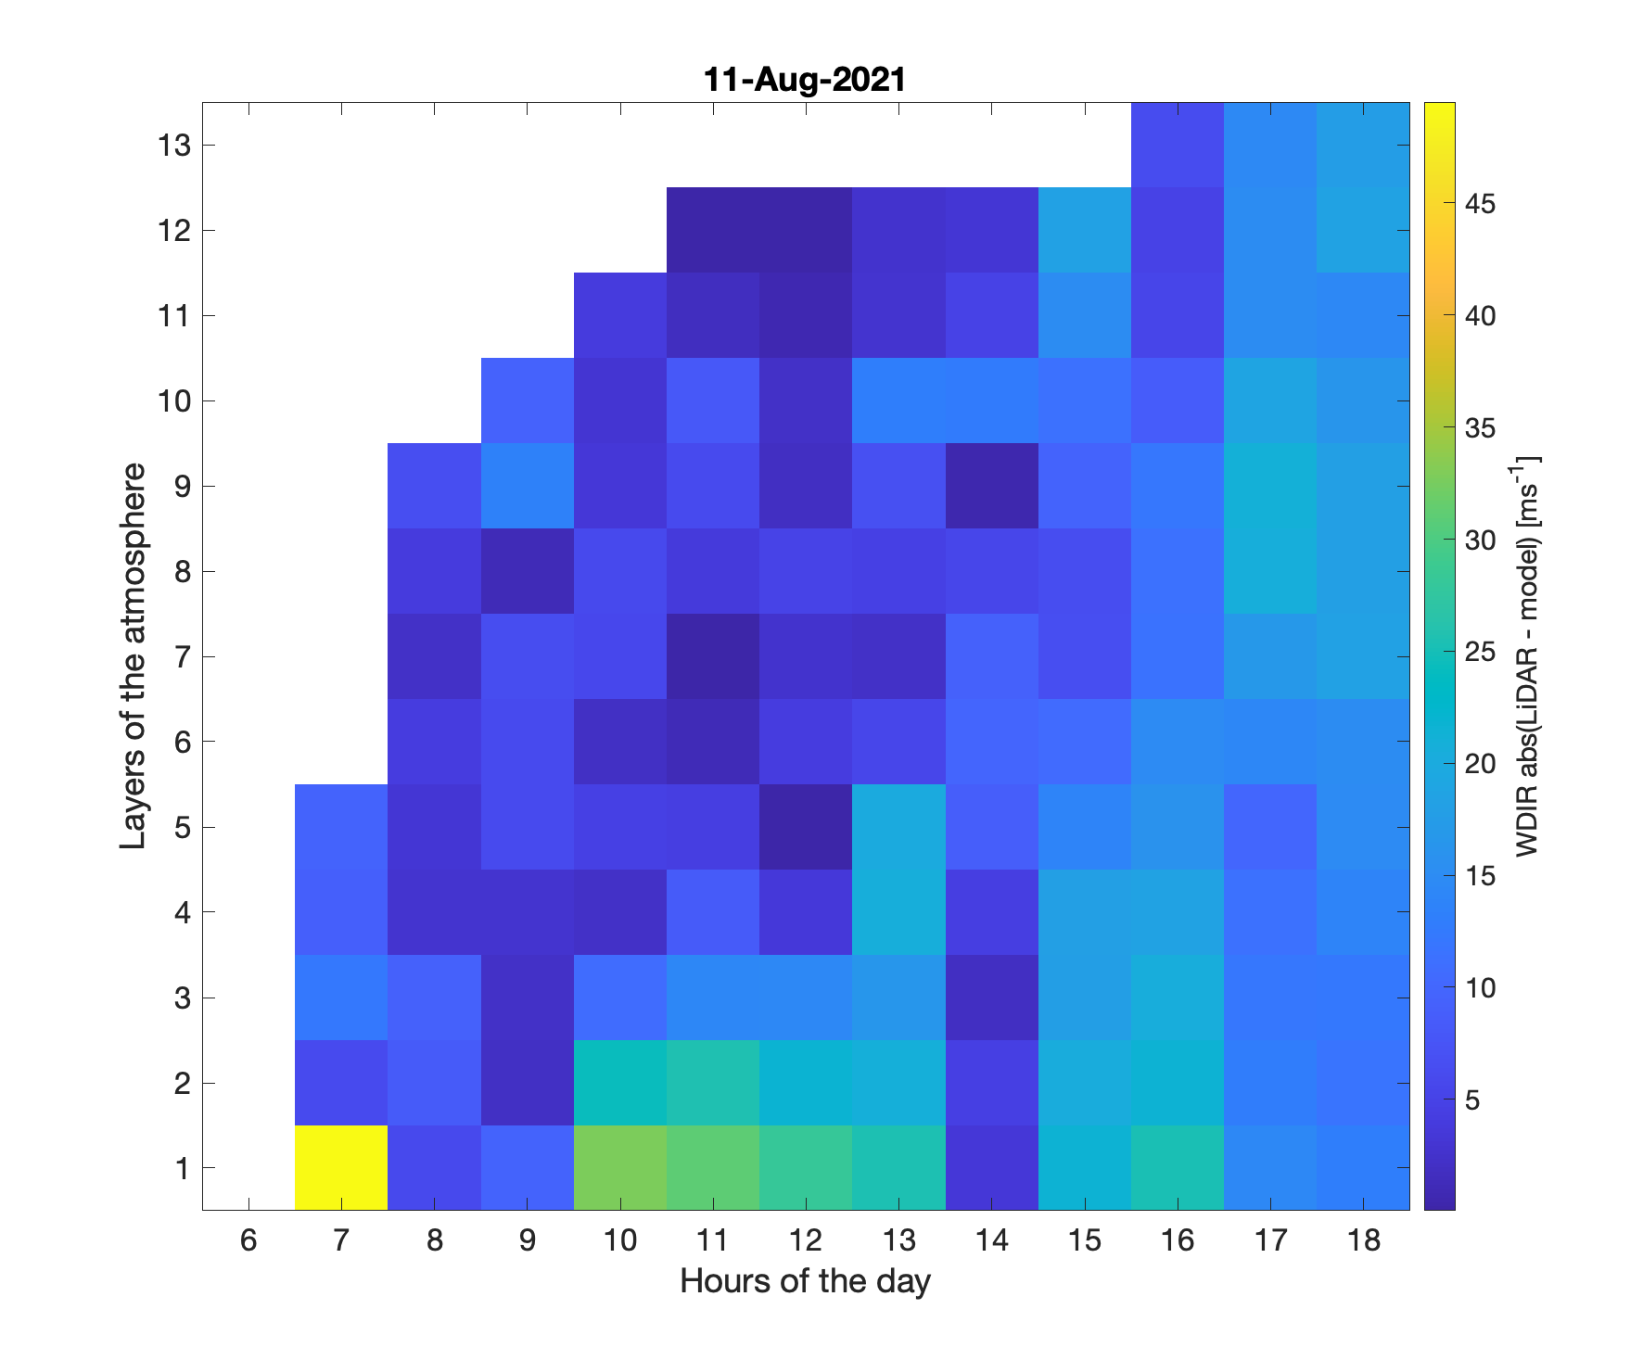
Do this for each hour of the day and then visualize

Slide 12
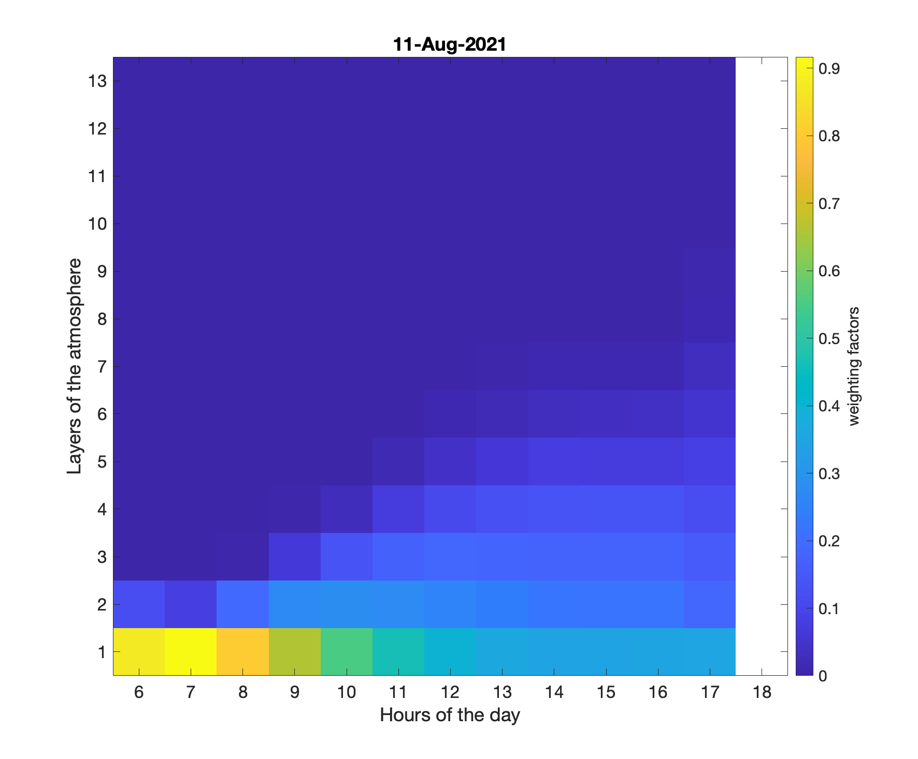
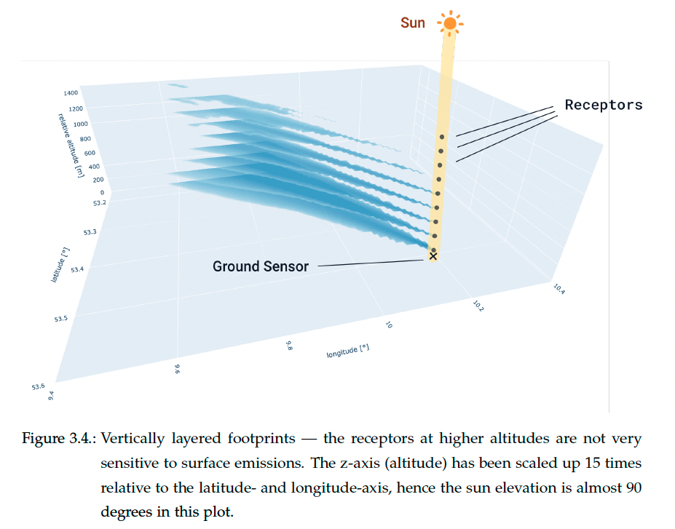
Combine footprint intensities and pressure scaling factors to get the weighting factors
Automating the Generation of Footprints Based on the STILT Model Using High-Performance Computing, Moritz Makowski

Slide 13
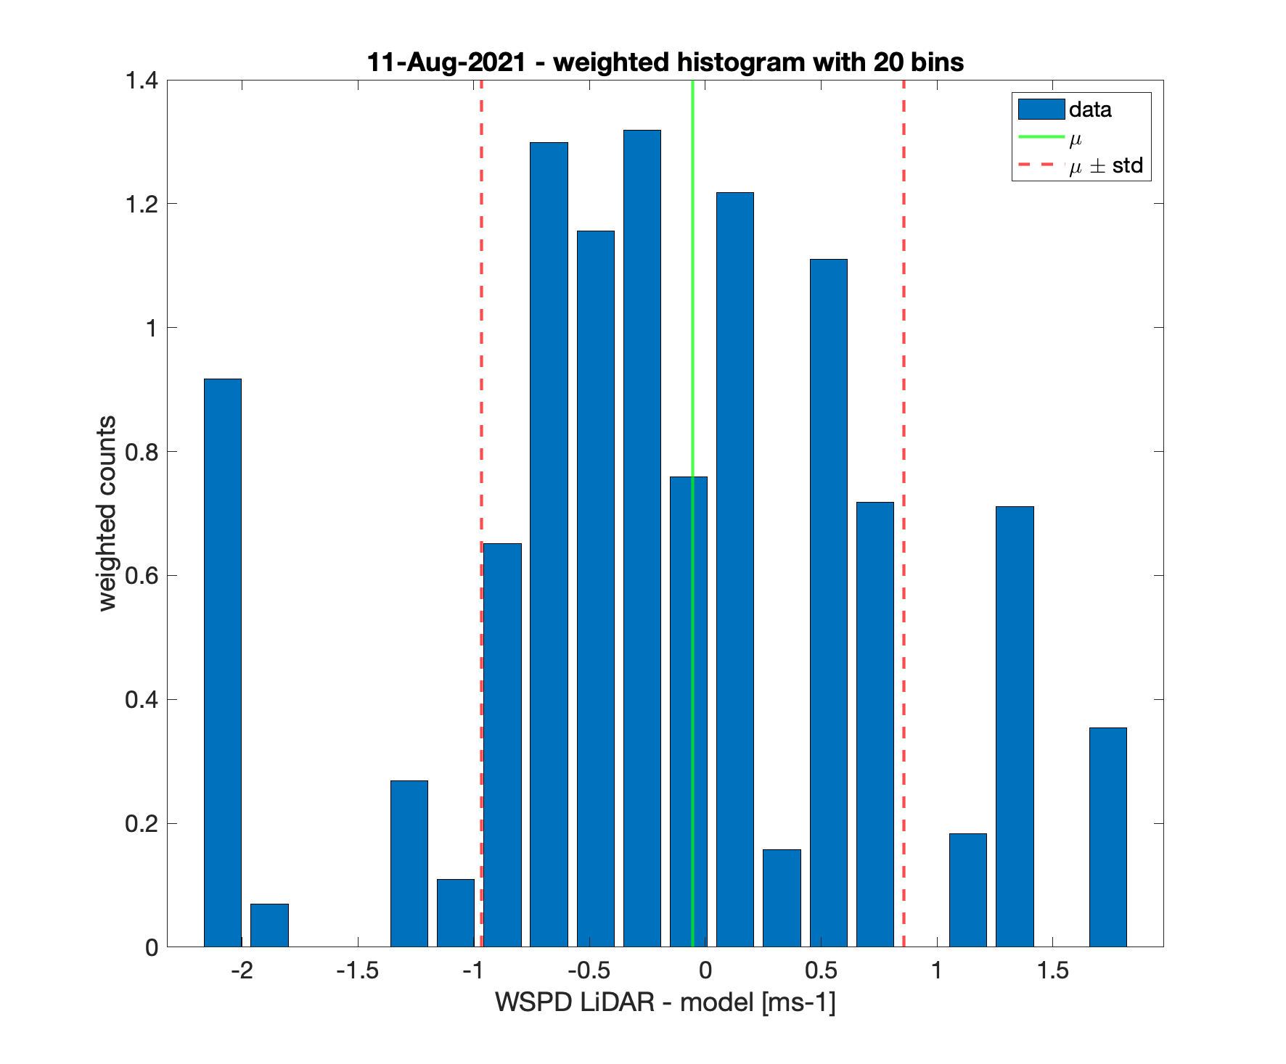
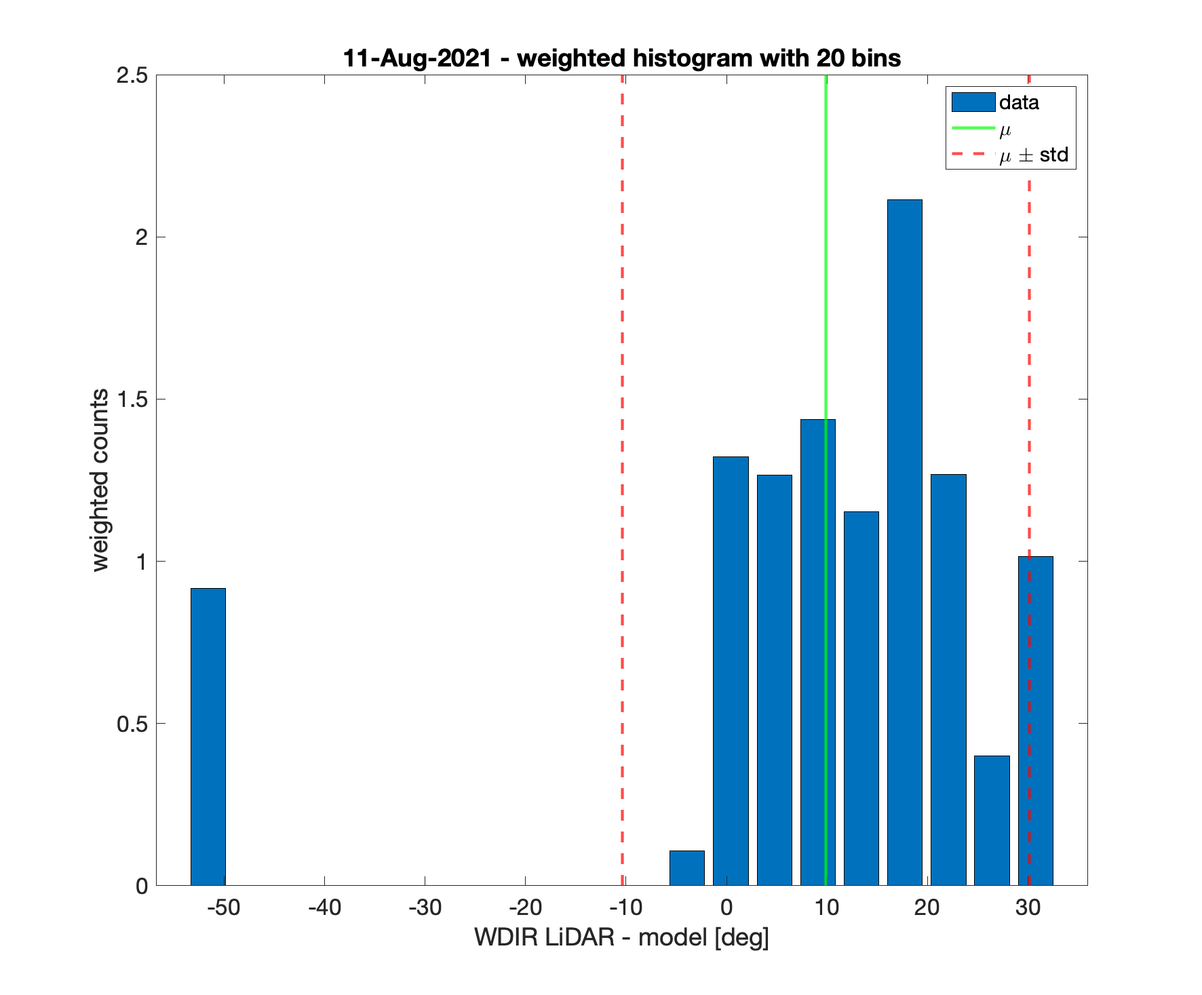
Weighted histograms for 11-Aug-2021

Slide 14
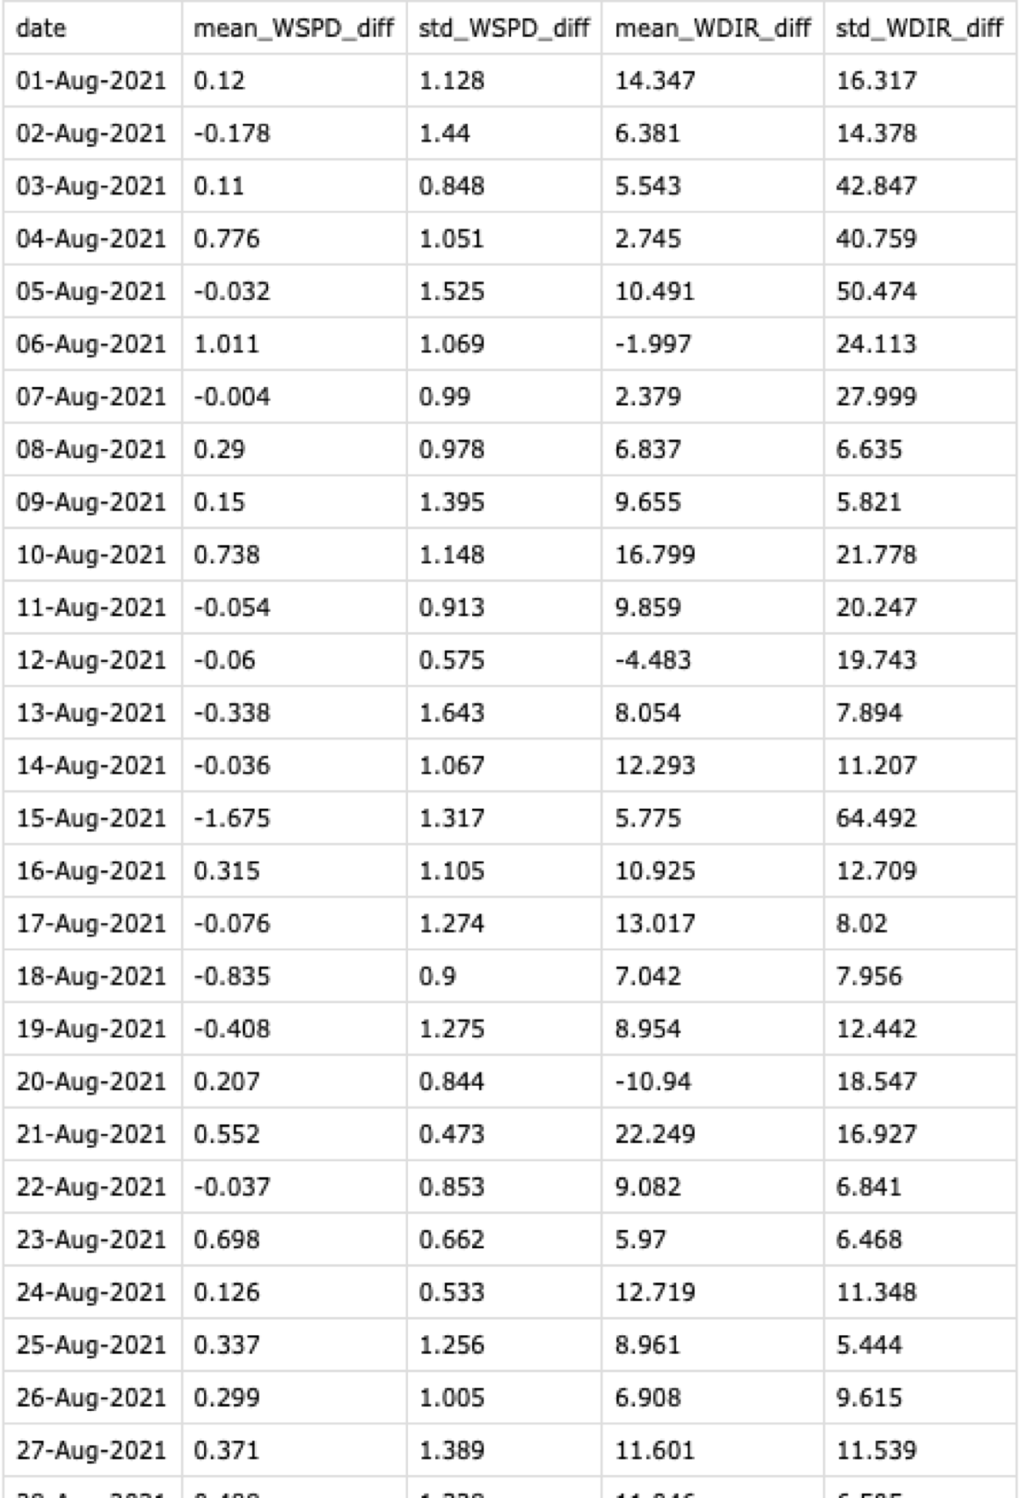
Model mismatches for each day

Slide 15
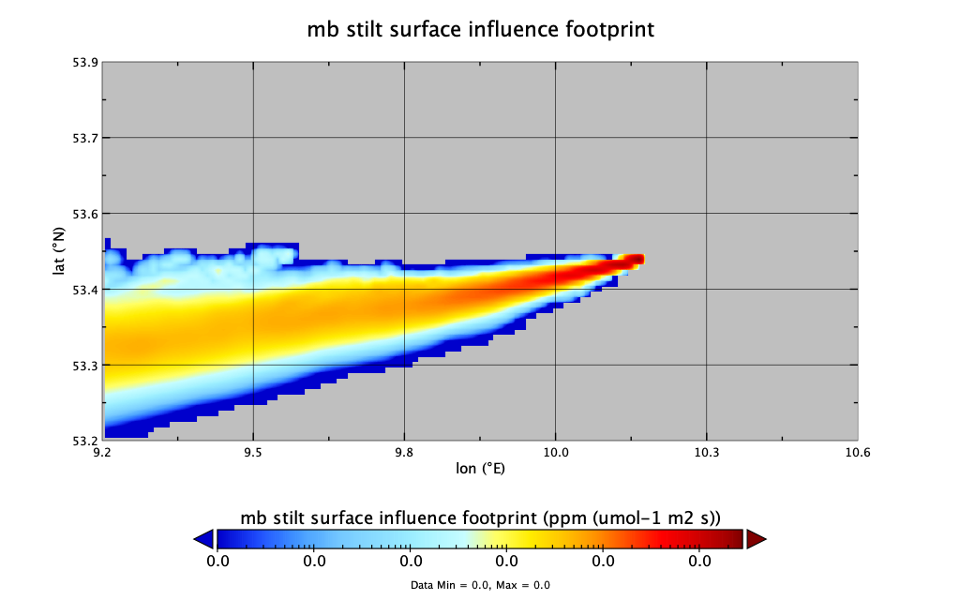
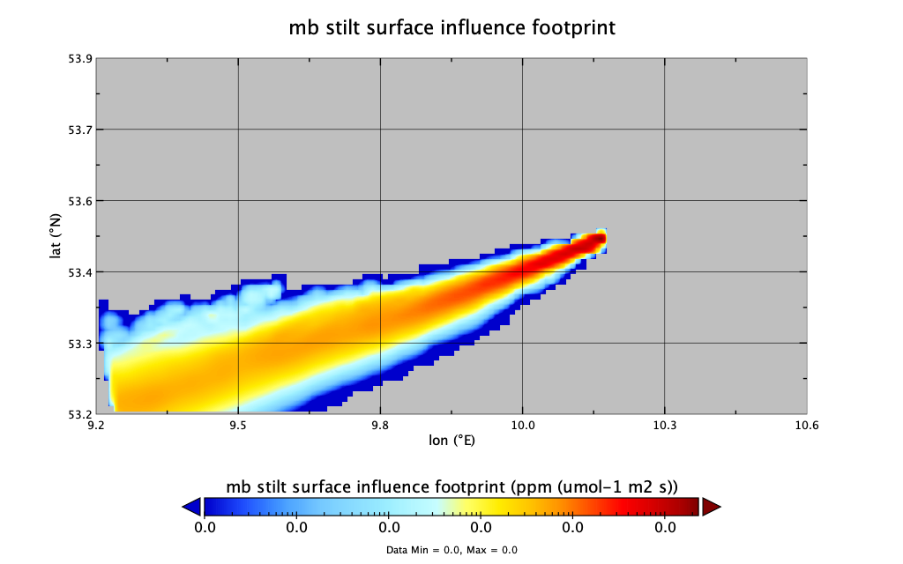
Use mean WDIR mismatch to rotate aggregated footprints
11-Aug-2021 rotate 9.9 deg CCW
rotated

Slide 16
Rotated aggregated footprints are used by Andreas in his inversion framework

Slide 17
Use the standard deviations for the wind speed and wind direction uncertainties to introduce Transport Error – Taylor’s script
Inputs for the script:
Inventory
particle trajectory file for each release height
Standard deviations for the wind speed amd wind direction uncertainties
In our case: 3 different inventories
HAM_CH4_inventory_city_and_river_smooth.nc
HAM_CH4_inventory_corrected_elev_bothInstruments_city_and_river_smooth.nc
HAM_CH4_inventory_corrected_raw_bothInstruments_city_and_river_smooth.nc

Slide 18
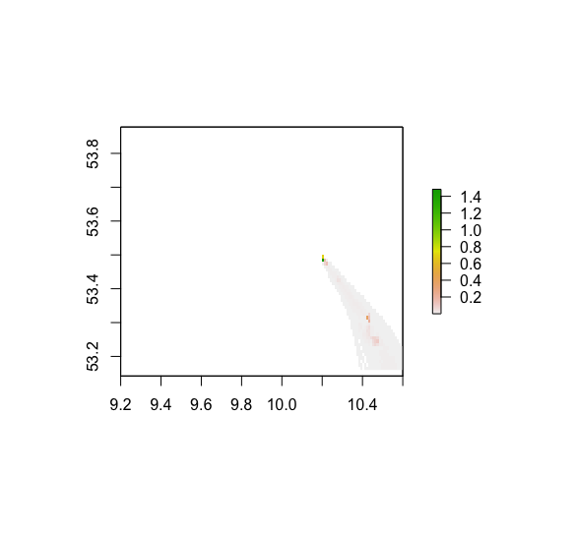
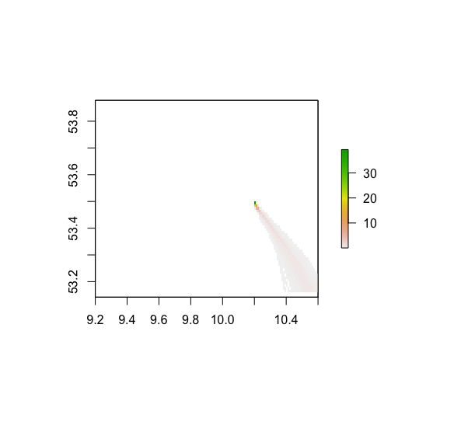
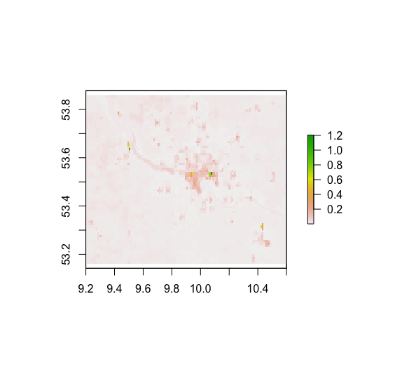
Multiply the inventory by the footprint to get the gridded enhancement contributions sum to get the total enhancement
Gridded enhancement
x
=
inventory
Rasterize the footprint of the particle trajectory file
sum -> 10.61 ppb

Slide 19
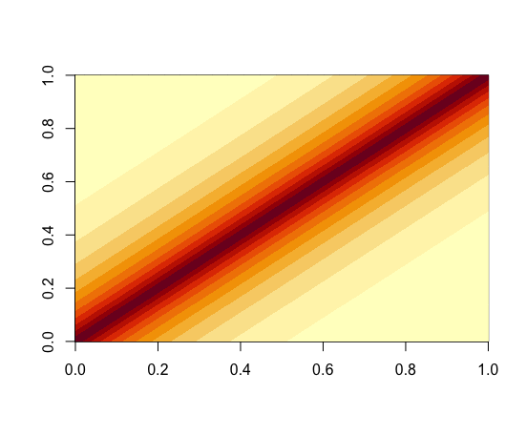
Build wind error covariance matrices to simulate errors that vary in time
Dark color represents high correlation
time

Slide 20
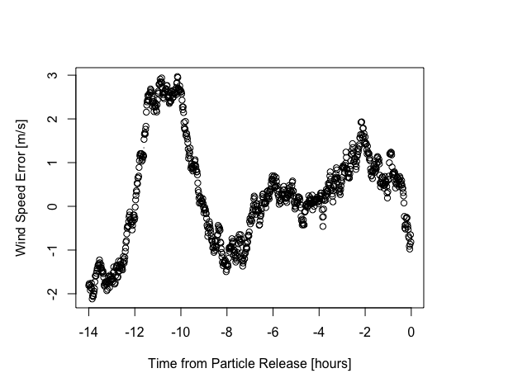
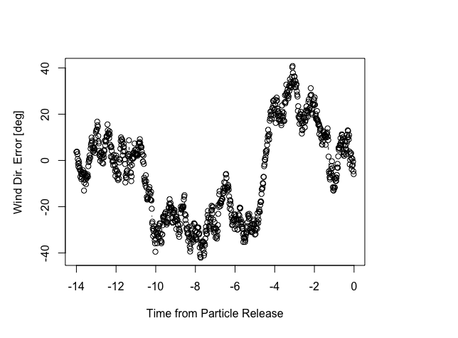
Pull wind speed and wind direction errors according to correlation matrix

Slide 21
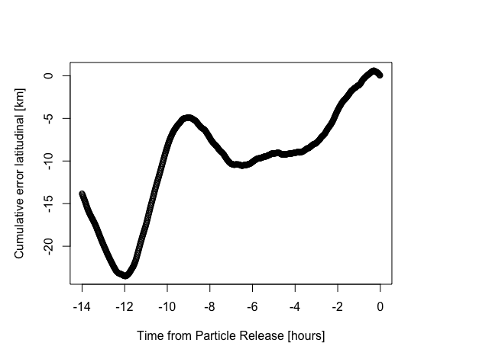
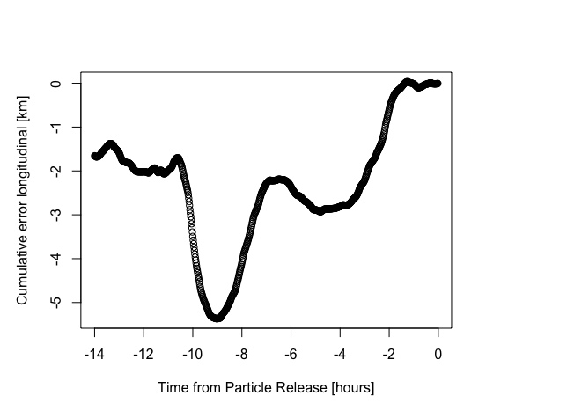
Accumulation of the error movements since the release time (t = 0)

Slide 22
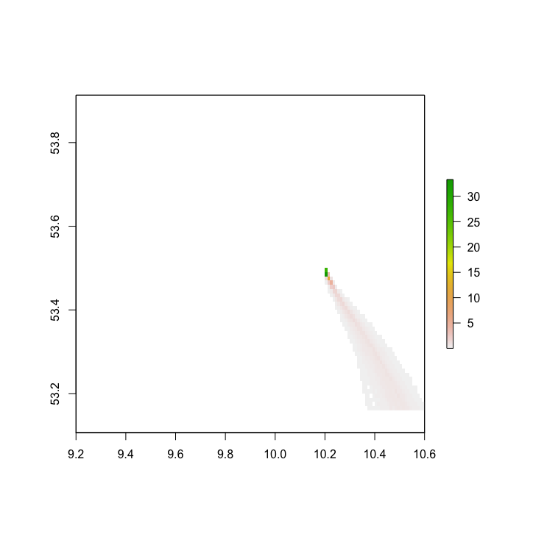
Calculate the error in the enhancement
Add this displacement to every particle and compute new particle positions
shifted particle file is created
Rasterize the footprint of the shifted particle file
again multiply with the inventory and then sum to compute the new ppb value
Subtract and get ppb error – in this case 10.93 ppb – 10.61 ppb = 0.32 ppb
Original particle footprint
shifted particle footprint
Enhancement -> 10.61 ppb
Enhancement->10.93 ppb

Slide 23
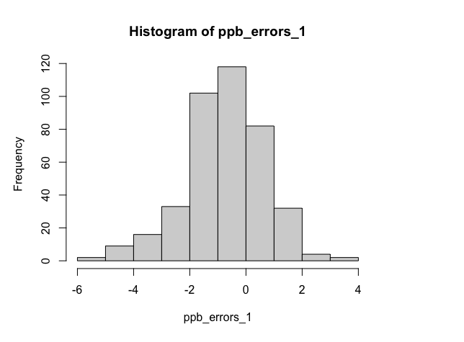
Repeat this process 400 times to get a distribution of ppb errors and then define the standard deviation of this distribution as transport error
1.41 ppb

Slide 24
Our Case : find a daily transport error
The days we’re interested in: 20210806, 20210811, 20210812, 20210823, 20210824, 20210831, 20210901, 20210903, 20210905
For one day -> 4 instrument sites [mb,mc,md,me] x 45 time points [06:00 to 17:00 every 15 min] x 13 atm. layers = ~2340 particle files
Run Taylor’s code for ~2340 particle files
Implement this on the cluster using parallel processing for faster computing
Took me quite some time to get the code working
Moritz helped a lot !

Slide 25
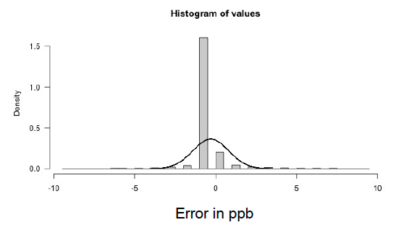
How to combine them to get a distribution that will represent one day?
Run Taylor’s code for ~2340 particle files and save the binned histogram counts
Size: [4x45x13]
Binned histograms from each height can be combined using the pressure weighting scaling factors
Size: [4x45]
average over 45 time points
Size: [4]
average over 4 sites
get daily binned histogram counts
Standard deviation of the distribution on the right side is the daily transport error

Slide 26
Conclusion
Daily histograms are used by Andreas in his inversion framework.
Aim: Compare the wind fields generated by a 3D scanning wind LiDAR and model output. The results create the necessary inputs for the inversion.

Slide 27
Many Thanks to Xinxu, Friedrich, Andreas and Moritz!
Any Questions?

