Slide 1

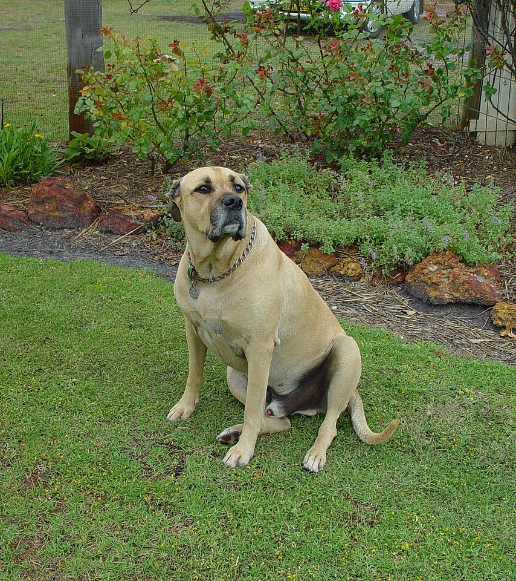
Yardura
Elevating Outdoor Pet Spaces
Investor Pitch Deck
July 18, 2025

Slide 2
The Problem & Market Opportunity
Existing bins and pee posts are bargain‑bin plastic eyesores that clash with décor and break easily.
No convenient, stylish solution exists: owners trek to the garage and inconsistent clean‑up kills lawns and plants.
Bargain products fail to bridge the $152B pet industry and $17B outdoor décor market—leaving a $20B+ opportunity untapped.
The Sweet Spot ≈30M design‑savvy pet households spend >$1K on pets and $1–5K on backyard décor per refresh, creating a $20B+ overlap.
[13] [14] [15] [16] [17] [18]

Slide 3

Key Market Insights
$49.6B
55%
>50%
65%
Projected global *pet* accessories market by 2034 (CAGR 7.9%)
Dogs’ share of global pet accessories market (2024)
Pet parents willing to pay extra for eco‑friendly gear
Gen Z & Millennials planning to add a pet within 5 years
[10] [11] [12] [19]

Slide 4
Outdoor × Pet Care: A New Market
Pet Care $152B pet industry
$33B supplies & accessories
68M dog households
> $1K/yr spent on pets
Outdoor Living $9B U.S. outdoor furniture market
Yards are extensions of the home
$1–5K spent per refresh
Overlap Opportunity ≈30M design‑conscious pet parents in a $20B+ yard décor × pet care sweet spot
[13] [14] [15] [16] [17] [18]

Slide 5
Target Customer
01
Demographics
Age 25–65, mid‑ to‑high income homeowners who treat the yard as an extension of the living room. 68M U.S. dog‑owning households.
02
Psychographics
Pet parents treat animals as family; invest in premium, design‑forward pet and patio products; follow home décor & pet influencers; value sustainability.
03
Use Case
Daily yard clean‑up and pee training using a stylish bin with integrated scooper and dolly. Holds a week’s waste, encourages routine, and complements outdoor décor.
[15] [16] [17] [18]

Slide 6
Our Flagship Product
Elegant Design
Odor & Hygiene
Durability
Integrated System
Modern silhouette and furniture‑grade finishes elevate any patio.
Tight seal with optional charcoal filter; easy‑clean surfaces and insect‑resistant design.
Weather‑resistant metals & woods with simplified mechanics for longevity and all‑season use.
Includes modular scooper, dolly & PetPost attachments for waste, bags and leash in one stylish unit.
Form & Function Our WasteWell system encourages daily clean‑up and pee training by making your yard’s pet corner beautiful, convenient and habit‑forming.
[6] [7]

Slide 7
Product Roadmap & Brand Identity
Brand Identity
WasteWell System
PetPost Organizer
Premium bin with integrated scooper, dolly & optional PetPost organizer.
Modular rail or mount with leash latch, bag dispenser & treat holder.
Mission: Elevate the outdoor pet experience by merging style, durability & sustainability—bridging pet care with yard décor. Vision: Be the first lifestyle brand to create furniture‑grade pet solutions for the yard, inspiring pride & routine care. Values: Design excellence, longevity, sustainability & customer delight.
MarkMate
PlayPod
Discreet pee post that trains dogs to one spot – no neon stakes.
Weatherproof storage/play box for toys and gear.
TreatTower
HydrationHub
Elevated treat station with storage & dispenser.
Outdoor water station with refillable bowl & storage.

Slide 8
Competitive Landscape
Product | Price | Odor Control | Aesthetics | Materials
Basic Plastic | $30 | Low | 1/5 | Thin Plastic
Pet Genie | $50 | Med | 2/5 | Plastic
Planter Style | $40 | Low | 3/5 | Plastic/Faux
Metal Can | $30 | Low | 2/5 | Thin Metal
Yardura | $199 | High | 5/5 | Premium Metal/Wood
First premium dog waste station: form & function in harmony
Odor‑free design with gasket seal & charcoal filter
Robust materials built for all seasons
Family of products encourages brand loyalty
[6] [7] [8]

Slide 9
Business Model & Pricing
Pricing & Margins WasteWell System (bin + scooper + dolly): $199 PetPost Organizer: $49 Future modules (PlayPod, TreatTower, HydrationHub): $30–$79 Average order value ≈$250 with attachments. Estimated COGS ~$80 per system, yielding ~68% gross margin. Early runs of ~100 units break even; profits reinvested into inventory, marketing & new products.

Slide 10
Go‑To‑Market Strategy
Pre‑Launch
Launch
Growth
Expansion
Market research, design & prototyping; build email list & social community.
Kickstarter campaign & Shopify site; collect early orders & feedback.
Digital ads, influencer partnerships, UGC content & email nurture.
Introduce accessories; pursue select retail & wholesale partners.
Direct‑to‑consumer via Shopify; Kickstarter for validation
Targeted ads & SEO; email & content marketing
Influencer partnerships and user‑generated content
Local events, pet fairs & community engagement

Slide 11
Operations & Roadmap
Lean & Flexible Operations Begin with small‑batch domestic production for oversight and quality. Evaluate overseas options as volume grows, considering tariffs and lead times. Maintain a nimble supply chain with multiple vendors and a strict QC process.
Period | Months 1–2 | Months 3–4 | Month 5 | Month 6 | Months 7–8 | Months 9–12
Milestones | Research & planning | Design & prototype | Finalize design & prep tooling | Launch & crowdfunding | Fulfil orders & gather feedback | Scale production & expand line

Slide 12
Financial Projections
Assumptions: Year 1: 150 WasteWell systems sold (AOV ~$250)
Year 2: 350 systems + PetPost & MarkMate
Year 3: 700 systems & full product lineup
Revenue figures exclude taxes & shipping; profits reinvested into growth.

Slide 13
Team & Next Steps
Founder Your Name – Seasoned B2B sales professional passionate about design & pets. Skilled in networking, communication and building customer relationships. Seeking to bring a beautiful new category to life.
Advisors & Partners Looking for co‑founders, product designers & digital marketing experts to help scale. Building a network of pet‑loving ambassadors and investors.
Join the Journey Seeking seed capital & strategic guidance to fund tooling, initial runs and marketing. Get in early on the next big thing in pet care.

