Slide 1
PROJECT-1
TEAM MEMBERS
Abhishek Kumar : 8097443 (Team leader)
Seshasree Tallam : 8099273
Samuel Erra : 8097395
Nageshwar Reddy : 8097443

Slide 2
Objective:
To print single dimensional array by changing the positions of elements

Slide 3
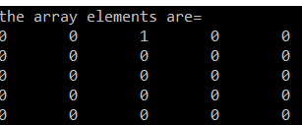
Main function:
The single dimensional array will be printed in the console.

Slide 4
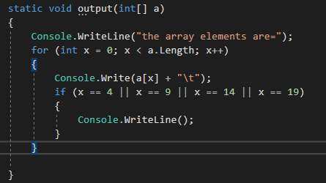
Output function:
Displays the array element. For loop from 0 to the value less than size of array. If statement will divide the elements into new line having 5 value in each row when the index hits 4, 9, 13 & 19.

Slide 5
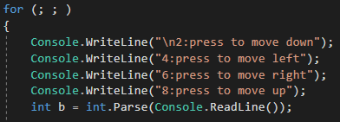
for(; ;) is a infinite loop, b is the input from user. Based on the input we have switch case.
The above statements are represented as below :
Press 2 to move down
Press 4 to move left
Press 6 to move right
Press 8 to move up

Slide 6
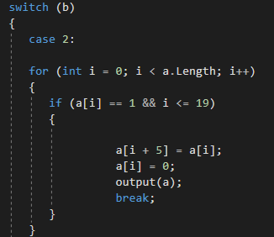
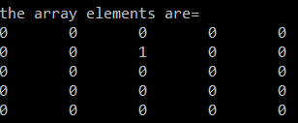
Case 2 : For loop iterating all the elements, IF statement checks for 1 in the array element. If found, the element just below 1 becomes 1 and at that position where 1 was initially becomes 0.
Initially the array is like this
After we press 2 the element will change the position

Slide 7
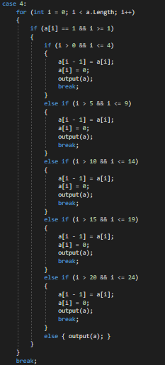
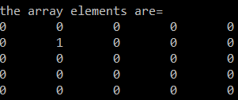
Case 4 : For loop iterates, all the elements in if statement checks for 1 in the array element. If found the element just left of 1 becomes 1 and the position where1 was initially becomes 0.
Initially the array is like this
After we press 4 the element will move the left position

Slide 8
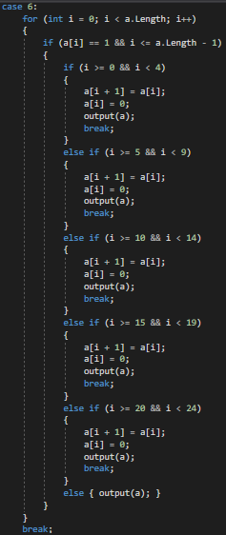
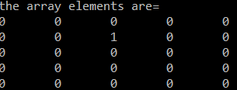
Case 6 : For loop iterates, all the elements in if statement checks for 1 in the array element. If found the element just right of 1 becomes 1 and the position where1 was initially becomes 0.
Initially the array is like this
After we press 6 the element will move the left position

Slide 9
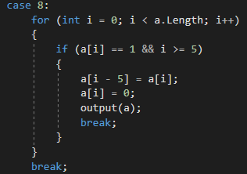
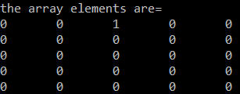
Case 8 : For loop iterating all the elements, if statement checks for 1 in the array element. If found the element just Above of 1 becomes 1 and the at position where 1 was initially becomes 0
Initially the array is like this
After we press 4 the element will move the left position

Slide 10
Result : Hence printed the single dimensional array by changing the positions of elements.

