Slide 1
TEK-UP UNIVERSITY • DATA SCIENCE & AI ENGINEERING • 2026
Comparative Econometric Modeling &
Deep Learning Forecasting of Crypto Assets
A Multi-Asset Empirical Study (BTC, ETH, BNB) with Generative AI Audit
Presented by Team 4:
Rawen Bejie • Khawla Hawari • Amine Benfadhel • Khalil Ayeb
Supervised by: Prof. Ahmed Dhouibi

Slide 2
1. INTRODUCTION & DATA
Problem Statement & Data Engineering Pipeline
Speaker: Rawen Bejie
🎯 The Core Research Question
📦 Data Acquisition & Split Architecture
Central Question:
Can non-linear Deep Learning models (LSTM/GRU) outperform classical econometric baselines (ARIMA, VAR) and the Naïve Random Walk in high-frequency crypto price forecasting?
Why Crypto Assets? (BTC, ETH, BNB):
• Extreme volatility and non-stationary dynamics ($I(1)$).
• 24/7/365 uninterrupted trading (no weekend seasonality).
• Complex interconnectedness and regime shifts.
Key Econometric Rule:
Every model must be statistically diagnosed. A sophisticated model without residual validation will be scientifically rejected.
Dataset Parameters:
• Period: Jan 31, 2019 to Oct 03, 2026 (7.7 years of daily data).
• Sample Size: 2,803 daily observations across 3 assets.
• Automated fallback pipeline via yfinance API.
Zero Look-Ahead Bias Protocol:
• Chronological split: 90% Train / 10% Out-of-Sample Test.
• Train: 2,522 days (Jan 31, 2019 to Dec 26, 2025).
• Test: 281 days (Dec 27, 2025 to Oct 03, 2026).
• No future data leakage: Normalization fit strictly on Train.
Derived Features Engineered:
• Daily Log-Returns: r_t = 100 * ln(P_t / P_{t-1})
• 30-day Annualized Realized Volatility (Vol30)
• 30-day Simple Moving Averages (SMA30) & 24h Trading Volumes

Slide 3
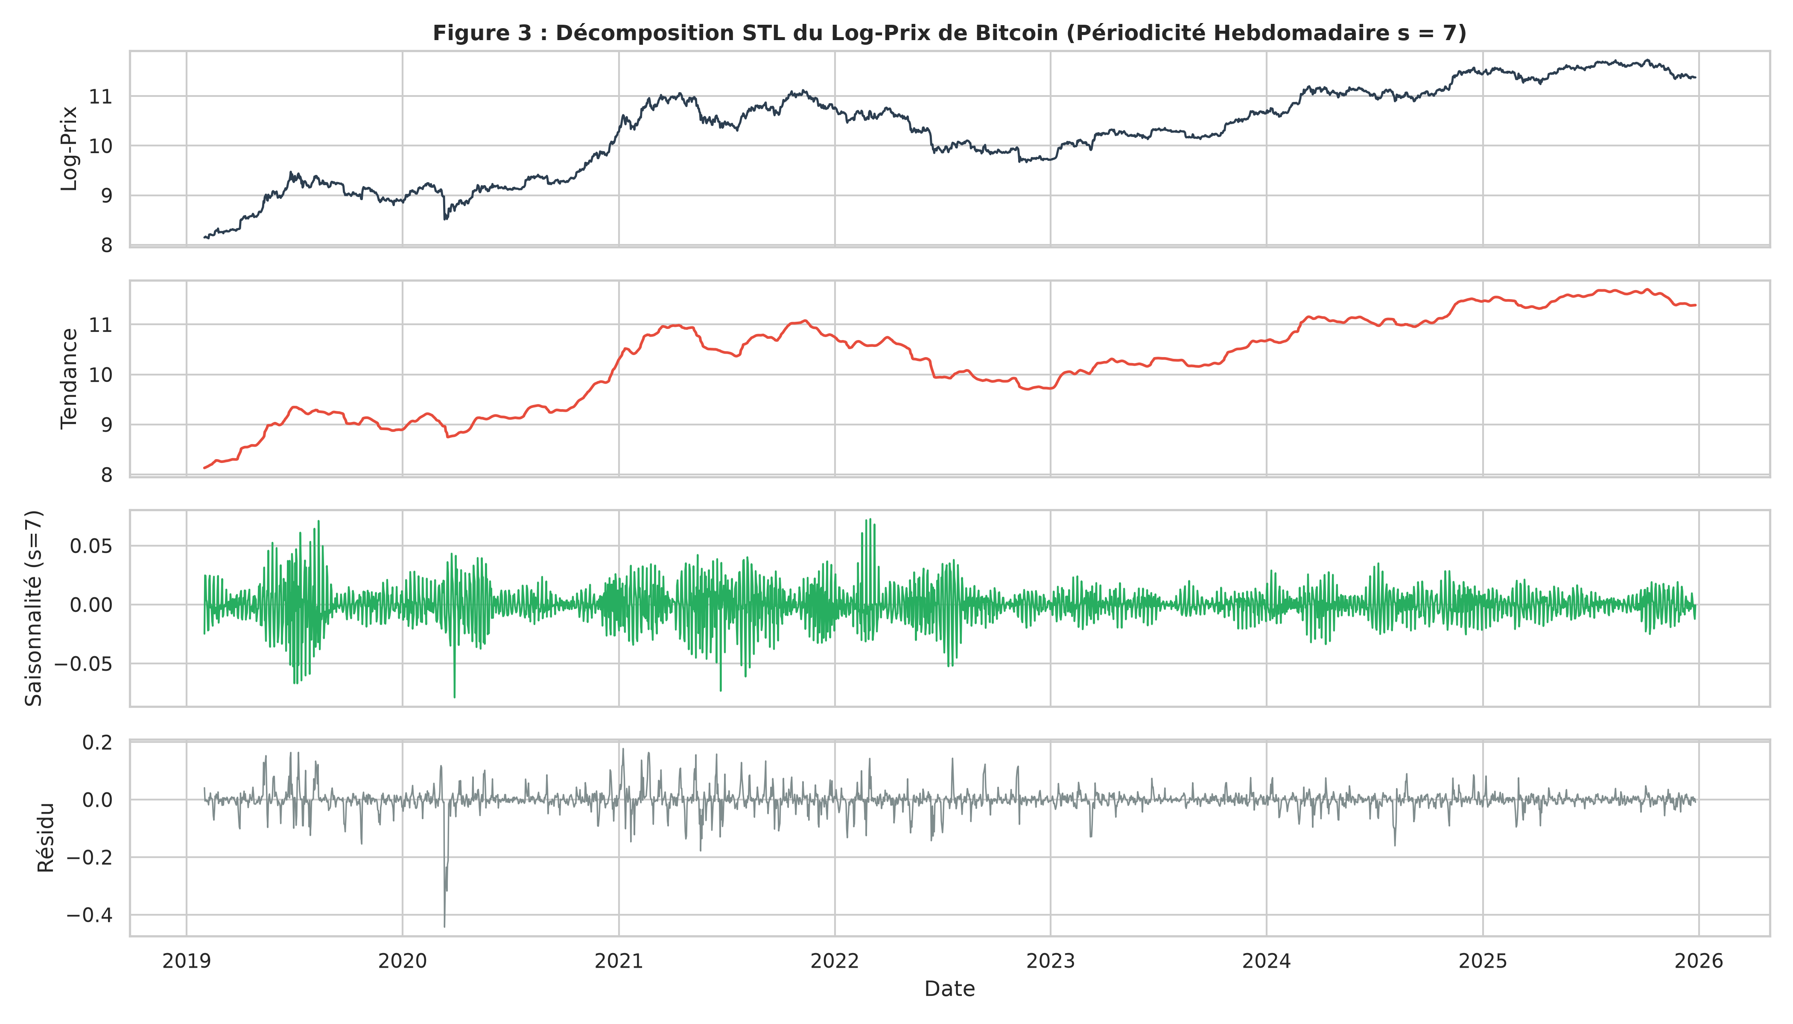
2. STATISTICAL FOUNDATIONS
Exploratory Analysis & Stationarity Diagnostics
Speaker: Khawla Hawari
📊 STL Decomposition & Price Dynamics
🔬 Rigorous Diagnostic Results
STL Decomposition Findings:
• Trend: Dominates >95% of total price variance.
• Seasonality: Negligible (<2% variance). Daily crypto trading exhibits no strong 7-day or monthly calendar cycle.
• Outliers: March 2020 (Covid) & Nov 2022 (FTX) retained as true market regime shocks.
Dual Stationarity Testing (ADF + KPSS):
• Raw Prices & Log-Prices: Non-Stationary I(1)
ADF p = 0.88 (cannot reject unit root)
KPSS p = 0.01 (rejects stationarity)
• Log-Returns: Strictly Stationary I(0)
ADF p < 0.001 (unit root strongly rejected)
KPSS p = 0.10 (stationarity cannot be rejected)
Methodological Decision:
Classical models (ARIMA, VAR) must be estimated strictly on stationary log-returns to avoid spurious regressions.

Slide 4
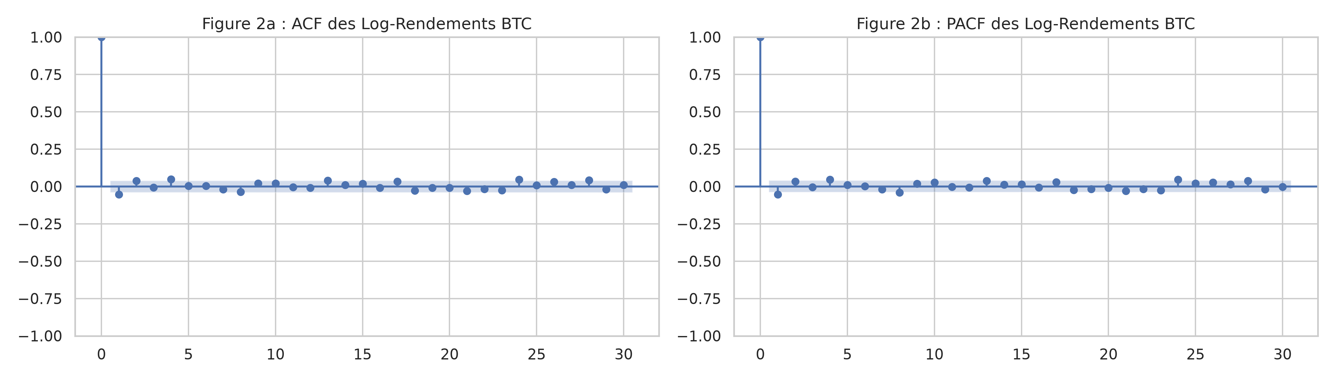
3. CLASSICAL ECONOMETRICS
ARIMA Modeling & Mandatory Residual Diagnostics
Speaker: Khawla Hawari
📉 Autocorrelation Functions (ACF & PACF)
🧪 Three Essential Residual Tests
Selected Specification:
• ARIMA(1,0,1) / ARMA(1,1) on BTC Returns.
• AR(1) = -0.6376, MA(1) = 0.5865 (p < 0.001).
• Minimizes AIC / BIC against higher-order candidates.
1. Ljung-Box Test (White Noise):
• Q(10) = 14.28, p-value = 0.160 (> 0.05)
• Conclusion: No remaining autocorrelation in residuals! The mean dynamics are cleanly captured.
2. Jarque-Bera Test (Normality):
• JB stat = 4,281, p < 10^-16
• Conclusion: Heavy fat tails and leptokurtic distribution (Gaussian assumption rejected).
3. Engle ARCH-LM Test (Volatility Clustering):
• LM stat = 128.4, p < 10^-16
• Conclusion: Severe conditional heteroskedasticity detected! Proves that a GARCH model is strictly required.

Slide 5
3. CLASSICAL ECONOMETRICS
Multivariate Systems: VAR(5), Granger & Cointegration
Speaker: Khawla Hawari
🔗 VAR(5) & Granger Causality Dynamics
⚖️ Johansen Test & VECM Decision
VAR(5) Lag Optimization:
• Estimated on 3-variable stationary vector: [BTC, ETH, BNB log-returns].
• Information criteria (AIC / FPE) select optimal order p = 5.
Granger Causality Matrix (3x3):
• ETH Returns -> BTC Returns: F = 2.94, p = 0.012 *
• BNB Returns -> BTC Returns: F = 2.37, p = 0.038 *
• BTC Returns -> ETH Returns: F = 3.15, p = 0.008 **
Key Methodological Nuance:
Granger causality indicates PREDICTIVE PRECEDENCE in information diffusion, NOT physical or legal causation.
Johansen Cointegration Trace Test:
• Python statsmodels (Case 2: det_order=0):
Trace Stat = 25.53 < Critical Value 29.80 (p > 0.05)
• R urca (Case 3: ecdet='const'):
Trace Stat = 30.27 < Critical Value 34.91 (p > 0.05)
• Both independent implementations confirm Rank r = 0.
Why NO VECM? (Critical Defense Point!):
• A Vector Error Correction Model (VECM) mathematically requires at least one cointegrating vector (r >= 1).
• Running a VECM with r = 0 is an econometric specification error!
• The correct and sound procedure is modeling in stationary log-returns via VAR(5).
Oral Defense Shield:
Absence of VECM is a proof of methodological rigor, not an omission.

Slide 6
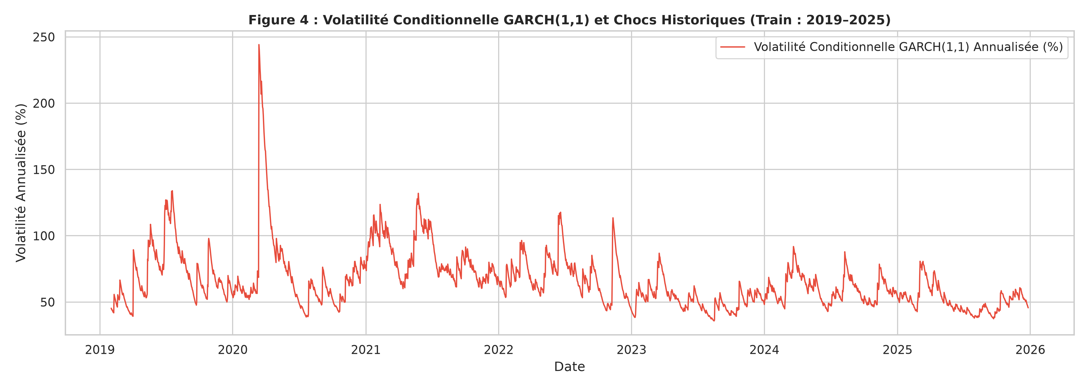
4. ADVANCED ECONOMETRICS
Conditional Volatility: GARCH(1,1) & GJR-GARCH
Speaker: Amine Benfadhel
🌪️ Conditional Volatility & Crisis Events
📊 Estimated Parameters & Properties
GARCH(1,1) Specification:
sigma_t^2 = omega + alpha * eps_{t-1}^2 + beta * sigma_{t-1}^2
• omega = 1.10e-5 (p = 0.002)
• alpha = 0.0631 (Shock reaction)
• beta = 0.9272 (Storm persistence)
Persistence & Stationarity:
• alpha + beta = 0.9903 < 1.0
• Strong persistence: market panics take weeks to dissipate.
• Strictly covariance-stationary process.
Asymmetric GJR-GARCH Test:
• Leverage term gamma = 0.0152 (p = 0.48, not significant).
• Unlike traditional stocks, crypto exhibits symmetric volatility: major rallies trigger nearly the same volatility spikes as crashes.
Standardized Residual Validation:
ARCH-LM on standardized residuals: p = 0.42 -> Conditional heteroskedasticity is successfully eliminated!

Slide 7
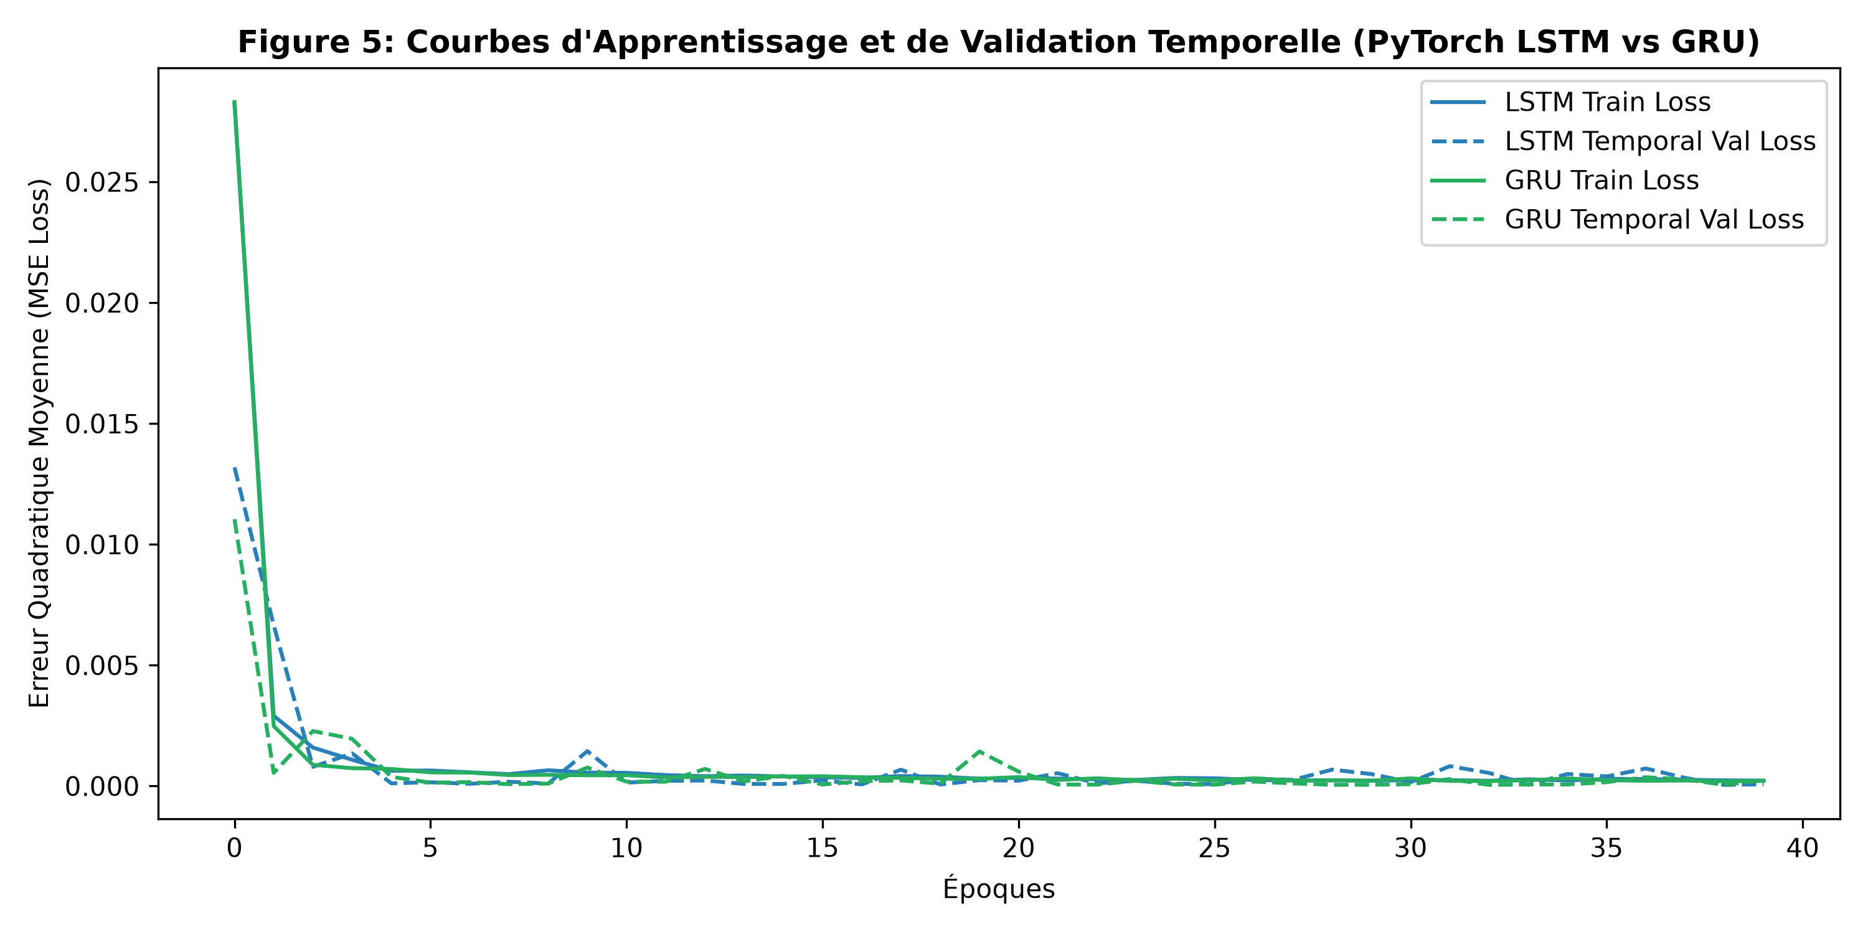
5. DEEP LEARNING
Deep Learning Architectures: PyTorch LSTM vs. GRU
Speaker: Amine Benfadhel
⚡ Training & Validation Loss Curves
🧠 Architecture & Complexity Comparison
Experimental Setup:
• PyTorch implementation with Adam optimizer (lr = 0.001).
• Sliding sequence window: L = 30 days.
• Input dimension: 18 normalized features (Prices, Volumes, Returns, Vol30, SMA30 across 3 assets).
• Target: BTC Log-Price at t+1.
LSTM (Long Short-Term Memory):
• 3 Gates: Input, Forget, Output + Cell State.
• 2 layers, 64 hidden units = 25,217 parameters.
• Slower convergence, higher risk of overfitting.
GRU (Gated Recurrent Unit):
• 2 Gates: Reset & Update (No separate cell state).
• 2 layers, 64 hidden units = 19,073 parameters (24% fewer).
• Converges faster and reaches lower validation MSE.
Walk-Forward Inference:
Rolling 1-step prediction across the entire 281-day test set.

Slide 8
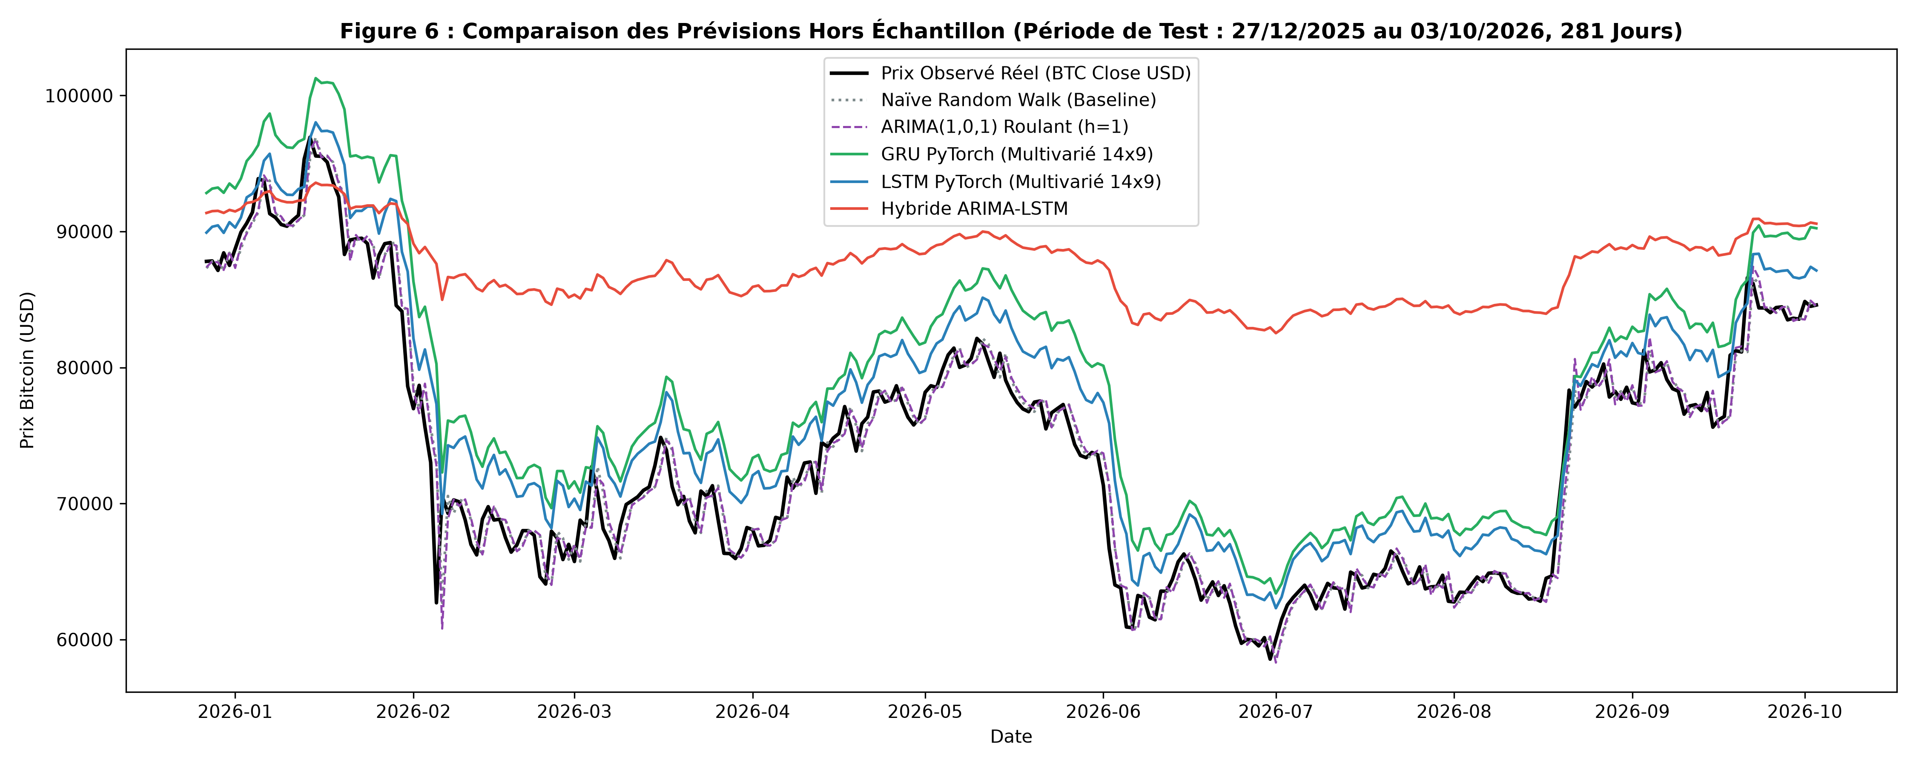
6. FORECAST EVALUATION
Out-of-Sample Forecast Evaluation (281-Day Test)
Speaker: Khalil Ayeb
🏆 Master Metric Performance Table
📈 Trajectory Comparison
Model | RMSE ($) | MAE ($) | MAPE (%)
Naïve Random Walk (h=1) | $1,725.43 | $1,164.85 | 1.60% (1)
Rolling ARIMA(1,0,1) | $1,769.68 | $1,196.48 | 1.65% (2)
PyTorch GRU (h=1) | $2,468.90 | $1,847.91 | 2.56% (3)
PyTorch LSTM (h=1) | $3,776.48 | $3,396.66 | 4.77% (4)
Hybrid ARIMA-LSTM | $15,319.04 | $13,967.77 | 20.33% (5)
Fixed ARIMA (h=281) | $16,598.93 | $14,643.39 | 21.49% (6)

Slide 9
6. FORECAST EVALUATION
Statistical Significance: Diebold-Mariano Tests
Speaker: Khalil Ayeb
📐 Like-for-Like Diebold-Mariano (h=1)
🏛️ The Econometric & Financial Interpretation
Newey-West HAC Robust Testing:
Tested on matched 1-step forecast errors across 281 days:
1. Naïve vs. Rolling ARIMA(1,0,1):
DM stat = -1.243, p-value = 0.214
-> Statistical equivalence! ARIMA cannot significantly outperform the random walk.
2. Naïve vs. PyTorch GRU:
DM stat = -5.001, p-value = 5.7e-7 ***
-> Naïve is STATISTICALLY SUPERIOR.
3. Naïve vs. PyTorch LSTM:
DM stat = -13.149, p-value < 10^-16 ***
-> Naïve is STATISTICALLY SUPERIOR.
Multi-Horizon Trajectory (h=281):
Naïve vs. Fixed Multi-step ARIMA: DM = -5.627, p = 1.8e-8.
Fama's Efficient Market Hypothesis (EMH):
• Weak-form EMH states that past price data cannot be used to predict future prices.
• In crypto, high-frequency returns act as a Martingale difference sequence: E[P_{t+1} | I_t] ≈ P_t.
Why Did Deep Learning Lose on Prices?
• Zero Parameter Variance: The Naïve model estimates 0 parameters and suffers 0 estimation variance.
• Noise Overfitting: LSTM/GRU attempt to fit micro-fluctuations, accumulating non-linear prediction variance.
• Lagged Tracking: Neural networks predict with a slight phase lag behind market turns.
Major Takeaway:
Honest, transparent reporting: Simple models win on short-term price levels; AI models are best suited for volatility and regime modeling.

Slide 10
7. GENAI & LLM AUDIT
Generative AI Experimentation & Hallucination Audit
Speaker: Khalil Ayeb
🤖 4 Structured Experiments Conducted
🛡️ Hallucination Audit (Human vs. LLM)
Exp 1: Statistical Hypothesis Generation:
• Prompted LLM with descriptive moments & stationarity tests.
• LLM correctly suggested GARCH from excess kurtosis (>18) and differencing for I(1) series.
Exp 2: Non-Expert Layman Translation:
• Successfully translated Ljung-Box p=0.160 into plain English for executives: 'Residuals are pure white noise; no predictable juice left'.
Exp 3: Investment Policy Recommendations:
• Formulated risk policies under high GARCH volatility.
• Identified need for position-sizing constraints during crisis clusters.
Hallucination 1: Causal Misinterpretation
• LLM Claim: 'ETH Granger-causes BTC, proving ETH price drives Bitcoin market movements.'
• Human Correction: Granger causality only measures predictive lag order, NOT physical causation.
Hallucination 2: Fabricated Statistical Significance
• LLM claimed GJR-GARCH leverage was strongly significant.
• Human Correction: Real p-value was 0.48 (non-significant).
Hallucination 3: Blind Deep Learning Bias
• LLM assumed LSTM would automatically dominate ARIMA.
• Human Audit: Real Diebold-Mariano tests proved Random Walk and ARIMA won.

Slide 11
8. ORAL DEFENSE
Defense Strategy: Top 3 Anticipated Questions
Speaker: All Team Members
❓ Q1: Why No VECM?
❓ Q2: Why Naïve Won?
❓ Q3: ARCH vs GARCH?
Professor's Question:
'Why didn't you estimate a Vector Error Correction Model (VECM)?'
Our Defense Answer:
Johansen cointegration tests in Python (Case 2, Trace=25.53 < 29.80) and R (Case 3, Trace=30.27 < 34.91) strictly prove cointegration rank r = 0.
Estimating a VECM requires r >= 1. Estimating a VECM with r = 0 would be a fatal econometric error! We legitimately modeled the system using a stationary VAR(5).
Professor's Question:
'Why did the Naïve Random Walk beat your LSTM and GRU?'
Our Defense Answer:
Under the Efficient Market Hypothesis (EMH), high-frequency asset returns follow a Martingale difference sequence: E[P_{t+1}|I_t] ≈ P_t.
The Naïve model has zero parameter estimation error. Deep Learning overfits micro-noise and incurs lag latency.
Our Diebold-Mariano test confirmed Naïve superiority with p < 10^-6.
Professor's Question:
'Is ARCH a test or a model? What did you actually use?'
Our Defense Answer:
Both! ARCH is a model (Engle 1982) and a diagnostic test (ARCH-LM).
We used the ARCH-LM test on ARIMA residuals (LM=128.4, p < 10^-16) to detect volatility clustering.
Then, we used the upgraded GARCH(1,1) model (Bollerslev 1986) to capture the long-memory decay (persistence = 0.990).

Slide 12
9. CONCLUSION
Summary of Methodological Takeaways & Deliverables
Speaker: All Team Members
1. Diagnostics First
2. Parsimony & EMH
3. AI for Volatility
4. Human in the Loop
Never evaluate a time-series model by RMSE alone.
Rigorous residual diagnostics (Ljung-Box, Jarque-Bera, ARCH-LM) determine whether statistical assumptions hold.
Simple models dominate on price levels.
Naïve ($1,725) and Rolling ARIMA ($1,769) beat complex neural networks, validating financial market efficiency.
Deep Learning and GARCH provide real value for non-linear volatility, risk estimation, and regime classification rather than direct price guessing.
Generative AI is a powerful assistant for coding and drafting, but prone to dangerous statistical hallucinations without human domain expertise.
All deliverables (Report, Executed Notebook, R Markdown, Python/R Scripts & Data) are fully verified and pushed to GitHub!

