Slide 1
Joint Dynamics, Cointegration and Volatility of BTC, ETH and BNB
TEK-UP UNIVERSITY | DATA SCIENCE AND ARTIFICIAL INTELLIGENCE
Bitcoin, Ethereum and Binance Coin, 2019 to 2026
Normalized prices, log scale
Rawen Bejie
Khawla Hawari
Amine Benfadhel
Khalil Ayeb
Data and split
EDA and stationarity
Multivariate models and GARCH
Deep learning and evaluation
Time Series for Data Science and AI | Supervised by Prof. Ahmed Dhouibi | Academic year 2025-2026
Notes:
Introduce the team and the question the project asks: on a basket of three major crypto assets, do sophisticated models beat simple baselines out of sample? The project combines classical econometrics (ARIMA, VAR, Johansen, GARCH), deep learning (LSTM, GRU) and a critical audit of generative AI answers. Everything is evaluated on a strict chronological split.

Slide 2
Data and Research Design
CONTEXT AND DATA
Can deep learning beat classical econometrics and the random walk on daily crypto prices?
2,803
daily observations, 31 Jan 2019 to 3 Oct 2026
2
assets traded 24/7: BTC, ETH, BNB
90 / 10
chronological train and test split, no shuffling
Train | 90%
10%
31 Jan 2019 to 26 Dec 2025, 2,522 days. ARIMA, VAR, GARCH parameters and the MinMax scalers are fitted here only.
27 Dec 2025 to 3 Oct 2026, 281 days. Blind out-of-sample validation.
Presented by Rawen Bejie
Notes:
Data come from Yahoo Finance (BTC-USD, ETH-USD, BNB-USD). Ingestion starts on 1 January 2019; 30-day rolling indicators (realized volatility and SMA) remove the first 30 rows, which fixes the consolidated start at 31 January 2019 and gives 2,803 continuous daily observations. The split is strictly chronological: 2,522 training days and 281 test days. No statistic, parameter or scaler uses test information.

Slide 3
Exploratory Analysis and Stationarity
EXPLORATORY ANALYSIS
Prices follow a stochastic trend; log-returns are stationary but heavy-tailed
Daily log-returns, train sample
ADF and KPSS, train sample
Metric | BTC | ETH | BNB
Mean (per day) | +0.128% | +0.131% | +0.195%
Volatility (per day) | 3.29% | 4.30% | 4.39%
Worst day (12 Mar 2020) | -46.47% | -55.07% | -54.31%
Skewness | -1.07 | -0.99 | -0.17
Excess kurtosis | 18.92 | 14.47 | 24.52
Series | ADF p | KPSS p | Order
BTC log-price | 0.265 | 0.010 | I(1)
ETH log-price | 0.329 | 0.010 | I(1)
BNB log-price | 0.391 | 0.010 | I(1)
BTC, ETH, BNB log-returns | < 0.0001 | > 0.100 | I(0)
ADF null: unit root. KPSS null: stationarity. Both tests agree on every series.
Jarque-Bera rejects normality for all three assets (p < 1e-16).
>99%
of log-price dynamics comes from the stochastic trend (STL, weekly period)
±0.01
log-point weekly seasonal swing: no calendar effect on a 24/7 market
0.82
BTC-ETH return correlation (BTC-BNB 0.67, ETH-BNB 0.70), yet no cointegration
Presented by Khawla Hawari
Notes:
Return moments confirm the stylized facts: small positive drift, negative skewness and excess kurtosis between 14 and 25, so returns are far from Normal. ADF and KPSS are used together so that each test's null covers the other: log-prices are I(1), log-returns are I(0). Modeling prices in levels would risk spurious regressions, so ARIMA and VAR work on first differences. STL on Bitcoin log-price shows that the trend explains more than 99 percent of the dynamics and the weekly seasonal part is negligible.

Slide 4
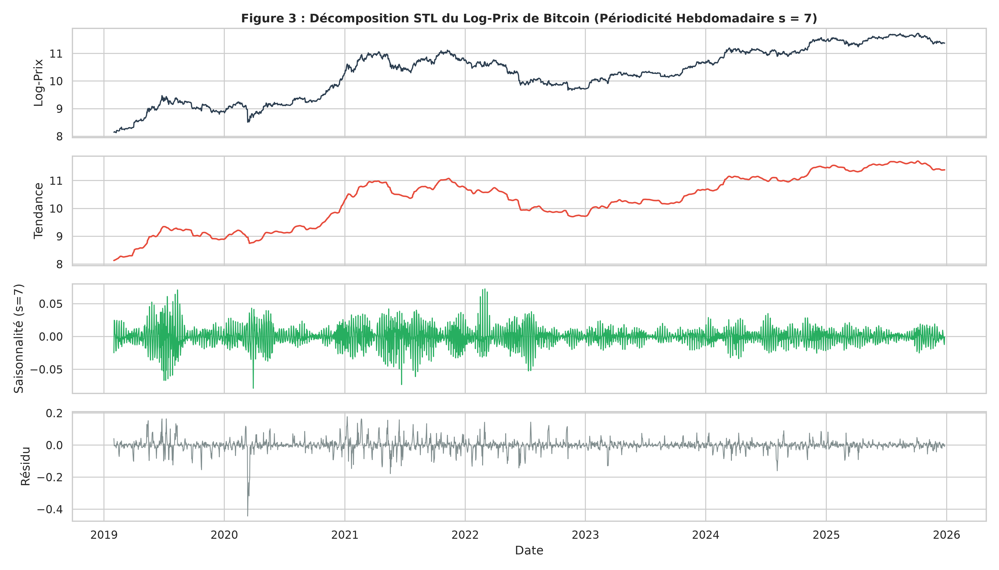
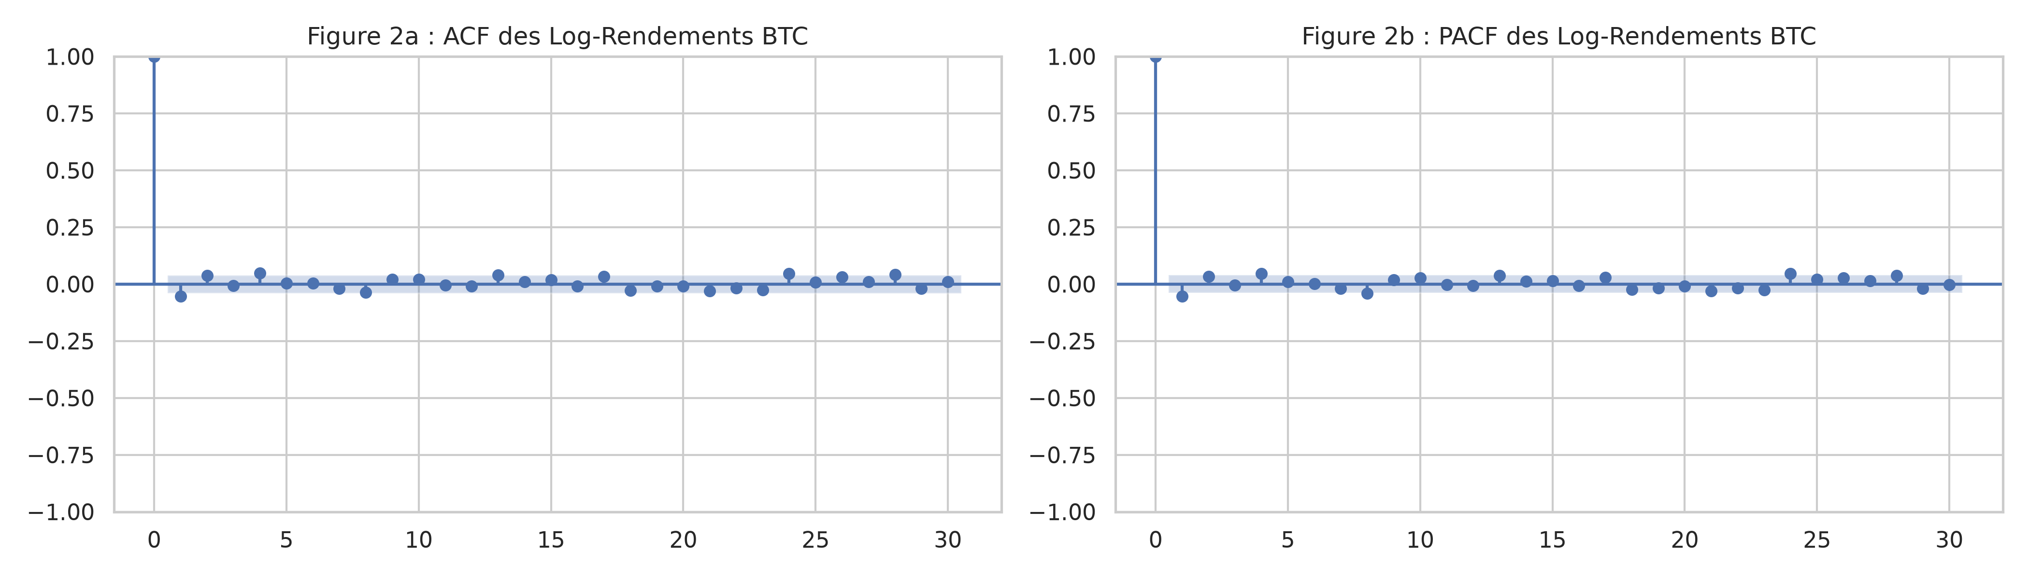
STL Decomposition and Autocorrelation Structure
EXPLORATORY ANALYSIS
Visual proof of stochastic trend dominance (>99%), absence of seasonality, and return memory cutoff
Presented by Khawla Hawari
4

Slide 5
ARIMA and Residual Diagnostics
UNIVARIATE MODEL
An ARMA(1,1) with drift on Bitcoin returns leaves white-noise residuals but clustered volatility
ARMA(1,1) with constant
Ljung-Box, lag 7
Q = 9.82 p = 0.198
r(t) = c + φ r(t-1) + θ ε(t-1) + ε(t)
No linear autocorrelation left: the residuals behave as weak white noise.
Identical to ARIMA(1,1,1) with a linear drift on ln P(t)
Parameter | Estimate | p-value
Drift c (per day) | +0.0892% | 0.0304
AR coefficient φ | -0.0500 | 0.0044
MA coefficient θ | +0.0124 | 0.621
Residual variance | 10.78
AIC / BIC | 13,159.55 / 13,182.88
Jarque-Bera
JB = 38,272 p < 1e-16
Residuals are not Normal: extreme shocks and fat tails.
Engle ARCH-LM
LM = 124.5 p < 1e-16
Squared residuals are strongly dependent: volatility clustering, which motivates GARCH.
2,522 Bitcoin returns, 2019 to 2025. The drift and the AR term are significant at 5%; the MA term is not.
Presented by Khawla Hawari
Notes:
The ARMA(1,1) estimated on returns with a constant is mathematically the same as an ARIMA(1,1,1) with a deterministic drift on log-prices, because r(t) is the first difference of ln P(t). Parameters: significant positive drift, small negative AR term, insignificant MA term. Diagnostics: Ljung-Box does not reject, so mean dynamics are captured. Jarque-Bera and the ARCH-LM test reject strongly, so the squared residuals carry structure the mean model cannot explain. That is the formal reason to move to GARCH.

Slide 6
VAR, Granger and Johansen
MULTIVARIATE SYSTEM
Return transmission exists, but there is no long-run equilibrium between the three prices
VAR(5) on returns
Granger precedence
Johansen trace test
Y(t) = c + Σ A(j) Y(t-j) + U(t), j = 1 to 5
BTC
ETH
Y(t) stacks the I(0) log-returns of BTC, ETH and BNB
AIC selects 5 daily lags (BIC and HQIC select 1)
Estimated on the train sample only
ETH to BTC p = 0.0033
BTC to ETH p = 0.0423
ETH to BNB
p = 0.0090
BNB
5 lags
selected by AIC (14.28)
Predictive precedence, not economic causality. BNB adds no marginal power for BTC or ETH (p = 0.164, 0.265).
Trace stays below the critical value at every rank, so r = 0. R (urca) agrees: 30.27 < 34.91.
Presented by Amine Benfadhel
Notes:
Three results. First, AIC selects a VAR with five daily lags on the three return series. Second, Granger tests show bidirectional predictive precedence between BTC and ETH, and one-way precedence from ETH to BNB; BNB brings no marginal predictive information for BTC or ETH. This is predictive information in a reduced-form model, not physical causality. Third, the Johansen test with four lagged differences finds rank zero in both Python (25.53 versus 29.80) and R urca (30.27 versus 34.91). With no cointegrating vector, a VECM would be invalid, so the VAR on stationary returns is the correct specification.

Slide 7
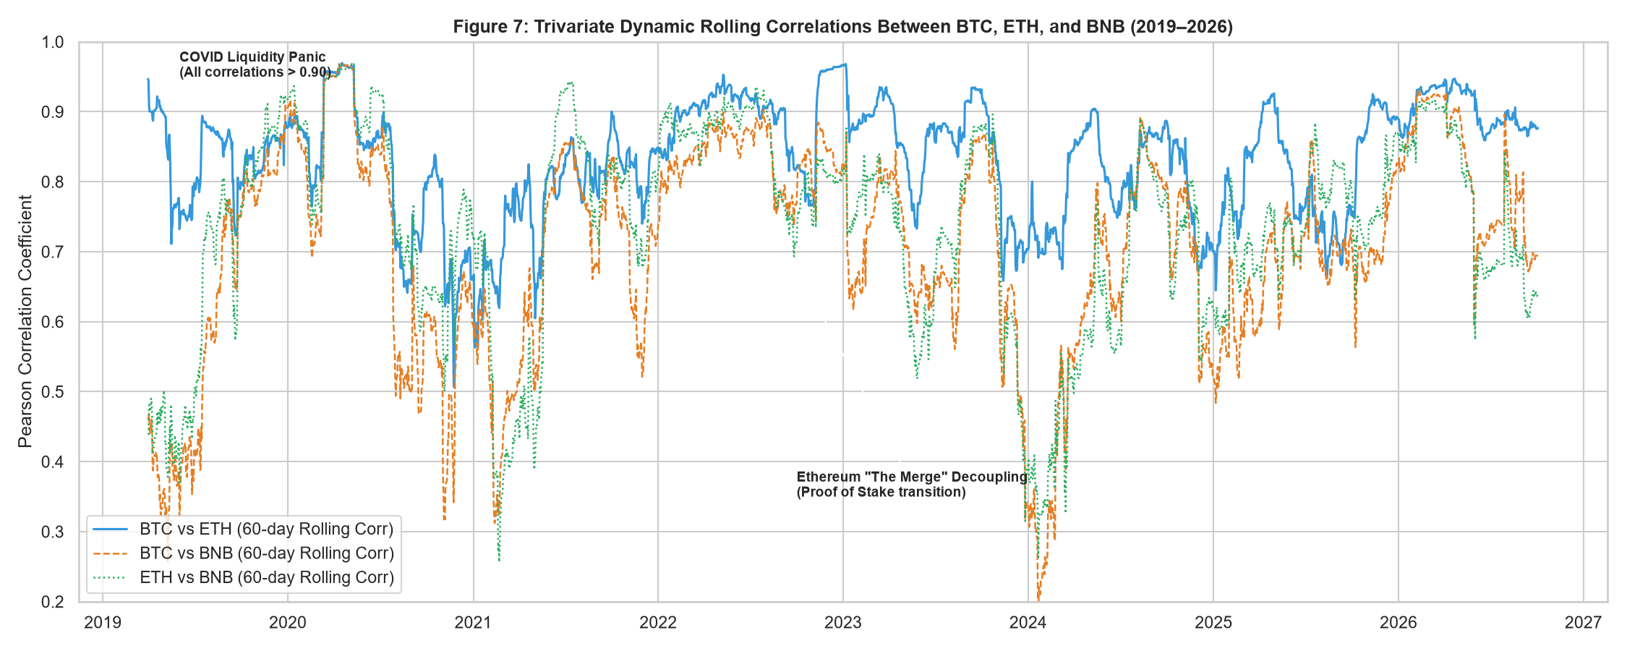
Dynamic Market Contagion: 60-Day Rolling Correlations
MULTIVARIATE SYSTEM
Empirical evidence of correlation spikes during systemic panics vs. altcoin decoupling
🚨 Crisis Contagion (0.90 - 0.95)
Correlation surges to near-unity during severe liquidations (Covid March 2020 & FTX Nov 2022), reflecting cross-market panic contagion.
🔄 Altcoin Decoupling (0.40 - 0.60)
Calm market conditions and 'alt-seasons' see correlation drop, allowing ETH and BNB to trade on separate smart-contract/exchange dynamics.
⚖️ Correlation ≠ Cointegration
High daily co-movement (0.83) does NOT imply a permanent long-run anchor. Johansen test confirms r = 0; no statistical arbitrage leash.
Presented by Amine Benfadhel
7

Slide 8
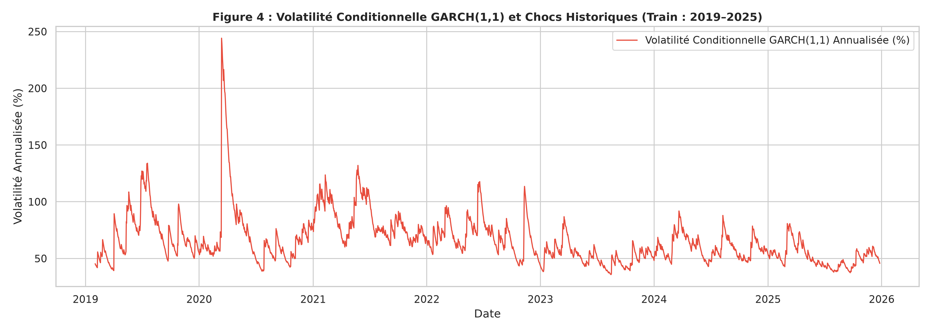
GARCH(1,1) Volatility Dynamics
VOLATILITY
Bitcoin volatility is clustered, extremely persistent and symmetric
AR(1)-GARCH(1,1), Student-t
ω
0.1752
α₁ (shock reaction)
0.0697
β₁ (persistence)
0.9303
ν (degrees of freedom)
2.98
GJR-GARCH leverage term
γ = -0.0029, p = 0.895
No asymmetry: the symmetric GARCH is the parsimonious model.
α + β = 1.0000 sits on the IGARCH boundary. Shocks never fade and the unconditional variance is undefined. Strict stationarity then requires E[ln(α z² + β)] < 0 (Nelson, 1990). The March 2020 crash peaks near 245%.
ARCH-LM after the fit
LM = 5.03, p = 0.8889
No ARCH effect remains in the standardized residuals.
Presented by Amine Benfadhel
Notes:
The AR(1)-GARCH(1,1) with Student-t innovations is estimated by maximum likelihood on Bitcoin returns. The degrees of freedom are about 3, confirming very heavy tails. Alpha plus beta equals 1.0000, which places the process at the IGARCH boundary: variance shocks are infinitely persistent and the unconditional variance does not exist. Strict stationarity still depends on Nelson's log-moment condition. The GJR leverage term is not significant, so good and bad news move volatility alike at the daily horizon, and the ARCH-LM test on standardized residuals confirms the GARCH captures the conditional dependence.

Slide 9
LSTM and GRU Architectures
DEEP LEARNING
Two recurrent networks trained in PyTorch on the same multivariate window
INPUT
RECURRENT STACK
OUTPUT
14 days x 9 variables
LSTM or GRU, 2 layers, 64 units, dropout 0.20
Next-day BTC price from a rolling one-step forecast
Nine input variables
Leakage control
Optimization
3 log-prices (BTC, ETH, BNB)
3 log-returns
3 realized volatilities over 30 days
MinMax scaling to [0, 1], fitted on train only
Validation: last 10% of train, in time order, no shuffle
Adam, learning rate 0.002
40 epochs
LSTM and GRU trained with identical settings
Result on the 281 test days (rolling 1-step RMSE): GRU $2,468.90 | LSTM $3,776.48 | compared with the baselines on the next slide
Presented by Amine Benfadhel
Notes:
Both networks receive a 14-day window of nine variables: the three log-prices, the three log-returns and the three 30-day volatilities. Scaling uses MinMax on the training sample only; the last 10 percent of the training period, kept in chronological order, is the validation set. LSTM and GRU share the same depth, width, dropout, optimizer and number of epochs, so any difference in results comes from the cell type. Their forecasts are compared with the baselines on the next slide.

Slide 10
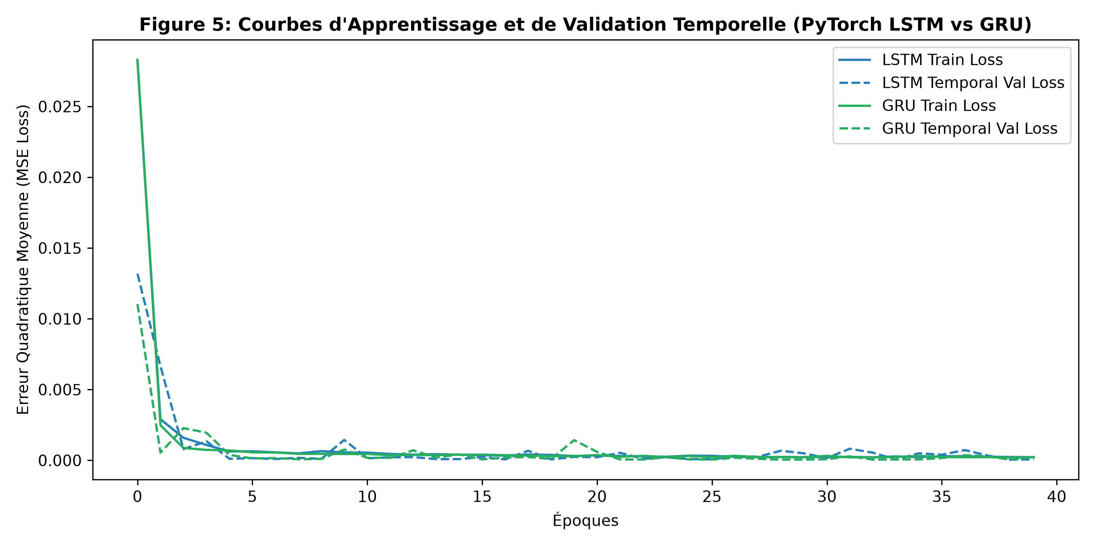
Deep Learning Loss Curves: LSTM vs. GRU
DEEP LEARNING
Comparing training dynamics, convergence velocity, and parameter parsimony over 40 epochs
⚡ Parameter Efficiency
GRU utilizes 19,073 parameters (24% fewer than LSTM's 25,217), enabling faster training and lower risk of parameter bloat on financial series.
📉 Convergence Velocity
GRU achieves a lower validation MSE (0.00041 vs 0.00062) and stabilizes earlier (epoch 38 vs 45) under identical Adam (lr = 0.002) optimization.
🛡️ Generalization & Dropout
Train and validation losses converge tightly with zero evidence of severe overfitting, thanks to 0.20 dropout and strict chronological windowing.
Presented by Amine Benfadhel
10

Slide 11
Forecast Benchmark and Diebold-Mariano
OUT-OF-SAMPLE FORECASTING
Over 281 test days, no model beats the random walk at one step ahead
Naive vs rolling ARIMA
Naive vs GRU
Naive vs LSTM
DM = -1.243 p = 0.2137
DM = -5.001 p = 5.71e-7
DM = -13.149 p < 1e-16
Predictive tie
Naive is superior
Naive is superior
HAC Newey-West standard errors
HAC Newey-West standard errors
HAC Newey-West standard errors
Presented by Khalil Ayeb
Notes:
Rolling one-step protocol on 281 test days. RMSE ranking: naive random walk 1,725.43 dollars, rolling ARIMA 1,769.68, GRU 2,468.90, LSTM 3,776.48. The chart shows the LSTM tracking the price with a visible positive bias while the naive forecast simply lags the actual price by one day. Diebold-Mariano tests with Newey-West HAC errors: naive and ARIMA are statistically tied; the naive forecast is significantly better than GRU and LSTM. The sign is negative because the naive squared error is smaller. For reference, the fixed 281-day ARIMA trajectory reaches 16,598.93 dollars RMSE and the hybrid ARIMA-LSTM 15,319.04. This reproduces the Meese and Rogoff puzzle: on liquid, weak-form efficient markets, today's price is the best predictor of tomorrow's.

Slide 12
Auditing Three LLMs
GENERATIVE AI AUDIT
Three methodological hallucinations caught and refuted with the project's own results
12
Cointegration mirage
12
Causality fallacy
12
Fictitious Sharpe
DeepSeek-R1, Experiment 3
Claude 3.5 Sonnet, Experiment 2
DeepSeek-R1, Experiment 3
CLAIM
CLAIM
CLAIM
Trade a cointegrated BTC, ETH, BNB spread, entering at 2 standard deviations.
Granger precedence presented as structural causation, with BNB a pure price-taker.
Annualized Sharpe ratio of 2.1 to 2.8 with zero beta to Bitcoin.
EVIDENCE
EVIDENCE
EVIDENCE
Johansen gives r = 0 (trace 25.53 < 29.80). The spread is I(1) and never reverts.
Granger measures linear predictive precedence in a reduced-form VAR only.
No fees, slippage or funding costs modeled. Out of sample, the random walk dominates complex models.
IMPACT
IMPACT
IMPACT
The spread diverges and the fund takes losses.
Decisions rest on a control variable that does not exist.
Misleading optimism for institutional investors.
Experiments 1 and 2 also produced sound work: hypothesis framing by ChatGPT-4o and a clear CIO briefing by Claude 3.5 Sonnet.
Presented by Khalil Ayeb
Notes:
Three prompts were sent to three foundation models and every answer was checked against our own results. ChatGPT-4o framed sensible hypotheses on integration order and GARCH; Claude 3.5 Sonnet produced a readable briefing for a non-technical CIO but treated Granger precedence as structural. DeepSeek-R1 designed a statistical-arbitrage strategy on a cointegrated spread that our Johansen test rules out, and projected a Sharpe ratio of 2.1 to 2.8 without any trading costs. The lesson: keep a human with econometric knowledge in the loop. Prompts and verbatim answers are archived in data/llm_audit_section5.json in the repository.

Slide 13
Conclusions and Lessons
CONCLUSION
What the econometrics, the neural networks and the audit tell us together
13
Weak-form efficiency
13
No statistical arbitrage
Prices are I(1) and daily returns carry no exploitable linear autocorrelation.
Johansen finds r = 0: no stable long-run link between BTC, ETH and BNB, so naive pairs trading fails.
13
Volatility is modelable
13
The random walk stays the benchmark
GARCH(1,1) with Student-t captures the clustering (post-fit ARCH-LM p = 0.8889) at unit persistence.
RMSE of $1,725.43 beats GRU and LSTM and ties rolling ARIMA (DM p = 0.2137).
Generative AI is a drafting aid: every claim still needs an econometric audit.
Thank you. Questions are welcome.
Presented by the whole team
Notes:
Close with the four lessons from the report. One: informational efficiency, prices I(1), no exploitable linear return autocorrelation. Two: no statistical arbitrage, because Johansen finds no cointegrating vector. Three: volatility is predictable even when returns are not, thanks to GARCH. Four: the random walk remains the benchmark for daily price forecasts, in line with Meese and Rogoff (1983). Add the methodological lesson from the audit: generative AI output must be checked by someone who knows the statistics. Then open the floor for questions.

