Slide 1
Final Project
CS 464 - Data Mining - Spring 2016
Matt Durrin - Ayechan San - Steven Mowry

Slide 2
Airline Data
src: https://www.researchgate.net/publication/237067843_airlinesarff
Original Data
539,383 instances
8 attributes per instance
Airline, Flight, AirportFrom, AirportTo, DayOfWeek, Time, Length, Delay (Green = Numeric)
Modified Data
250,000 instances - randomly selected (Bayes and NaiveBayes)
25,000 instances - randomly selected (Voted Perceptron and J48 w/o CFS)
1,000 instances - randomly selected (SMO)
300,000 instances - randomly selected (J48 with CFS)
Eliminated Flight, Time, and Length attributes (HyperPipes)
Goal: Predict the probability of delay based on the given factors in the data set

Slide 3
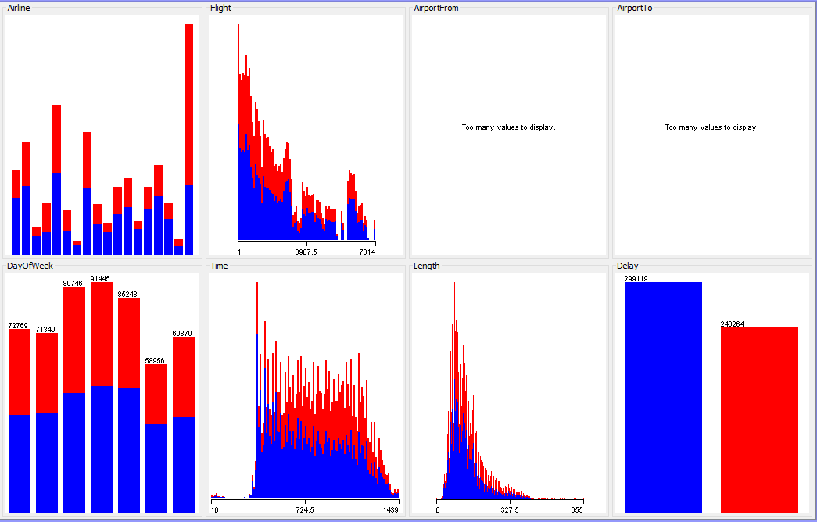
Visualizing the Data
Class = Delay

Slide 4
Algorithms
Classifiers - Supervised
Clusterers - Unsupervised
simplekMeans (Ayechan)
Bayes
BayesNet (Matt)
NaiveBayes (Matt)
Functions
VotedPerceptron (Matt)
SMO (Ayechan)
Trees
J48 (Ayechan)
DecisionStump (Ayechan)
Misc
HyperPipes (Steven)
Attribute Selections
CfsSubsetEval
WrapperSubsetEval
RandomSubsetEval

Slide 5
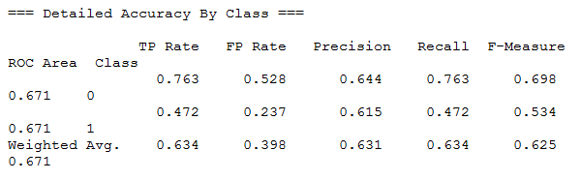
Bayes: BayesNet (Default)
250,000
Run Information
Scheme:
weka.classifiers.bayes.BayesNet -D -Q
weka.classifiers.bayes.net.search.local.K2 -- -P 1 -S BAYES -E
weka.classifiers.bayes.net.estimate.SimpleEstimator -- -A 0.5
Relation: out-
weka.filters.unsupervised.instance.ReservoirSample-S1-Z250000
Attributes Included: all 8 (Airline, Flight, AirportFrom, AirportTo, DayOfWeek, Time, Length, Delay)
Mean absolute error 0.4212
Root mean squared error 0.4805
Relative absolute error 85.2726 %
Root relative squared error 96.7033 %
Correctly Classified Instances 53873 63.38 %
Incorrectly Classified Instances 31127 36.62 %

Slide 6
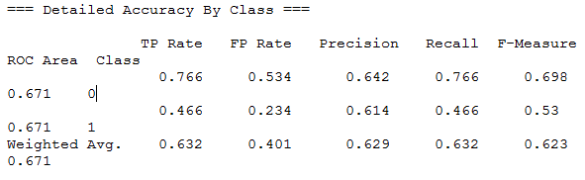
Bayes: BayesNet (CfsSubsetEval)
250,000
Run Information
Scheme:
weka.classifiers.bayes.BayesNet -D -Q
weka.classifiers.bayes.net.search.local.K2 -- -P 1 -S BAYES -E
weka.classifiers.bayes.net.estimate.SimpleEstimator -- -A 0.5
Relation: out-
weka.filters.unsupervised.instance.ReservoirSample-S1-Z250000-
weka.filters.supervised.attribute.AttributeSelection-
Eweka.attributeSelection.CfsSubsetEval-
Sweka.attributeSelection.RandomSearch -F 25.0 -seed 1
Attributes Included: 5 (Airline, AirportFrom, AirportTo, Time, Delay)
Mean absolute error 0.4264
Root mean squared error 0.4777
Relative absolute error 86.3163 %
Root relative squared error 96.1364 %
Correctly Classified Instances 53746 63.2306 %
Incorrectly Classified Instances 31254 36.7694 %

Slide 7
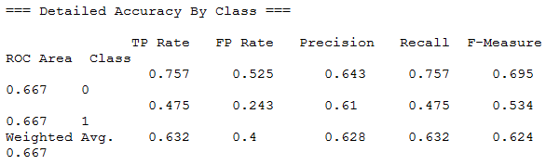
Bayes: NaiveBayes (Default)
250,000
Run Information
Scheme:
weka.classifiers.bayes.NaiveBayes
Relation: out-
weka.filters.unsupervised.instance.ReservoirSample-S1-Z250000
Attributes Included: all 8 (Airline, Flight, AirportFrom, AirportTo, DayOfWeek, Time, Length, Delay)
Mean absolute error 0.4263
Root mean squared error 0.4802
Relative absolute error 86.2979 %
Root relative squared error 96.6351 %
Correctly Classified Instances 53696 63.1718 %
Incorrectly Classified Instances 31304 36.8282 %

Slide 8
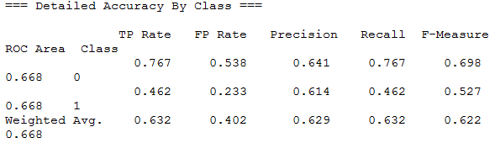
Bayes: NaiveBayes (CfsSubsetEval)
250,000
Run Information
Scheme:
weka.classifiers.bayes.NaiveBayes
Relation: out-
weka.filters.unsupervised.instance.ReservoirSample-S1-Z250000-
weka.filters.supervised.attribute.AttributeSelection-
Eweka.attributeSelection.CfsSubsetEval-
Sweka.attributeSelection.RandomSearch -F 25.0 -seed 1
Attributes Included: 5 (Airline, AirportFrom, AirportTo, Time, Delay)
Mean absolute error 0.4285
Root mean squared error 0.4787
Relative absolute error 86.7405 %
Root relative squared error 96.3374 %
Correctly Classified Instances 53685 63.1588 %
Incorrectly Classified Instances 31315 36.8412 %

Slide 9
Averaging Bayes Results
Mean absolute error 0.4256
Root mean squared error 0.4792
Relative absolute error 86 %
Root relative squared error 96 %
Correctly Classified Instances 53750 63 %
Incorrectly Classified Instances 31315 36 %

Slide 10
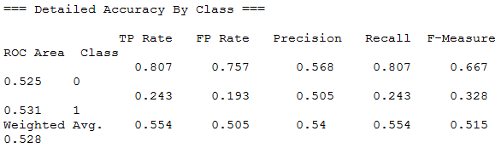
Functions: VotedPerceptron (Default)
25,000
Run Information
Scheme:
weka.classifiers.functions.VotedPerceptron -I 1 -E 1.0 -S 1 -M 10000
Relation: out-
weka.filters.unsupervised.instance.ReservoirSample-S1-Z25000
Attributes Included: all 8 (Airline, Flight, AirportFrom, AirportTo, DayOfWeek, Time, Length, Delay)
Mean absolute error 0.4457
Root mean squared error 0.6676
Relative absolute error 90.1319 %
Root relative squared error 134.2516 %
Correctly Classified Instances 13856 55.424 %
Incorrectly Classified Instances 11144 44.576 %

Slide 11
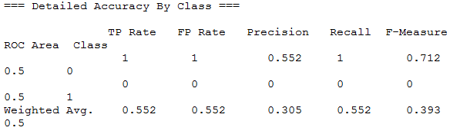
Functions: VotedPerceptron (CfsSubsetEval)
25,000
Run Information
Scheme:
weka.classifiers.functions.VotedPerceptron -I 1 -E 1.0 -S 1 -M 10000
Relation: out-
weka.filters.unsupervised.instance.ReservoirSample-S1-Z25000-
weka.filters.supervised.attribute.AttributeSelection-
Eweka.attributeSelection.CfsSubsetEval-
Sweka.attributeSelection.RandomSearch -F 25.0 -seed 1
Attributes Included: 5 (Airline, AirportFrom, AirportTo, Time, Delay)
Mean absolute error 0.4478
Root mean squared error 0.6692
Relative absolute error 90.5468 %
Root relative squared error 134.5711 %
Correctly Classified Instances 13805 55.22 %
Incorrectly Classified Instances 11195 44.78 %

Slide 12
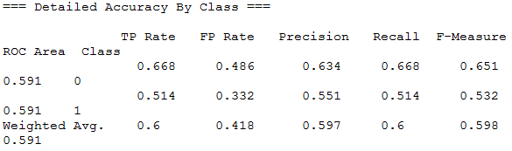
Functions: SMO (Default)
1,000
Run Information
Scheme:
weka.classifiers.functions.SMO -C 1.0 -L 0.001 -P 1.0E-12 -N 0 -V -1 -W 1 -K "
weka.classifiers.functions.supportVector.PolyKernel -C 250007 -E 1.0"
Relation: out-
weka.filters.unsupervised.instance.ReservoirSample-S1-Z1000
Attributes Included: all 8 (Airline, Flight, AirportFrom, AirportTo, DayOfWeek, Time, Length, Delay)
Mean absolute error 0.4
Root mean squared error 0.6325
Relative absolute error 81.0881 %
Root relative squared error 127.3499 %
Correctly Classified Instances 600 60 %
Incorrectly Classified Instances 400 40 %

Slide 13
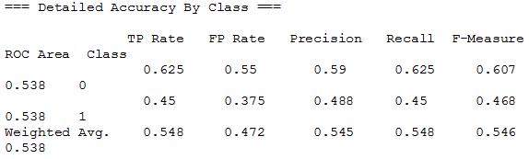
Functions: SMO (WrapperSubsetEval)
1,000
Run Information
Scheme:
weka.classifiers.functions.SMO -C 1.0 -L 0.001 -P 1.0E-12 -N 0 -V -1 -W 1 -K "
weka.classifiers.functions.supportVector.PolyKernel -C 250007 -E 1.0"
Relation: out-
weka.filters.unsupervised.instance.ReservoirSample-S1-Z1000-
weka.filters.supervised.attribute.AttributeSelection-
Eweka.attributeSelection.WrapperSubsetEval -B
weka.classifiers.rules.ZeroR -F 5 -T 0.01 -R 1 ---
Sweka.attributeSelection.RandomSearch -F 25.0 -seed 1
Attributes Included: 5 (Flight,, AirportFrom, AirportTo, Time, Delay)
Mean absolute error 0.452
Root mean squared error 0.6723
Relative absolute error 91.6296 %
Root relative squared error 135.3748 %
Correctly Classified Instances 548 54.8 %
Incorrectly Classified Instances 452 45.2 %

Slide 14
Averaging Functions Results
Mean absolute error 0.4363
Root mean squared error 0.65
Relative absolute error 88 %
Root relative squared error 132 %
Correctly Classified Instances NA 56 %
Incorrectly Classified Instances NA 43 %

Slide 15
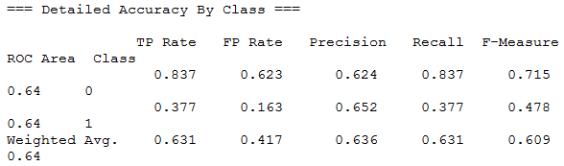
Trees: J48 (Default)
25,000
Run Information
Scheme:
weka.classifiers.trees.J48 -C 0.25 -M 2
Relation: out-
weka.filters.unsupervised.instance.ReservoirSample-S1-Z25000
Attributes Included: all 8 (Airline, Flight, AirportFrom, AirportTo, DayOfWeek, Time, Length, Delay)
Mean absolute error 0.4502
Root mean squared error 0.4849
Relative absolute error 91.0245 %
Root relative squared error 97.5062 %
Correctly Classified Instances 15773 63.092 %
Incorrectly Classified Instances 9227 36.908 %

Slide 16
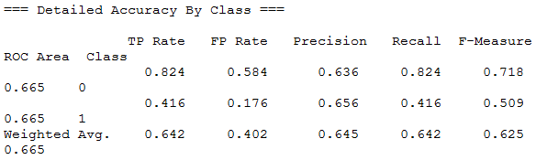
Trees: J48 (CfsSubsetEval)
300,000
Run Information
Scheme:
weka.classifiers.trees.J48 -C 0.25 -M 2
Relation: out-
weka.filters.unsupervised.instance.ReservoirSample-S1-Z300000-
weka.filters.supervised.attribute.AttributeSelection-
Eweka.attributeSelection.CfsSubsetEval-
Sweka.attributeSelection.BestFirst -D 1 -N 5
Attributes Included: 4 (Airline, DayOfWeek, Time, Delay)
Mean absolute error 0.4472
Root mean squared error 0.4732
Relative absolute error 90.4739 %
Root relative squared error 95.1876 %
Correctly Classified Instances 192522 64.174 %
Incorrectly Classified Instances 107478 35.826 %

Slide 17
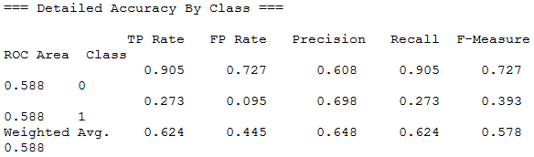
Trees: DecisionStump (Default)
539,383
Run Information
Scheme:
weka.classifiers.trees.DecisionStump
Attributes Included: all 8 (Airline, Flight, AirportFrom, AirportTo, DayOfWeek, Time, Length, Delay)
Mean absolute error 0.4671
Root mean squared error 0.4833
Relative absolute error 94.554 %
Root relative squared error 97.239 %
Correctly Classified Instances 336336 62.3557 %
Incorrectly Classified Instances 203047 37.6443 %

Slide 18
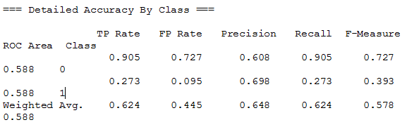
Trees: DecisionStump (CfsSubsetEval)
539,383
Run Information
Scheme:
weka.classifiers.trees.DecisionStump
Relation: out-
weka.filters.supervised.attribute.AttributeSelection-
Eweka.attributeSelection.CfsSubsetEval-
Sweka.attributeSelection.BestFirst -D 1 -N 5
Attributes Included: 5 (Airline, DayOfWeek, Time, Delay)
Mean absolute error 0.4671
Root mean squared error 0.4833
Relative absolute error 94.554 %
Root relative squared error 97.239 %
Correctly Classified Instances 336336 62.3557 %
Incorrectly Classified Instances 203047 37.6443 %

Slide 19
Averaging Trees Results
Mean absolute error 0.45
Root mean squared error 0.48
Relative absolute error 92%
Root relative squared error 96 %
Correctly Classified Instances NA 63 %
Incorrectly Classified Instances NA 36 %

Slide 20
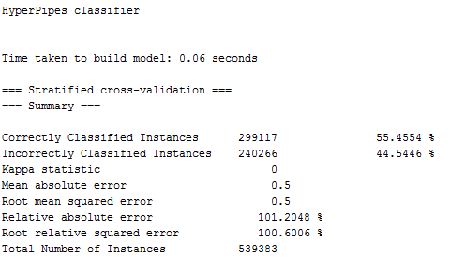
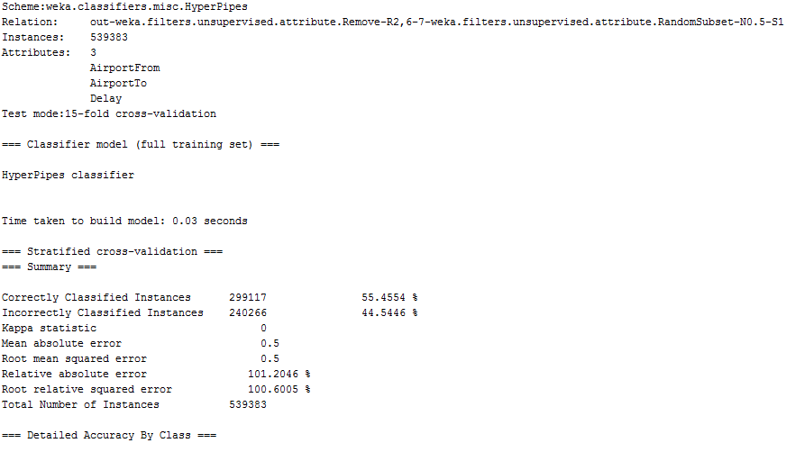
Misc: HyperPipes
539,383
Default
RandomSubsetEval

Slide 21
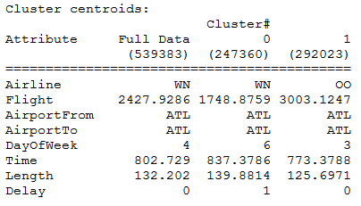
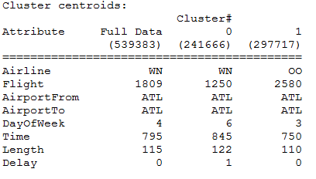
Clusters: simpleKMeans
539,383
Run Information
Scheme:
weka.clusterers.SimpleKMeans -N 2 -A "
weka.core.EuclideanDistance -R first-last" -I 500 -S 10
weka.core.ManhattanDistance -R first-last" -I 500 -S 10
Attributes Included: all 8 (Airline, Flight, AirportFrom, AirportTo, DayOfWeek, Time, Length, Delay)
EuclideanDistance
0 247360 ( 46%)
1 292023 ( 54%)
ManhattanDistance
0 241666 ( 45%)
1 297717 ( 55%)

Slide 22
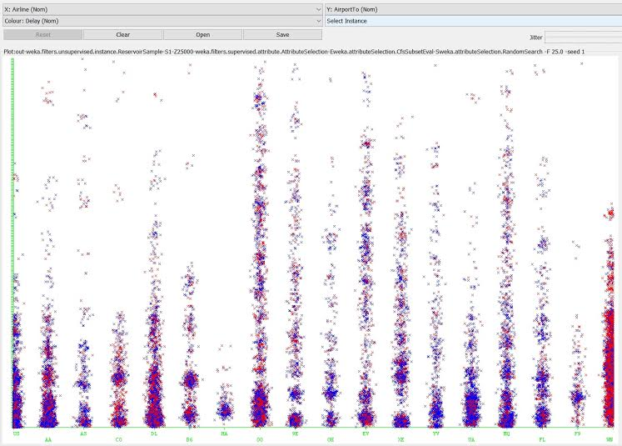
Airlines to Airports

Slide 23
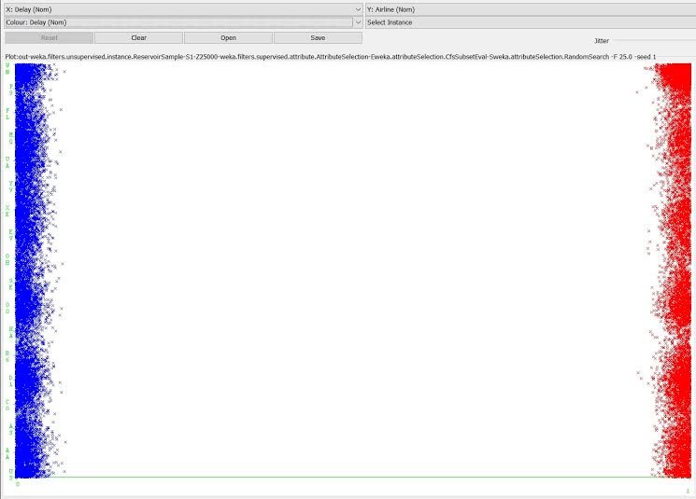
Delay by Airline

Slide 24
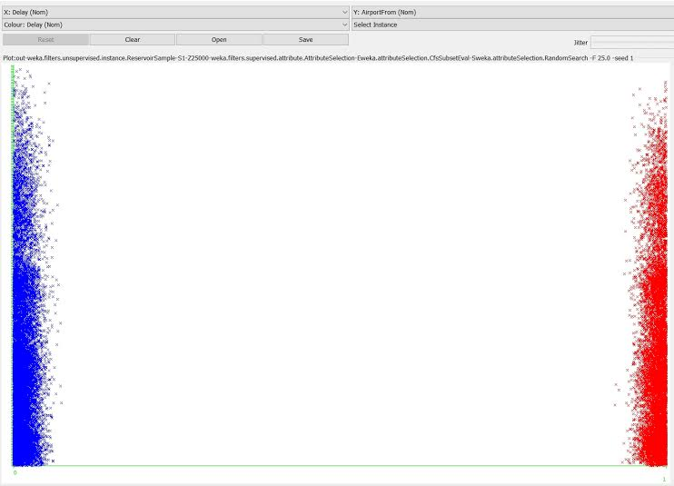
Delay by Airport

Slide 25
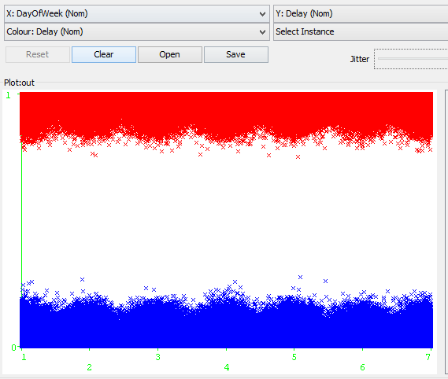
Delay by Time of Week

Slide 26
Conclusion
South West is the worst airline
Alaska is the best airline
Denver and Atlanta are the worst airports

