Slide 1
Individual Project 2
CSCI 464 - Data Mining - Spring 2016
Ayechan San

Slide 2
Data Set (Originally)
World of Warcraft
Relationship between character’s level, class, race, factions, etc.
Level up faster if you are in the Alliance? Or if you play as a Blood-Elf or Troll?

Slide 3
Data Set
Original data
After removing missing values
Ski Resort - CSV from Data Mining Course
Converted to .arff using Weka
989 instances, 16 attributes (4 numeric, 10 binary, two nominal)
862 instance, 16 attributes (4 numeric, 12 binary)
Attributes: (4)Rating, Survey, Prize, Punishment (12)Resort Names
src: http://mines.humanoriented.com/classes/2010/fall/csci568/data/final.csv

Slide 4
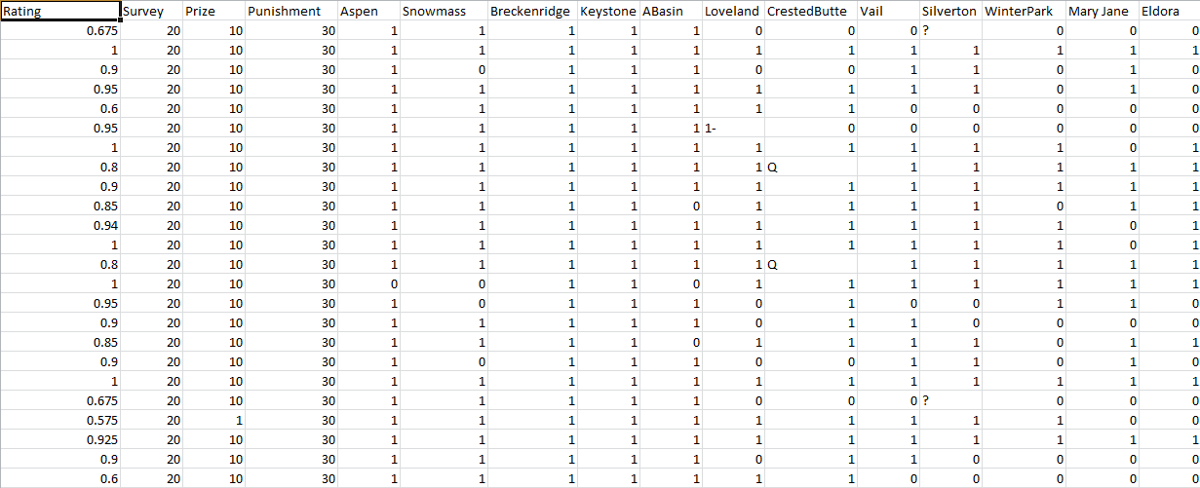
Data Set: CSV

Slide 5
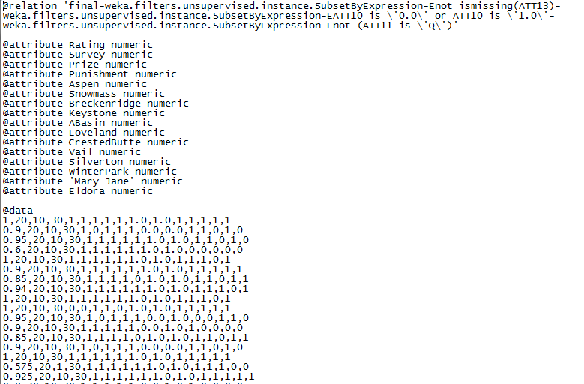
Data Set: .arff

Slide 6
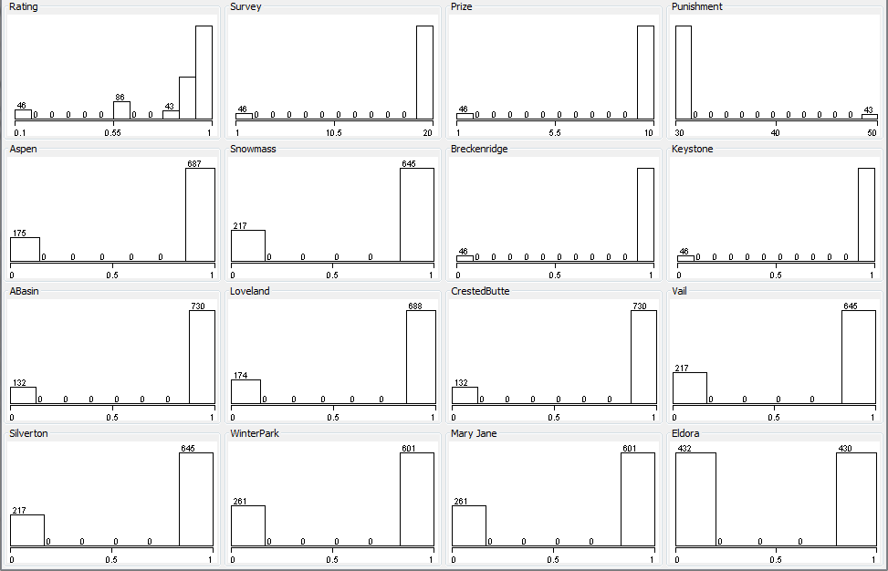
Data Set: Visualizing in Weka

Slide 7
Algorithms
Decision Tree
DecisionStump
M5P
Clustering
KMeans
XMeans
Classifiers
SMOreg
Normalize + SMOreg
ZeroR
Normalize + ZeroR
Reference: http://machinelearningmastery.com/a-tour-of-machine-learning-algorithms/

Slide 8
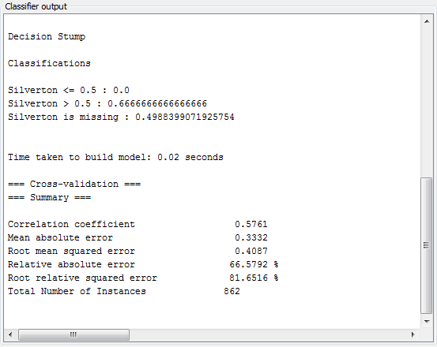
Decision Tree: DecisionStump

Slide 9
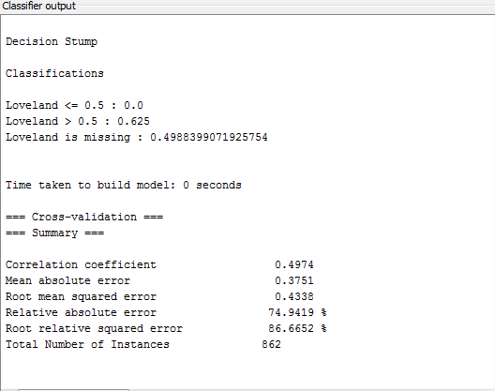
Decision Tree: DecisionStump

Slide 10
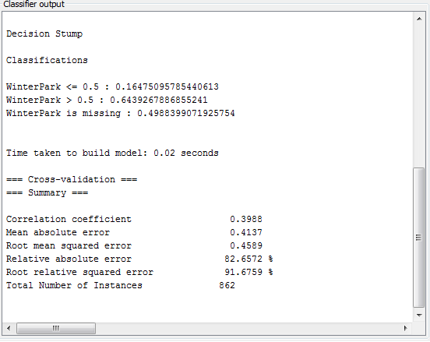
Decision Tree: DecisionStump

Slide 11
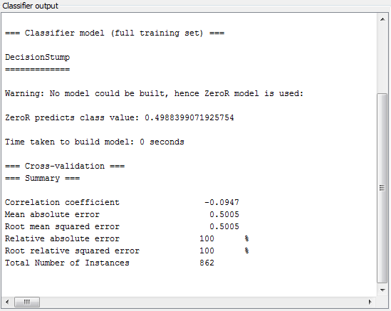
Decision Tree: DecisionStump
16 attributes:
Correlation coefficient: 0.5761
Mean absolute error: 0.3332
Root mean squared error: 0.4087
Relative absolute error: 66.5792 %
Root relative squared error: 81.6516 %
Removing attributes: (Eldora)
Correlation coefficient: -0.0947
Mean absolute error: 0.5005
Root mean squared error: 0.5005
Relative absolute error: 100 %
Root relative squared error: 100%
Relative absolute error jumps:
Silverton: 66 to 74
Winterpark: 74 to 82
CrestedButte: 82 to 89
Survey: 87 to 96

Slide 12
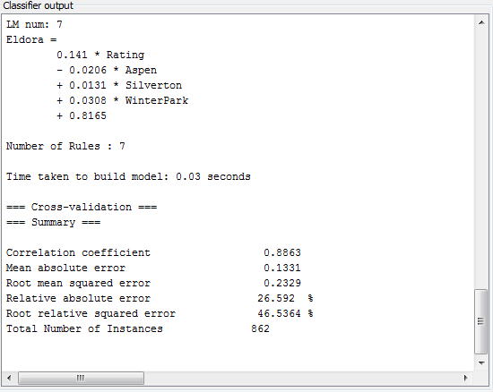
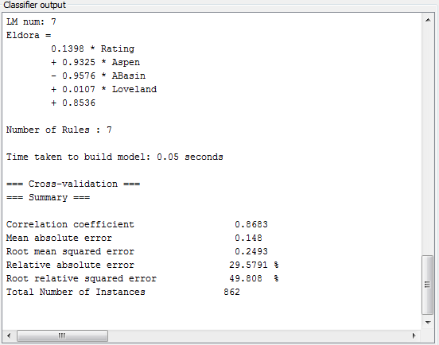
Decision Tree: M5P
16 attributes, P = 4, 8, 12
12 attributes, P = 4
Removed: Survey, Silverton, Winterpark, CrestedButte

Slide 13
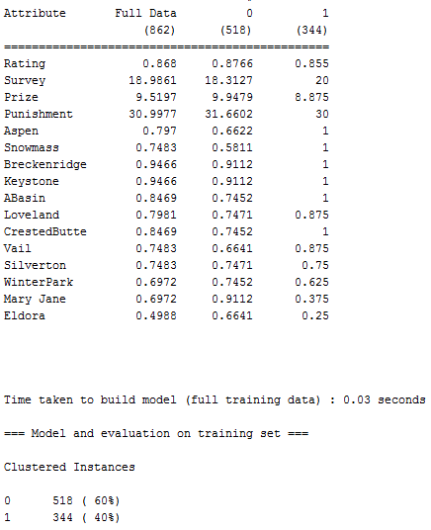
Clustering
1st iteration:
KMeans: [0:518], [1:344]

Slide 14
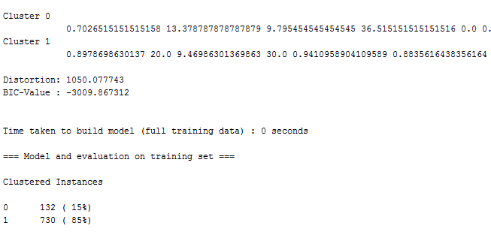
Clustering
1st iteration:
KMeans: [0:518], [1:344]
XMeans: [0:132], [1:730]

Slide 15
Clustering
1st iteration:
KMeans: [0:518], [1:344]
XMeans: [0:132], [1:730]

Slide 16
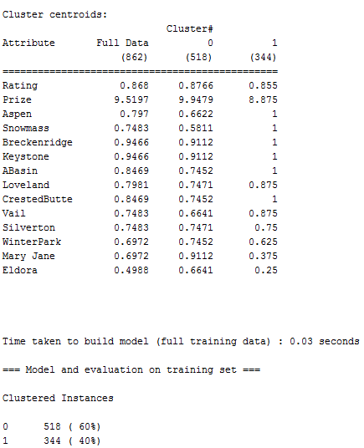
Clustering
1st iteration:
KMeans: [0:518], [1:344]
XMeans: [0:132], [1:730]
2nd iteration:
KMeans: [0:518], [1:344]

Slide 17
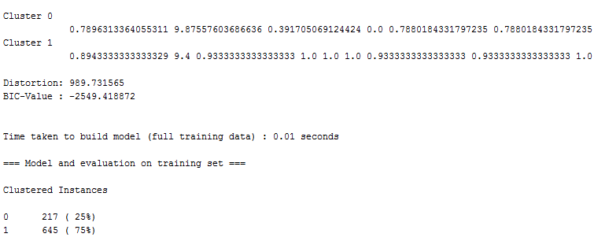
Clustering
1st iteration:
KMeans: [0:518], [1:344]
XMeans: [0:132], [1:730]
2nd iteration:
KMeans: [0:518], [1:344]
XMeans: [0:217], [1:645]

Slide 18
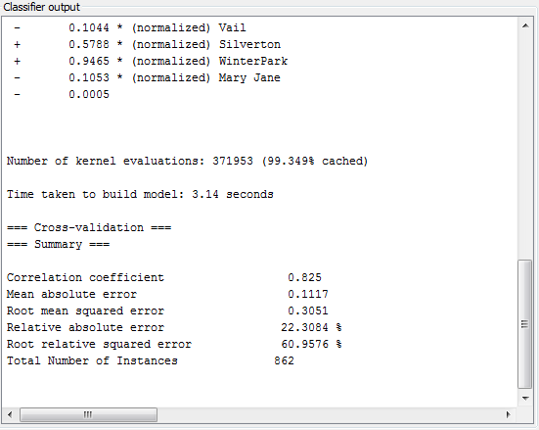
Classifiers: SMOreg
Default data + SMOreg:
Correlation coefficient: 0.825
Mean absolute error: 0.1117
Root mean squared error: 0.3051
Relative absolute error: 22.3084 %
Root relative squared error: 60.9576 %

Slide 19
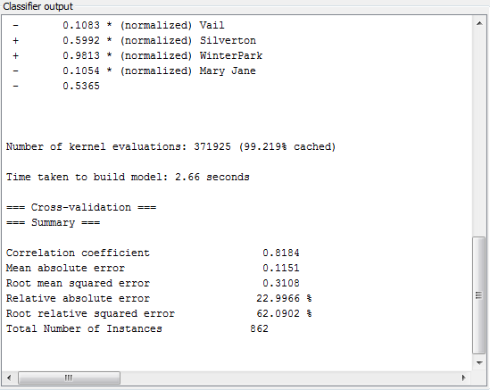
Classifiers: SMOreg
Default data + SMOreg:
Correlation coefficient: 0.825
Mean absolute error: 0.1117
Root mean squared error: 0.3051
Relative absolute error: 22.3084 %
Root relative squared error: 60.9576 %
Normalized data + SMOreg:
Correlation coefficient: 0.8184
Mean absolute error: 0.1151
Root mean squared error: 0.3108
Relative absolute error: 22.9966 %
Root relative squared error: 62.0902 %

Slide 20
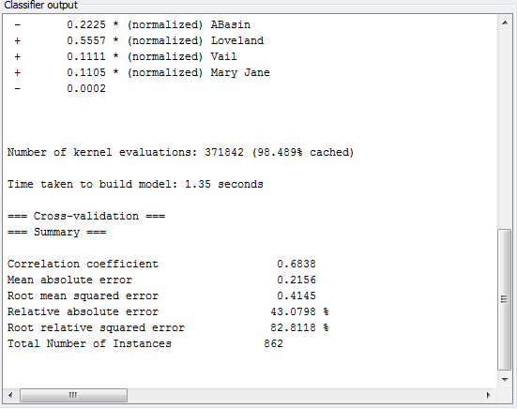
Classifiers: SMOreg
Default data + SMOreg:
Correlation coefficient: 0.825
Mean absolute error: 0.1117
Root mean squared error: 0.3051
Relative absolute error: 22.3084 %
Root relative squared error: 60.9576 %
Normalized data + SMOreg:
Correlation coefficient: 0.8184
Mean absolute error: 0.1151
Root mean squared error: 0.3108
Relative absolute error: 22.9966 %
Root relative squared error: 62.0902 %
Default data (- 4 attr.) + SMOreg:
Correlation coefficient: 0.6838
Mean absolute error: 0.2156
Root mean squared error: 0.4145
Relative absolute error: 43.0798 %
Root relative squared error: 82.8118 %

Slide 21
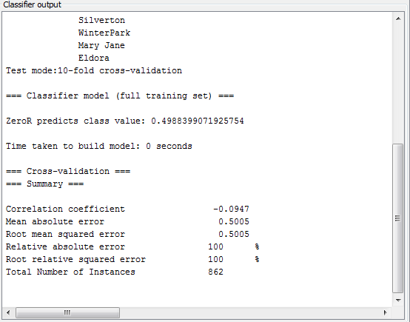
Classifiers: ZeroR
Default data + ZeroR:
Correlation coefficient: -0.0947
Mean absolute error: 0.5005
Root mean squared error: 0.5005
Relative absolute error: 100 %
Root relative squared error: 100 %
Normalized data + ZeroR:
Correlation coefficient: -0.0947
Mean absolute error: 0.5005
Root mean squared error: 0.5005
Relative absolute error: 100 %
Root relative squared error: 100 %
Default data (- 4 attr.) + ZeroR:
Correlation coefficient: -0.0947
Mean absolute error: 0.5005
Root mean squared error: 0.5005
Relative absolute error: 100 %
Root relative squared error: 100 %

Slide 22
Results
Corr. Coefficient
Mean Abs. Error
Root Mean Sqrt Error
Relative Abs. Error
Root Realtive Sqrt Err
DecisionStump
0.5761
0.3332
0.4087
66.5792%
81.6516 %
DecisionStump
(- 4 attributes)
-0.0947
0.5005
0.5005
100%
100 %
M5P
0.8863
0.1331
0.2329
26.592%
46.5364%
SMOreg
0.825
0.1117
0.3051
22.3084 %
60.9576 %
SMOreg
Normalized
0.1151
0.8184
0.3108
22.9966 %
62.0902 %
SMOreg
(-4 attributes)
0.6838
0.2156
0.4145
43.0798 %
82.8118 %
ZeroR
-0.0947
0.5005
0.5005
100 %
100 %
First Iteration (16 attributes)
Second Iteration (Removed Punishment and Survey)
KMeans
Cluster 0: 518, Cluster 1: 344
Cluster 0: 518, Cluster 1: 344
XMeans
Cluster 0: 132, Cluster 1: 730
Cluster 0: 217, Cluster 1: 645

