Slide 1

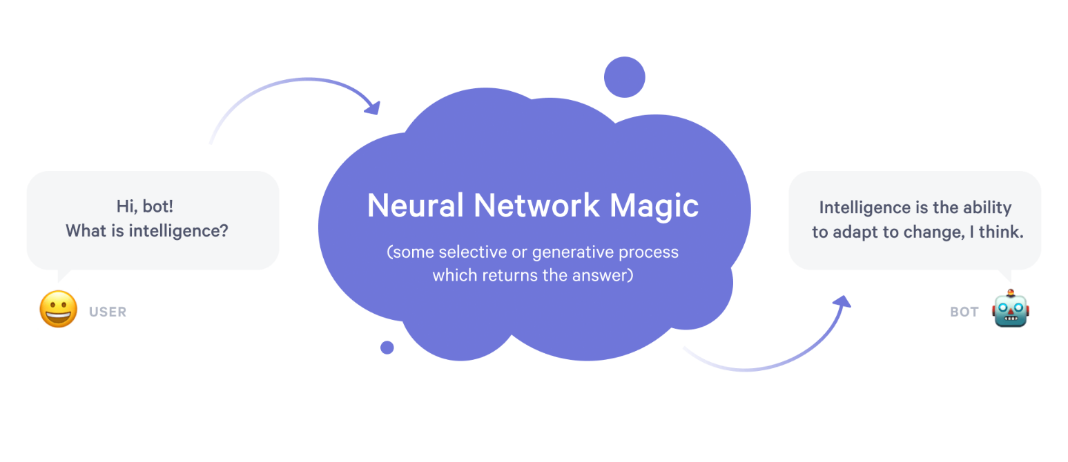
A Personality based Neural Chatbot
Computer Science & Engineering
Session 2018-2019
Shri Ram Murti Smarak College of Engineering & Technology, Bareilly (U.P.)
Guided By:
Mr. Hiresh Kumar Gupta
Submitted by:-
Mohd. Bilal(1601410065)
Himanshu Joshi(1601410042)
Astitva Singh(1601410027)
Rishabh Umrao(1601410086)

Slide 2
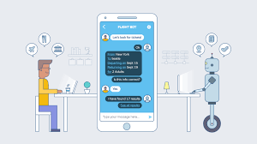
What is a ChatBot?
A chatbot is a computer program or an artificial intelligence which conducts a conversation via auditory or textual methods. Such programs are often designed to convincingly simulate how a human would behave as a conversational partner, thereby passing the Turing test.

Slide 3
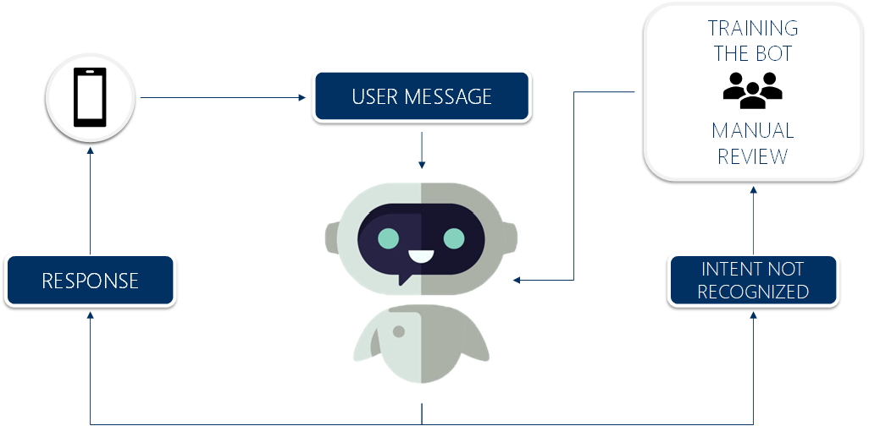
CHATBOT PERSONALITY
IS THE KEY TO RETENTION

Slide 4
Chatbot
+
Personality
+
Memory
(Generative; not Hardcoded)
=
Personality Based Neural Chatbot

Slide 5
What’s
NEW??
Omni-Capable
Conversational Maturity
Integrates with CRM
Emotionally Intelligent
Pre - Trained
Autonomous Reasoning
Generative
Persona

Slide 6
Neural Model
Advanced Interface
STT and TTS

Slide 7
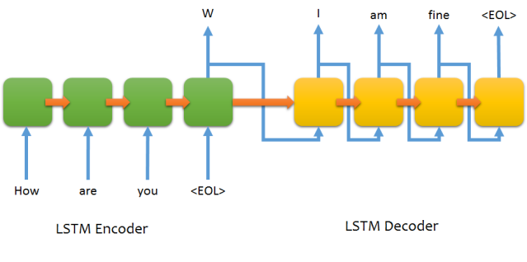
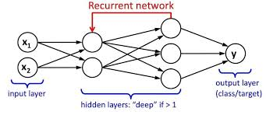
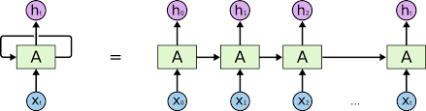
How is it made?
Python 3
NLTK
Tensorflow
Keras

Slide 8
How it HELPS?
Chatbots for children
24/7 customer service
Chatbots for parents
Endless queries, zero chance of sass
Less stress
Chatbots for the elderly
Better service
Project Murphy(‘what if’ bots)
interactive marketing platform
Artistic chatbots
cut down on operational costs

Slide 9
How Can Chatbots Help Me Save?
Reduced Operational Costs
Lower Labor Expenses
Cheap 24/7 Availability
Value in Customer Satisfaction
Greater Savings Over Time
The approximate cost to build a chatbot from scratch can be anywhere from $6000 to $12240.
Integration with one chat (40-56 hours)
Command language user interpreter (40-56 hours.)
Natural language user interface (120-160 hours)
Business logic (120-160 hours)
Researchers predict that within the next five years, between 75 and 90% of queries will be dealt with by ChatBot, resulting in cost savings of up to $0.70 per interaction.

Slide 10
References
https://link.springer.com/chapter/10.1007/978-3-642-00563-3_5
https://link.springer.com/chapter/10.1007/978-3-642-16761-4_40
https://dl.acm.org/citation.cfm?id=1040269
https://www.mytotalretail.com/post/chatbots-with-personality/
https://www.quora.com/How-do-you-design-the-personality-of-a-chatbot

