Slide 1

Shri Ram Murti Smarak College of Engineering & Technology Bareilly
2019-20
Department of Computer Science Engineering
Project Presentation on “Voice Command Automated Infrastructure Manager”
(Group no: - 12)
By-
Astitva Singh (1601410027)
Mohammad Bilal (1601410065)
Rishabh Umrao (1601410086)
Guided by:
Mr. Durgesh Tripathi
(CS Department)
SRMSCET, Bareilly

Slide 2
CONTENTS:
Introduction
Objective of the Project
Requirement Specification
Methodology/Technique
List of Modules/Functionalities
Project Application
Project Limitation

Slide 3
INTRODUCTION:
In today’s world of digitalization and automation we need a smart automated system to manage the infrastructure of companies or industries ranging from a startup to Google or Facebook.
It is a Voice based infrastructure management framework. Using this framework any individual can manage the infrastructure at different levels of abstraction to deploy different type of services.
This tool makes provisioning as simple as that a layman can also make of use of it without any much difficulty.
This tool helps any individual who possess no knowledge about system or server administration can also operate efficiently using this tool.

Slide 4
OBJECTIVE OF THE PROJECT
To design and implement voice automated server provisioning framework using which we can deploy different services over different clusters and manage how they work together.

Slide 5
REQUIREMENT SPECIFICATION
Requirement: -
Platform - Bare-metal Linux Machine (or a Linux virtual machine will also work)
Storage – Minimum 10GB (actual requirement varies according to usage)
Memory – Minimum 512MB (actual requirement varies according to usage)
O.S. – RedHat Enterprise Linux 7.5
Other dependencies –
Web Server (Apache httpd)
Python3.5 and above
Few other python libraries

Slide 6
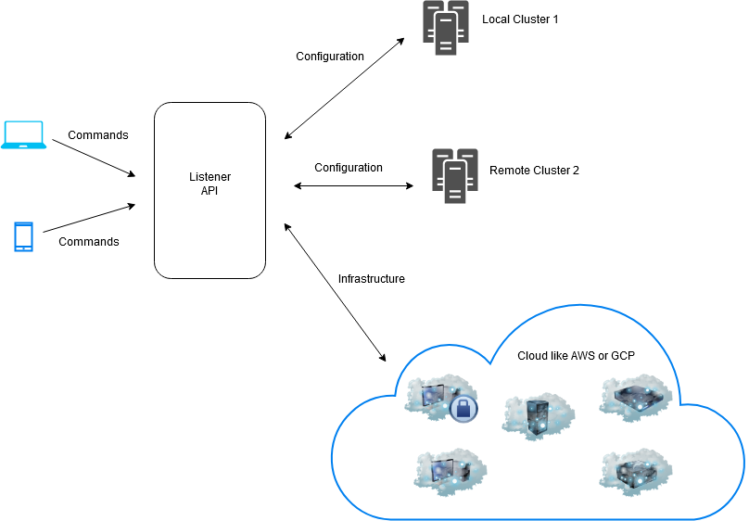
METHODOLOGY/TECHNIQUES
Fig. 1: System Architecture

Slide 7
MODULES
Operator
Acts as an input unit that provides the voice command which acts as an input about the service that needs to be deployed.
ListenerAPI
Receives the commands from Operator and processes it to perform the related tasks.
Snippets
Driver codes to support and handle multiple properties like user management, service management, infrastructure management and package management.

Slide 8
PROJECT APPLICATIONS/ADVANTAGES
Using this framework any individual can manage the infrastructure at different levels of abstraction to deploy different type of services.
Can also be tuned to provision domain specific technologies like home automation, APT Detection and Mitigation, Multi-cloud Infrastructure Management, etc.
Additional pluggable module can be used to scale in and scale out. Also that individual can be used to add extra features to the technology stack with the concept of hot-plug.

Slide 9
PROJECT LIMITATION
Limited Customization without pre-customized templates.
Operator voice recognition and detection module.

Slide 10
Thank You

