Slide 1
PROJECT: COMPARISON BETWEEN MONGO DB AND

Slide 2
FUNCTIONALITIES OF MONGO DB
MongoDB is a popular open-source, NoSQL database system that provides high performance, scalability, and flexibility for storing and retrieving data.
Here are some key functionalities of MongoDB:
Document-Oriented Storage: MongoDB stores data as documents in a flexible JSON-like format, making it easy to represent complex hierarchical relationships.
Indexing: MongoDB provides efficient indexing to allow for fast querying of large datasets.
Scalability: MongoDB can scale horizontally by adding more nodes to a cluster, making it easy to handle large amounts of data.
Aggregation: MongoDB provides a rich set of aggregation operations that allow for complex data analysis and processing.
Replication and High Availability: MongoDB supports replica sets, which provide automatic failover and ensure high availability.
Flexible Data Model: MongoDB's schema-less design allows for flexible and dynamic data modeling, making it easy to handle changes in data requirements.

Slide 3
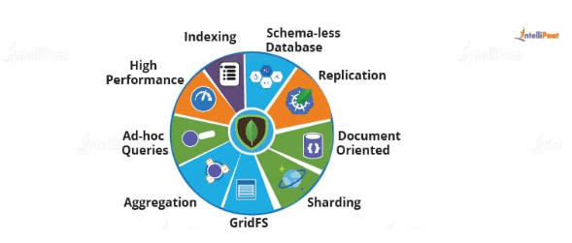
FUNCTIONALITY OF MONGODB

Slide 4
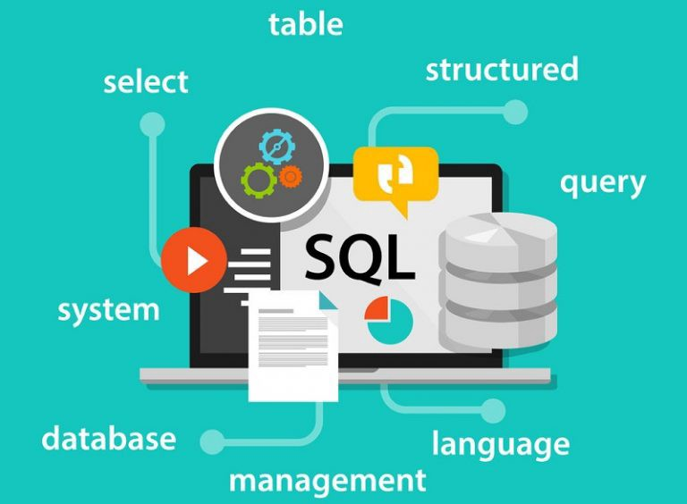
What is SQL?
SQL (Structured Query Language) is a programming language used for managing relational databases.
It provides a set of commands for defining, manipulating, and querying data stored in a relational database management system (RDBMS).

Slide 5
FUNCTIONALITIES OF SQL
SQL (Structured Query Language) is a domain-specific language used for managing relational databases. Here are some key functionalities of SQL:
Data Definition Language (DDL): SQL provides a set of commands to define and manage the structure of a database, including tables, indexes, and constraints.
Data Manipulation Language (DML): SQL provides a set of commands to manipulate data in a database, including inserting, updating, and deleting records.
Query Language: SQL provides a powerful query language for retrieving data from one or more tables based on specific criteria.
Transactions: SQL supports transactions, which ensure the integrity and consistency of data by allowing multiple database operations to be treated as a single, atomic unit.
Views: SQL allows the creation of virtual tables, called views, that can present data from one or more tables in a customized format.
Indexing: SQL provides efficient indexing to allow for fast querying of large datasets.
Stored Procedures: SQL allows the creation of stored procedures, which are precompiled database objects that can be used to perform complex database operations.

Slide 6
MONGODB VS SQL
Feature | MongoDB | SQL
Data Model | Document-oriented | Relational
Scalability | Horizontally scalable | Vertically scalable
Query Language | MongoDB Query Language (MQL) | Structured Query Language (SQL)
Indexing | Efficient indexing for large data | Efficient indexing for small-medium data
Transactions | Limited support | Full support
Schema | Dynamic and flexible | Static and rigid
Joins | No support for join operations | Support for join operations
Data Integrity | No strict data integrity | Strict data integrity
Security | Authentication and authorization | Authentication and authorization
Geospatial Support | Built-in support | Available as an extension
Replication | Built-in replication support | Available through clustering

