Slide 1
Interpretable & Efficient Deep RL for Autonomous Driving
Mohammadamin Kiani, Danial Parnian
Department of Computer Engineering, Sharif University of Technology
{mohammadamin.kiani01, danial.parnian01}@sharif.edu

Slide 2
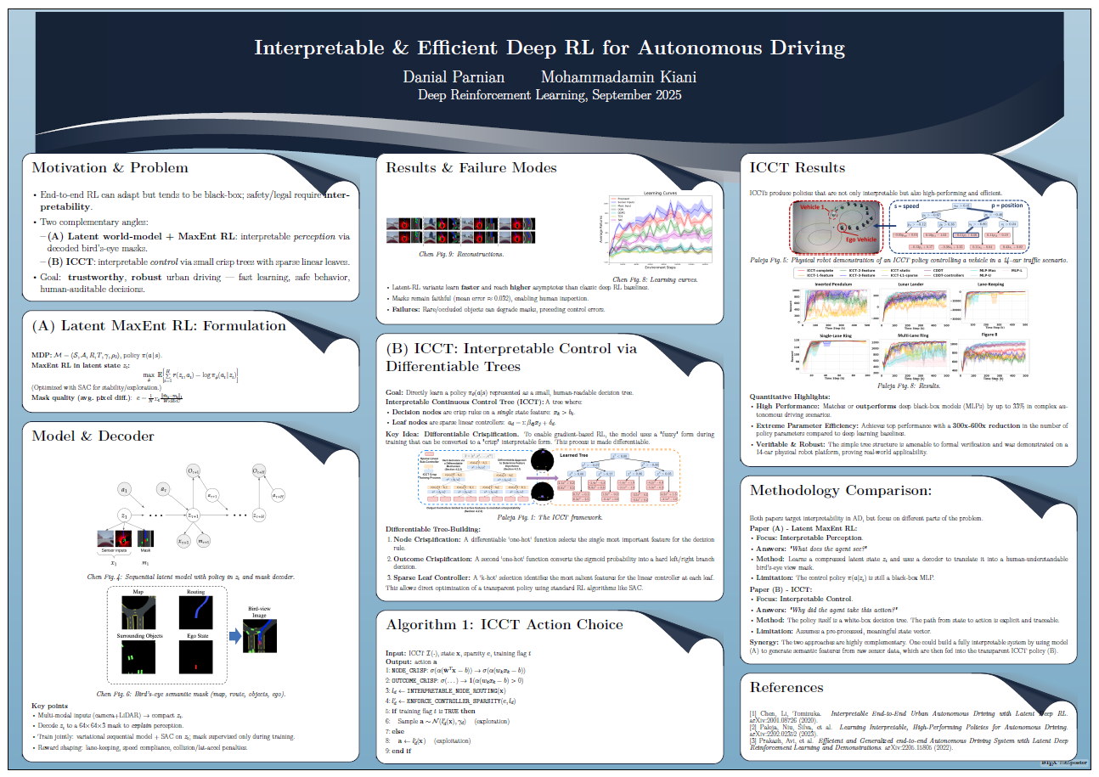

Slide 3
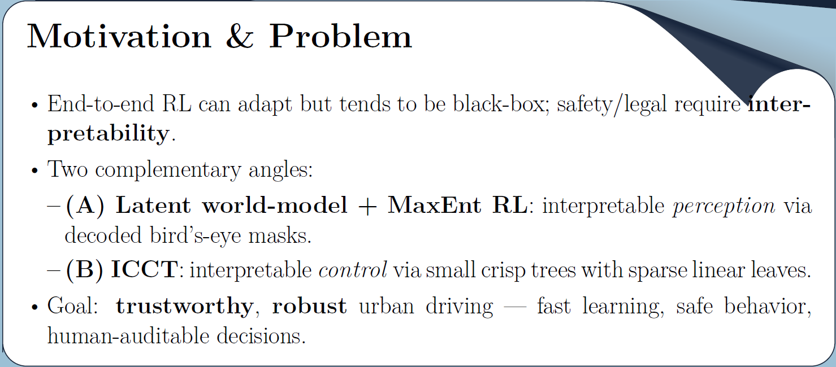

Slide 4


Slide 5
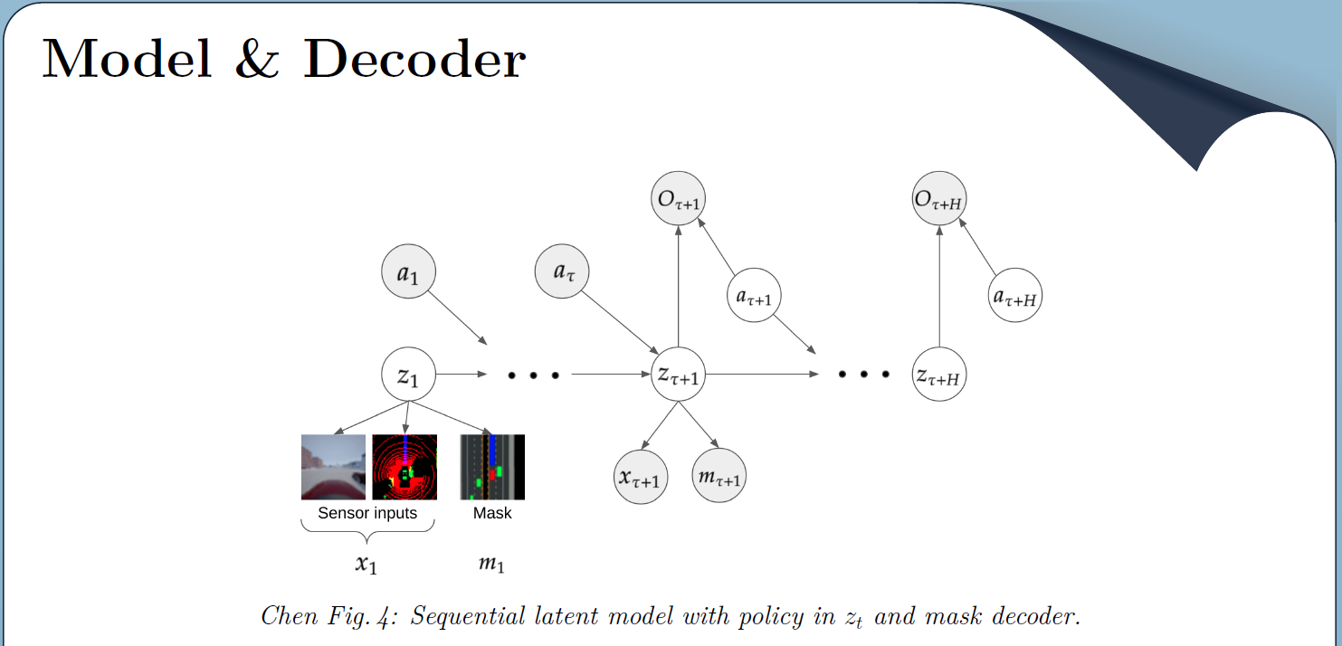

Slide 6
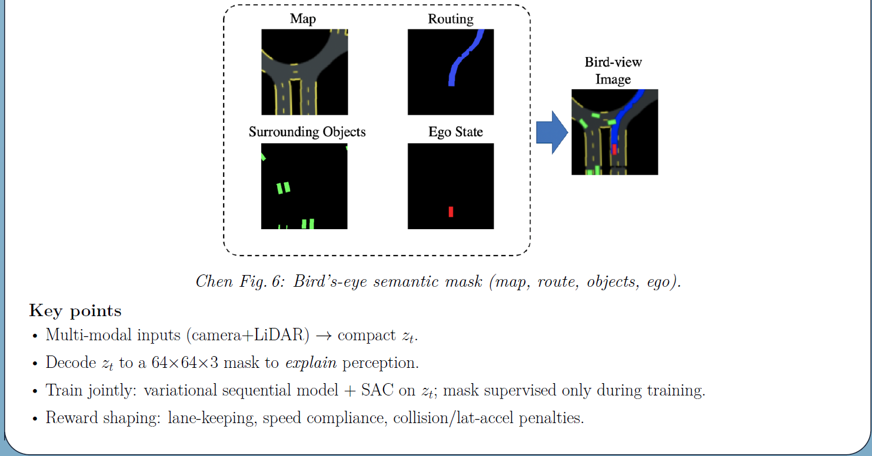

Slide 7
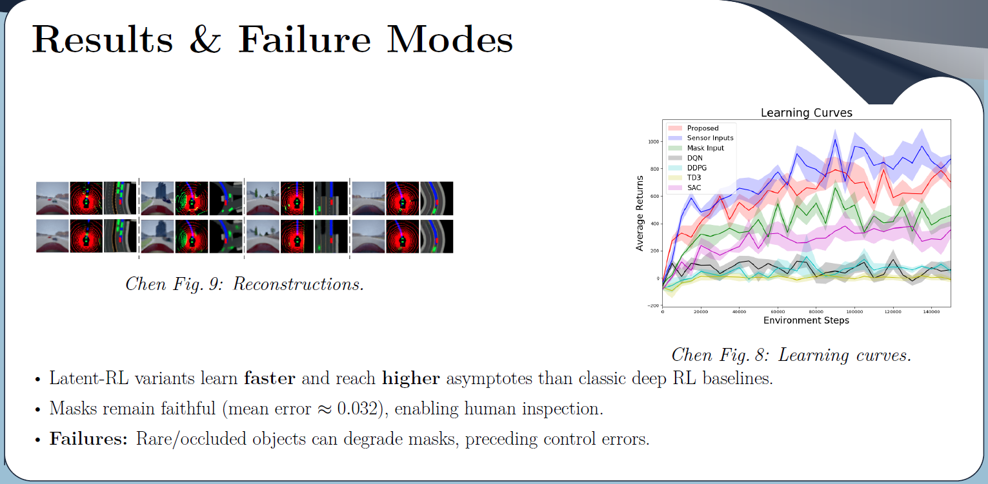

Slide 8
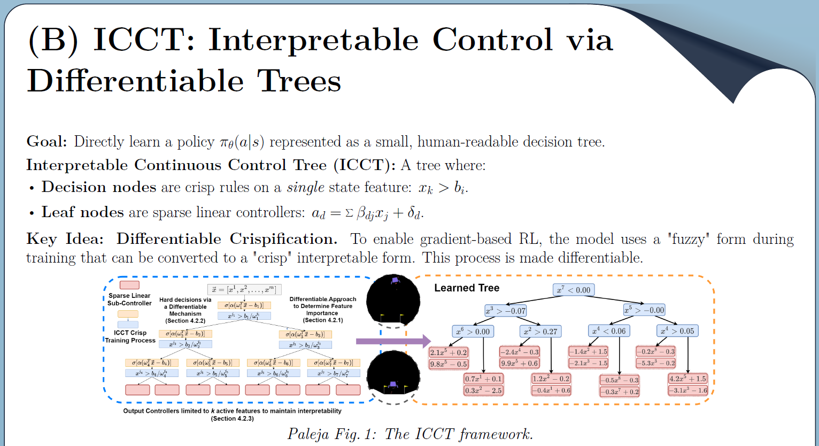

Slide 9


Slide 10
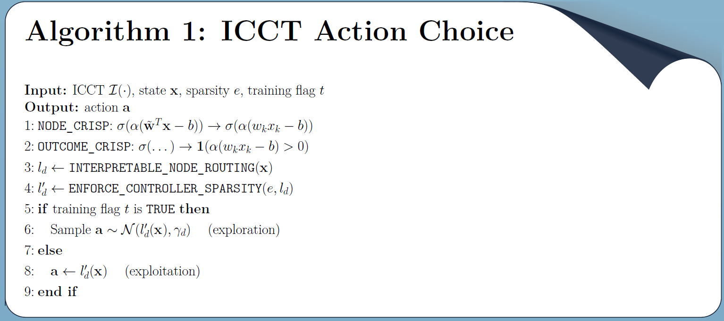

Slide 11
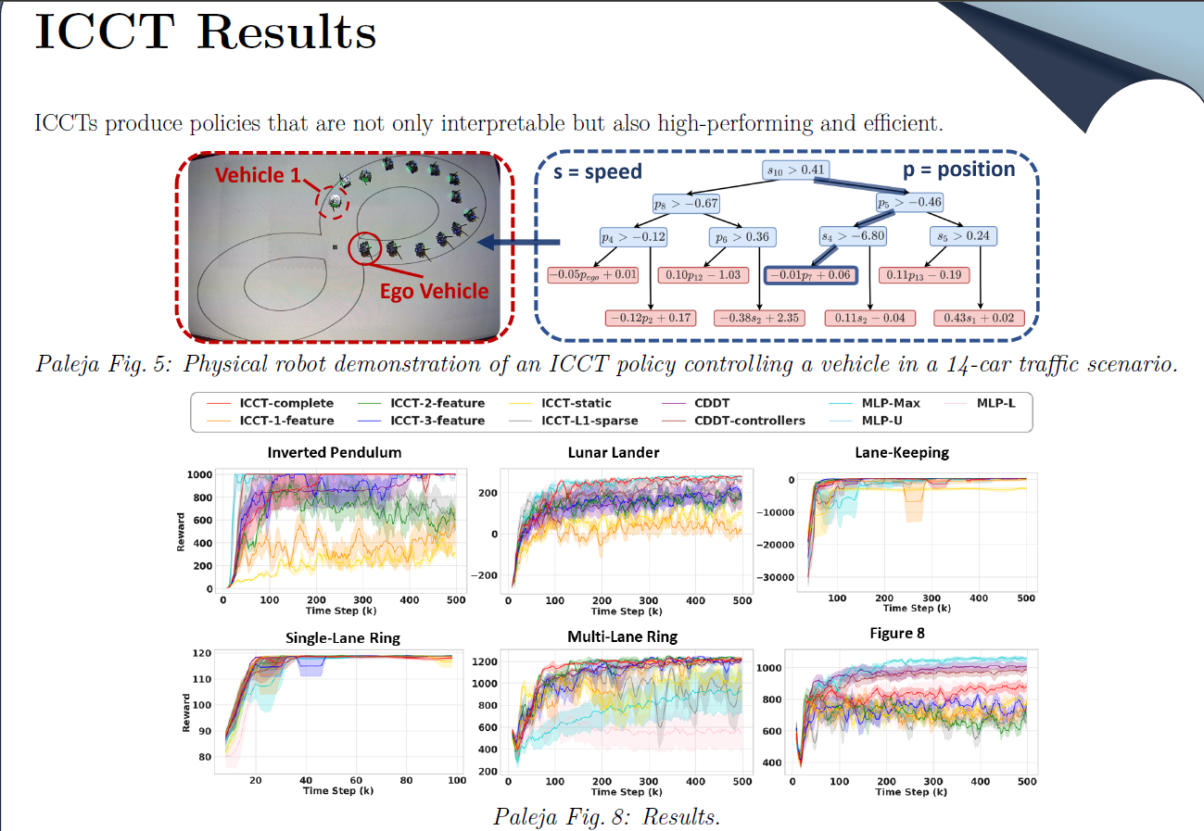

Slide 12


Slide 13
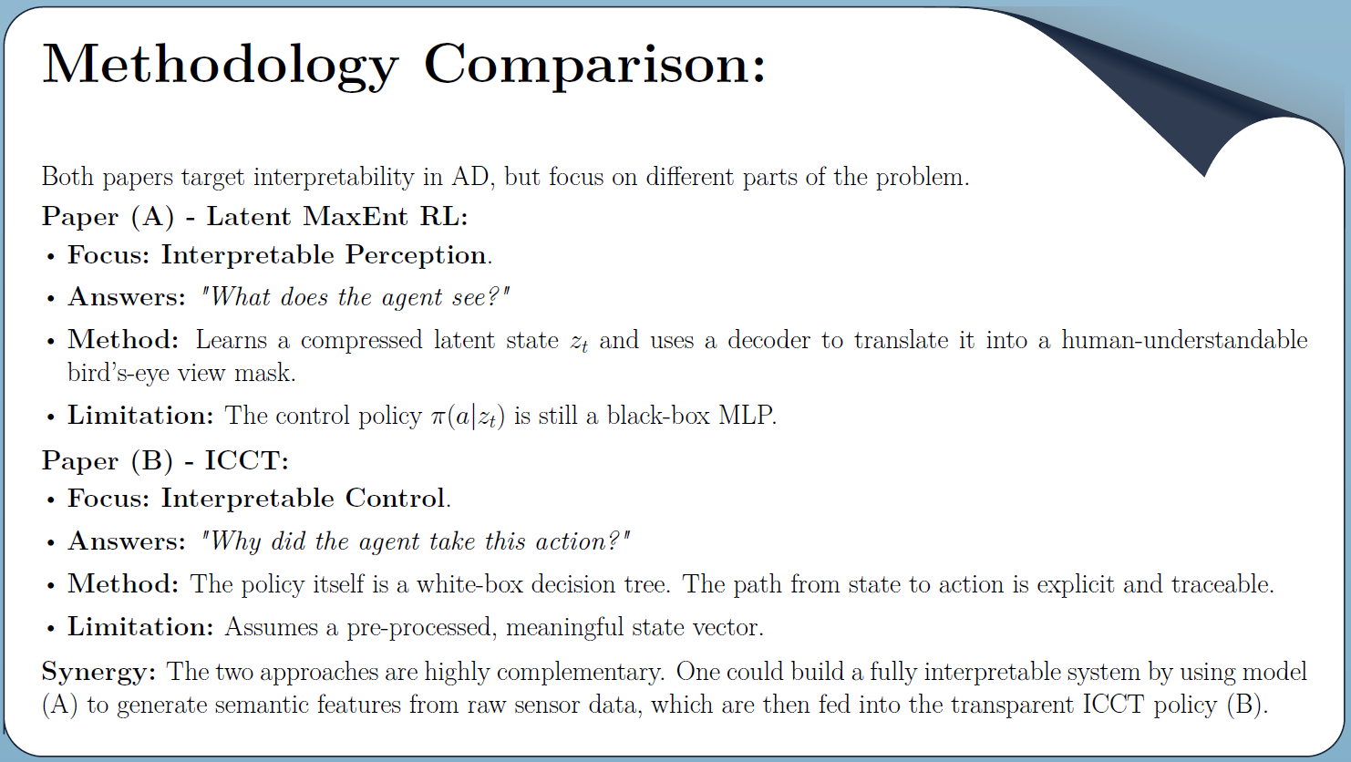

Slide 14


