Slide 1
Apple Website
Avigail Shlomov and Ayelet Daniel

Slide 2
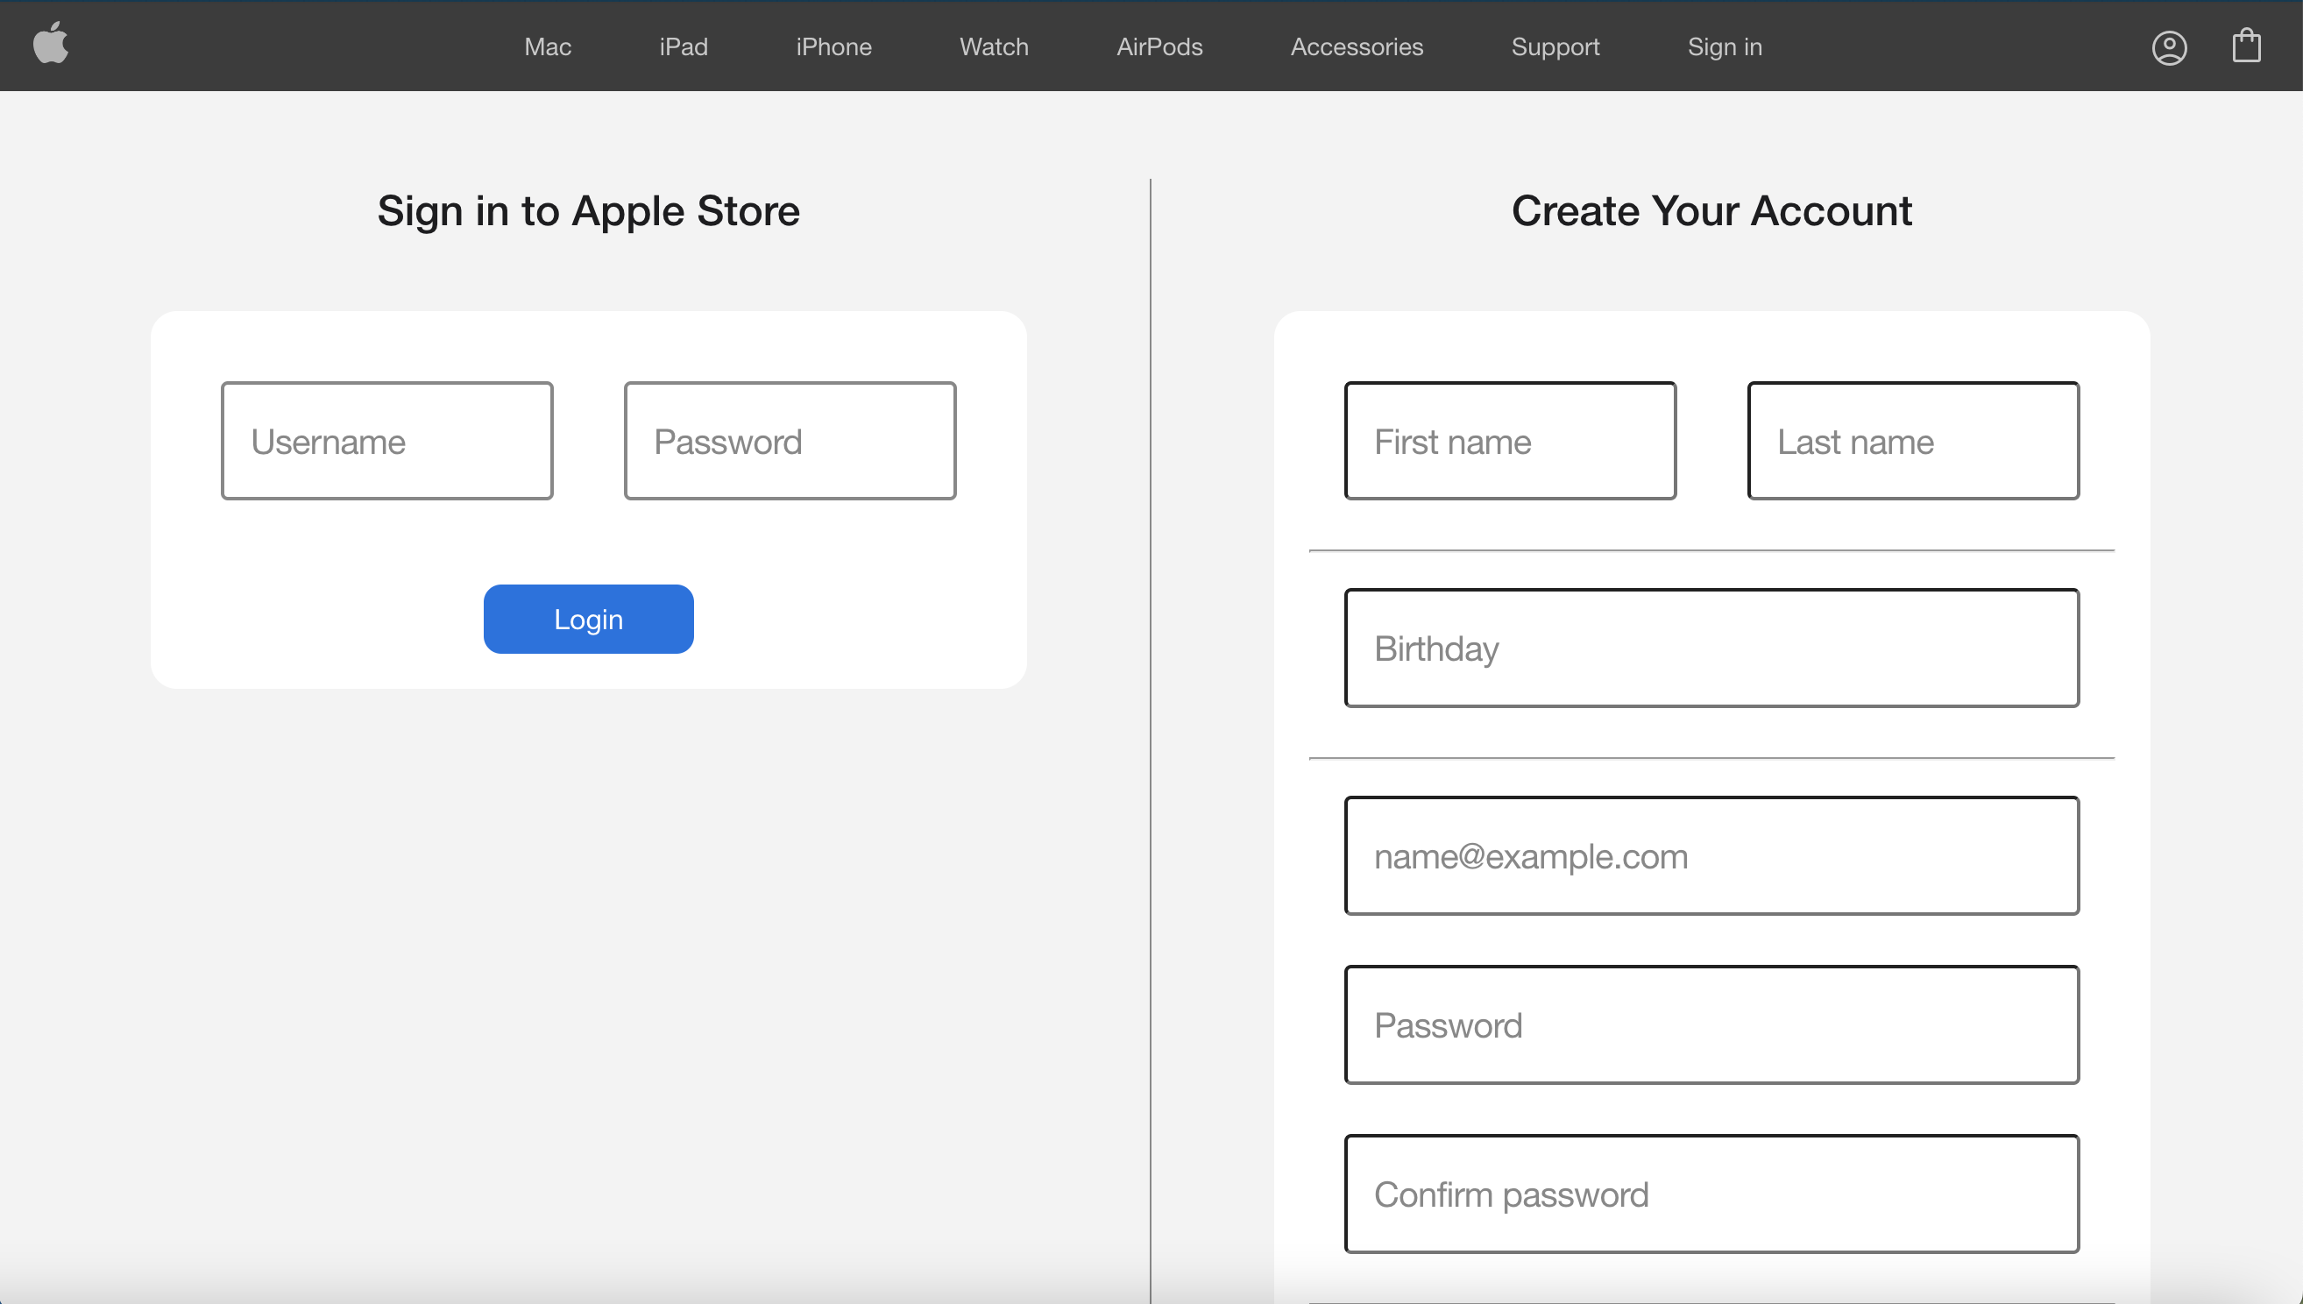

Slide 3
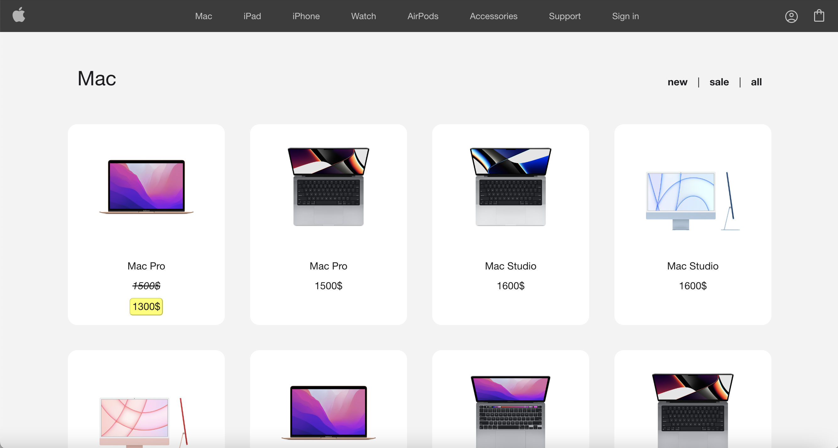

Slide 4
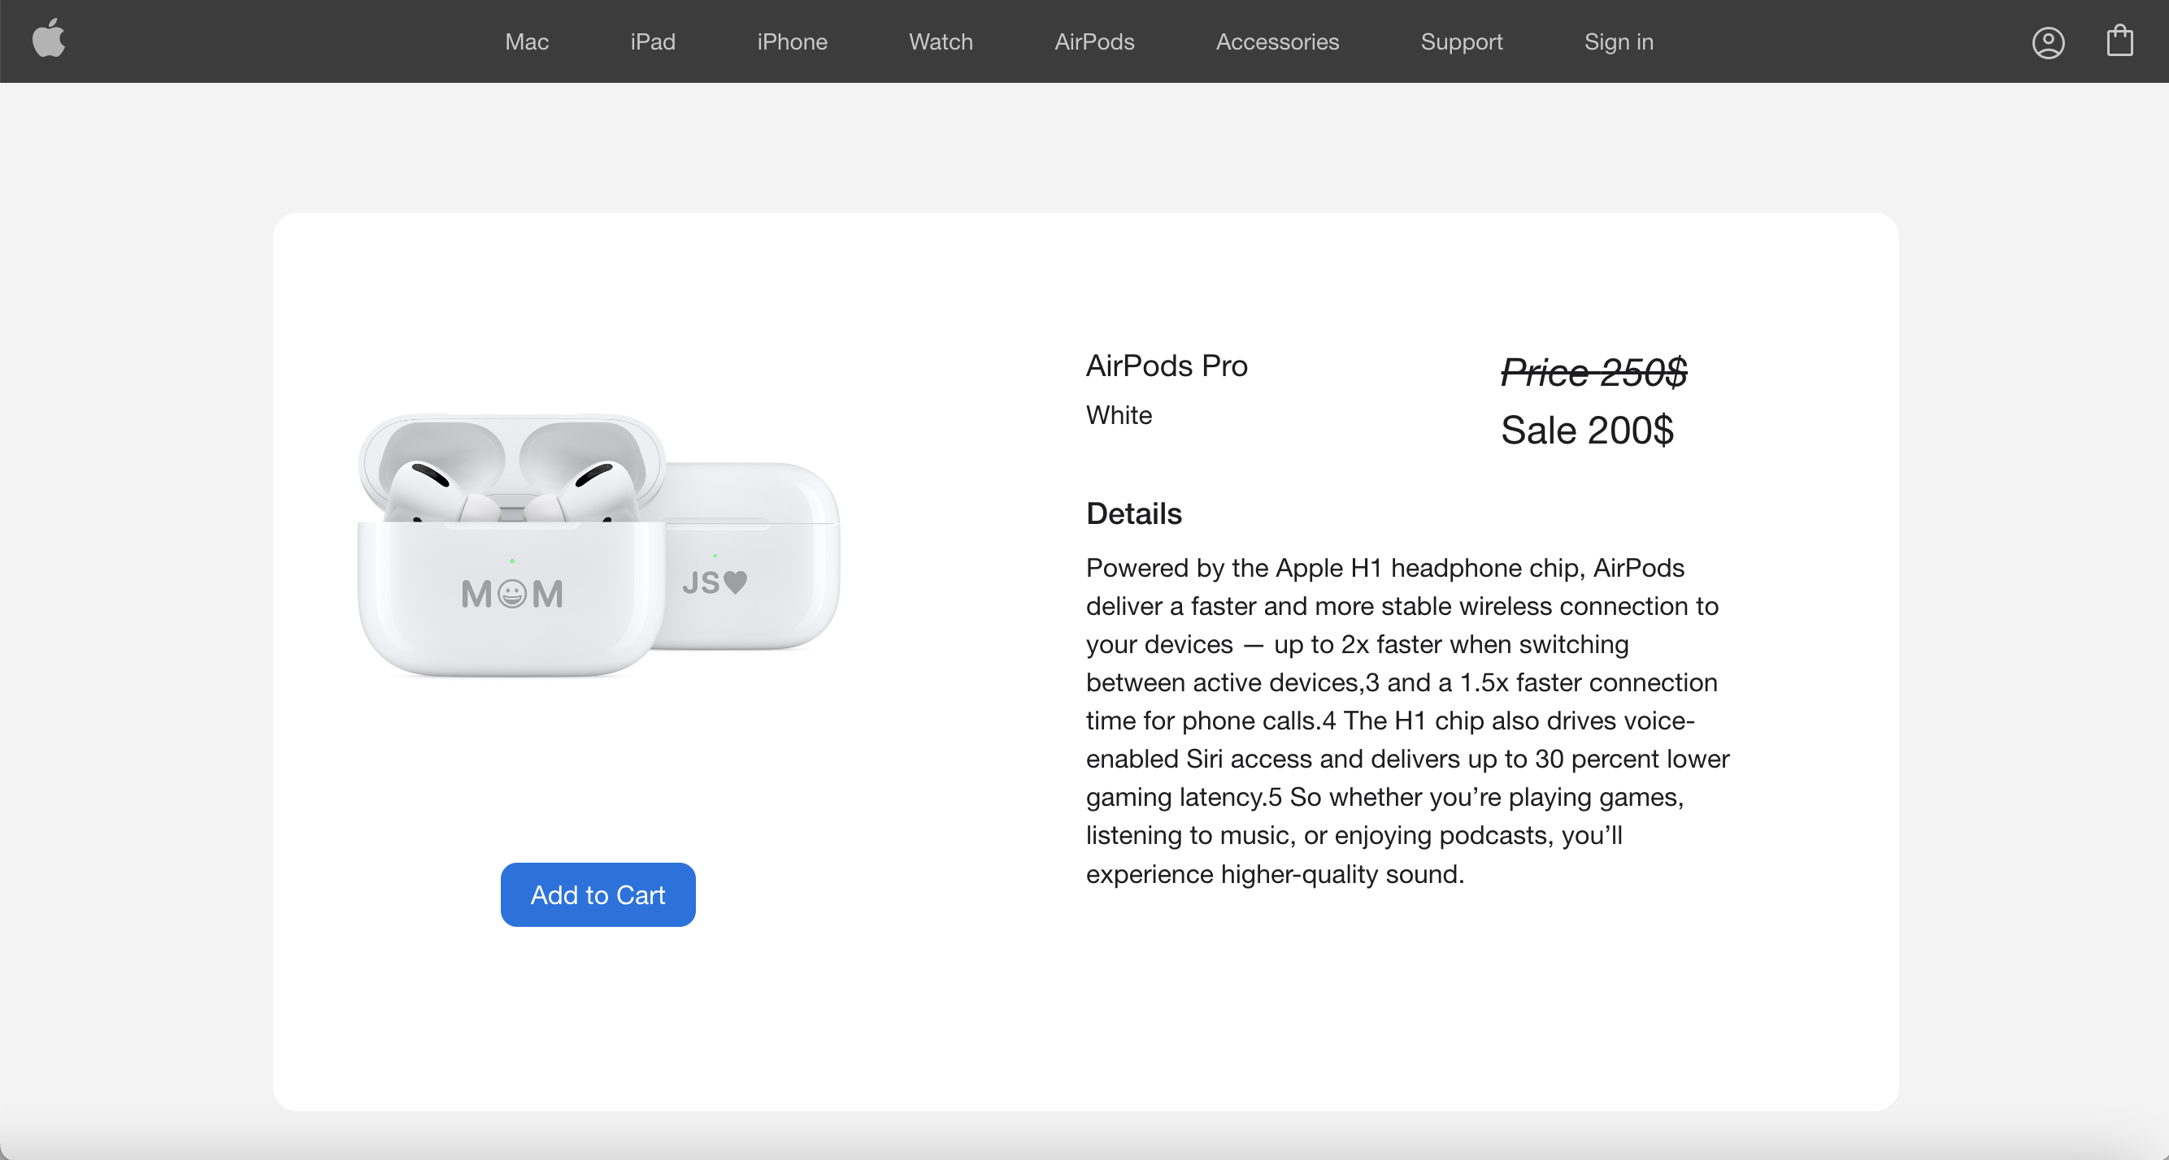

Slide 5
Online Apple Store
Register and sign in
Shopping cart and history
Watching products by category and filtered by different filters

Slide 6
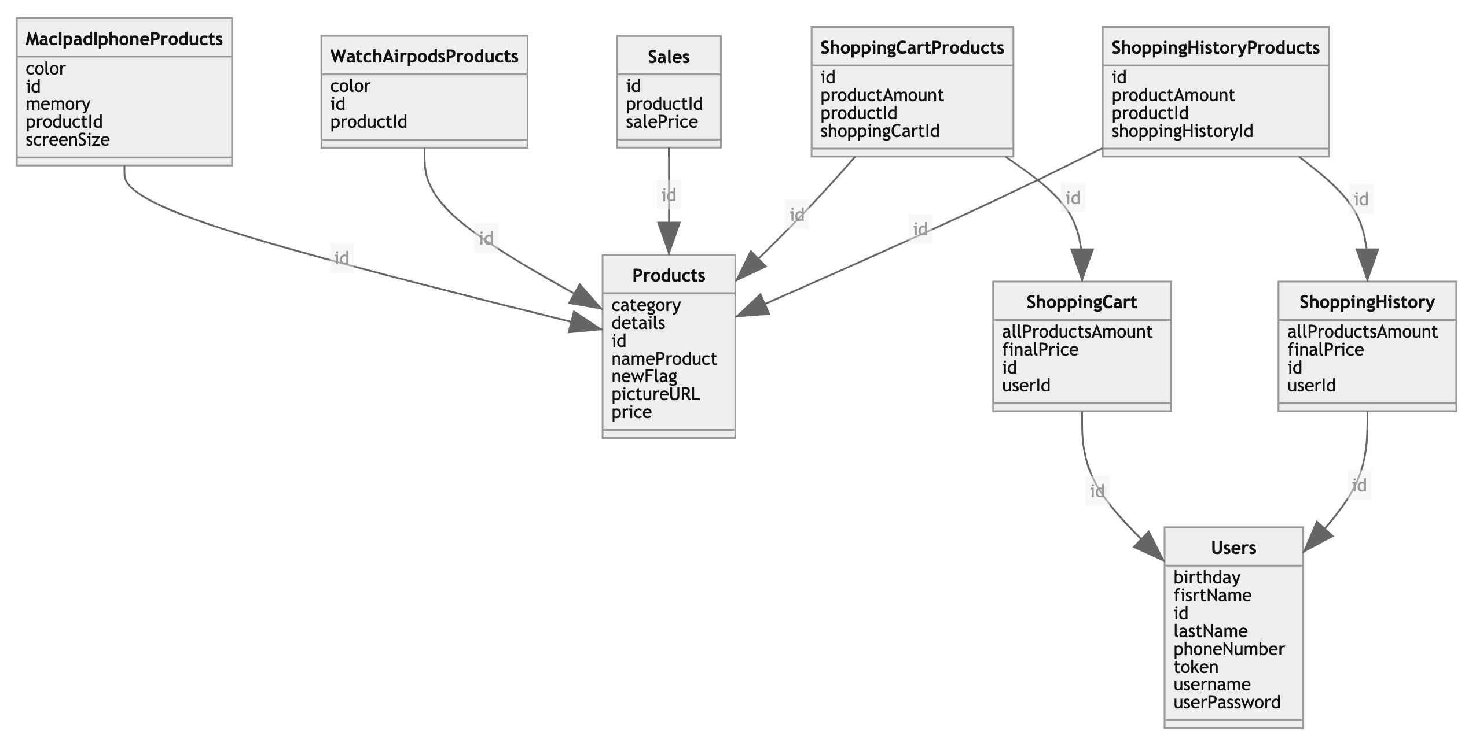
ERD – Entity Relationship Diagram

Slide 7
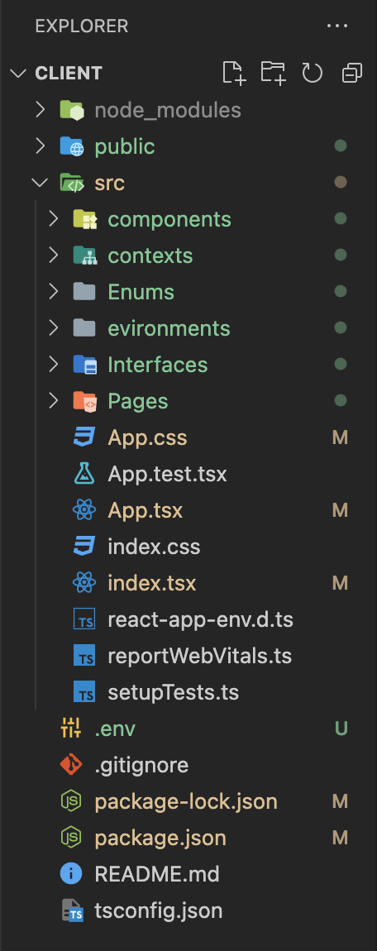
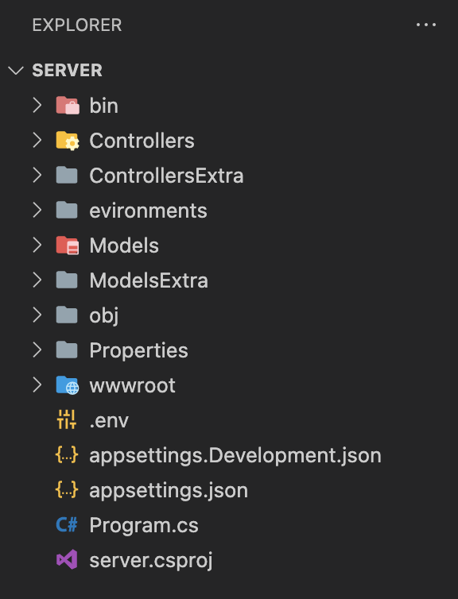

Slide 8
Challenges
Server – procedures and controllers
CSS – responsive
Feature – cart and history of a user

