Slide 1
Recursive Ray Tracer -Abhishek Yenpure

Slide 2
Ray Tracing Alogrithm
// loop over all pixels
Vec3f *framebuffer = new Vec3f[imageWidth * imageHeight];
for (int j = 0; j < imageHeight; ++j) {
for (int i = 0; i < imageWidth; ++i) {
for (int k = 0; k < numObjectsInScene; ++k) {
Ray ray = buildCameraRay(i, j);
if (intersect(ray, objects[k]) {
// do complex shading here but for now basic (just constant color)
framebuffer[j * imageWidth + i] = objects[k].color;
}
else {
// or don't do anything and leave it black
framebuffer[j * imageWidth + i] = backgroundColor;
}
}
}
}

Slide 3
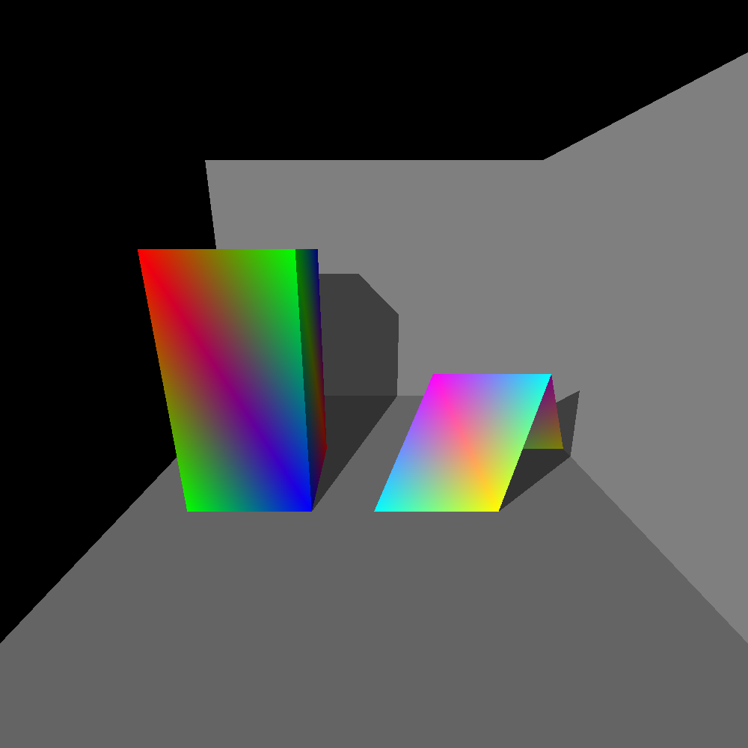
Depth = 1 (only shadows)

Slide 4
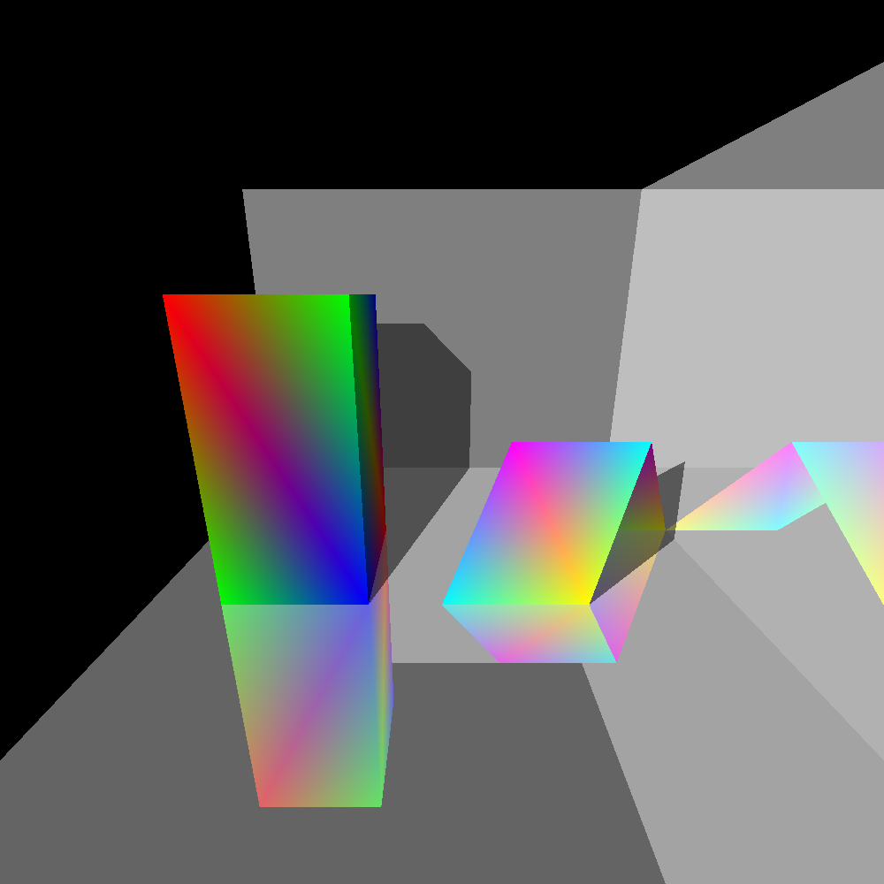
Depth = 2 (shadows and reflection)

Slide 5
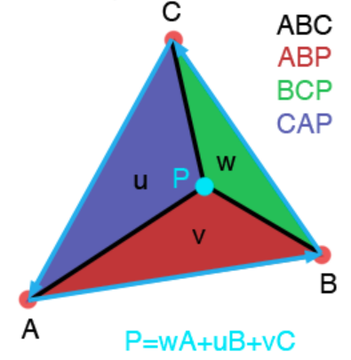
Barycentric co-ordinates
Barycentric coordinates can be used to express the position of any point located on the triangle with three scalars. The location of this point includes any position inside the triangle, any position on any of the three edges of the triangles, or any one of the three triangle's vertices themselves. To compute the position of this point using barycentric coordinates we use the following equation
P=uA+vB+wC

Slide 6
Pending
Refractions
...

Slide 7
Thank You

