Slide 1

Comprehensive security Monitoring system

Slide 2






Team members:
Usman Gill
Saira Akram
Ayesha Virk
Tinashe Dzemwa
Khadeeja Baqui
Majid Ali

Slide 3
agenda
PROJECT OVERVIEW
KEY TECHNOLOGIES
CORE AREA OF FOCUSES
BENEFITS
SYSTEM ARCHITECTURE
IMPLEMENTATION STRATEGY
FUTURE EHANCEMENTS

Slide 4
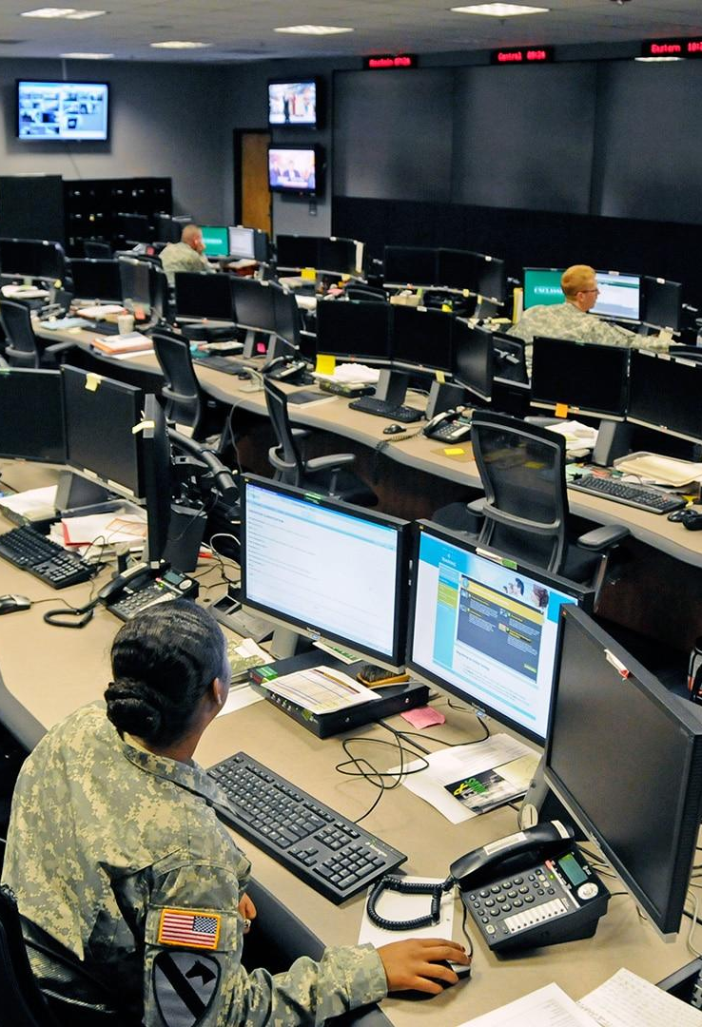
Innovative Edge AI-Based Security & Monitoring System
PROJECT OVERVIEW
Objective: Enhance security and monitoring across multiple domains using advanced AI technologies.

Slide 5


Key Technologies
Llama 3.1:
Synthetic data generation
Improves training and testing of security models
Phi-3 Mini Model:
Edge device deployment
Real-time analysis and response

Slide 6


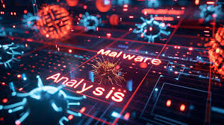
CORE AREA OF Focuses
Malware Detection:
Identifies and responds to malicious detection.
Analyzes patterns and behaviors.
Unusual Login Activity Tracking:
Tracks login behaviors for anomalies
Flags unusual access patterns and failed attempts
Traffic Monitoring:
Monitors network traffic for unusual patterns
Detects abnormal spikes and unauthorized access

Slide 7
benefits
BENEFITS
Scalability:
Easily deployable across multiple devices and locations
Efficiency:
Reduces data transfer needs with edge processing
Real-Time Performance:
Immediate threat detection and response
Operational Transparency:
Continuous monitoring and real-time alerts

Slide 8

System Architecture
Data Generation:
Llama 3.1 for synthetic datasets
Edge Deployment:
Phi-3 Mini Model for real-time analysis
Security Modules:
Malware detection, traffic monitoring, login tracking

Slide 9
Implementation Strategy
Integration:
Seamless integration with existing infrastructure
Deployment:
Rollout plan for edge devices
Maintenance:
Ongoing updates and model tuning

Slide 10
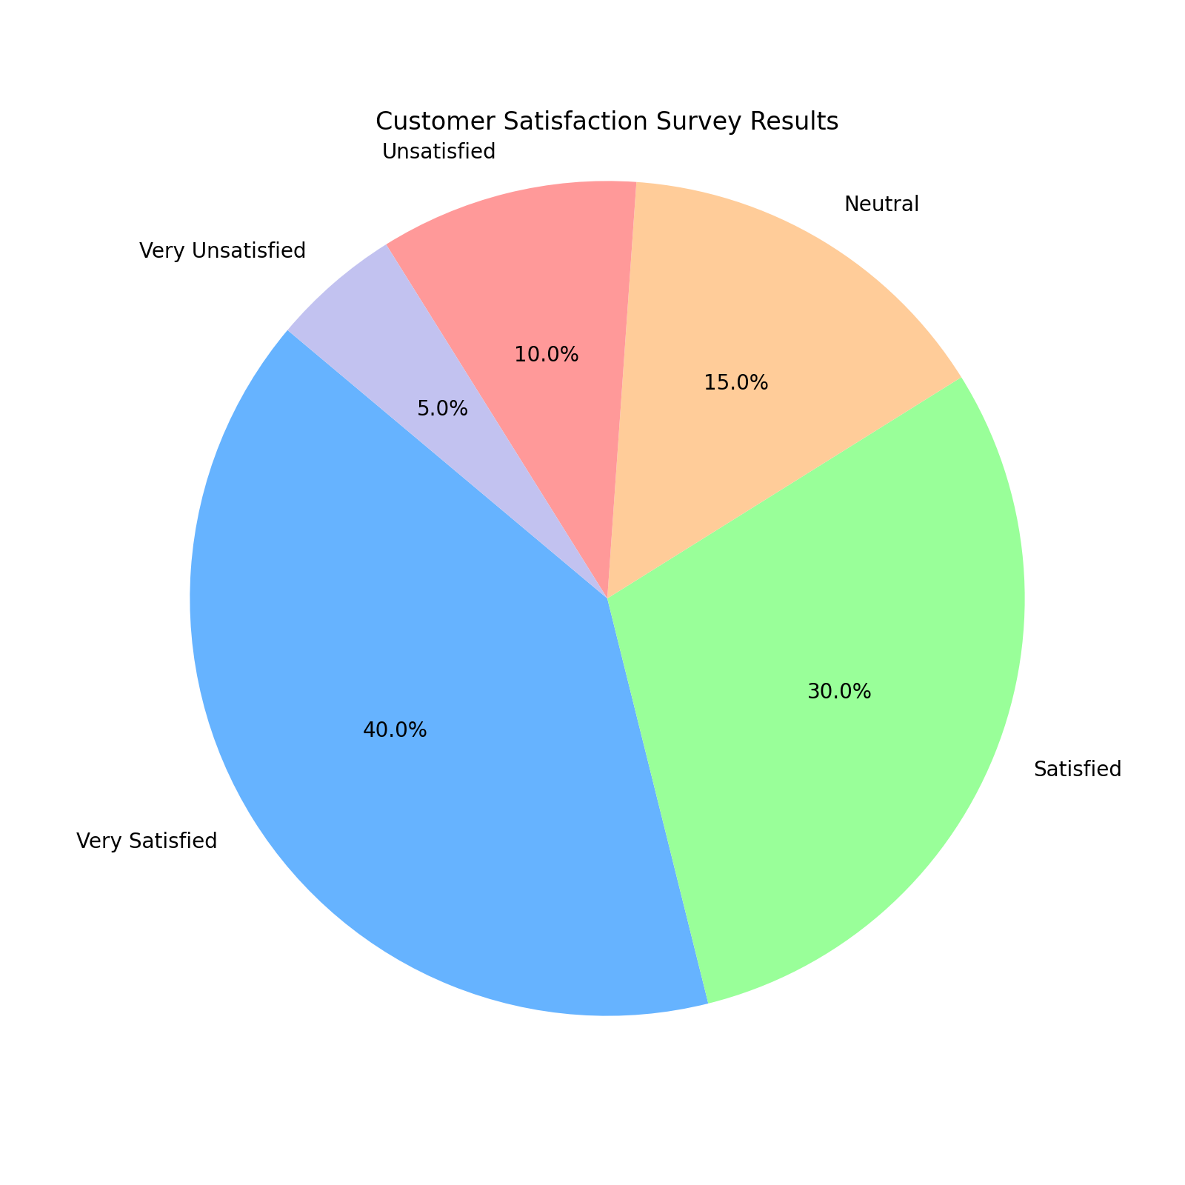
This chart shows the proportion of users rating their satisfaction with our product across different satisfaction levels.

Slide 11
Future Enhancements
Advanced Analytics:
Incorporation of additional machine learning techniques
Expanded Monitoring:
Coverage for new security threats
User Feedback:
Incorporate user feedback for continuous improvement

