Slide 1

MINI PROJECT ON
STANLEY COLLEGE OF ENGINEERING AND TECHNOLOGY FOR WOMEN (AUTONOMOUS)
Approved by AICTE, Accredited by NBA and NAAC with ‘A’ grade
INFORMATION TECHNOLOGY
PLAGIARISM DETECTION TOOL
INTERNAL GUIDE : MR. T. SANDEEP
PRESENTED BY:
AYESHA JAHAN (160619737055)
K. SANGEETHA (160619737074)
K. SATHVIKA (160619727075)

Slide 2
CONTENTS:
1. Abstract
2. Introduction to Project
3. Existing System
4. Proposed System
5. System Requirements
6. Flowchart
7. Algorithm
8. Sequence Diagram
9. Code
10. Output Screens
11. Conclusion
12. References

Slide 3
ABSTRACT:
PLAGIARISM is presenting someone else’s work or ideas as your own, with or without their consent, by incorporating it into your work without full acknowledgement. This project introduces a computer based plagiarism detection technique which combines the functionality of substring matching and keyword similarity to give more accurate results. To make the algorithm more efficient clustering is done by ranking the documents in which LCS (Longest Common Subsequence Algorithm) based algorithm is used for text based plagiarism. For image plagiarism detection we are using FMM (Five Modules Method) . It is based on image processing, which helps to manipulate and perform operations on image to detect plagiarism. Previously lot of work is done to detect plagiarism on text, but there is no much work done in this area. This project is an attempt is made to detect difference between the images using image subtraction. The system also overcomes the vulnerability of re-sizing and rotation. The similarity and the difference between the images using histogram.

Slide 4
INTRODUCTION TO PROJECT
With the spread of computers and the Internet, a large number of documents became available as electronic data. Digital documents are easy to copy and reuse, which encourages plagiarisms from copyrighted contents and academic documents such as research papers. This situation impedes the sound development of the creative activities of humans.
A simple solution for the problem is to develop a method that detects plagiarisms from a large number of documents of accurately as possible.
We aim to create a corpus that could be used for the development and evaluation of plagiarism detection systems that reflects the types of plagiarism practiced by students in an academic setting as far as realistically possible.
Here we are using TEXT and IMAGE based plagiarism and it will also detect the RATE OF ACCURACY for text and histogram for images. Thus we know that how much amount of data is being plagiarized.
The ultimate goal of our project is to identify and detect plagiarism present in research papers, professional letters and student assignments.

Slide 5
EXISTING SYSTEM:
The existing methodology maybe sufficient for detecting plagiarism of images when the source and suspected image have not been rotated by a large margin, but in case of rotational changes the existing methodology will fail.
Also the existing system is not efficient to detect plagiarism properly for different types of images.

Slide 6
PROPOSED SYSTEM:
The proposed methodology will ensure that even if the image is rotated or re-sized plagiarism is detected, thus if it has occurred or if an attack of rotational change has been made.
The proposed system will ensure that by using adaptive threshold values. The algorithm makes sure that the matching time of the images is less by reducing the search field by a significant factor each time the refinement is done.

Slide 7
PROPOSED SYSTEM:
The Proposed Text and Image of images plagiarism detection will take input from the database of the user. Then the threshold value of that image would be generated using the FMM Algorithm.
Now the input image would be checked for plagiarism against the images in local database.
In Database, images are stored with their respective threshold values. This would include calculating hamming distance between threshold values of input image and images in database.
At the end based on results achieved in detection engine, results will be displayed. In the same way text file also detected using LCS Algorithm.

Slide 8
SYSTEM REQUIREMENTS:
HARDWARE REQUIREMENTS:
Processor : Intel 5
RAM : 256 GB
SOFTWARE REQUIREMENTS:
Operating System: Windows 10
Programming Language: Python 3.10.4

Slide 9
FLOWCHART:
START
PROCESSING TEXT/IMAGE FILES PRESENT IN DATABASE
UPLOAD SUSPICIOUS TEXT/IMAGE FILE
CHECK FOR PLAGIARISM

Slide 10
IF
LCS SCORE>=0.6 OR HISTOGRAM PIXEL MATCHING SCORE >=2200
NO
YES
PLAGIARISM DETECTED
NO PLAGIARISM DETECTED
STOP

Slide 11
ALGORITHM:
Step 1: START
Step 2: Processing text/image files in database
Step 3: Upload suspicious text/image file respectively
Step 4: Check for plagiarism
Step 5: If LCS score>=0.6 for text file or Histogram pixel matching score>=2200 for image file, then Plagiarism is detected
Step 6: Else, No Plagiarism is detected
Step 7: STOP

Slide 12
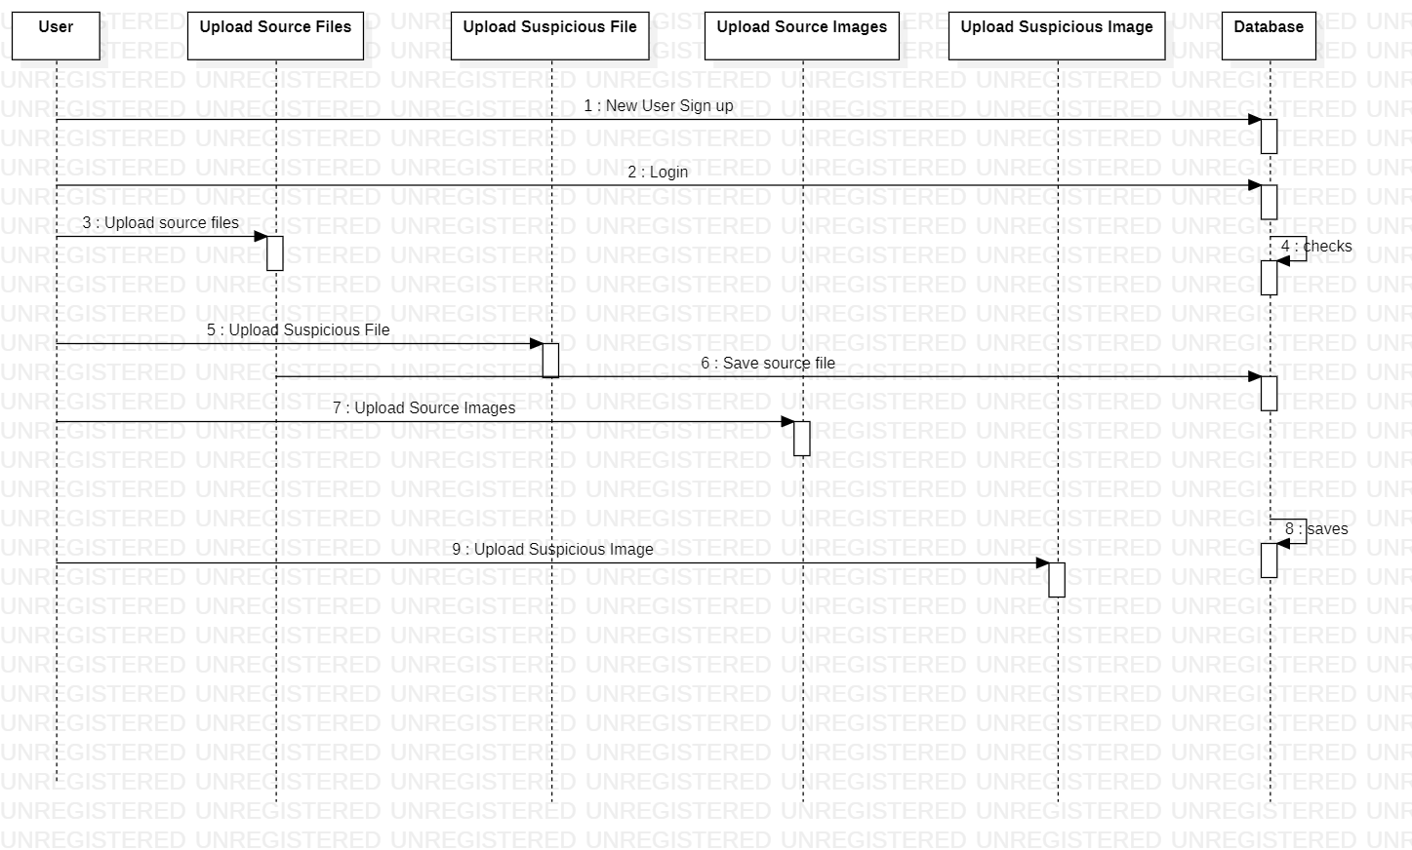
SEQUENCE DIAGRAM:
A sequence diagram simply depicts interaction between objects in a sequential order i.e. the order in which these interactions take place.
Sequence diagrams describe how and in what order the objects in a system function.

Slide 13
CODE:
from django.shortcuts import render
from django.template import RequestContext
from django.contrib import messages
import pymysql
from django.http import HttpResponse
from django.conf import settings
from django.core.files.storage import FileSystemStorage
import matplotlib.pyplot as plt
import re
import cv2
import numpy as np
from string import punctuation
from nltk.corpus import stopwords
import nltk
from nltk.stem import WordNetLemmatizer
from nltk.stem import PorterStemmer

Slide 14
import os
from nltk.tokenize import word_tokenize
stop_words = set(stopwords.words('english'))
lemmatizer = WordNetLemmatizer()
porter = PorterStemmer()
def LCS(l1,l2): #LCS method
s1 = word_tokenize(l1)
s2 = word_tokenize(l2)
dp = [[None]*(len(s1)+1) for i in range(len(s2)+1)]
for i in range(len(s2)+1):
for j in range(len(s1)+1):
if i == 0 or j == 0:
dp[i][j] = 0
elif s2[i-1] == s1[j-1]:
dp[i][j] = dp[i-1][j-1]+1
else:
dp[i][j] = max(dp[i-1][j] , dp[i][j-1])
return dp[len(s2)][len(s1)]

Slide 15
def cleanPost(doc):
tokens = doc.split()
table = str.maketrans('', '', punctuation)
tokens = [w.translate(table) for w in tokens]
tokens = [word for word in tokens if word.isalpha()]
tokens = [w for w in tokens if not w in stop_words]
tokens = [word for word in tokens if len(word) > 1]
tokens = [lemmatizer.lemmatize(token) for token in tokens]
tokens = [porter.stem(token) for token in tokens]
tokens = ' '.join(tokens)
return tokens text_files = []
text_data = []
image_files = []
image_data = []
def index(request):
if request.method == 'GET':
return render(request, 'index.html', {})

Slide 16
def Register(request):
if request.method == 'GET':
return render(request, 'Register.html', {})
def Login(request):
if request.method == 'GET':
return render(request, 'Login.html', {})
def UploadSuspiciousFile(request):
if request.method == 'GET':
return render(request, 'UploadSuspiciousFile.html', {}) def UploadSuspiciousImage(request):
if request.method == 'GET':
return render(request, 'UploadSuspiciousImage.html', {})
def FMM(name):#five modules algorithm
img = cv2.imread(name)
img = cv2.resize(img,(50,50))
img = cv2.cvtColor(img, cv2.COLOR_BGR2GRAY)
rows,cols = img.shape

Slide 17
for i in range(rows):
for j in range(cols):
if img[i,j] < 120:
img[i,j] = 210
for i in range(rows):
for j in range(cols):
k = img[i,j]
if (k % 5) == 4:
img[i,j] = k + 1
elif (k % 5) == 3:
img[i,j] = k + 2
elif (k % 5) == 2:
img[i,j] = k - 2
elif (k % 5) == 1:
img[i,j] = k - 1
for i in range(rows):
for j in range(cols):
k = img[i,j]
k = k / 5
img[i,j] = k

Slide 18
temp = img.ravel()
temp = np.min(img)
for i in range(rows):
for j in range(cols):
if img[i,j] > 0:
img[i,j] = img[i,j] - temp
hist = cv2.calcHist([img], [0], None, [256], [0, 256])
return hist def UploadSuspiciousImageAction(request):
if request.method == 'POST' and request.FILES['t1']:
output = ''
myfile = request.FILES['t1']
fs = FileSystemStorage()
name = str(myfile)
filename = fs.save(name, myfile)
hist = FMM(name)
os.remove(name)
similarity = 0
file = 'No Match Found'

Slide 19
hist1 = 0
for i in range(len(image_files)):
metric_val = cv2.compareHist(hist, image_data[i], cv2.HISTCMP_INTERSECT)
if metric_val > similarity:
similarity = metric_val
file = image_files[i]
hist1 = image_data[i]
output = '<table border=1 align=center><tr><th>Source Original Image Name</th><th>Suspicious Image Name</th><th>Histogram Matching Score</th><th>Plagiarism Result</th></tr>'
result = 'No Plagiarism Detected'
print(str(name)+" "+str(similarity))
if similarity >= 2200:
result = 'Plagiarism Detected'
output+='<tr><td><font size="" color="white">'+file+'</td><td><font size="" color="white">'+name+'</td>'
output+='<td><font size="" color="white">'+str(similarity)+'</td><td><font size="" color="white">'+result+'</td></tr>'
context= {'data':output}
fig, ax = plt.subplots(2,1)

Slide 20
ax[0].plot(hist1, color = 'b')
ax[1].plot(hist, color = 'g')
plt.xlim([0, 256])
ax[0].set_title('Original image')
ax[1].set_title('Plagiarised image')
plt.show()
return render(request, 'SuspiciousImageResult.html', context) def UploadSuspiciousFileAction(request):
if request.method == 'POST' and request.FILES['t1']:
output = ''
myfile = request.FILES['t1']
fs = FileSystemStorage()
name = str(myfile)
filename = fs.save("test.txt", myfile)
data = ‘’
with open("test.txt", "r", encoding='iso-8859-1') as file:
for line in file:
line = line.strip('\n')
line = line.strip()
data+=line+" "

Slide 21
file.close()
os.remove("test.txt")
data = cleanPost(data.strip().lower())
sim = 0
ff = 'No Match Found'
for i in range(len(text_data)):
similarity = LCS(text_data[i],data)
if similarity > sim:
sim = similarity
ff = text_files[i]
output = '<table border=1 align=center><tr><th>Source Original File Name</th><th>Suspicious File Name</th><th>LCS Score</th><th>Plagiarism Result</th></tr>'
result = 'No Plagiarism Detected'
similarity_percent = 0
if sim >= 0:
similarity_percent = sim/len(word_tokenize(data))
if similarity_percent >= 0.60:
result = 'Plagiarism Detected'

Slide 22
output+='<tr><td><font size="" color="white">'+ff+'</td><td><font size="" color="white">'+name+'</td>'
output+='<td><font size="" color="white">'+str(similarity_percent)+'</td><td><font size="" color="white">'+result+'</td></tr>'
context= {'data':output}
return render(request, 'SuspiciousFileResult.html', context) def UploadSourceImage(request):
if request.method == 'GET':
if len(image_files) == 0:
for root, dirs, directory in os.walk('images'):
for j in range(len(directory)):
hist = FMM(root+"/"+directory[j])
image_data.append(hist)
image_files.append(directory[j])
output = '<table border=1 align=center><tr><th>Source Image File Name</th><th>Histogram Values</th></tr>'
for i in range(len(image_files)):
output+='<tr><td><font size="" color="white">'+image_files[i]+'</td><td><font size="" color="white">'+str(image_data[i])+"</td></tr>"
context= {'data':output}
return render(request, 'UploadSourceImage.html', context)

Slide 23
def UploadSource(request):
if request.method == 'GET':
if len(text_files) == 0:
for root, dirs, directory in os.walk('corpus-20090418'):
for j in range(len(directory)):
data = ''
with open(root+"/"+directory[j], "r", encoding='iso-8859-1') as file:
for line in file:
line = line.strip('\n')
line = line.strip()
data+=line+" "
file.close()
data = cleanPost(data.strip().lower())
text_files.append(directory[j])
text_data.append(data)
output = '<table border=1 align=center><tr><th>Source File Name</th><th>Words in File</th></tr>'
for i in range(len(text_files)):
length = len(text_data[i].split(" "))

Slide 24
output+='<tr><td><font size="" color="white">'+text_files[i]+'</td><td><font size="" color="white">'+str(length)+"</td></tr>"
context= {'data':output}
return render(request, 'UploadSource.html', context)
def UserLogin(request):
if request.method == 'POST':
username = request.POST.get('username', False)
password = request.POST.get('password', False)
index = 0
con = pymysql.connect(host='127.0.0.1',port = 3308,user = 'root', password = 'root', database = 'plagiarism',charset='utf8')
with con:
cur = con.cursor()
cur.execute("select * FROM users")
rows = cur.fetchall()
for row in rows:
if row[0] == username and password == row[1]:
index = 1
break

Slide 25
if index == 1:
file = open('session.txt','w')
file.write(username)
file.close()
context= {'data':'welcome '+username}
return render(request, 'UserScreen.html', context)
else:
context= {'data':'login failed'}
return render(request, 'Login.html', context)
def Signup(request):
if request.method == 'POST':
username = request.POST.get('username', False)
password = request.POST.get('password', False)
contact = request.POST.get('contact', False)
email = request.POST.get('email', False)
address = request.POST.get('address', False)
db_connection = pymysql.connect(host='127.0.0.1',port = 3308,user = 'root', password = 'root', database = 'plagiarism',charset='utf8')
db_cursor = db_connection.cursor()

Slide 26
student_sql_query = "INSERT INTO users(username,password,contact_no,email,address) VALUES('"+username+"','"+password+"','"+contact+"','"+email+"','"+address+"')"
db_cursor.execute(student_sql_query)
db_connection.commit()
print(db_cursor.rowcount, "Record Inserted")
if db_cursor.rowcount == 1:
context= {'data':'Signup Process Completed'}
return render(request, 'Register.html', context)
else:
context= {'data':'Error in signup process'}
return render(request, 'Register.html', context)

Slide 27
CONCLUSION:
The source documents are processed and retrieved with the proposed algorithm to demonstrate performance of the proposed similarity measure in document plagiarism detection by implemented web applications.
The experiments were evaluated from two aspects:
Efficiency tests by type of document
Effectiveness test regarding correctness
The results show that the proposed system can detect document types .docx and .txt as designed and can detect plagiarized documents with an average accuracy of 95.01%.

Slide 28
FUTURE ENHANCEMENTS:
Detect more types of plagiarism, particularly those coming from synonym replacement, translation, or paraphrase. Some semantic analysis results look promising, although their use will increase the amount of time needed for evaluating a system.
Clearly identify the source location in the report, do not just report “Internet source” or “Wikipedia”, but specify the exact URL and date stored so that an independent comparison can be done.

Slide 29
REFERENCES:
Potthast, M., Stein, B., Eiselt, A., no, A.B.C., Rosso, P.: Overview of the 1st International Competition on Plagiarism Detection. In: SEPLN 2009 Workshop on Uncovering Plagiarism, Authorship, and Social Software Misuse (PAN 09), CEUR-WS.org (September 2009)
Maurer, H., Kappe, F., Zaka, B.: Plagiarism - a Survey . Journal of Universal Computer Science 12(8) (2006)
Helfman, J.: Dotplot: a program for exploring self-similarity in millions of lines of text and code. Journal of Computational and Graphical Statistics 2(2) (1993) 153–174
Potthast, M., Stein, B., Barron-Cede ´ no, A., Rosso, P.: An Evaluation Framework for Plagiarism Detection. In: Proceedings of the 23rd International Conference on Computational Linguistics (COLING 2010) (to appear), Beijing, China, Association for Computational Linguistics (August 2010)

Slide 30
REFERENCES:
Abdi, S. M. Shamsuddin, N. Idris, R. M. Alguliyev, and R. M. Aliguliyev, “A linguistic treatment for automatic external plagiarism detection,” Knowledge-Based Systems, vol. 135, pp. 135–146, 2017.
J. P. Bao, J. Y. Shen, X. D. Liu, and Q. B. Song, “A survey on natural language text copy detection,” Journal of software, vol. 14, no. 10, pp. 1753–1760, 2003.
K. Vani and D. Gupta, “Unmasking text plagiarism using syntactic-semantic based natural language processing techniques: comparisons, analysis and challenges,” Information Processing & Management, vol. 54, no. 3, pp. 408–432, 2018.
L. Ahuja, V. Gupta, and R. Kumar, “A new hybrid technique for detection of plagiarism from text documents,” Arabian Journal for Science and Engineering, vol. 45, pp. 1–14, 2020.

