Slide 1


Counterfactual TD3-Based Resource Allocation for ISAC-Aided Vehicular Edge Computing
By Areeba Sarfraz
Supervisor: DR. Sardar Khaliq U Zaman

Slide 2
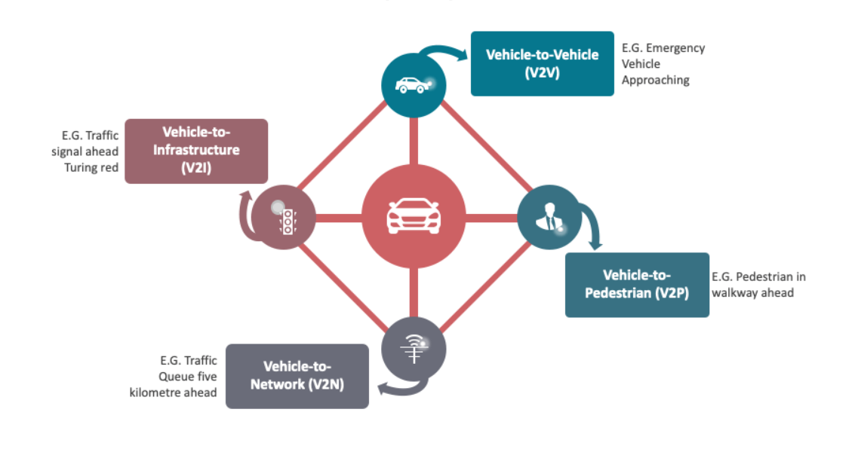
Introduction to 6G and V2X Communication
Goal : Enable seamless information exchange between vehicles and their surroundings

Slide 3
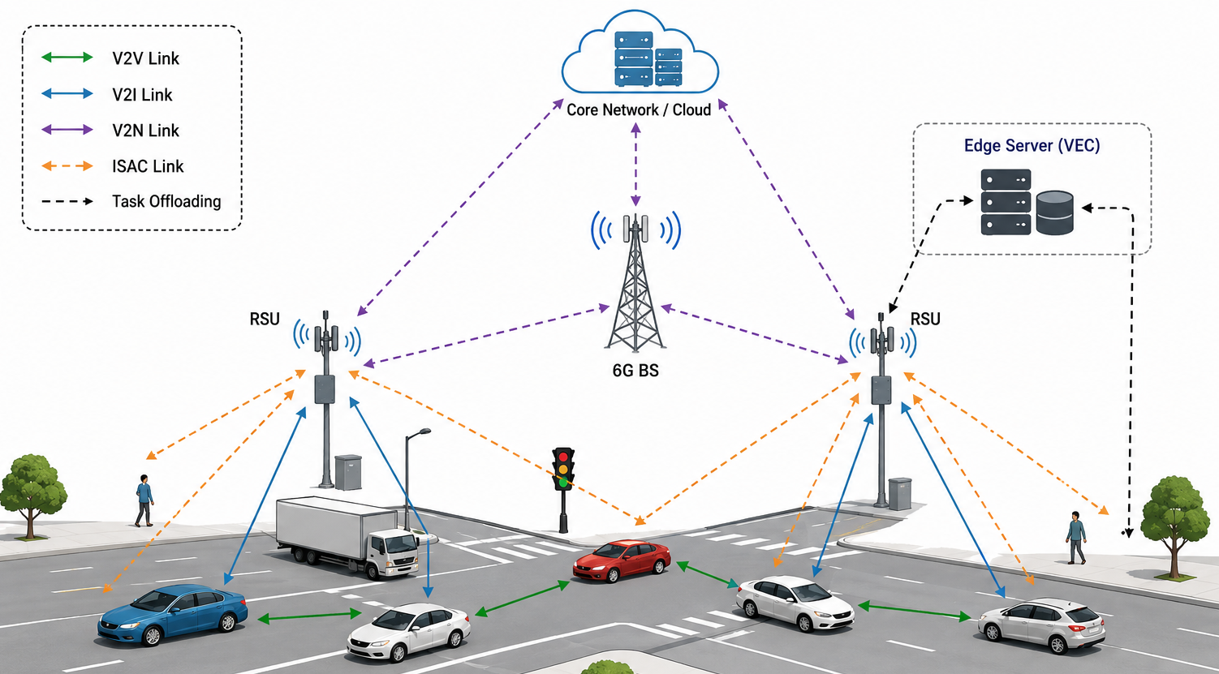
ISAC-Aided VEC
Goal : Integrate sensing, communication, and edge computing for intelligent vehicular networks

Slide 4
Introduction Cont.
The Resource Allocation Challenge
Decisions: Power, channel, user association, task offloading
Challenges: High mobility, fluctuating channels, dynamic interference
Limitation of Existing DRL
❌ Learns from correlations, not causation
❌ Cannot distinguish true causal effects from hidden confounders
❌ Results: High variance, poor efficiency, unstable performance
Our Contribution: CF-TD3
✅ Integrates counterfactual reasoning into TD3
✅ Answers: "What if different action was taken?"
✅ Enables causal-aware, robust, and sample-efficient allocation
3

Slide 5
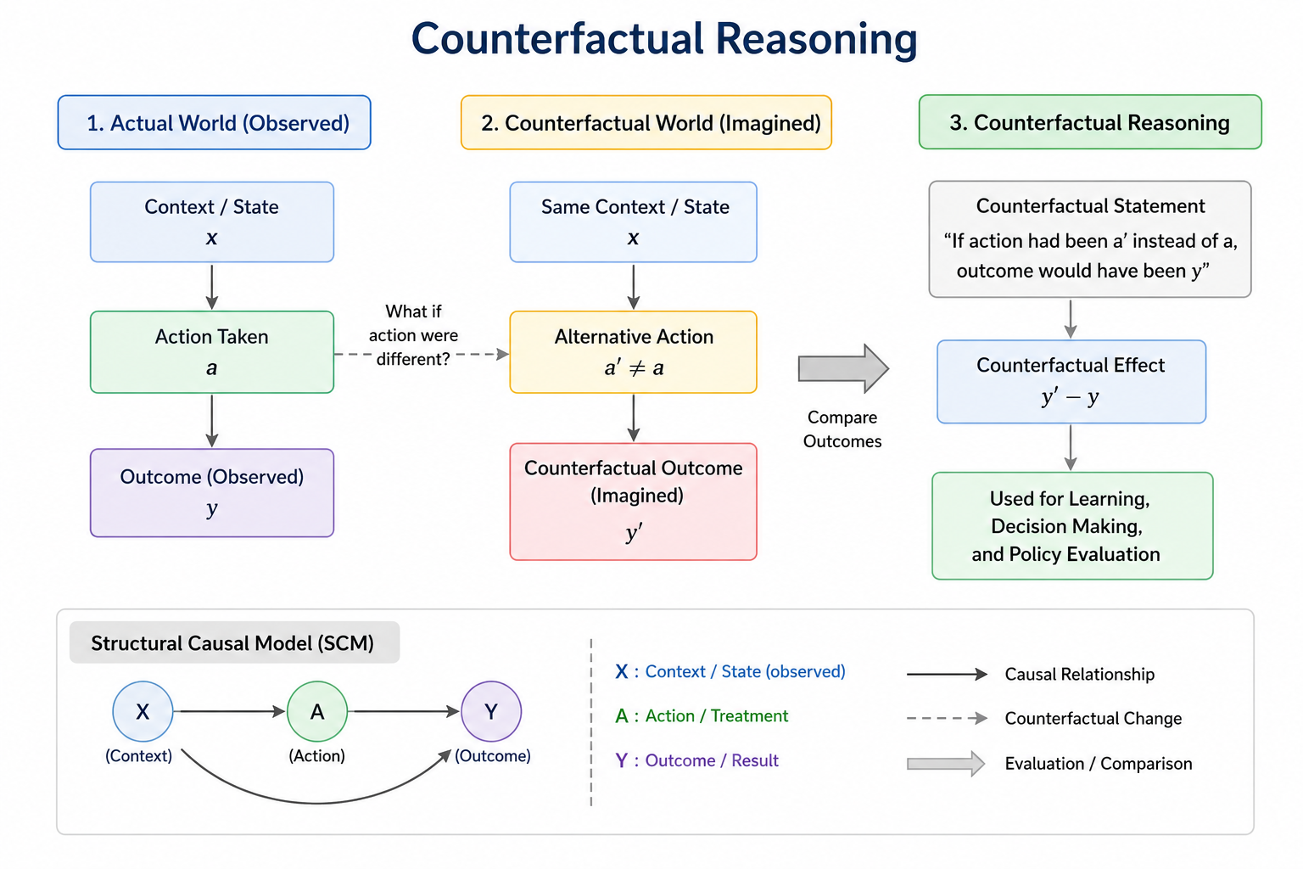
Counterfactual Reasoning
Goal : Causal-aware, robust, and sample-efficient allocation
4

Slide 6
Motivation
ISAC-aided VEC systems demand low-latency, energy-efficient resource allocation under high mobility
Existing DRL methods like D3QN-TD3 fail to distinguish causal effects from spurious correlations, causing high variance and poor efficiency
With rapid growth of connected vehicles by 2026, robust, causal-aware resource allocation is essential
This research proposes CF-TD3 to integrate counterfactual reasoning into ISAC-aided VEC resource allocation.
5

Slide 7
Related Works
Authors | Contribution | Methodology | Dataset/Samples | Strength | Limitation
Li, C. et al. (2025) [1] | D3QN-TD3 for user association and resource allocation in ISAC-aided VEC | D3QN + TD3 | ISAC-VEC MIMO sim | Primary baseline for ISAC-VEC | No counterfactual reasoning Learns only from factual correlations
Li, C. et al. (2025) [2] | ID-TD3 with OTFS for latency sensitive ISAC-VEC tasks | ID-TD3 + OTFS for high-mobility channels | ISAC-VEC simulation with OTFS | Optimizes delay and energy | No counterfactual reasoning Learns only from factual correlations
An, Y. et al. (2025) [3] | MATD3 for beamforming, RIS, and resource allocation | Multi-Agent TD3 for cooperative VEC-ISAC | ISAC-VEC MIMO sim | Multi-agent coordination | No counterfactual reasoning Learns only from factual correlations
6

Slide 8
Related Works
Authors | Contribution | Methodology | Dataset/Samples | Strength | Limitation
Zhang, Y. et al. (2025) [4] | TD3-based orchestration for multi-edge, multi-vehicle VEC | TD3 | Simulated multi-edge VEC environment | 15-38% cost reduction, scalable | No counterfactual reasoning Learns only from factual correlations
Xue, J. et al. (2025) [5] | TD3PO with digital twin for IoV ISAC | TD3PO + digital twin | Digital twin-based IoV ISAC simulation | Dynamic environment adaptation | No counterfactual reasoning Learns only from factual correlations
Khan, S. & Mylonas, A. (2026) [6] | CE-DRL with causal inference for 6G orchestration | Causal inference + DRL + attention mechanisms | Simulated 6G network environment | 35% latency, 28% energy reduction; counterfactual reasoning | Not ISAC-VEC specific
7

Slide 9
Problem Statement
The main challenge is optimal resource allocation in ISAC-aided VEC networks under high mobility and dynamic interference. Existing DRL methods like D3QN-TD3 rely solely on factual correlations and ignore hidden confounders (sudden congestion, channel fading), preventing causal-aware decision-making. This leads to high policy variance, poor sample efficiency, and unstable performance in dynamic V2X environments.
8

Slide 10
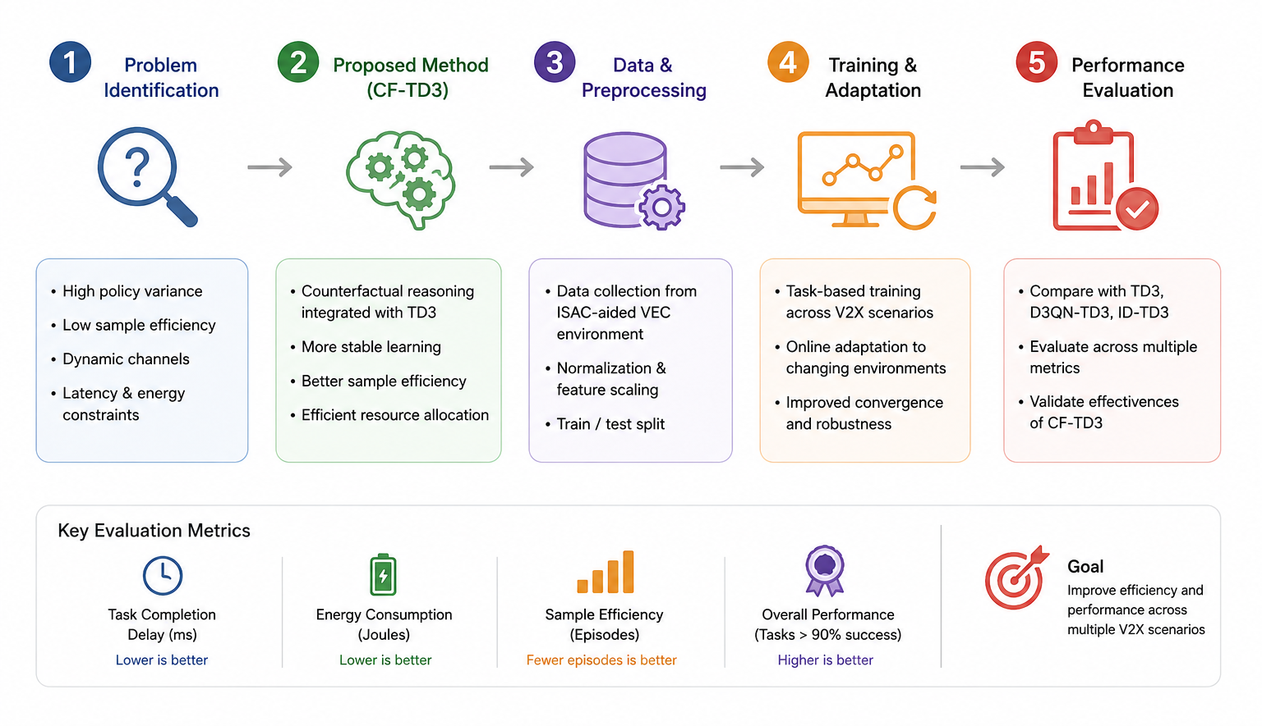
Proposed Methodology
9

Slide 11
Evaluation Metrics
Metric | Description | Purpose
Task Completion Delay (ms) | Average time from task arrival to completion | Lower is better
System Energy Consumption (J) | Total energy consumed by vehicles and RSUs | Lower is better
Sample Efficiency (episodes) | Episodes to reach 90% optimal performance | Lower is better
10

Slide 12
References
C. Li, K. Long, M. Yang, L. Zhao, X. Deng, D. Li, and S. Wan, "D3QN-TD3 for ISAC-Aided Vehicular Edge Computing," ACM Trans. Sensor Netw., vol. 21, no. 4, Article 38, pp. 1–31, Jul. 2025.
C. Li, Y. Zhang, and L. Yu, "Improved TD3 for Latency-sensitive Tasks in ISAC-aided VEC," ACM Trans. Sensor Netw., vol. 21, no. 6, pp. 52:1–52:27, 2025.
Y. An et al., "MATD3 for Beamforming and Resource Allocation in VEC-ISAC," in IEEE ICCC 2025, Aug. 2025.
Y. Zhang et al., "TD3-Based Orchestration for Multi-Edge VEC," IEEE Trans. Mobile Comput., vol. 24, no. 5, pp. 3456–3470, May 2025.
J. Xue et al., "TD3PO with Digital Twin for IoV ISAC," Ad Hoc Networks, vol. 179, 104009, Dec. 2025.
S. Khan and A. Mylonas, "CE-DRL for Causal-Aware 6G Resource Orchestration," Comput. Netw., vol. 278, 112074, 2026.
11

Slide 13
Thank you

