Slide 1

METEOR.JS
Javascript web framework

Slide 2
Group Members
Ayesha Munir
Muhammad Hasnain Naeem
Syed Muazzam Ali Shah
Syed Ayan Haider
Zunaira Salam

Slide 3
METEOR
A free open source JavaScript web framework written using Node.js
Allows rapid prototyping and produces cross platform code
Officially released in April 2012
Collection of tools to write fast and secure web apps
Uses MongoDB and distributed data protocol

Slide 4


Meteor vs React vs Express.js
‘Meteor’ is a full stack platform (Front end and Backend)
Meteor uses React, Angular or Vue.js for front end
‘React’ is only concerned with view layer
‘Express’ is MVC framework built in Javascript and powered by node

Slide 5
Striking features
Full Stack Solution : complete client side and server side solutions
Database Integration : Offers MongoDB and Minimongo written in javascript
Live Reload: Only required DOM elements are reloaded
Deployment Ecosystem: Provides tools for application development life cycle
Abundance of packages and libraries
Simplicity

Slide 6
Drawbacks of Meteor
Meteor comes bundled only with mongoDB, other database supports are not available
Package system is not npm. All meteor packages are developed by meteor themselves
The framework has severe requirement for Internet connection., if it weak, the possibility to lose synchronization between front end and backend increases

Slide 7



Companies using Meteor
ICON Aircraft, Inc
Langdale Ford Company
Chargify LLC
Zirra ltd

Slide 8
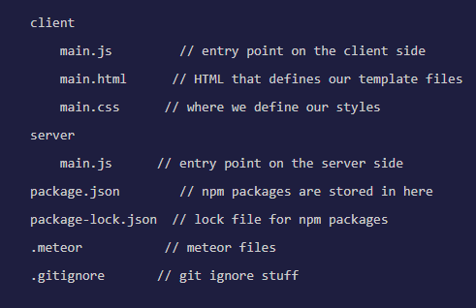
Setup
Install chocolatey from https://chocolatey.org/ and run the following command
choco install meteor
To create the app, open terminal and type
meteor create simple-todos
A folder will be created like this:
To run the created app, run:
cd simple-todos
meteor
Lastly, add npm packages for react using:
meteor npm install –save react react-dom

Slide 9
Imports directory
The imports folder will house all our components
Meteor loads all the code in application for us, but the code in ‘imports’ and ‘exports’ needs to be conditionally loaded
For Our application, we create a file in folder ui inside imports as: imports/ui/App.js, which will create tasks and represents whole app
Another file is created as imports/ui/Task.js, which represents a single todo item

Slide 10
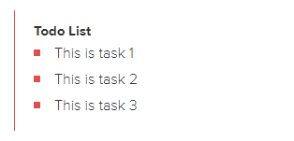
Import/ui/App.js
Import/ui/Task.js
import React, { Component } from 'react';
import Task from './Task.js';
export default class App extends Component {
getTasks() {
return [
{ _id: 1, text: 'This is task 1' },
{ _id: 2, text: 'This is task 2' },
{ _id: 3, text: 'This is task 3' },
];
}
renderTasks() {
return this.getTasks().map((task) => (
<Task key={task._id} task={task} />
)); }
render() {
return (
<div className="container">
<header>
<h1>Todo List</h1>
</header>
<ul>
{this.renderTasks()}
</ul>
</div>
); }}
import React, { Component } from 'react';
export default class Task extends Component {
render() {
return (
<li>{this.props.task.text}</li>
);
}
}
In browser, the app will look like:

Slide 11
‘Collection’ in Meteor
Collections can be accessed from both server and client, making it easy to view logic
Less server side code is needed to access data from client
Server side collections: they create collections within MongoDB and an interface that is used to communicate with server
Client side Collection: there is no direct connection to MongoDB database. Instead a collection is a client side cache of database . Minimongo library in memory is implementation of MongoDB API

Slide 12
A directory ‘api’ is created in imports folder, which will store API related files
App fetches tasks from Task collection
Imports/api/tasks.js
Imports/ui/App.js
import { Mongo } from 'meteor/mongo';
export const Tasks = new Mongo.Collection('tasks');
import React, { Component } from 'react';
import { withTracker } from 'meteor/react-meteor-data';
import { Tasks } from '../api/tasks.js';
import Task from './Task.js';
// App component - represents the whole app
class App extends Component {
renderTasks() {
return this.props.tasks.map((task) => (
<Task key={task._id} task={task} />
));
}
...some lines skipped...
);
}
}
export default withTracker(() => {
return {
tasks: Tasks.find({}).fetch(),
};
})(App);
To use data from collection inside React component , Meteor package ‘react-meteor-data’ is used:
meteor add react-meteor-data
Inserting Tasks from server side database console:
db.tasks.insert({ text: "Hello world!", createdAt: new Date() });

Slide 13
FORMS
Forms are used to add tasks to the list
The imports/ui/App.js file is updated as:
Handling submit method which adds tasks in collection
import React, { Component } from 'react';
import ReactDOM from 'react-dom';
import { withTracker } from 'meteor/react-meteor-data';
import { Tasks } from '../api/tasks.js';
// App component - represents the whole app
class App extends Component {
handleSubmit(event) {
event.preventDefault();
// Find the text field via the React ref
const text = ReactDOM.findDOMNode(this.refs.textInput).value.trim();
Tasks.insert({
text,
createdAt: new Date(), // current time
});
// Clear form
ReactDOM.findDOMNode(this.refs.textInput).value = '';
}
renderTasks() {
return this.props.tasks.map((task) => (
<Task key={task._id} task={task} />
<div className="container">
<header>
<h1>Todo List</h1>
<form className="new-task" onSubmit={this.handleSubmit.bind(this)} >
<input
type="text"
ref="textInput"
placeholder="Type to add new tasks"
/>
</form>
</header>
<ul>

Slide 14
Updating Task Components to add features
Imports/ui/Task.js
A check box and a delete button is added, with event handlers for updating or removing tasks from collection
render() {
// Give tasks a different className when they are checked off,
// so that we can style them nicely in CSS
const taskClassName = this.props.task.checked ? 'checked' : '';
return (
<li className={taskClassName}>
<button className="delete" onClick={this.deleteThisTask.bind(this)}>
&times;
</button>
<input
type="checkbox"
readOnly
checked={!!this.props.task.checked}
onClick={this.toggleChecked.bind(this)}
/>
<span className="text">{this.props.task.text}</span>
</li>
);
}
}
import React, { Component } from 'react';
import { Tasks } from '../api/tasks.js';
// Task component - represents a single todo item
export default class Task extends Component {
toggleChecked() {
// Set the checked property to the opposite of its current value
Tasks.update(this.props.task._id, {
$set: { checked: !this.props.task.checked },
});
}
deleteThisTask() {
Tasks.remove(this.props.task._id);
}

Slide 15
Adding user accounts
Meteor comes with ‘account system’ and a drop-in login user interface
Currently, this UI component uses Blaze, meteor’s default UI engine. In future React specific component might be used
To add login dropdown, add relevant packages:
meteor add accounts-ui accounts-password
The drop down displays only a password field
To use Blaze UI component, we need to wrap in React Component. A new component is created ‘AccountsUiWrapper’

Slide 16
Imports/ui/AccountsUIWrapper.js
Including component in App.js
import React, { Component } from 'react';
import ReactDOM from 'react-dom';
import { Template } from 'meteor/templating';
import { Blaze } from 'meteor/blaze';
export default class AccountsUIWrapper extends Component {
componentDidMount() {
// Use Meteor Blaze to render login buttons
this.view = Blaze.render(Template.loginButtons,
ReactDOM.findDOMNode(this.refs.container));
}
componentWillUnmount() {
// Clean up Blaze view
Blaze.remove(this.view);
}
render() {
// Just render a placeholder container that will be filled in
return <span ref="container" />;
}
}
import { Tasks } from '../api/tasks.js';
import Task from './Task.js';
import AccountsUIWrapper from './AccountsUIWrapper.js';
// App component - represents the whole app
class App extends Component {
...some lines skipped...
Hide Completed Tasks
</label>
<AccountsUIWrapper />
<form className="new-task" onSubmit={this.handleSubmit.bind(this)} >
<input
type="text"

Slide 17
Adding User related functionality
Only display new task input field to logged in users
Show which user created task
Imports/ui/App.js
Update insert to save username and owner
Imports/ui/App.js
Wrap new task form to only show when logged in
import React, { Component } from 'react';
import ReactDOM from 'react-dom';
import { Meteor } from 'meteor/meteor';
import { withTracker } from 'meteor/react-meteor-data';
import { Tasks } from '../api/tasks.js';
...some lines skipped...
Tasks.insert({
text,
createdAt: new Date(), // current time
owner: Meteor.userId(), // _id of logged in user
username: Meteor.user().username, // username of logged in user
});
// Clear form
…
<AccountsUIWrapper />
{ this.props.currentUser ?
<form className="new-task" onSubmit={this.handleSubmit.bind(this)} >
<input
type="text"
ref="textInput"
placeholder="Type to add new tasks"
/>
</form> : ''
}
</header>
<ul

Slide 18
Display Username field on each Task
onClick={this.toggleChecked.bind(this)}
/>
<span className="text">
<strong>{this.props.task.username}</strong>: {this.props.task.text}
</span>
</li>
);
}

Slide 19
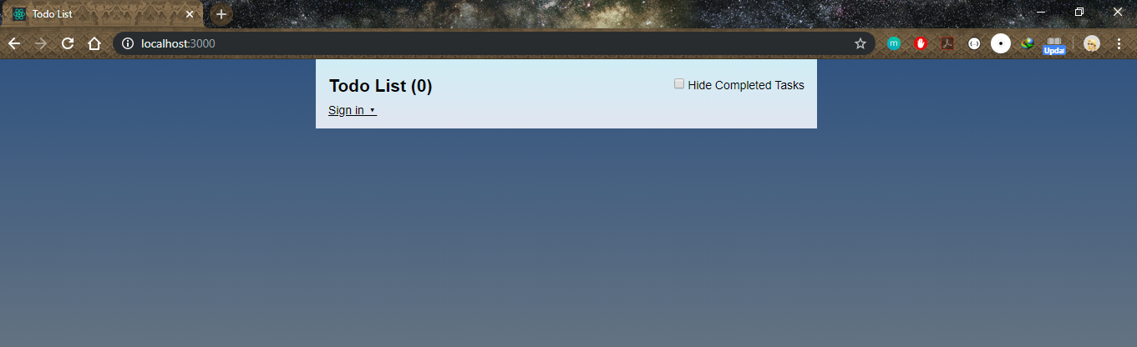
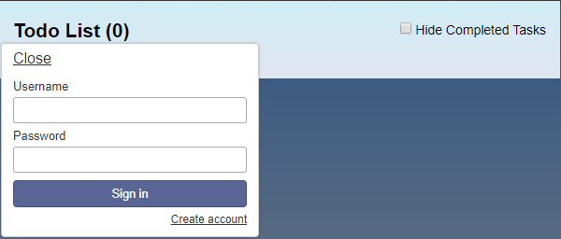
Final Output

Slide 20
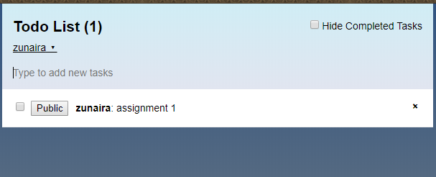
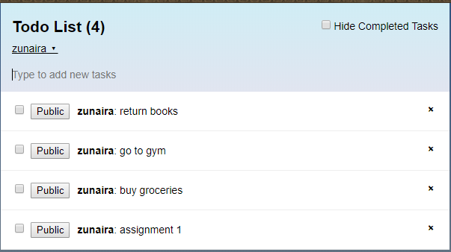

Slide 21
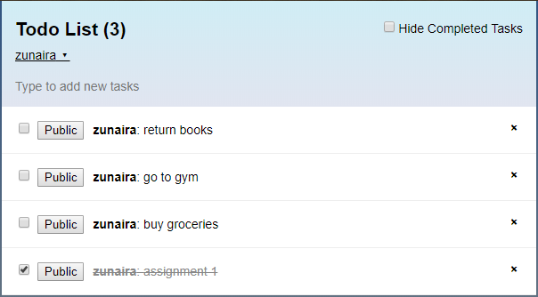
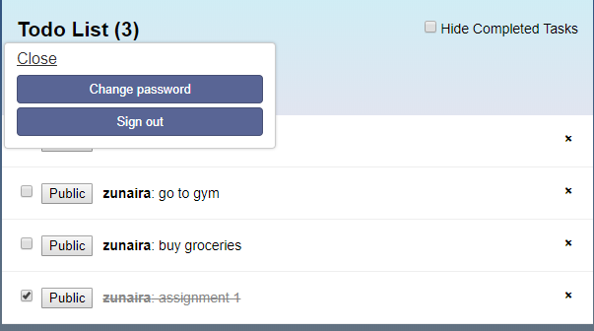

Slide 22
