Slide 1

Meteor.js
Todo App
Group Members:
Ayesha Munir
Eiman Fatima
Zunaira Salam

Slide 2
Meteor
A free open source JavaScript web framework written using Node.js
Allows rapid prototyping and produces cross platform code
Officially released in April 2012
Collection of tools to write fast and secure web apps
Uses MongoDB and distributed data protocol

Slide 3
Features of todo app
Add Tasks
Progress Bar
Group Categories
View Tasks of a particular category
Color Coding
Task Alerts notification
Assign Deadlines
Mark tasks as public or private
Show your public tasks to other users
Delete Tasks
Filter pending tasks
Mark tasks as done

Slide 4
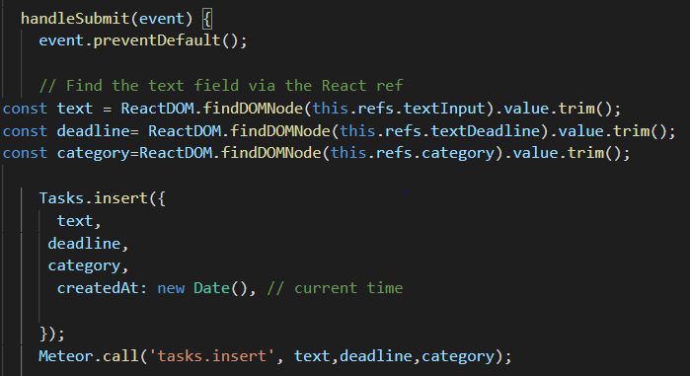
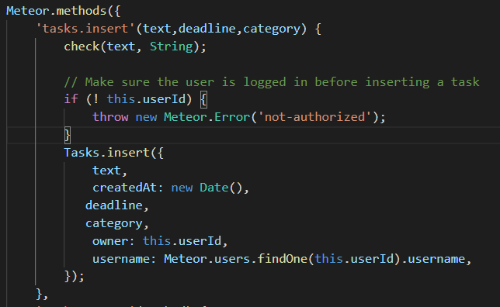
Adding Tasks

Slide 5
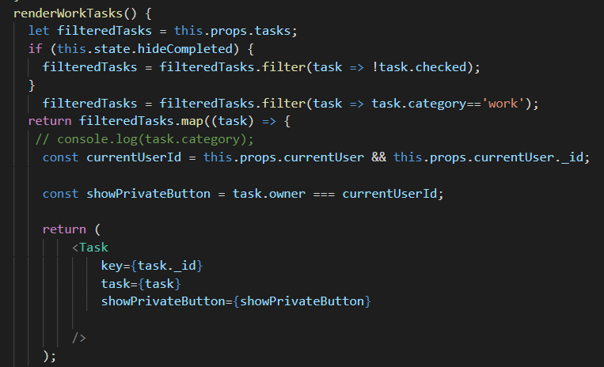
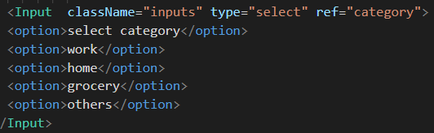
Categories
We have implemented four categories:
Home
Work
Grocery
Others

Slide 6
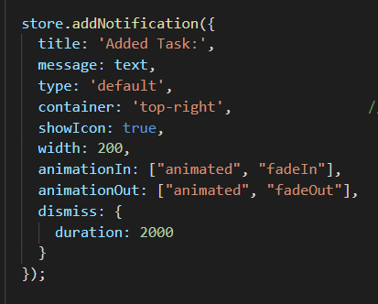

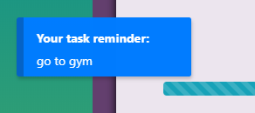
Tasks Alert Notification
For notification we have used ‘React-notification-Component’

Slide 7
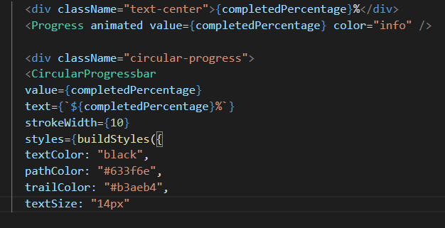
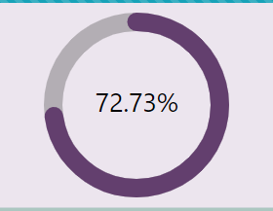
Progress Bar
We are using two types of Progress Bars:
Horizontal Progress Bar
Circular Progress Bar

Slide 8
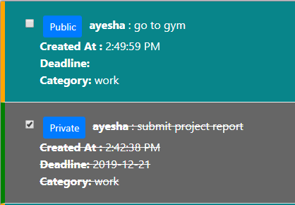

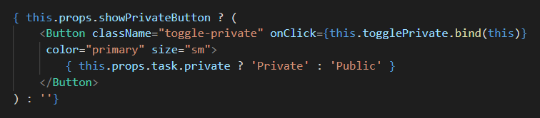
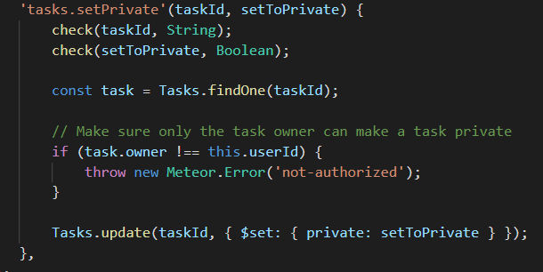
PUBLIC/PRIVATE Tasks

Slide 9
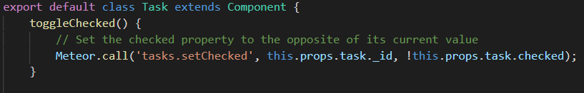
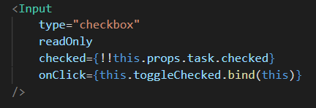
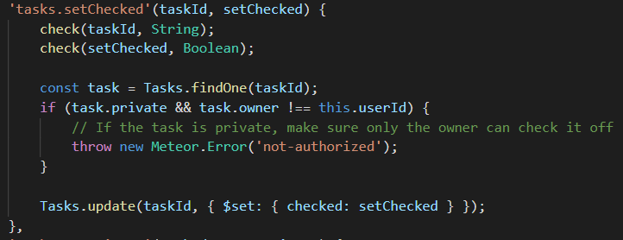

Mark Tasks As Done

Slide 10
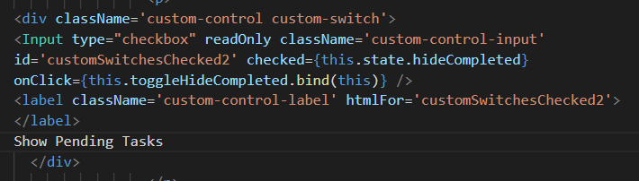
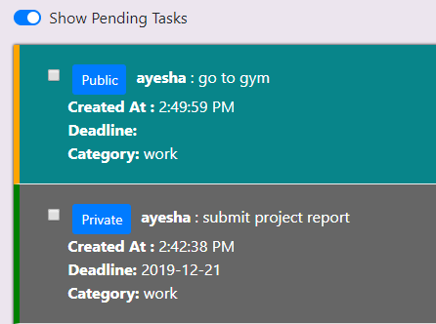
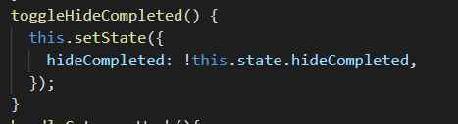
Filter Pending Tasks

Slide 11
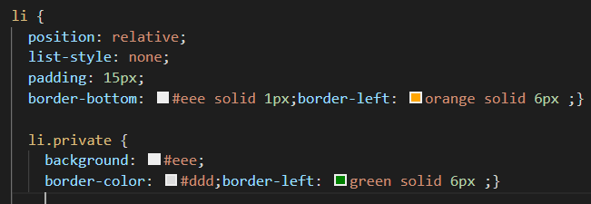
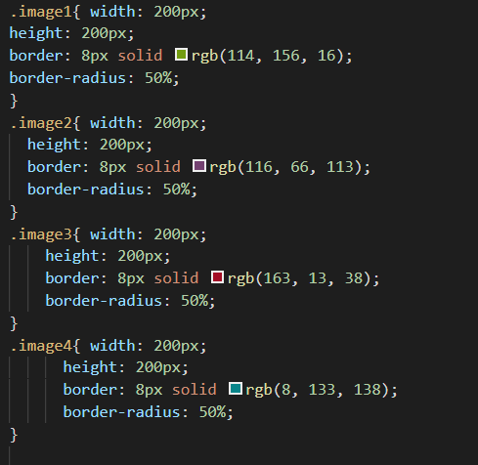
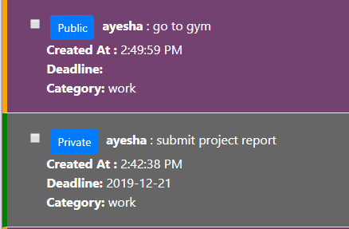
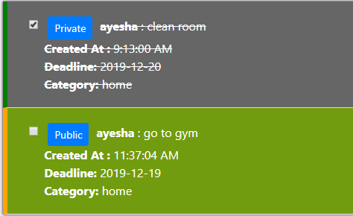
Color Coding
Two types of color coding have been used:
According to categories
According to public and private tasks

Slide 12
Output

Slide 13
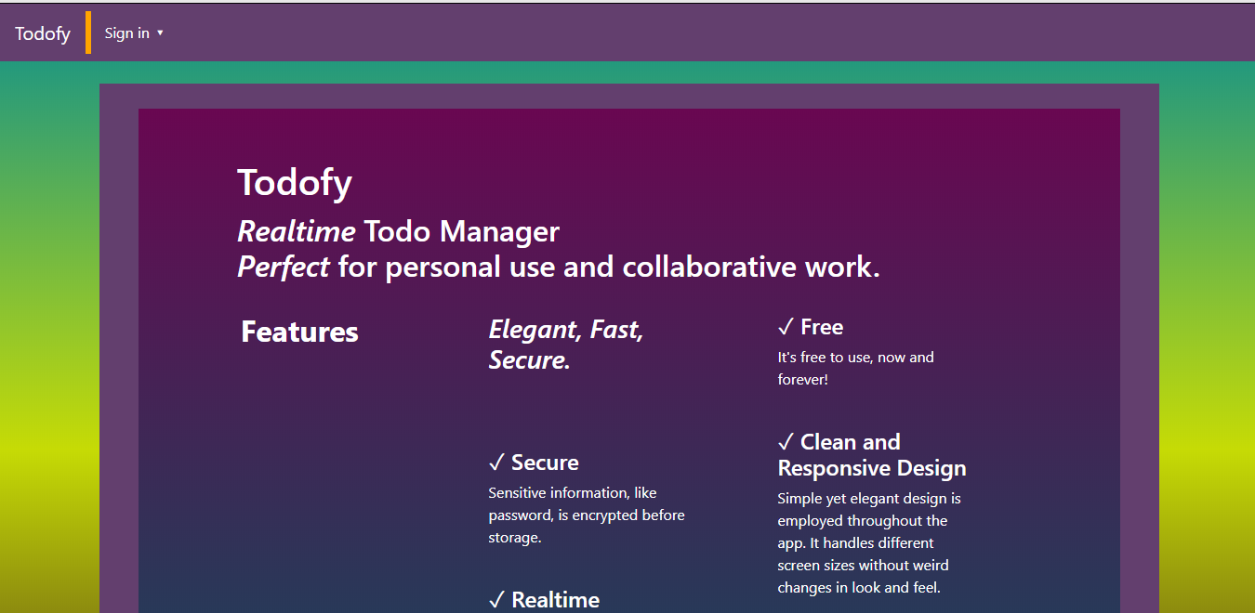

Slide 14
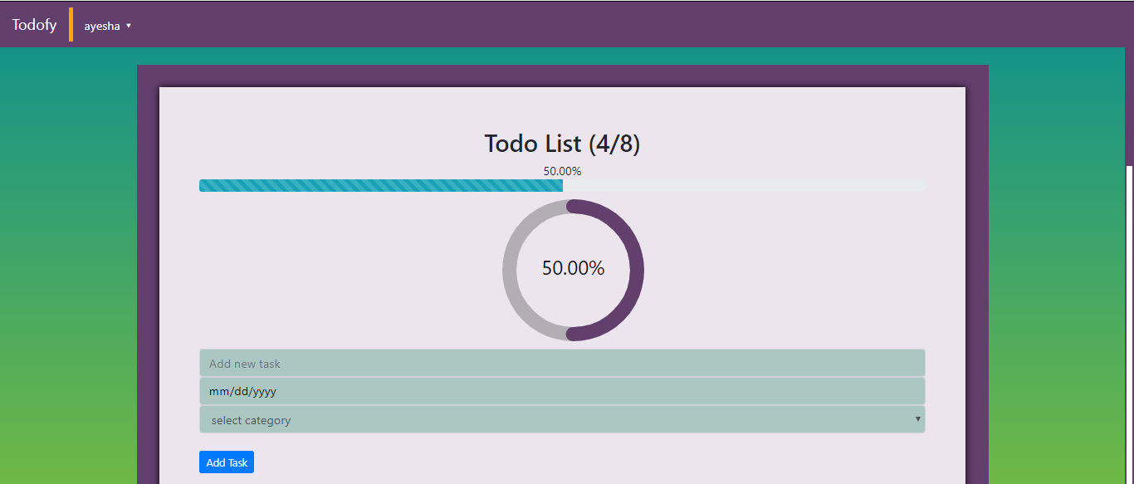

Slide 15
