Slide 1
TRANSFORMERS FOR NLP
BookWise
NLP powered Subject Matter Expert
By - Naman Khurpia and Ayesha Humaera

Slide 2
We all read books and sometimes we just forget a piece of information in the book that is hard to recall
Problem Statement Scenario-
PS – you cannot use google

Slide 3
We are trying to create a Subject Matter Expert on the book

Slide 4
Steps-
Write a script to convert pdf book into text.
Create a model from scratch and train the book on it. (BERT, Roberta, Deberta, Alberta) - SQUAD
Predict answers on the basis of context.
Write a script to find a valid context in the book with respect to the question.
Finally, predict the results.

Slide 5
Demonstration

Slide 6
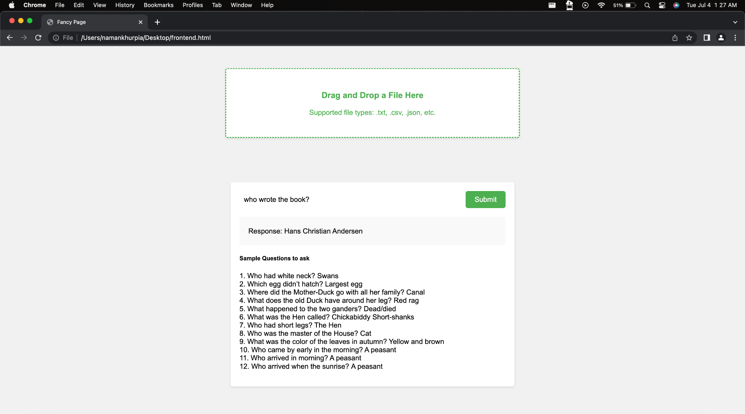
Screenshots

Slide 7
How does it work
Implemented a Question-answering pipeline which uses a question, valid context to give our the most probable response
Created a script for converting pdf to text file
Make sure the QA pipeline is trained on multiple question-answering dataset like SQUAD.
Getting the correct context via sentence transformers
We calculated the sentences similarities using cosine similarities and ranked the sentences and the top 5 choices were merged to form the context.
Once we have our context, we pass it to the QA pipeline and it gives us the result.

Slide 8
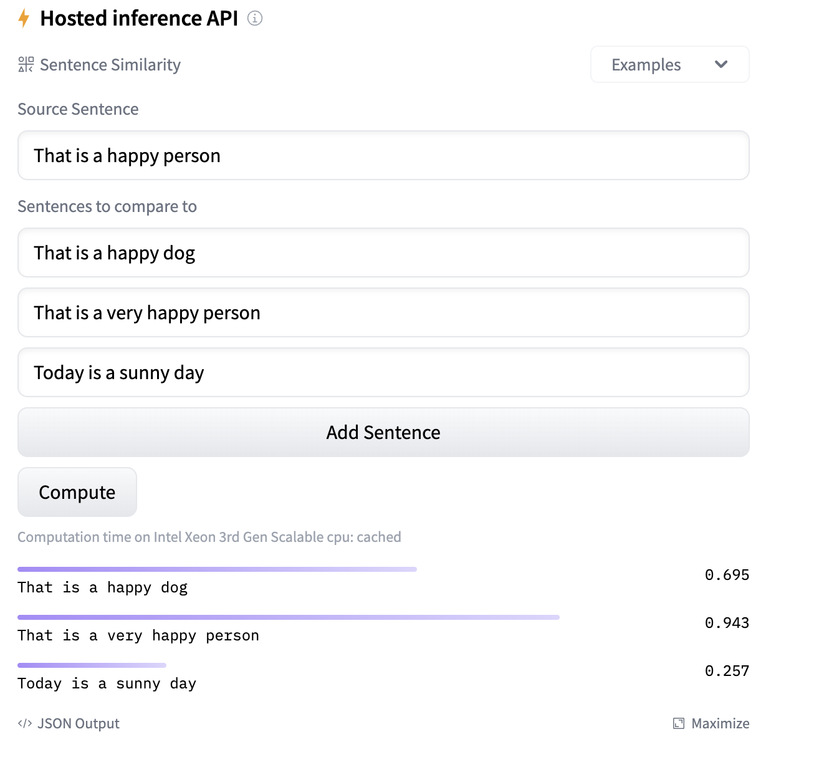
How does Sentence Similarity work?

Slide 9
How does Sentence Similarity work?

Slide 10
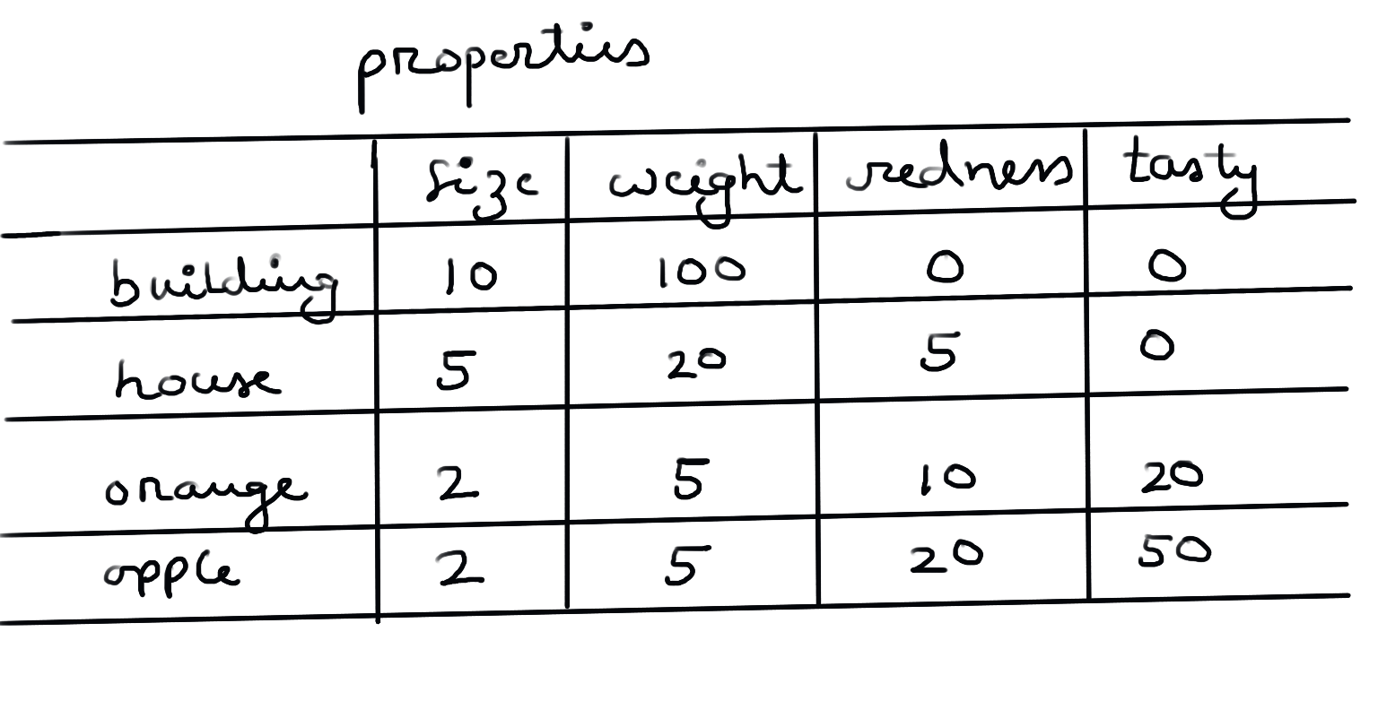
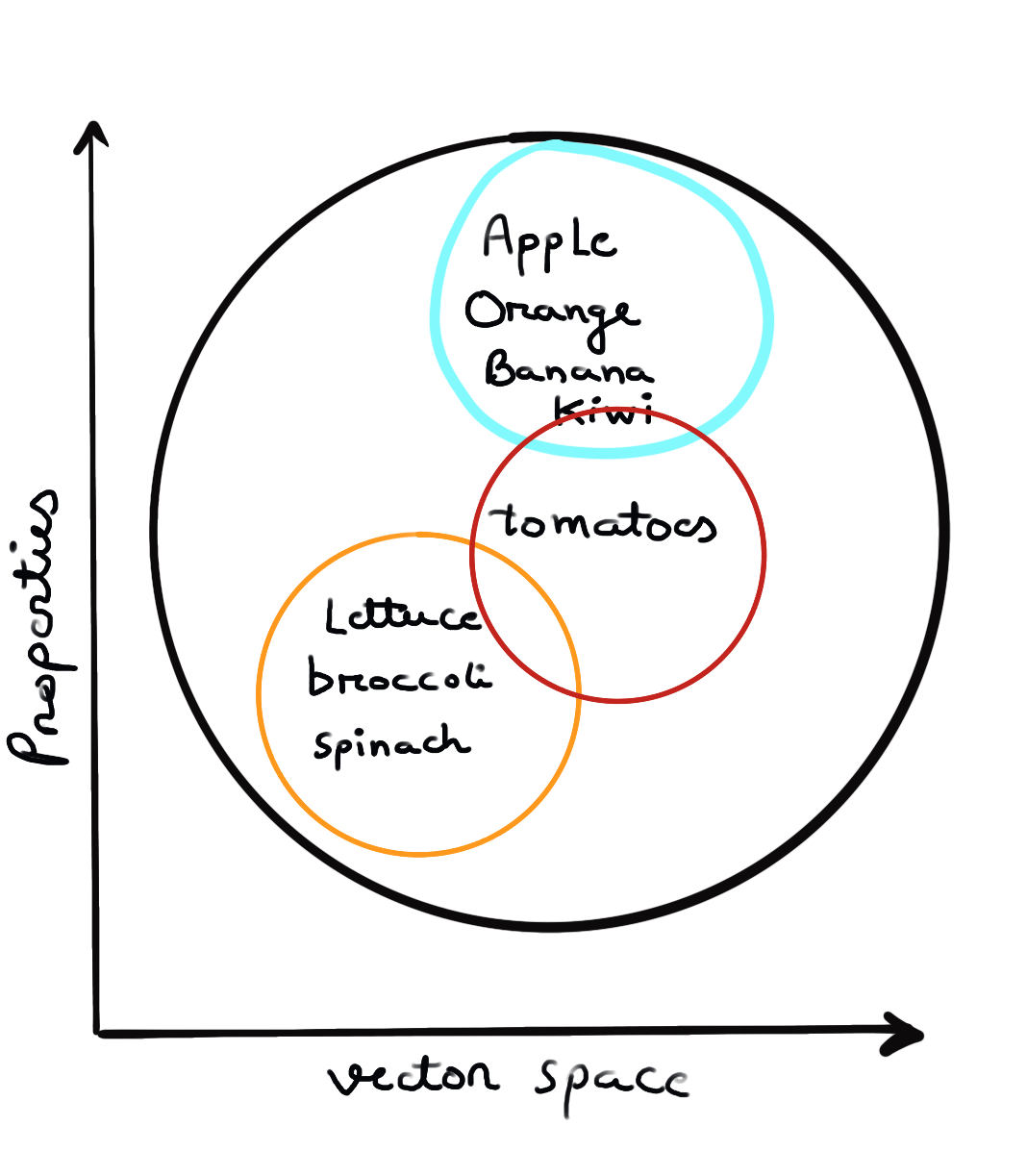
How does Sentence Similarity work?

Slide 11
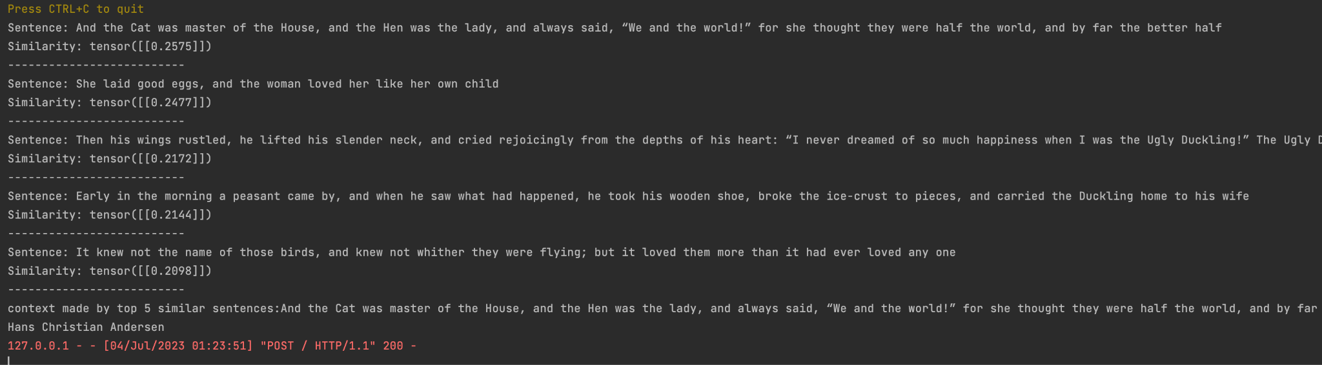
How does Sentence Similarity work?

Slide 12
Limitations
Reduced Model Capacity
Limited Contextual Understanding
Limited Pre-training Data
Lack of Fine-Grained Representations
Limited Support for Languages

Slide 13
Why is producing a large number of tokens in output a problem in BERT models?
In BERT models, there is a limit on the maximum number of tokens that can be input and output due to computational constraints. This limitation arises from two main factors:
Memory Constraints
Positional Encoding
To mitigate these constraints, BERT models typically use a fixed maximum sequence length for both input and output. The maximum sequence length determines the maximum number of tokens that can be processed or generated by the model.

Slide 14
Conclusion
Through this project, we have harnessed the capabilities of AI as a subject matter expert, contributing to the promotion, interest generation, sales, and recognition of the book. By bridging the gap between readers and valuable book content, this project highlights the transformative potential of NLP and AI in the domain of literature and publishing, offering new avenues for engaging and captivating readers in the digital age.

Slide 15
Thank you

