Slide 1
Automobile Sales Predictions
Presented by: AYESHA SINGH

Slide 2
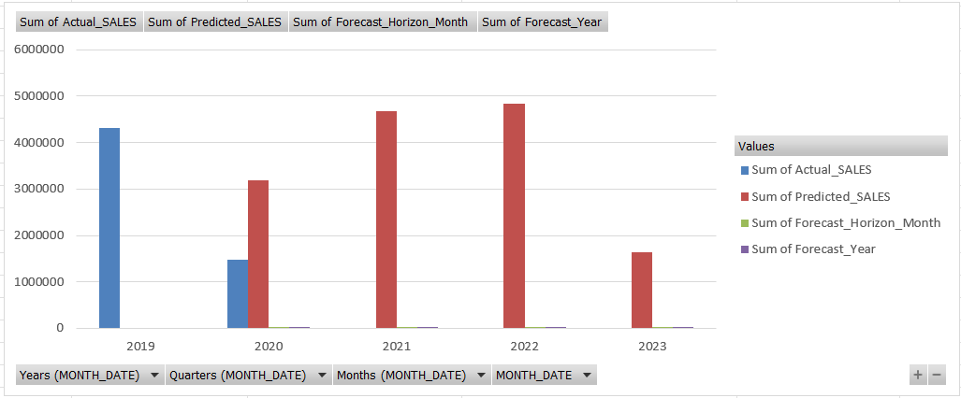
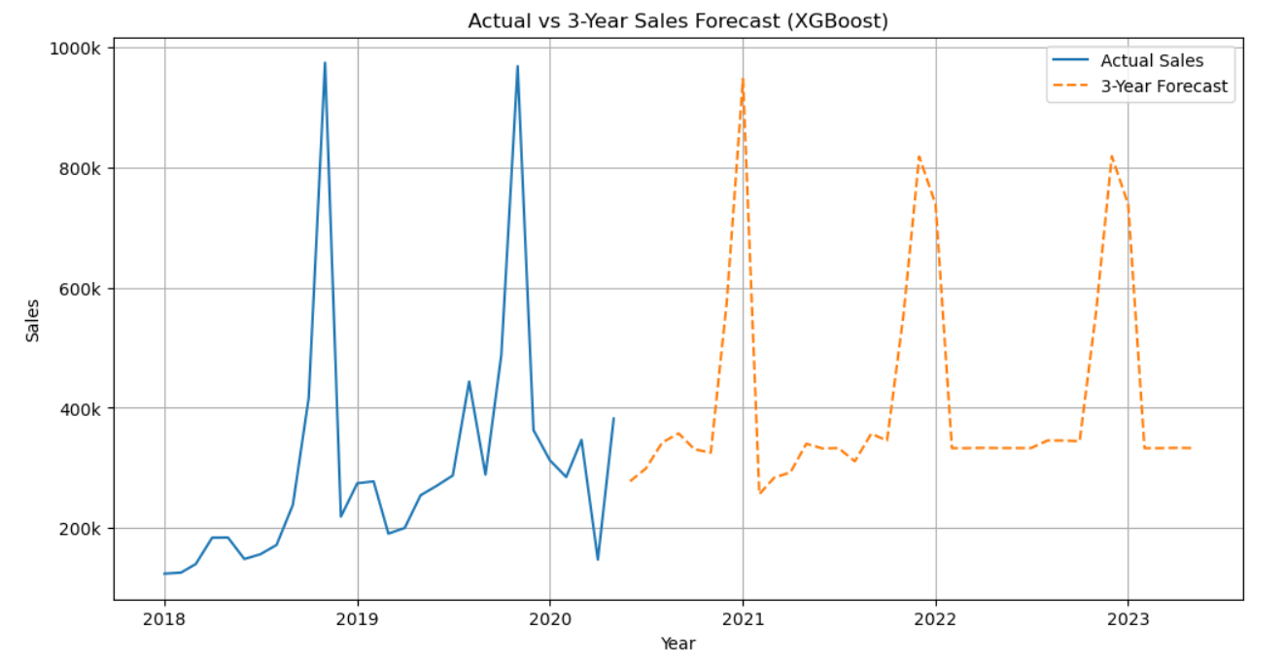
A. Forecasting Future Car Sales Using Machine Learning to Support Inventory and Demand Planning.
Insights:
.Sales show strong seasonality, with sharp annual peaks repeating each year, indicating predictable demand cycles.
.Baseline sales remain relatively stable, but spike months contribute a large share of total revenue.
.The forecast maintains historical patterns, suggesting the model has learned trend + seasonality well.
Recommendations:
.Increase inventory and production ahead of peak months to avoid stockouts and lost sales.
.Use off-peak periods for promotions or maintenance to smooth demand and optimize capacity.
.Plan cash flow and logistics around forecasted peak seasons for better cost control and service levels.

Slide 3
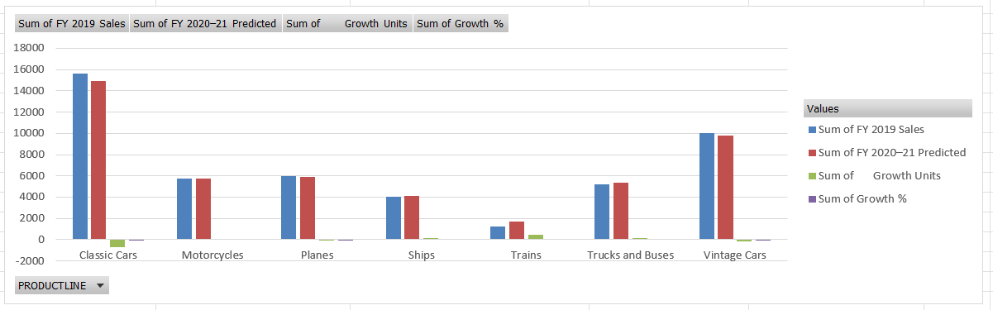
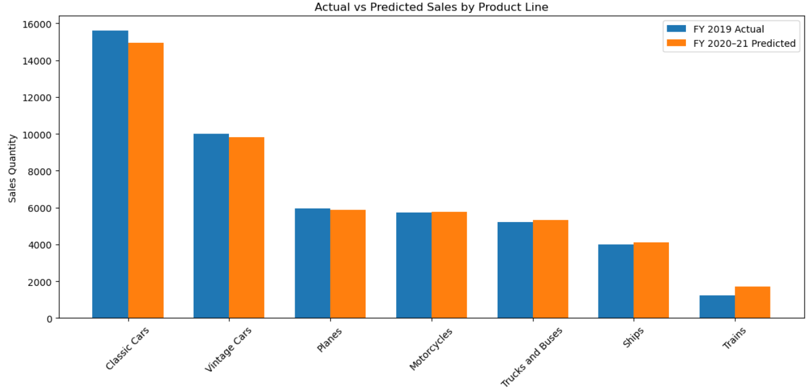
B. Time-Based Sales Forecasting and Growth Analysis by Product Line
Insights:
.Classic Cars & Vintage Cars remain the top revenue drivers, but predictions show a slight decline, indicating possible market saturation.
.Motorcycles, Trucks & Buses, and Ships show stable to moderate growth, suggesting steady demand and growth potential.
.Trains show a noticeable increase from a low base, indicating an emerging or niche opportunity.
.Planes remain mostly flat, implying a mature and stable segment with limited short-term growth.
Recommendations:
.Optimize inventory for Classic & Vintage Cars to avoid overstocking due to predicted slowdown.
.Invest marketing and expansion efforts in Motorcycles, Trucks & Buses, and Ships to capture growing demand.
.Explore growth strategies for Trains (new markets, promotions) as it shows upward momentum.
.Maintain current strategy for Planes, focusing on cost efficiency rather than aggressive expansion.

Slide 4
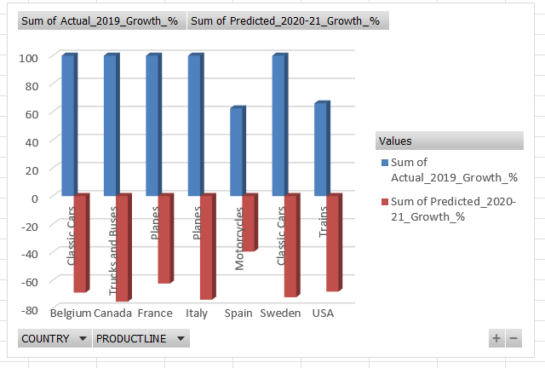
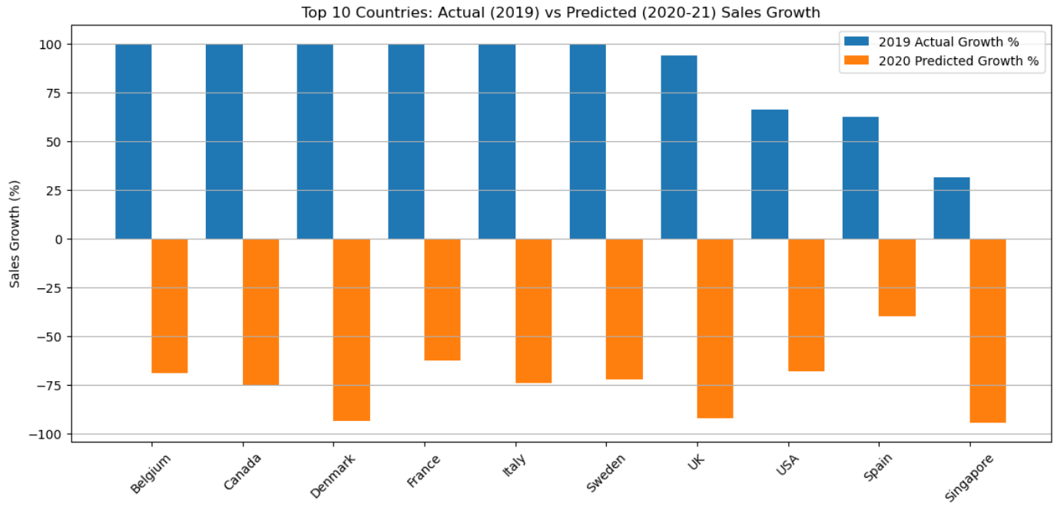
C. Country-wise Actual (2019) vs Predicted(2020-21) Growth Analysis
Insights :
.Most top countries had strong sales growth in 2019.
Sales are expected to decline in 2020–21 across all countries.
Denmark, UK, and Singapore show the highest risk due to sharp decline.
Spain and USA appear more stable with lower decline.
High past growth does not guarantee future growth.
Forecast shows that market conditions can change quickly.
Business Recommendations:
. Reallocate investments toward relatively stable markets like Spain and USA.
. Apply risk mitigation strategies (cost control, demand planning) in high-decline countries such as Denmark, UK, and Singapore.
. Optimize inventory and supply chain to avoid overstocking in declining markets.
. Use predictive analytics regularly, not only historical sales, for strategic decisions.
. Focus on high-performing product lines within each country to offset overall decline.
. Diversify market presence instead of relying heavily on previously high-growth countries.

Slide 5
CONCLUSION:
Machine learning successfully forecasted future car sales using historical data.
Sales show strong seasonality, with clear peak and low-demand periods every year.
Forecast indicates a slowdown in overall growth after 2019 across countries and products.
Some product lines and countries remain more stable and resilient than others.
Historical high growth does not always guarantee future performance.
The model helps identify risk areas and growth opportunities in advance.
These insights support better inventory planning, demand forecasting, and business decisions

