Slide 1



Objective:
Mutability and Immutability

Slide 2


Objectives/Outcomes
After this lab student will able to understand:
Introduction to Mutability and Immutability
Mutable and Immutable Data Types in a programming language
Characteristics of Mutable Objects
Characteristics of Immutable Objects
Implications of Mutability
Implications of Immutability
Applying Mutability and Immutability in Code
Making Informed Design Choices
Role of Mutability in Debugging
Real World Application of Mutability and Immutability

Slide 3

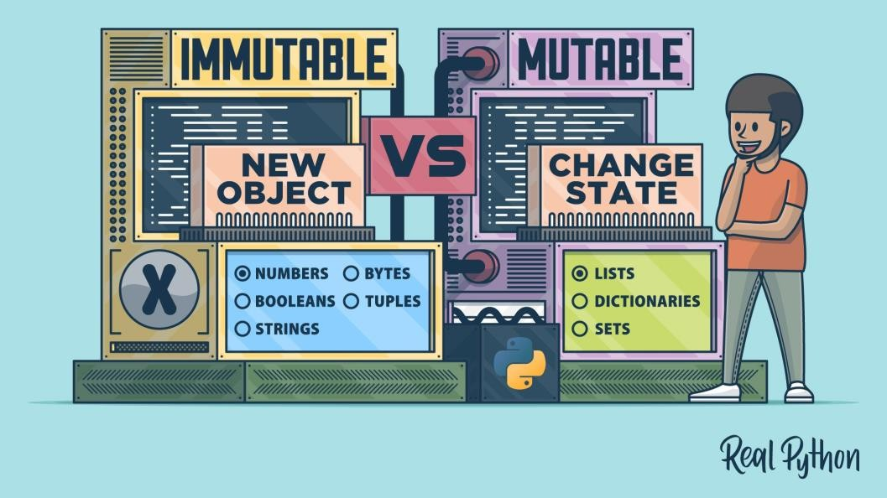
Slide 1: Introduction
C# or any other programming language deals with mutability and immutability of
objects.
Mutability: Ability to change (modify) an object after its creation.
Immutability: Inability to change (modify) an
object after its creation.

Slide 4
Mutable and immutable are English words that mean "can change" and "cannot change" respectively.
The meaning of these words is the same in C# programming language; that means the mutable types are those whose data members can be changed after the instance is created but Immutable types are those whose data members can not be changed after the instance is created.
When we change the value of mutable objects, value is changed in same memory. But in immutable type, the new memory is created and the modified value is stored in new memory.

Slide 5

Mutability:
Mutable Objects:
  Lists, Dictionaries, Sets, etc.
Characteristics:
  Can be modified after creation.
  Changes affect the original object.
Immutability
Immutable Objects:
  Integers, Floats, Strings, etc.
Characteristics:
  Cannot be modified after creation.
  Any operation creates a new object.

Slide 6
String in C#
Strings are immutable, which means we are creating new memory every time instead of working on existing memory.
So, whenever we are modifying a value of the existing string, i.e., we are creating a new object which refers to that modified string and the old one becomes unreferenced.
Hence, if we are modifying the existing string continuously, then numbers of the unreferenced object will be increased and it will wait for the garbage collector to free the unreferenced object and our application performance will be decreased..
Stringbuilder in C#
StringBuilder is a mutable type, that means we are using the same memory location and keep on appending/modifying the stuff to one instance.
It will not create any further instances hence it will not decrease the performance of the application.

Slide 7
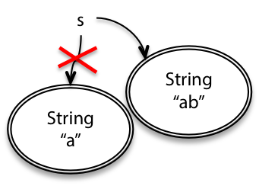

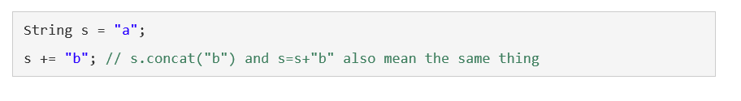
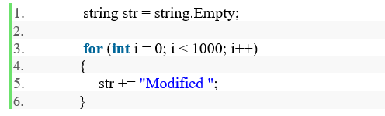
In the code given above, string str will update 1000 times inside the loop and every time it will create new instance so all old values will be collected by garbage collector after some time.
It is not a good approach for this solution so, it’s better to go for mutable type. So in C#, we have StringBuilder which is a mutable type. We have some advantages of immutable classes like immutable objects are simpler to construct, test, and use. immutable objects are always thread-safe and etc.

Slide 8
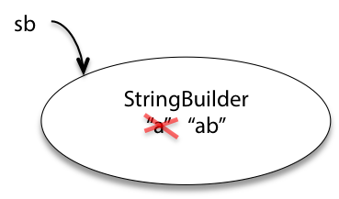
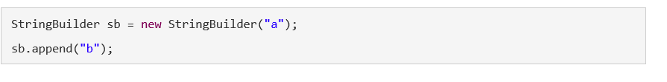
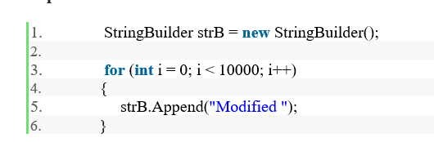
In the code given above, It has the huge impact of allocated memory because it will not create instance each time.

Slide 9
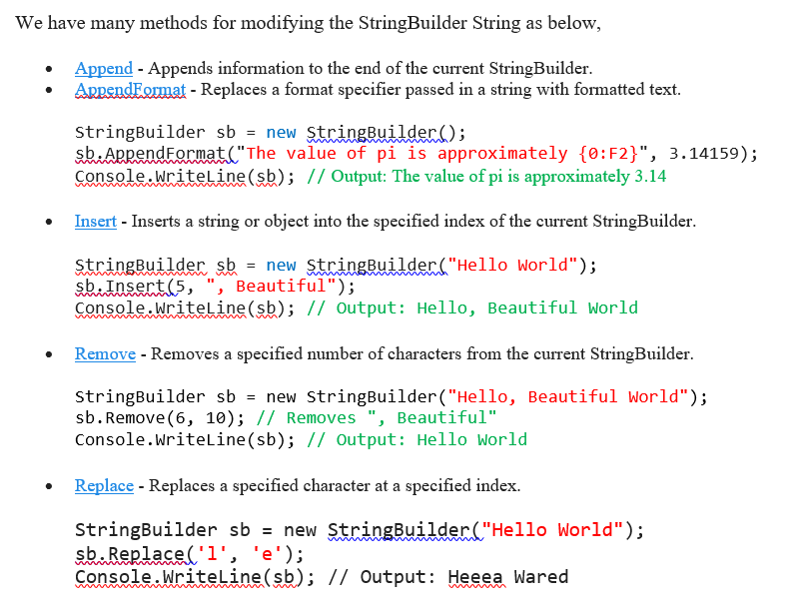

Slide 10
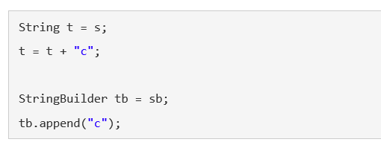
This shows that changing t had no effect on s, but changing tb affected sb too — possibly to the surprise of the programmer. That’s the essence of the problem we’re going to look at in this reading.
Since we have the immutable String class already, why do we even need the mutable StringBuilder in programming? A common use for it is to concatenate a large number of strings together. Consider this code:

Slide 11
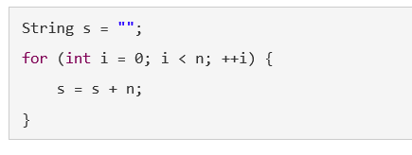
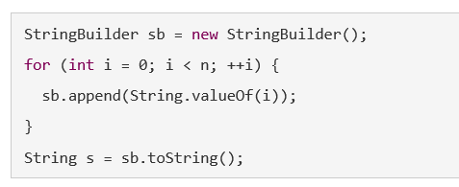
Using immutable strings, this makes a lot of temporary copies — the first number of the string ("0") is actually copied n times in the course of building up the final string, the second number is copied n-1 times, and so on. It actually costs O(n2) time just to do all that copying, even though we only concatenated n elements.
StringBuilder is designed to minimize this copying. It uses a simple but clever internal data structure to avoid doing any copying at all until the very end, when you ask for the final String with a toString() call:

Slide 12
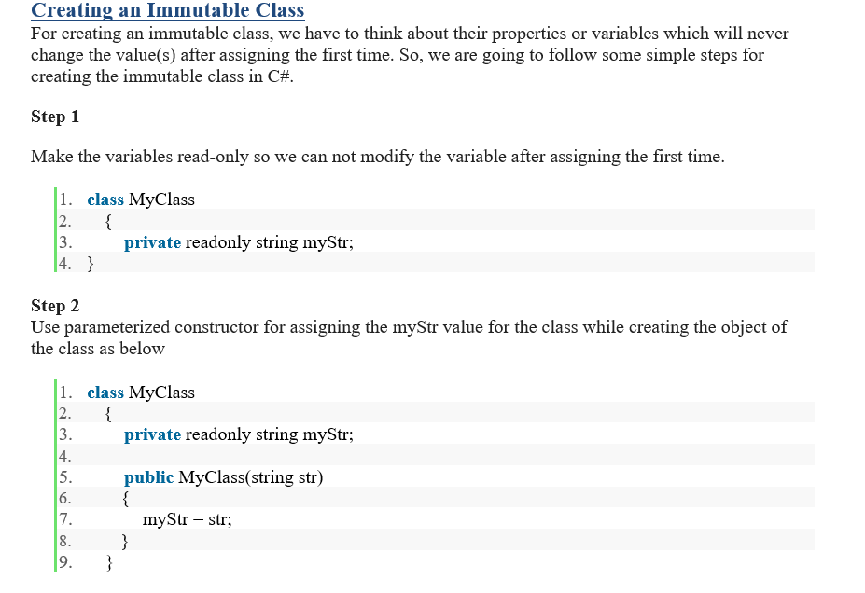
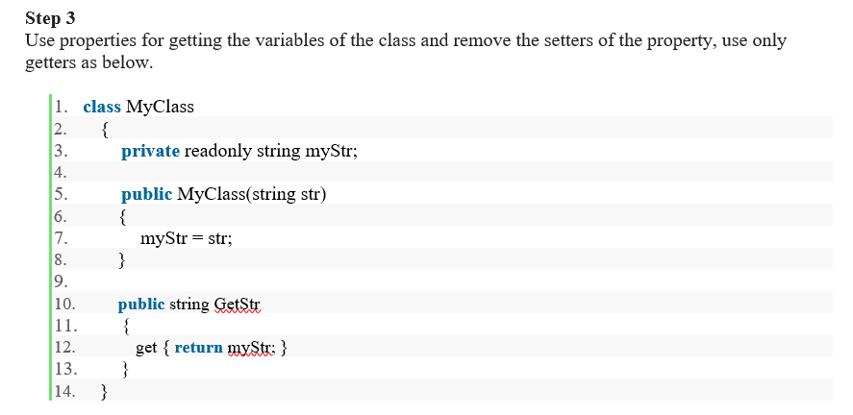

Slide 13


Mutability:
Mutability refers to the ability of an object or data structure to be modified after it has
been created.
Advantages:
Flexibility: , which can be useful in many scenarios
Mutable objects can be changed on the fly
where data needs to be updated.
In-place operations: on the object
Some operations can be performed directly
without creating
a new one, which can be
more memory efficient
.
Disadvantages:
Unintended side effects: and is
If an object is passed around different parts of a program
modified in one place, it can lead to unexpected behavior in other parts that reference the same object.
Concurrency issues: environments
Mutable objects can lead to problems in multi-threaded
where .
multiple threads might try to modify the same object simultaneously

Slide 14

Immutability
Immutability means that once an object or data structure is created, it cannot be
changed. If you want to modify it, you have to create a new object.
Advantages:
Predictability: to use in a program because you know
Immutable objects are safer
they
won't change unexpectedly.
Concurrency: Immutable objects are inherently thread-safe, making them a good choice
in multi-threaded environments.
Functional programming: Immutability is a core principle of functional programming, leading to cleaner and more maintainable code.
Disadvantages:
  Overhead: Every time you want to make a change, a new object needs to be created, which can lead to increased memory usage and potential performance overhead.
  Complexity: Some operations that are straightforward with mutable objects can become more complex with immutable ones.

Slide 15

Examples:
Strings in Java: In Java, strings are immutable. This means that when you modify a string, a new string object is created, and the original remains unchanged.
Lists in Python: Lists in Python are mutable. This means you can change their content, add or remove elements without creating a new list.

Slide 16

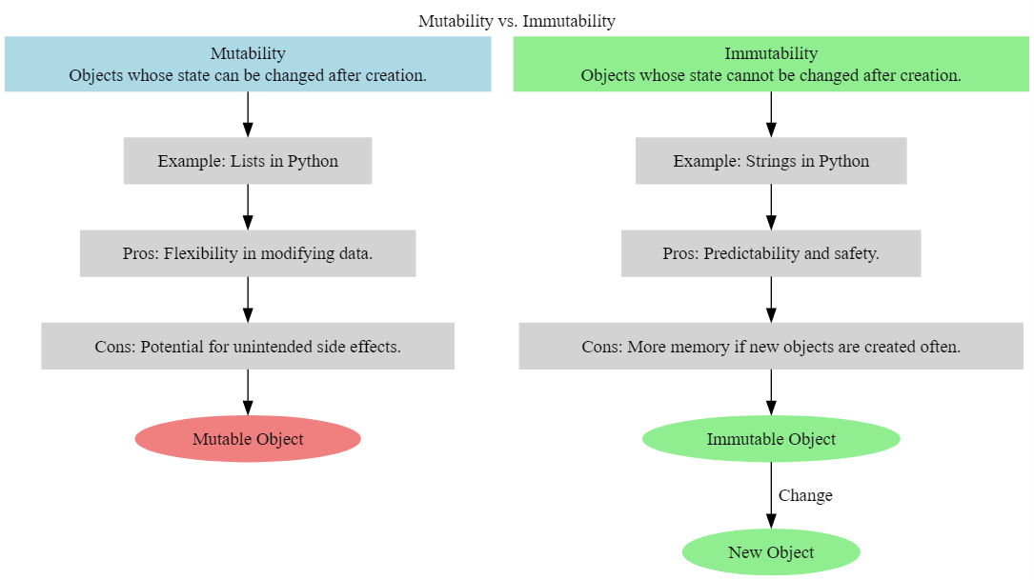

Slide 17

Consider the nature of your data and the operations you need to perform.
Use mutability when flexibility is crucial.
Use immutability when predictability and safety are top priorities.
Conclusion:
  Understanding mutability and immutability is fundamental in Python, C#, and in any programming language.
  Both concepts have their place depending on the specific requirements of your code.

Slide 18


Slide 19


Immutable String Modification
Strings in Python are immutable, meaning once they are created, they cannot be changed.
s = "hello"
# Trying to change the first character will result in an error
# s[0] = "H" # Type Error: 'str' object does not support item assignment
Mutable List Modification
Lists in Python are mutable, meaning their contents can be changed after creation.
lst = [1, 2, 3]
lst[0] = 100 # Changes the first element to 100 print(lst) # [100, 2, 3]
Immutable Tuple Modification
Tuples are immutable, so their contents cannot be changed after creation. t = (1, 2, 3)
# Trying to change an element will result in an error # t[0] = 100
# Type Error: 'tuple' object does not support item assignment
Mutable List Inside Immutable Tuple
Tuples can contain mutable objects, but the tuple's reference to the object cannot change.
lst = [1, 2, 3]
t = (lst,) lst.append(4)
print(t) # ([1, 2, 3, 4],)
Immutable Integer Modification
Integers are immutable. When you change an integer variable's
value, you're actually pointing it to a new integer object.
x = 10
y = x x += 5
print(y) # 10 (y remains unchanged)
Mutable Default Argument Danger
Using mutable default arguments in functions can lead to unexpected behavior.
def add_to_list(value, lst=[]): lst.append(value)
return lst
print(add_to_list(1)) # [1]
print(add_to_list(2)) # [1, 2] (Not just [2]!)

Slide 20

Immutable Set Modification
Sets are mutable, but their elements must be
immutable. s = {1, 2, 3}
s.add(4)
print(s) # {1, 2, 3, 4}
Dictionary Key Immutability Dictionary keys must be immutable. d = {}
# d[[1, 2, 3]] = "value" # TypeError: unshushable type: 'list' d[(1, 2, 3)] = "value" # Tuples are immutable and can be used as keys
Immutable Variable Reassignment Reassigning an immutable variable creates a new object in memory.
x = "hello" print(id(x)) x = "world"
print(id(x)) # Different memory address
Copying Mutable Objects
Copying mutable objects can lead to unintended side
effects.
original = [1, 2, 3] copy = original copy.append(4)
print(original) # [1, 2, 3, 4] (original list is also modified!)

Slide 21


Conclusion
Understanding mutability and immutability is like choosing between a whiteboard and a printed list when managing your shopping. Each has its place depending on the flexibility and predictability you need in your shopping experience.

Slide 22


MICROSOFT VISUAL STUDIO CODE

Slide 23


You have to design at-least 5-10 Mutable and immutable variables in your application with explanation of mutability or immutability.

Slide 24



