Slide 1

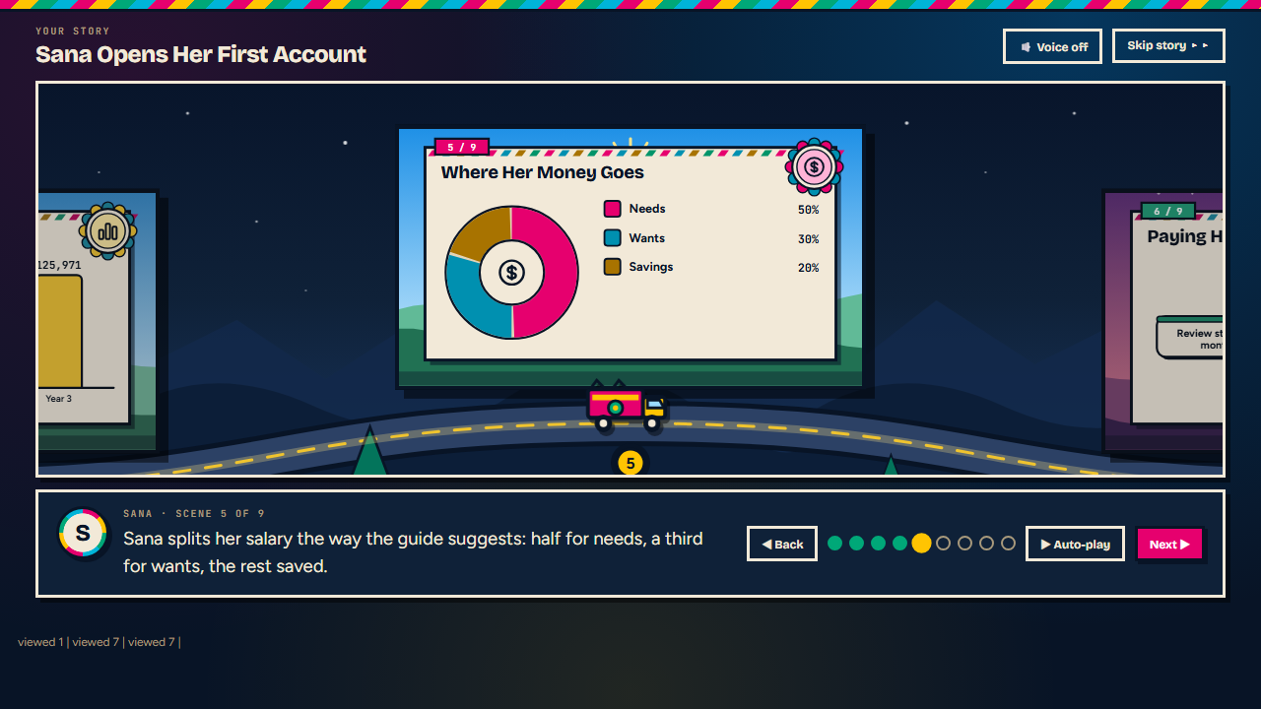
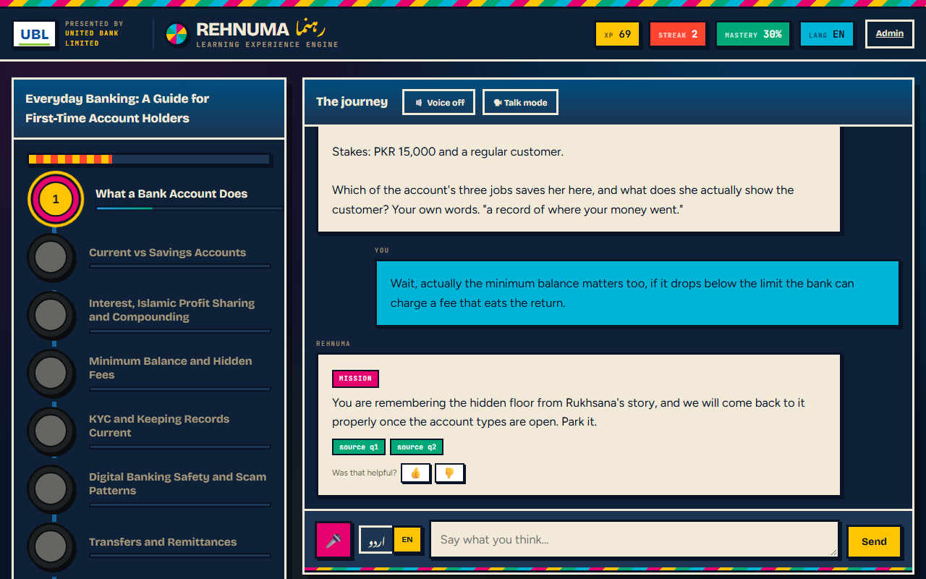
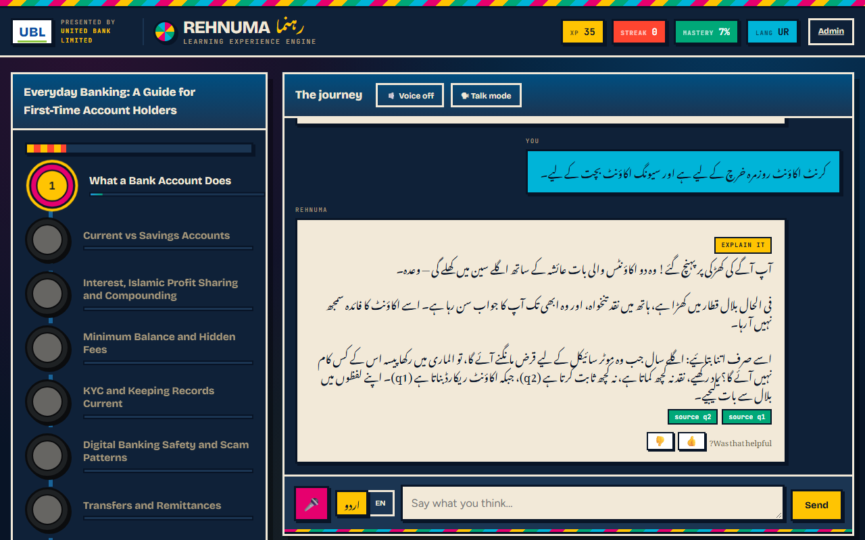
REHNUMA · رہنما
PROBLEM & EXPERIENCE
Nobody ever learned from a quiz
Rehnuma turns any document into a story you watch, then a game you play, in English or Urdu. It works out what you understand from how you talk — and never gives a test.
1
Bring anything
PDF, Word, PowerPoint, spreadsheet, web link or pasted text.
2
Watch the story
An illustrated road-trip through the ideas, drawn from your own document.
3
Play it
Missions and choices with consequences. Speak or type, Urdu or English.
4
See progress
Concepts unlock as understanding grows. No pass mark anywhere.
Above: a story scene, its chart drawn from the document’s own figures. Below: the game, and the same in Urdu, right-to-left.
Ayesha Faheem · Digital HR & AI Manager assignment · prototype for assessment, not an official UBL service
1 / 5
Notes:
PROBLEM AND EXPERIENCE. Every training tool ends with a quiz, and a quiz tells you what someone remembered this morning, not whether they can use it. Rehnuma never tests anyone. You give it any material; it turns it into an illustrated story you watch, then a game you play, in English or Urdu, typed or spoken. From how you talk it works out what you understand and changes how it teaches. The pictures on this slide are the real running system.

Slide 2
ARCHITECTURE
One service, three trust boundaries
It reads a document, proves every idea against it, tells the story, then holds the conversation — and keeps its own arithmetic for what you have understood.
Rehnuma service · FastAPI on one free Render instance
Learner’s browser
Story stage: SVG scenes, zooming camera
Voice in and out, Urdu and English
Streamed replies
Language, level, limits: live
Ingest
PDF · Word · PPT · CSV · link · text
Ground
every quote checked against the upload
Concept map
ideas with their source lines
Claude API
Opus 5: the tutor (judgement)
Sonnet 5: the storyteller (speed)
Offline engine if it fails
upload +
SSE stream
cached prompt +
structured JSON
Story
written while the map is read
Tutor loop
streamed, prompt-cached
Learner model
mastery, unlocks, adaptation: code
Why one service
No second deployment, no cross-origin set-up: fewer things to fail in front of a panel, and a one-step deploy to a free tier.
Any content
Tested on eight kinds: biology, safety policy, code, history, Urdu, CSV, .docx, .pptx.
SQLite: the verified map (never the upload), learners, turns, settings, logs
Admin control room
28 settings, live, no redeploy · analytics · exports · logs
Ayesha Faheem · Digital HR & AI Manager assignment · prototype for assessment, not an official UBL service
2 / 5
Notes:
ARCHITECTURE. One small Python service on Render's free tier serves both the pages and the API, so there is no second deployment and no cross-origin set-up. A document goes in; every quote in the concept map is checked against it before anything is saved; the story is written in the background while the learner reads the map; then the tutor loop runs, streaming each reply. The learner model, meaning mastery, unlocks and the adaptation decisions, is arithmetic in our own code, not the model's memory. The admin changes settings live; they apply on the next reply.

Slide 3
SECURITY, PRIVACY & RELIABILITY
Built for a bank
Two risks matter most: a tutor that invents a fact about a financial product, and a document written to hijack it. Everything else is layered around those.
Invented facts
Every quote is checked against the upload before it is saved; a claim must cite a real quote; off-source questions are refused and flagged. 100% verbatim across all eight content types tested.
Hijacking through content
Uploaded text and chat messages are marked as data and stripped of our prompt delimiters. The story can only name a layout or icon: it never supplies markup.
Attacks on the server
Web fetch refuses private networks and redirects to them; file type, size and archive limits; strict CSP with no inline or third-party script; frame, sniff and referrer protection.
Access and abuse
Admin cookie is signed and expires; no default password in production; per-client rate limits that hold behind the proxy (verified live); a daily spend cap.
Bad settings
Every setting is validated on the server. A rate limit of −5 used to break every request.
Privacy
The upload itself is never stored, only the verified map. No personal data: a first-name label and a random ID. Retention purge, and the learner or an admin can erase a session.
Reliable & observable
Structured logs, /health, an in-app log viewer, per-turn latency and tokens. If the AI service fails, the offline engine takes over and says so.
Ayesha Faheem · Digital HR & AI Manager assignment · prototype for assessment, not an official UBL service
3 / 5
Notes:
SECURITY AND PRIVACY. Two risks matter most for a bank: a tutor that invents a fact about a product, and a document written to hijack it. For the first, every quote is checked against the upload and every claim must cite one; off-source questions are refused and flagged. For the second, uploaded text and chat messages are marked as data and stripped of our own prompt delimiters, and the story can only name a layout or an icon, never supply markup. Around that: signed expiring admin sessions, no default password in production, per-client rate limits that hold behind the proxy, a daily spend cap, a strict content security policy, validated settings, minimal data and one-click erasure.

Slide 4
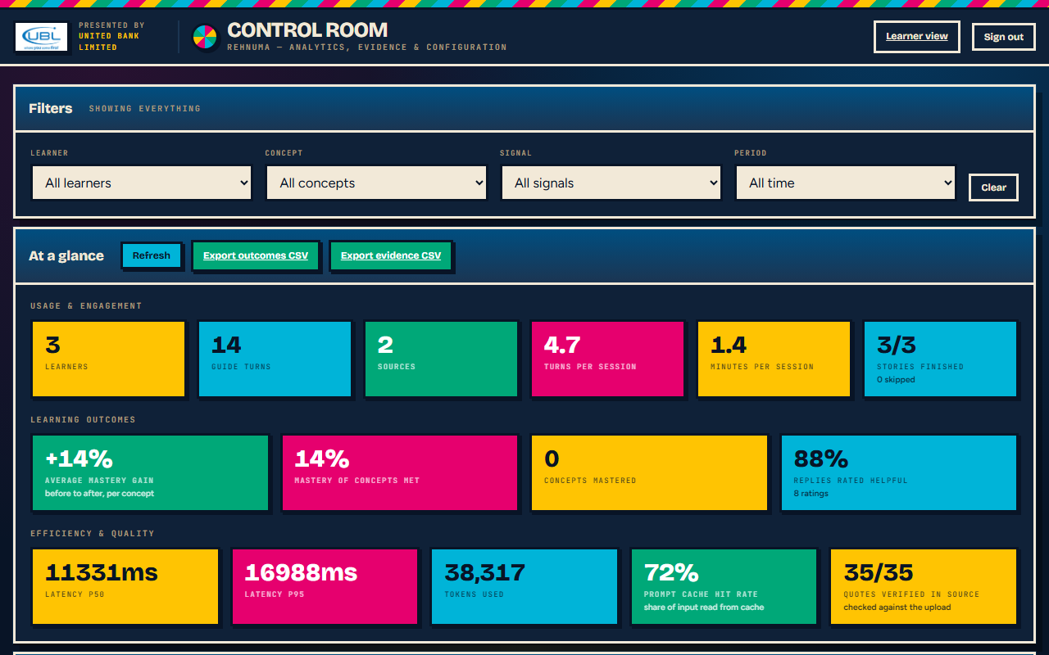
EFFICIENCY, EFFECTIVENESS & MEASUREMENT
Fast, adaptive, measured
Streaming and early preparation keep it quick. Adapting on measured evidence, and recording that evidence, is how it learns — and how we know.
FAST AND FRUGAL · measured on the live deployment
~3 s
to the first words of a reply, streamed
≤ 12 s
for the story, written while the map is read
72%
of prompt input served from cache
+14%
average mastery gain in the demo sessions
ADAPTS FROM MEASURED EVIDENCE, NOT THE MODEL’S MOOD
Difficulty, support, pace and the next concept are set in code from hints, streaks and strong answers.
Six behaviours judged every reply, each kept beside the learner’s own words: applied it · corrected themselves · used the vocabulary · asked ahead · leaned on a hint · remembered.
Language, level or a limit like “five minutes, on a phone” can change mid-session; the next reply obeys.
Hosting is $0 on Render’s free tier. Honest limits: an idle instance takes ~40 s to wake and free storage resets on redeploy.
The control room, read from three real learner sessions (English, Urdu, mixed): +14% mastery gain, 88% of 8 replies rated helpful, 72% cache hits, 35 of 35 quotes verified.
WHAT MANAGEMENT SEES
Mastery gain before → after · engagement and story completion · learning curve · where learners struggle · helpfulness · latency · cache hits. Filter by learner, concept, signal or period; export CSV; print a one-page learner report.
Ayesha Faheem · Digital HR & AI Manager assignment · prototype for assessment, not an official UBL service
4 / 5
Notes:
EFFICIENCY, EFFECTIVENESS AND MEASUREMENT. Fast: replies stream, so the first words arrive in about three seconds instead of after the whole answer; the story is written while the learner reads the concept map, so it is usually ready when they press Start; about seventy percent of the prompt is served from cache; and each job gets the right-sized model, Opus 5 for the tutor's judgement, Sonnet 5 for narration. Effective: adaptation is decided in code from measured evidence, not the model's mood: difficulty, how much support, pace, and which concept comes next. There is no test, so measurement is six behaviours judged in every reply, each stored beside the learner's own words: applied it, corrected themselves, used the vocabulary, asked ahead, leaned on a hint, remembered. Before-and-after mastery per concept is the outcome measure, and the control room shows it with engagement, the learning curve, where learners struggle, helpfulness, latency, cache hits and verified quotes, all filterable and exportable. Honest limits: free storage resets on redeploy and an idle instance takes about forty seconds to wake.

Slide 5
THE BRIEF, POINT BY POINT
How every requirement is covered
The twelve things the brief asks a solution to demonstrate: what covers each one here, and what powers it.
REQUIREMENT
HOW IT IS COVERED HERE
TECHNOLOGY
Any content → experience
Any document becomes a verified concept map, an illustrated story, then a game — not a summary or a quiz.
PyMuPDF · Word/PowerPoint parsing · CSV→prose · SSRF-guarded fetch · Claude structured outputs
Adaptive personalisation
Difficulty, support, pace and next concept come from measured hints and answers; language, level and limits change live.
Deterministic Python learner model · per-learner overrides in SQLite
Gamification & interaction
Story road with a truck, missions, puzzles, boss, choices with consequences, XP, streaks, badges, unlocks.
Vanilla-JS SVG scene engine · state machine in code
Assessment without tests
Six behaviours judged each reply with the learner’s own words as evidence; before/after mastery per concept.
Claude structured JSON (signals + deltas) · clamped arithmetic in Python
Voice + accessibility
Urdu/English speech in and out, code-switching, right-to-left Nastaliq, talk mode, text fallback, reduced motion, ARIA.
Web Speech API · Noto Nastaliq Urdu · CSS/ARIA
Accuracy & grounding
Every quote is checked against the upload; claims cite a real quote; off-source questions are refused and flagged.
grounding.py (normalised match + difflib repair) · citation chips
Highly configurable
28 settings — level, language, tone, mechanics, thresholds, custom rules — change live, validated.
Config service on SQLite · admin control room · pydantic
Dashboards & reports
Learner, engagement, mastery, usage and outcome views; filters; CSV exports; printable learner report.
Chart.js (self-hosted) · FastAPI analytics · CSV/HTML export
Efficient & effective
First words in ~3 s; story prepared while the map is read; 72% prompt-cache hits; measurable mastery gain.
SSE streaming · prompt caching · background threads · Opus/Sonnet right-sizing
Free cloud deployment
One stateless service on a free tier, redeployed from GitHub on every push; scales sideways.
Render free tier · render.yaml · GitHub · uvicorn/FastAPI
Cybersecurity & privacy
Signed admin sessions, rate limits, strict CSP, validated inputs, SSRF guard, upload never stored, erase and retention.
HMAC cookies · slowapi · CSP headers · pydantic · SQLite purge
Reliable & observable
JSON logs, /health, in-app event log, per-turn latency and tokens; offline engine takes over if the AI service fails.
Python logging · events table · /health · automatic fallback engine
Ayesha Faheem · Digital HR & AI Manager assignment · prototype for assessment, not an official UBL service
5 / 5
Notes:
HOW THE BRIEF IS COVERED. These are the twelve things the brief says a solution must demonstrate. Each row says what covers it here and which technology does the work. If the panel asks where a requirement is, point to its row and then show it in the running system.

