Slide 1
React Context API
How to Use the React Context API in Your Projects (freecodecamp.org)

Slide 2
State Management
React state management is a process for managing the data that React components need to render themselves.
A common way to manage state is by passing props.
Passing props means sending data from one component to another.

Slide 3
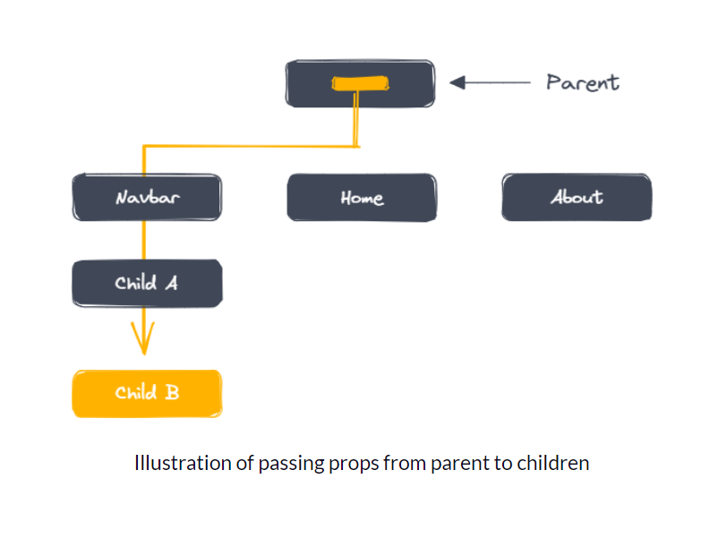
Problem?

Slide 4
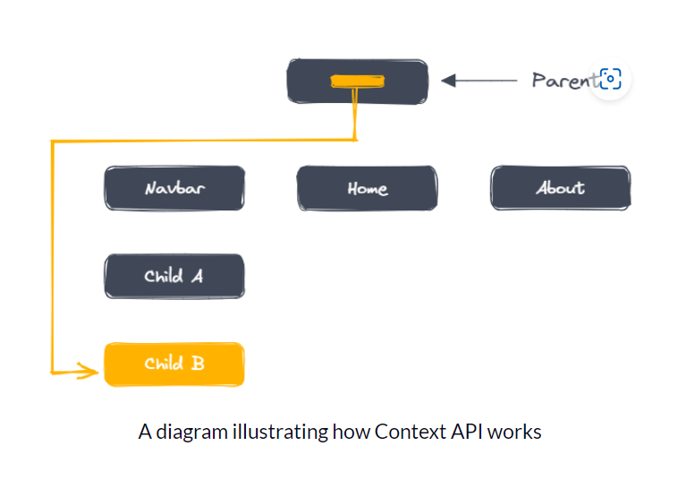
Solution

Slide 5
STEPS
Create
Create a Context Object
Wrap
Wrap Components with a Provider
Consume
Consume the Context

Slide 6
Create a Context Object
Create a context object using the createContext function from the 'react' library.
This context object will hold the data that you want to share across your application.

Slide 7
Wrap Components with a Provider
Need to wrap the components that need access to the shared data with a Provider component.
The Provider component accepts a "value" prop that holds the shared data,

Slide 8
Consume the Context
Now that we've created the provider component, we need to consume the context in other components.
To do this, we use the "useContext" hook from React.

