Slide 1
Site Map and deliverables Ayesha Hoque csc 3750

Slide 2
deliverables
Purpose?
Audience?
Opportunity/problem the site addresses?
Content?
2+ similar sites on the web?

Slide 3

Purpose The purpose of the site is to let people know we could help them navigate different ways one could work on their beauty such as skincare, makeup, and hair care. The site also has a product page which recommends products listed if anyone wishes to buy them. It has a contact page if anyone has questions about the mission and advice we give.

Slide 4

audience
The audience for a makeup, skincare, and hair care website is typically individuals of all backgrounds who are interested in enhancing their personal grooming routines. This audience includes beauty enthusiasts seeking the latest trends, product reviews, and application techniques to elevate their makeup looks.

Slide 5
Opportunity/Problems
The problem this website is addressing is that the people who are on this website need help to enhance their physical appearance.
This website takes the opportunity and addresses ways to improve one's appearance after utilizing the resources on my website.
If there are any other concerns the users could contact me to let me know what else to include

Slide 6
content
A makeup, skincare, and hair care website offers a rich array of content aimed at empowering individuals to enhance their beauty routines and achieve their desired looks. From comprehensive skincare guides covering topics like anti-aging treatments, acne management, and sensitive skin care, to makeup tutorials showcasing the latest trends in eyeshadow techniques, contouring methods, and lip artistry, the website serves as a valuable resource for beauty enthusiasts at every skill level.

Slide 7


Similar Websites
It is a website that gives advice on a topic that the admin gives and recommends products.
beauty advice
product recommendation
about page
Contact page
It is a website that gives advice on DIY and the admin recommends products that will help
DIY
Same Navigation Bar
Product recommendation
Contact page

Slide 8
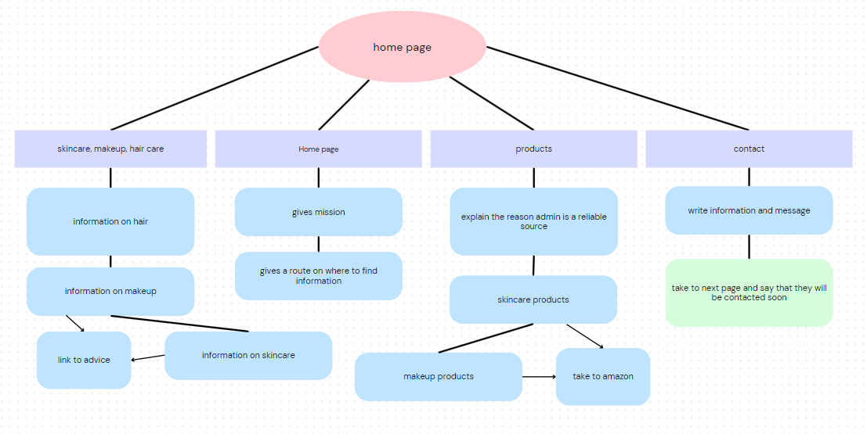
site map

Slide 9
Thank you
Ayesha Hoque
hh7751@wayne.edu

