Slide 1
DATA VISUALIZATION / ASSIGNMENT 01
Earnings in
Urban Sindh
What changes across the earnings distribution and age groups?
PSLM 2019–20 | Variant 3
Registration: FA24-BEDS-019
Student’s Name: Ayesha Iftikhar
ECO346 • DATA VISUALIZATION TECHNIQUES FOR ECONOMISTS

Slide 2
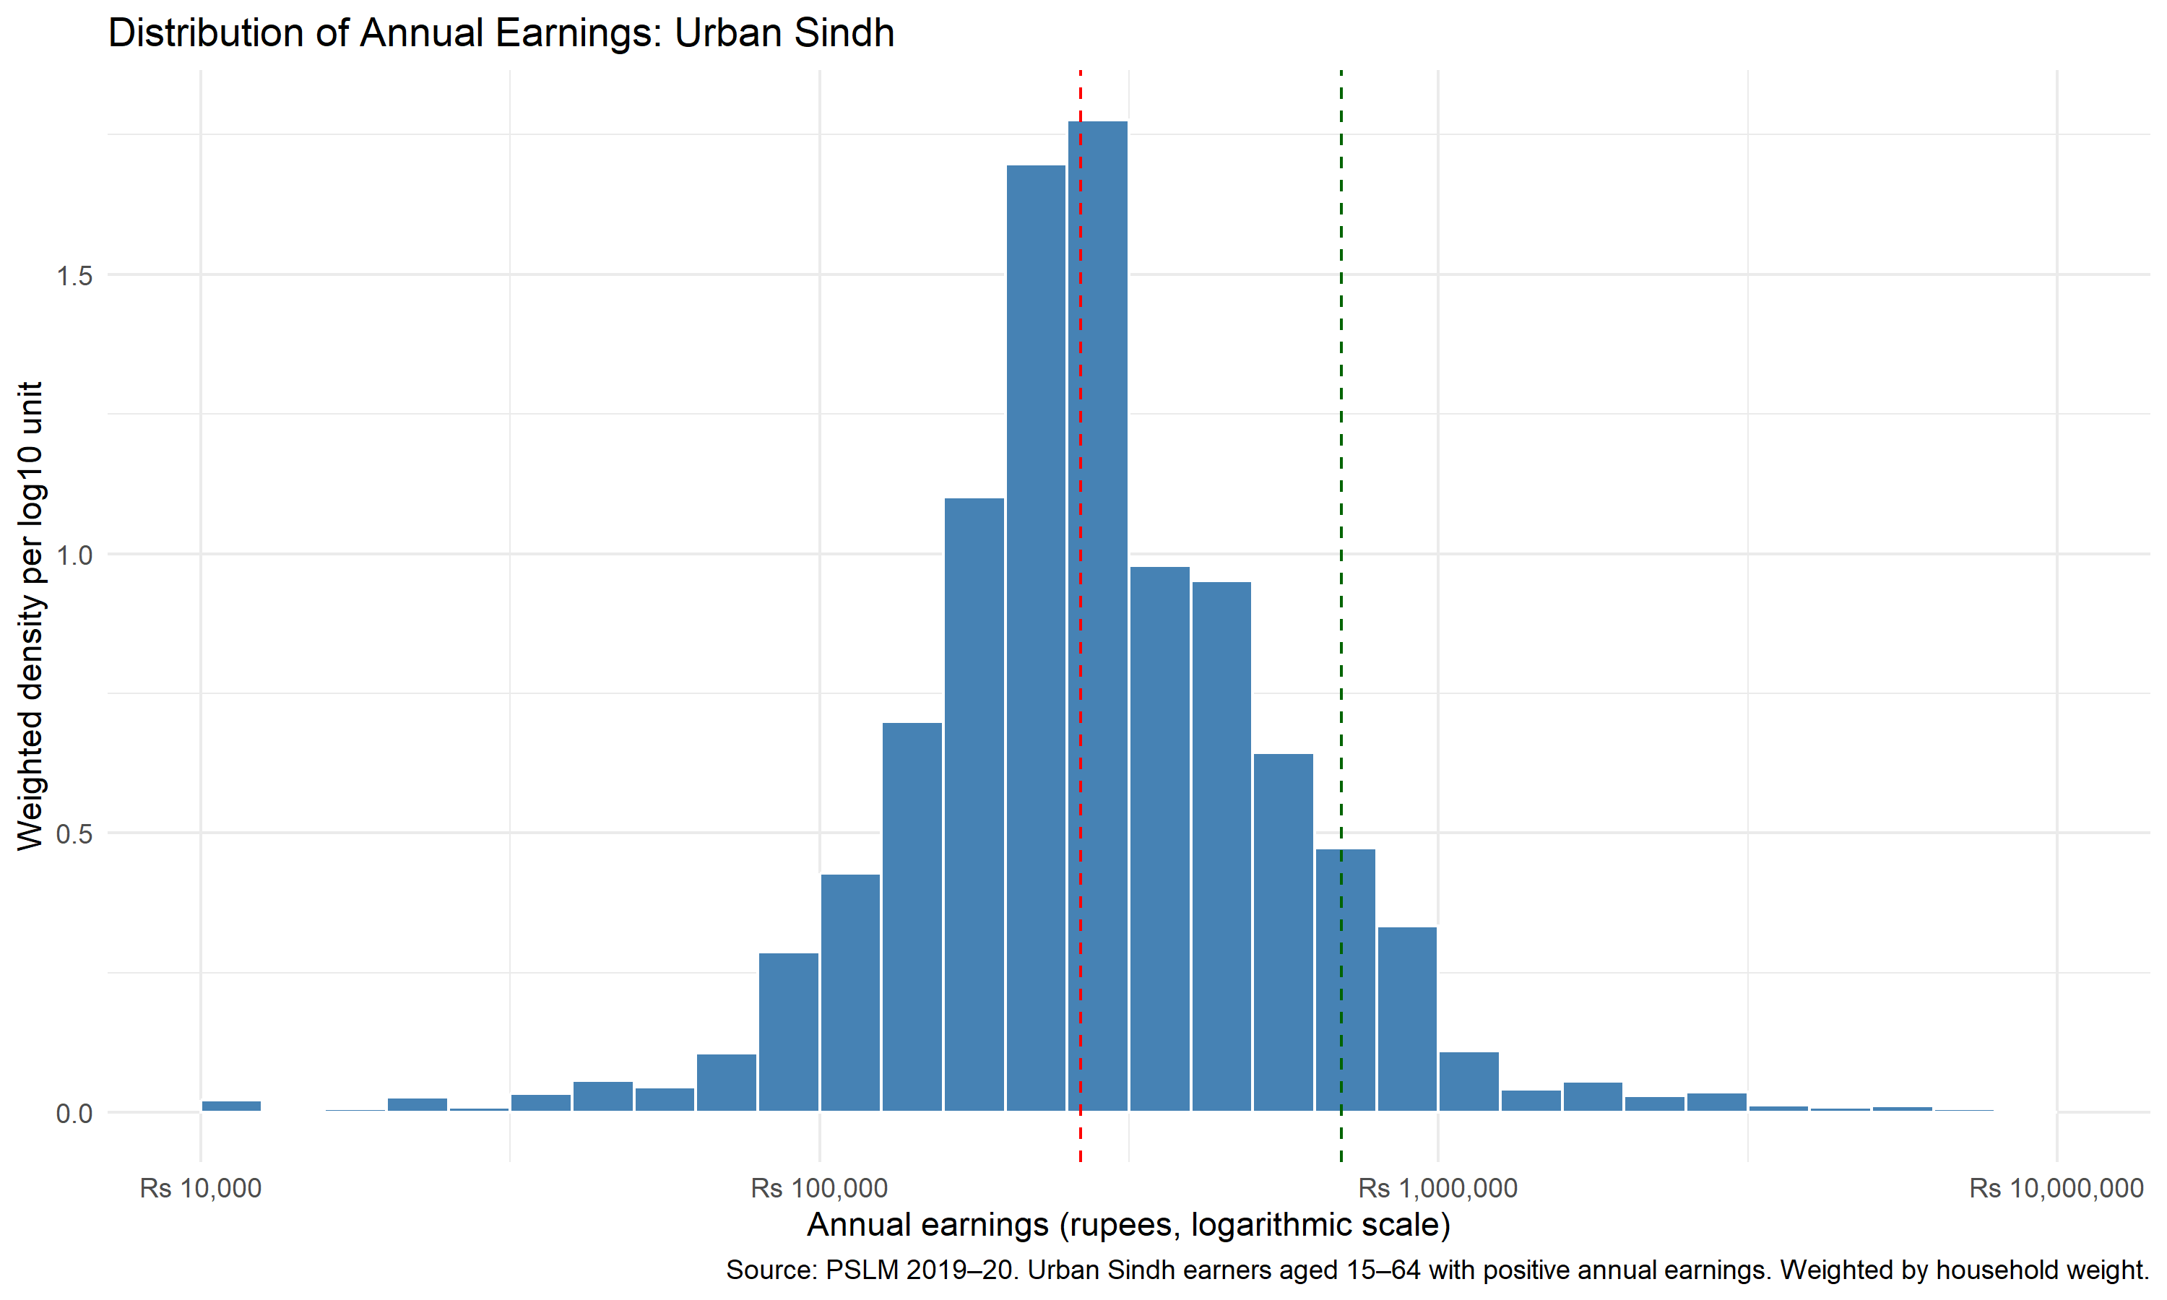
01 / The earnings distribution
Most earners cluster well below the top.
WEIGHTED MEDIAN
Rs 264,000
10TH PERCENTILE
Rs 120,000
90TH PERCENTILE
Rs 696,000
P90 / P10 RATIO
5.80×
Sample: 2,644 earners aged 15–64 with positive annual earnings. Statistics weighted by household weight.
ECO346 / PSLM 2019–20 / URBAN SINDH
02

Slide 3
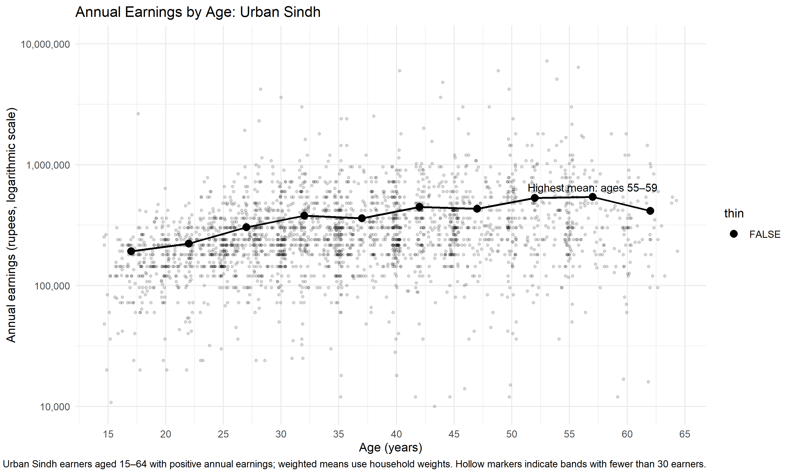
02 / Earnings across age groups
HIGHEST WEIGHTED MEAN
Rs 542,400
Ages 55–59
AGES 25–29
Rs 303,154
AGES 45–49
Rs 431,697
The pattern is not perfectly steady. This cross-sectional data does not track the same people over time.
ECO346 / PSLM 2019–20 / URBAN SINDH
03

Slide 4
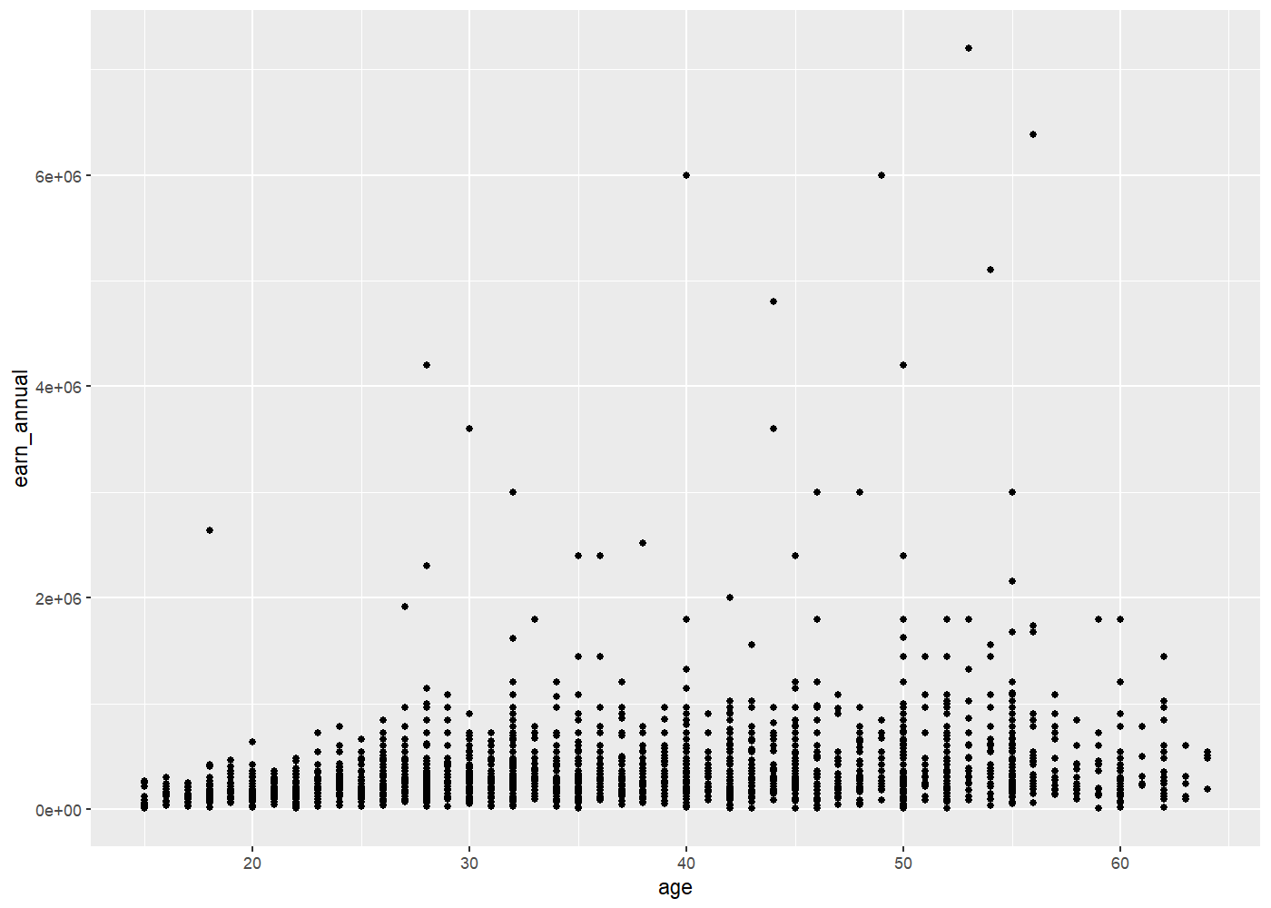
03 / From default to redesign
BEFORE / DEFAULT SCATTER
AFTER / REDESIGNED VIEW
Raw points; heavy overlap and limited context.
Transparency, log scale and weighted age-band means.
The redesign clarifies the overall pattern but hides some raw-point detail.
ECO346 / PSLM 2019–20 / URBAN SINDH
04

