Slide 1
Employee Attrition
ASSIGNMENT 1
SUBMITTED BY: AYESHA IQBAL

Slide 2
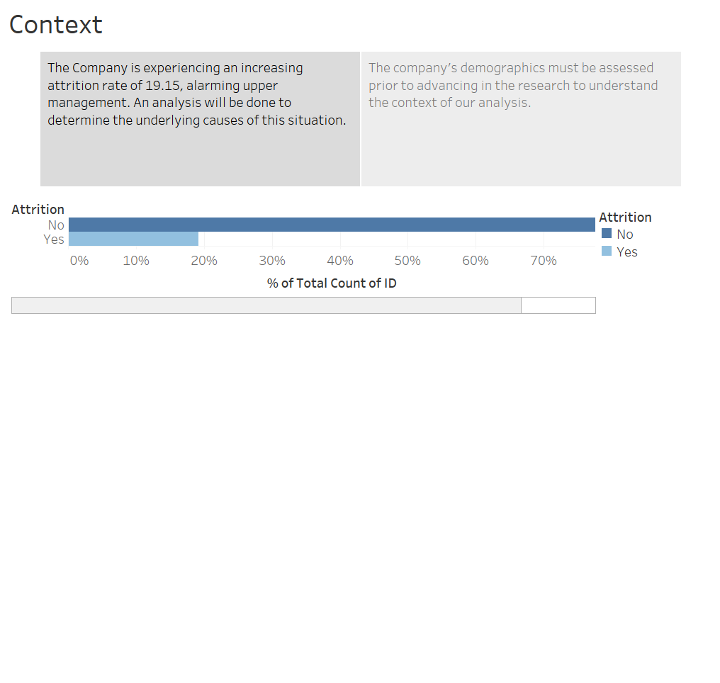

Slide 3
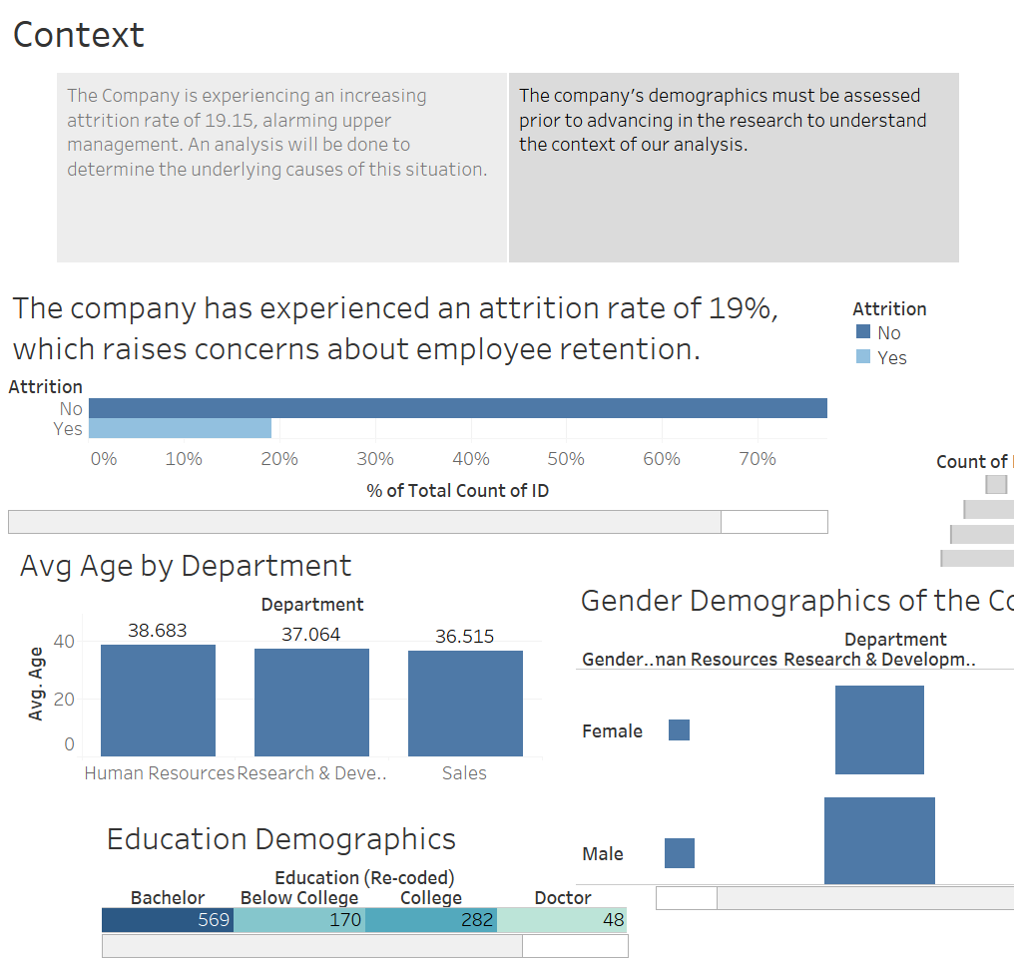

Slide 4
CONFLICT
Identifying the fundamental causes of Attrition and examining their relational dynamics to propose solutions.

Slide 5
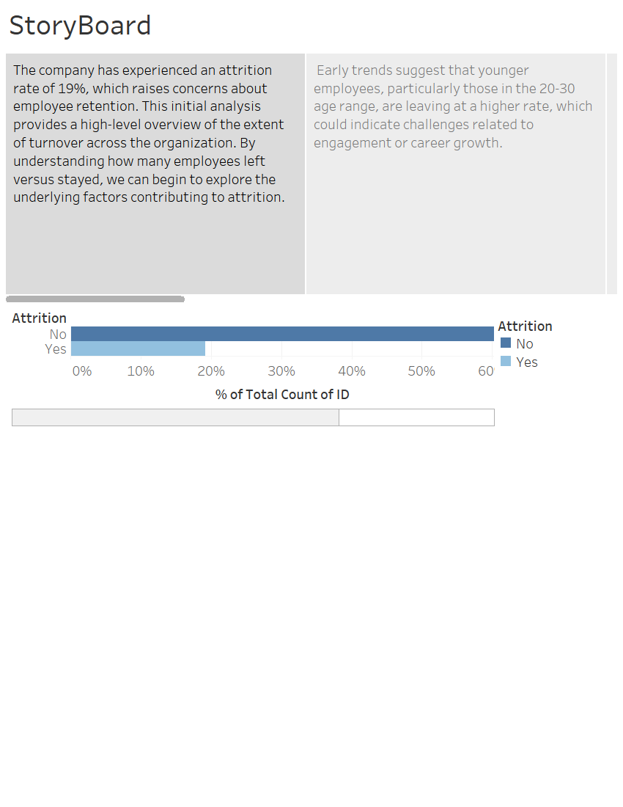


Slide 6
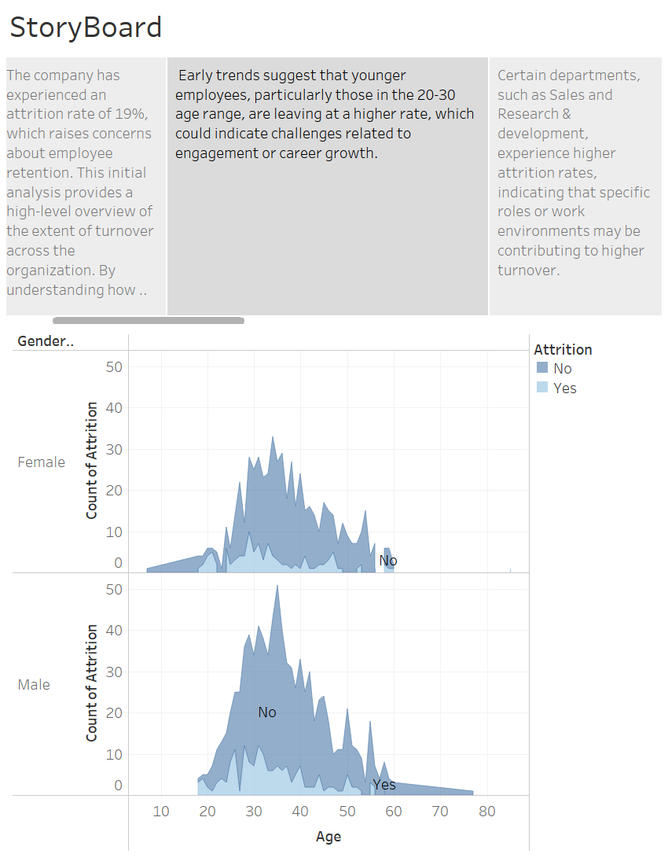

Slide 7
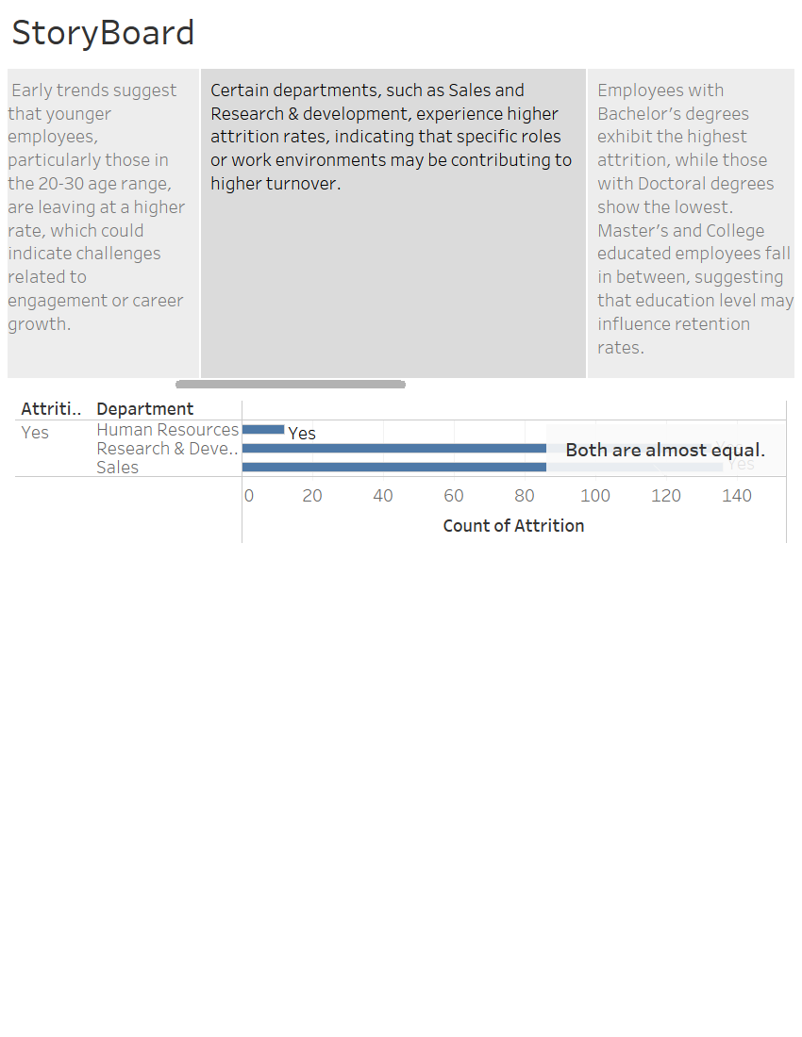

Slide 8
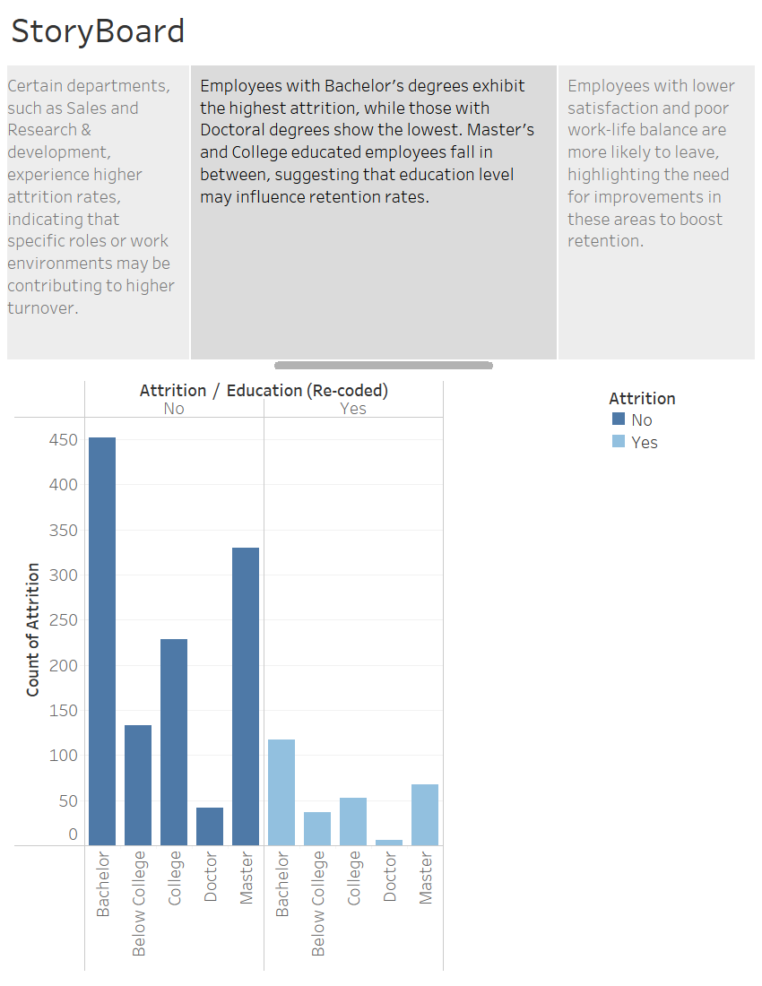

Slide 9
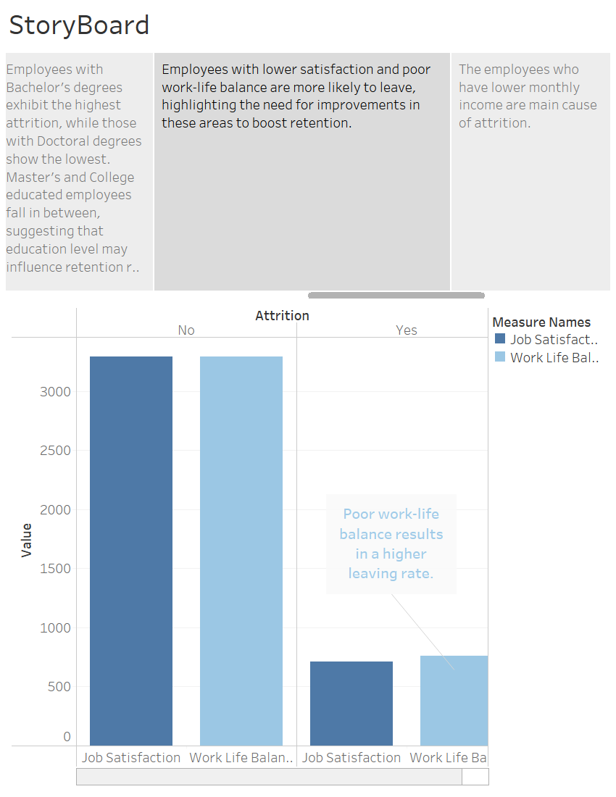

Slide 10
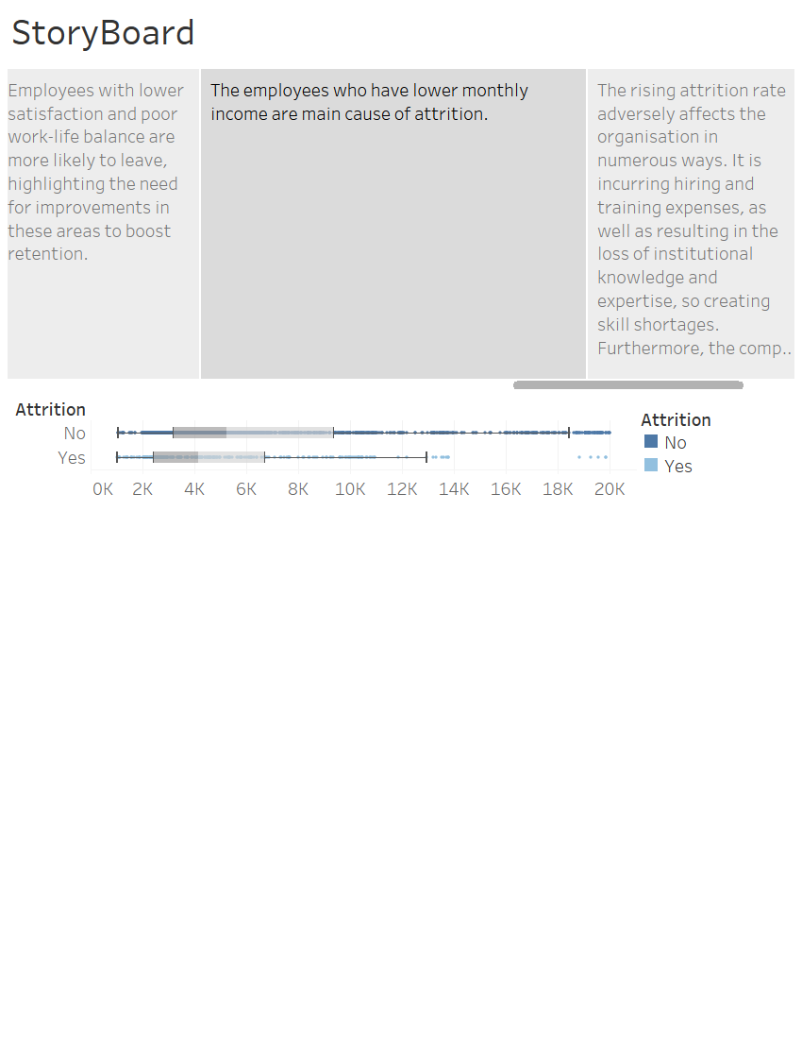
CONFLICT

Slide 11
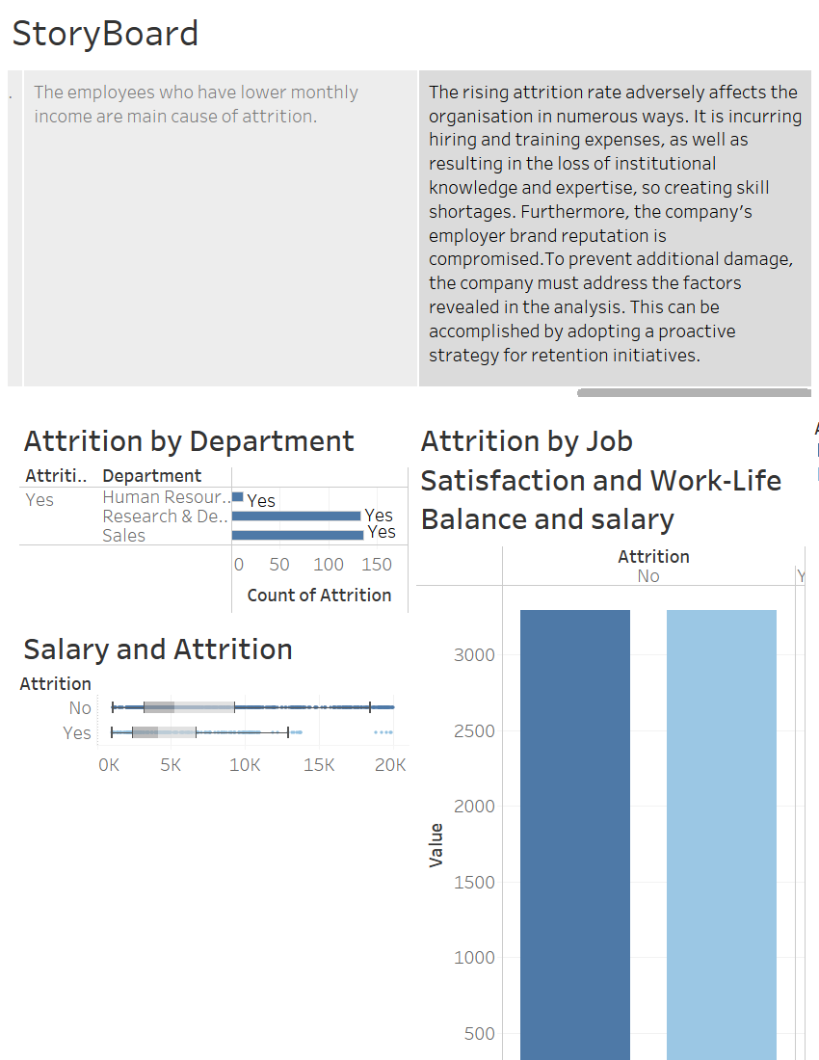
CONFLICT

Slide 12
RESOLUTION
The solution proposition.

Slide 13
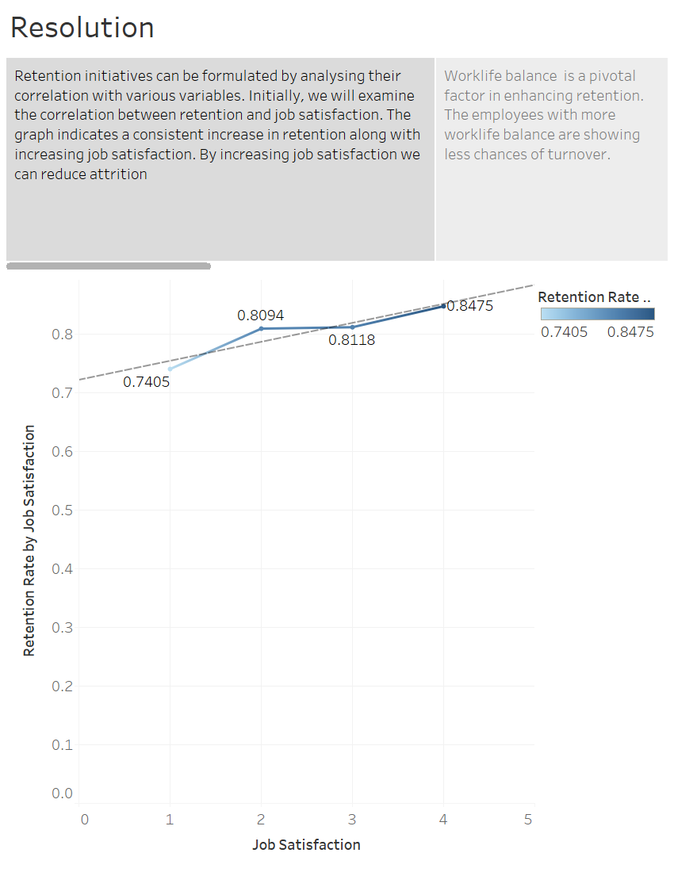

Slide 14
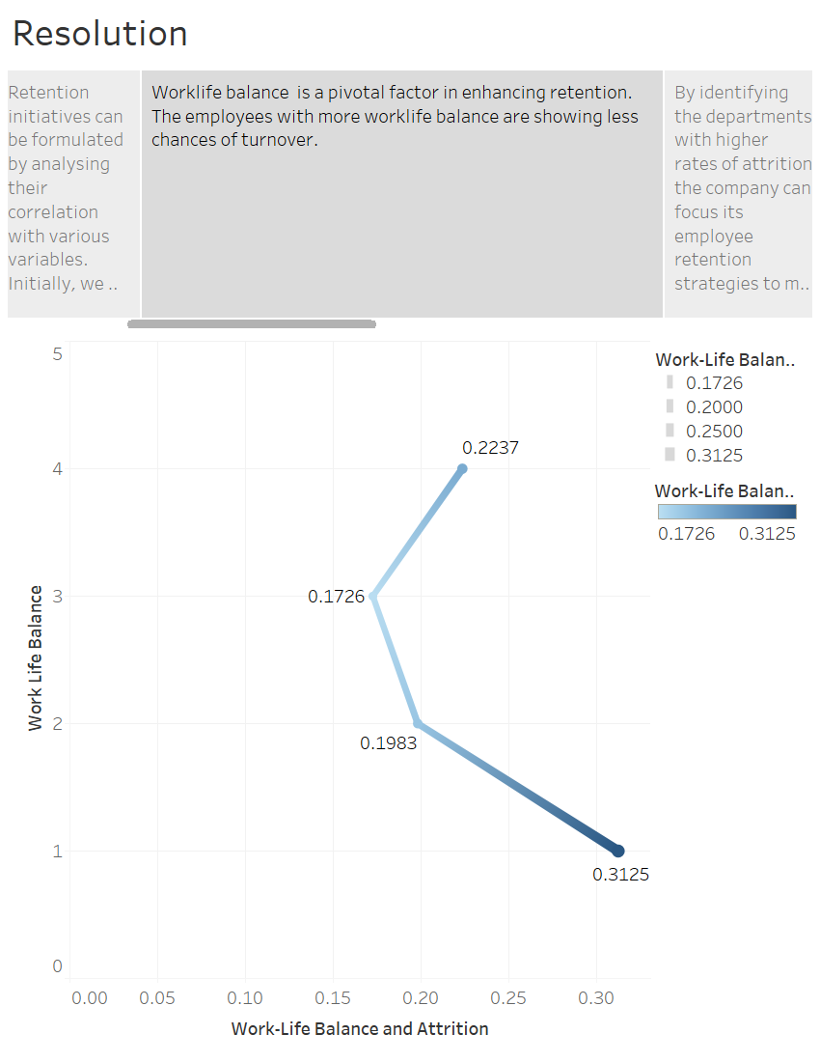

Slide 15
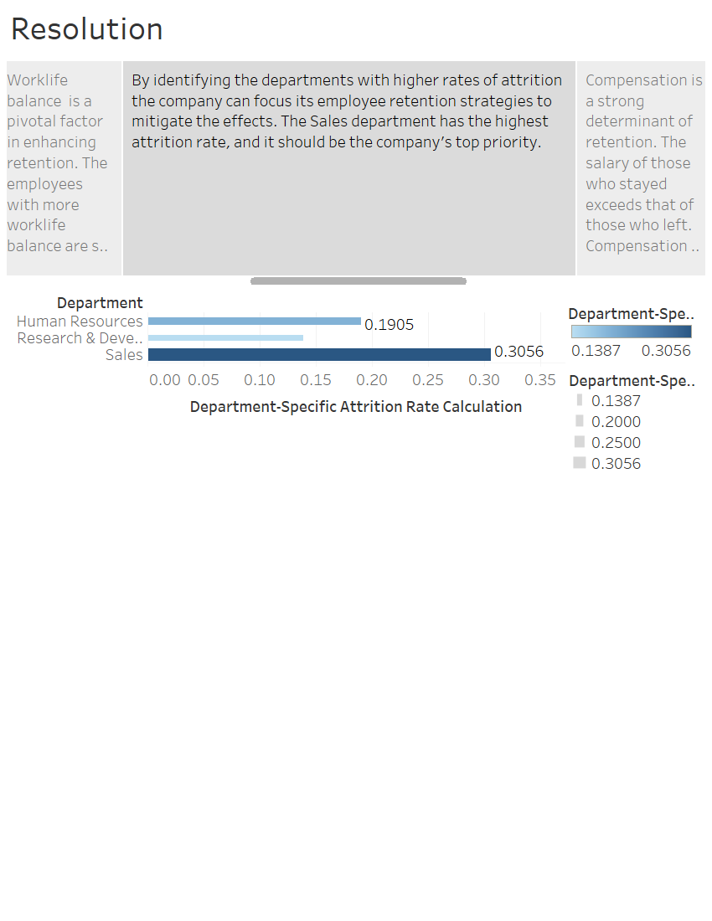

Slide 16
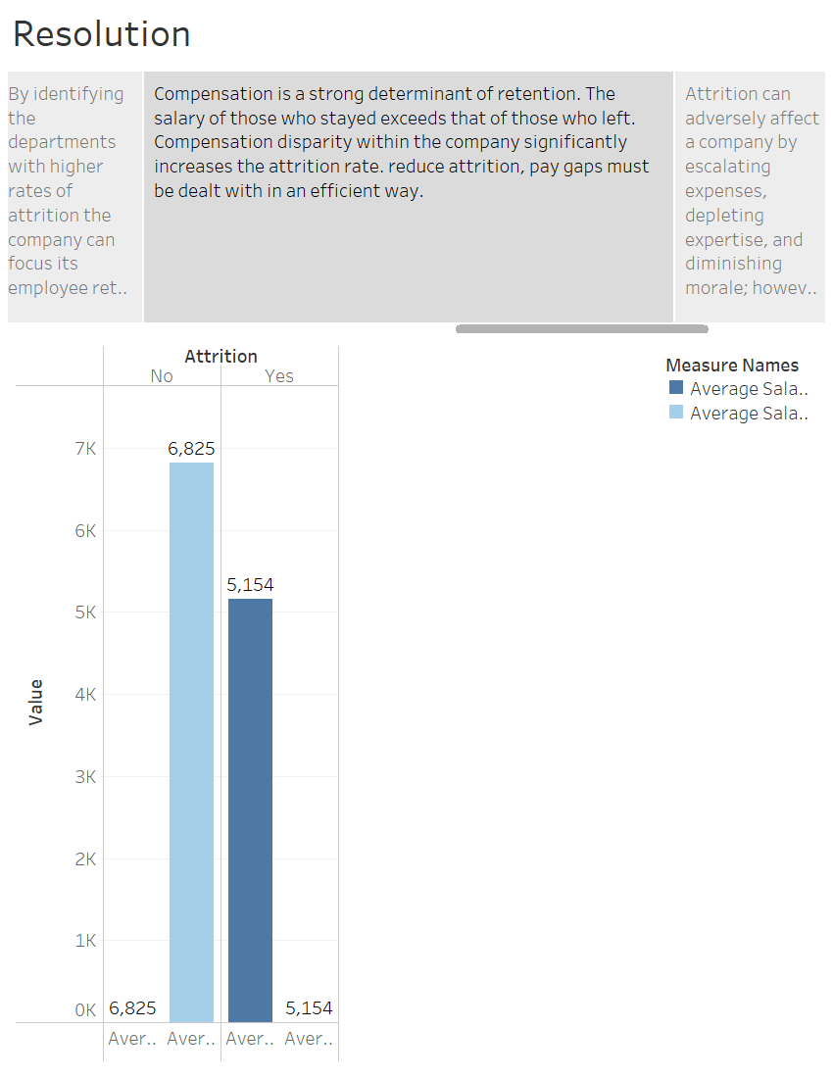

Slide 18
