Slide 1
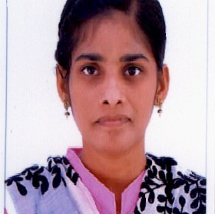


Ayusha.Shaik
Analyst/Software Engineer
Bachelor of Engineering
Computer Science : 2015 - 2019
Skills
Java 8 /J2EE | Java Basics, OOPS, Generics, Collections, Arrays, Loops, Lambda Exp, Stream API Junit, Mockito, Servlets
Spring core | IOC & Dependency Injection, Autowire
Spring REST | REST controllers, Implementation of GET, POST, PUT & DELETE, Bean Validation & Exception Handling, Testing Services, Controller & Repository layer
Spring Data JPA | Implement DAO layer using spring Data repositories, Transaction Management
Spring Boot Microservices | Spring Boot Starters, annotations, Messaging Service, Sync/Async comms, Swagger API specifications
Spring Cloud | Eureka, Hystrix, Zuul & Config Server
React | Components, Hooks, Event handling, Redux, Reducers, Testing using Jasmin & Karma
Database | MongoDB No Sql Advanced
UI Tech | HTML 5 & CSS 3,JavaScript, ES6 & TypeScript Reusable templates, Optimized UI Designed
Tools | Git, Postman, Maven, IDE,PMD,Checkstyle
Add On skills | Communications, Team management. Peer learning
Bangalore
Ayusha.shaik@capgemini.com
+91 6302104082
A4
Hands-on experience in creating microservices with Springboot, SpringSecurity, Spring Cloud API Gateway, Eurekaserver, resilience4j, load balancing,
.Hands on experience in implementing Microservices architecture & spring boot
. Hands-on experience in creating single web page Applications in React with Authentication with route guards, React forms, React routing, validations, and optimize codes.
Hands-on experience in developing web pages using HTML5, CSS3, Object Oriented Javascript, ES6, JSON, and XML. Good understanding of Document Object Model (DOM) and DOM Functions.
Implemented Nodejs in the case study and upskilled knowledge continuously.
Experienced in practicing TDD-based development using tools like Mockito, and Junit and ensuring quality
On-Demand Car Wash Application
Completed end-to-end case study of On Demand Car Wash Application along with Swagger, and payment testing using Braintree in MERN Stack. Material-UI and React Bootstrap are used for the user interface.
Check out my work on GitHub & Video Profile

