Slide 1
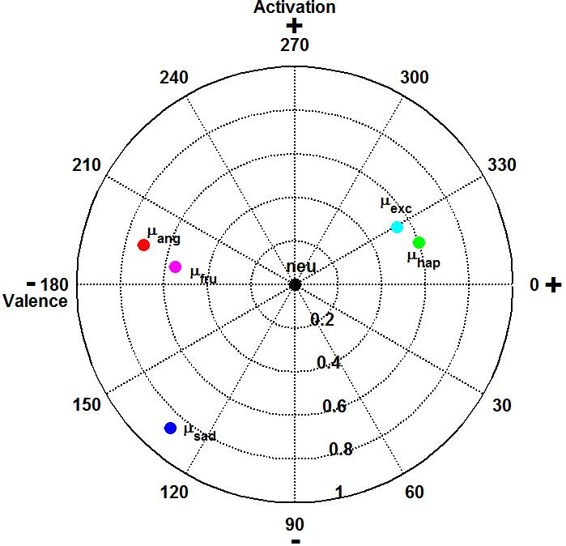
Mahalanobis distance of
test frame from µ_{ang}
P₂
P₁
P₁ and P₂: possible locations
of test frame

