Slide 1
MP ONLINE IDEA & INNOVATION HACKATHON 2026
Problem Statement 5 (PS-5) · GovTech | Artificial Intelligence | Digital Public Services
Project UNITY
Unified Nodal Interface for Tactical Infrastructure Yield & Governance
An AI-powered inter-departmental infrastructure coordination platform and citizen-centric governance portal preventing redundant road excavation and authenticating public grievances for Madhya Pradesh.
Team: HackHer Squad | Prototype Status: 100% Functional & Cloud-Deployed

Slide 2
PILLAR 1: CONCEPT EVALUATION
The Administrative Problem & The UNITY Concept
• Administrative Silos in Madhya Pradesh
Departments (PWD, MP Jal Nigam, Discoms, Municipalities) plan excavations independently without a shared spatial-temporal calendar.
• Infrastructure Destruction Cycle
Freshly carpeted roads are re-excavated within weeks for underground pipelines and power cables, creating public disruption and asset damage.
• Unstructured Citizen Grievance Flood
Helplines receive unverified, out-of-ward submissions, creating manual triaging delays and duplicate work orders.
• The Project UNITY Concept
A unified geospatial engine that proactively detects and halts overlapping excavation schedules before permits are issued, while verifying citizen reports via on-device Tesseract.js OCR.

Slide 3
PILLAR 2: TECHNICAL APPROACH
Dual-Engine Architecture: G2G Coordination + G2C Public Hub
• G2C Citizen Portal
Mobile-first responsive interface with live camera GPS watermarking, browser-native Tesseract.js OCR text extraction, and a universal 4-stage tracking timeline.
• G2G Departmental & Authority Matrix
Leaflet GIS mapping console for municipal engineers, displaying scheduled works, spatial buffer collision rings, and inter-agency NOC approvals.
• Executive Command Center
High-level dashboard for District Collectors with live weather integration, escalation triggers, and spatial analytics.
• Open-Standards Stack
React, Node.js, Express, MongoDB, Leaflet GIS, OpenStreetMap/Nominatim, and Tesseract.js with zero reliance on paid cloud vision APIs.

Slide 4
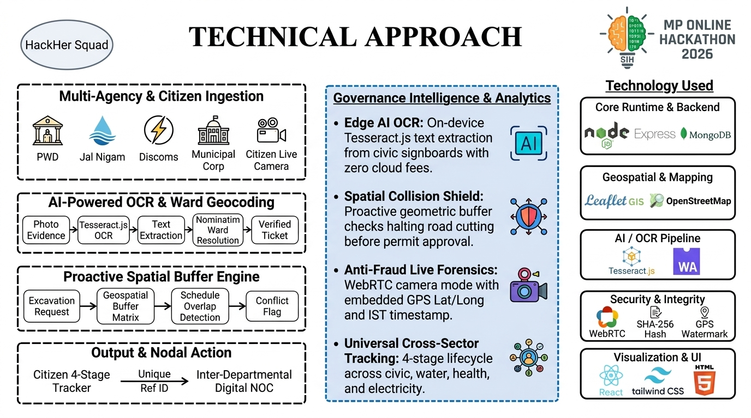

Slide 5
PILLAR 2: TECHNICAL APPROACH & LOGIC
Intelligent Workflow: From Field Capture to Nodal Resolution
• Proactive Spatial Buffering Algorithm
When a utility registers an excavation route, the engine projects a spatial buffer. If an overlapping road-laying schedule exists in that time window, permits are automatically blocked pending joint coordination.
• Edge AI Text Extraction (Tesseract.js)
Citizens upload signboard or grievance photos; Tesseract.js extracts key text on-device, classifying complaint categories without privacy leaks or API costs.
• Automated Municipal Ward Resolution
Lat/Lng coordinates reverse-geocoded via OpenStreetMap to assign tasks directly to the responsible zonal engineer.
• Universal Complaint Lifecycle
Status moves transparently through Filed → Assigned → Under Review → Resolved with full public auditability.

Slide 6
PILLAR 3: INNOVATION & UNIQUENESS
Novel Technological & Operational Innovations
• Zero-Cloud-Cost On-Device AI
Runs Tesseract.js WebAssembly OCR directly in the browser and backend, saving public funds on recurring cloud vision APIs while ensuring data sovereignty.
• Anti-Fraud Live Camera Verification
HTML5 WebRTC camera mode enforces real-time capture with dynamic GPS and IST timestamp watermarking, barring fake internet downloads.
• Pre-Excavation Spatial Shield
Pioneers proactive collision prevention rather than reactive post-damage complaint logging.
• Inter-Departmental Consensus Gate
Enforces cross-agency digital approvals before ground-level road cutting can legally commence.

Slide 7
PILLAR 4: OVERALL SOLUTION & EXECUTION
Prototype Status & Automated Quality Verification
• Fully Functional Cloud Prototype
Live, publicly accessible cloud deployment featuring end-to-end frontend/backend integration across all user roles.
• Automated E2E Test Suite
5/5 Playwright end-to-end automated test suites verified passing, testing everything from citizen grievance filing to departmental map conflict markers.
• Zero 404 Route Integrity
All 36 application routes pre-compiled to ensure flawless single-page application navigation across hosting providers.
• Multi-Role Ready
Instant institutional role switching between Citizen, Municipal Engineer, and District Collector for evaluation.

Slide 8
PILLAR 4: OVERALL IMPACT & SCALABILITY
Governance Scalability & Viksit Bharat 2047 Alignment
• Preserving Public Infrastructure Assets
Protects roads, water mains, and optical cables from premature destruction, ensuring tax revenues translate into durable public assets.
• Fostering Civic Trust & Accountability
Empowers residents of Madhya Pradesh with transparent, trackable civic services, eliminating bureaucratic black boxes.
• Statewide Scalability
Modular, microservice-ready architecture designed to scale seamlessly across all 55 districts and 413+ Urban Local Bodies of Madhya Pradesh.
• Viksit Bharat 2047 Mandate
Embodies the national mission for modern, transparent, citizen-centric, technology-powered governance.

