Slide 1
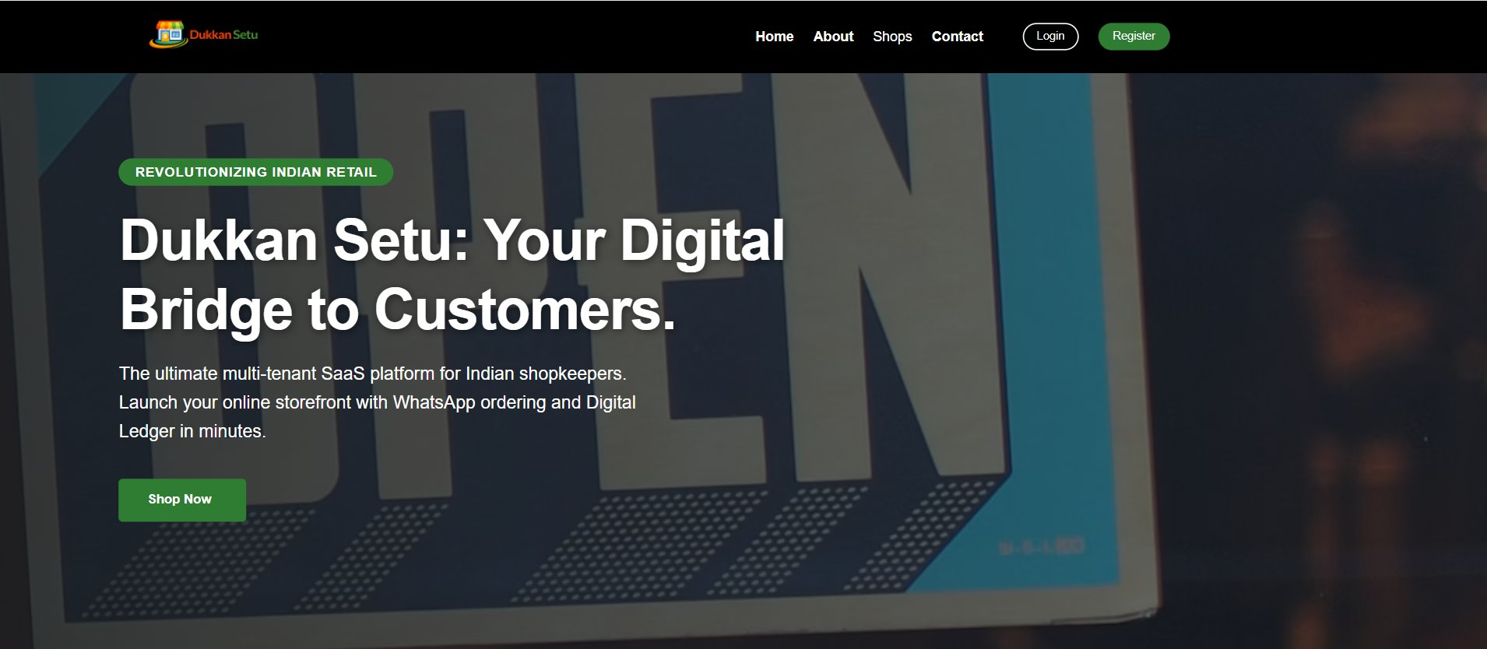
🛍️ DukaanSetu
Your Digital Bridge
to Customers.
The ultimate multi-tenant PaaS platform
for Indian shopkeepers.
Next.js 16
Prisma ORM
Vercel PaaS
WhatsApp Commerce
dukaansetu-xi.vercel.app

Slide 2
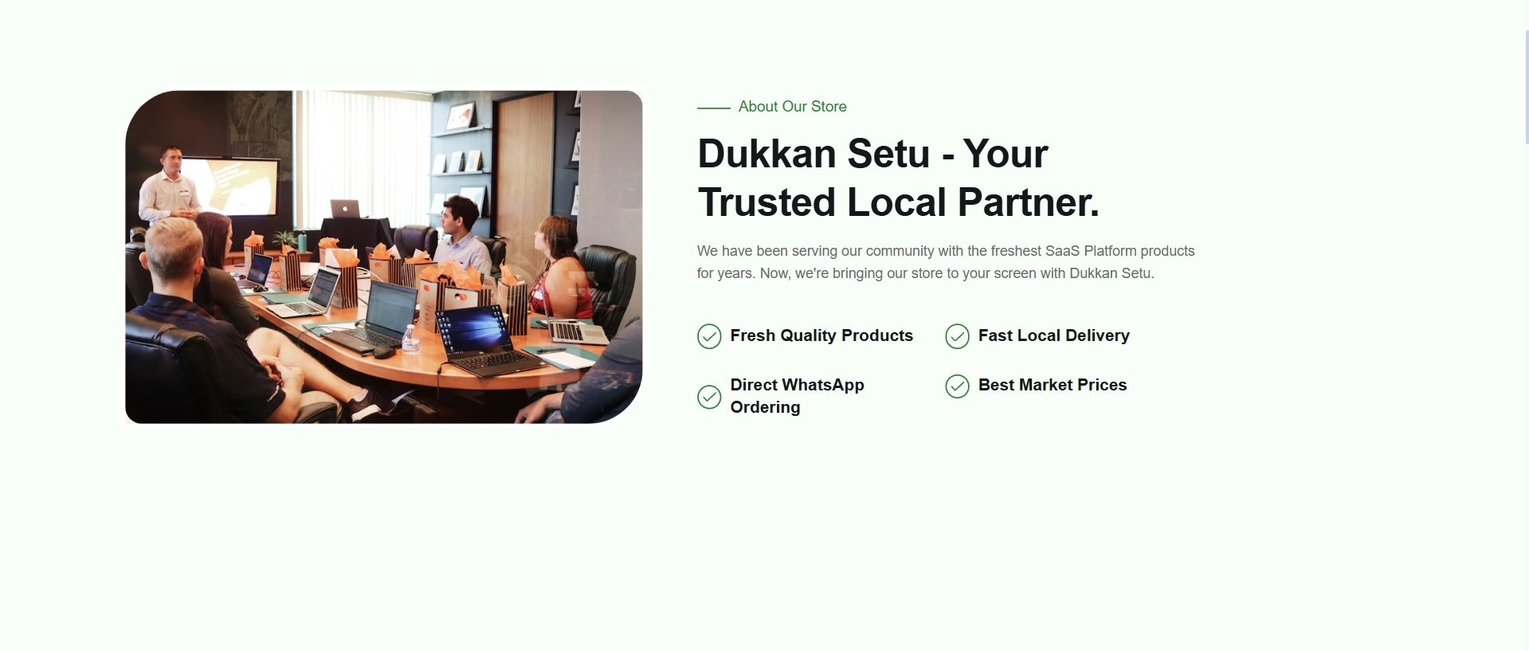
The Problem We're Solving
63M+
₹40T
0
Indian MSMEs still
operating offline
Retail market not
fully digitized
Easy platform for
local kirana stores
Our Solution:
DukaanSetu bridges the digital gap for India's local shops — a full-stack PaaS with storefronts, orders, WhatsApp commerce, and a digital ledger, all in one platform.
✅ Fresh Quality Products ✅ Direct WhatsApp Ordering ✅ Fast Local Delivery ✅ Best Market Prices

Slide 3
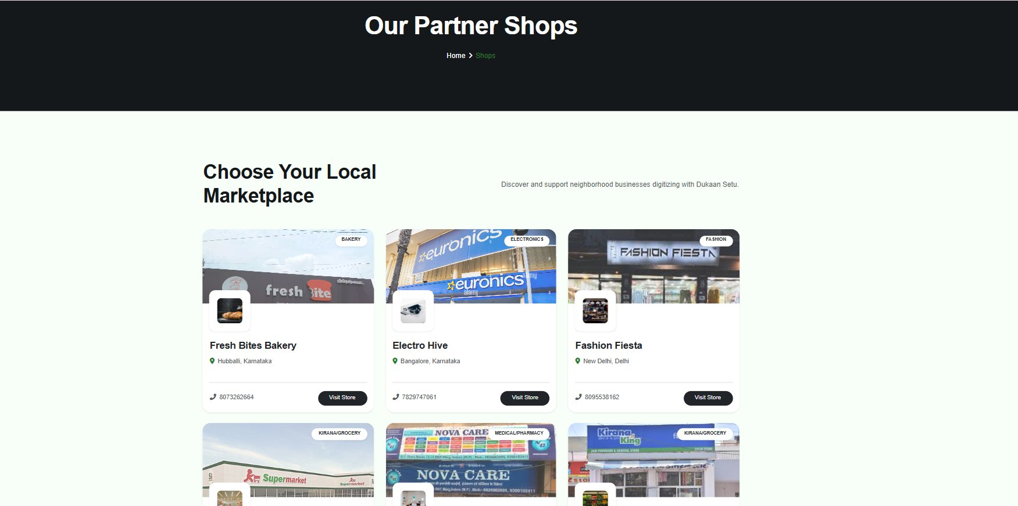
Platform Overview
Multi-tenant SaaS — one platform, hundreds of local storefronts
🏪 Fresh Bites Bakery · ⚡ Electro Hive · 👗 Fashion Fiesta · 🛒 Modern Supermart · 💊 NovaCare Pharmacy · 🥦 Kirana King

Slide 4
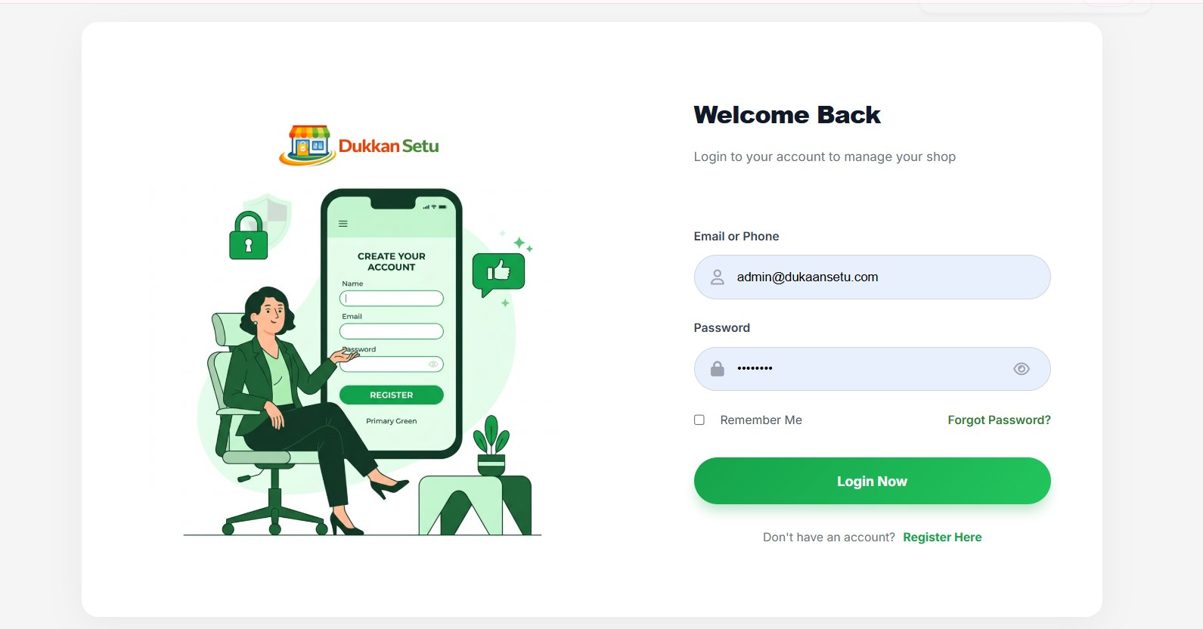
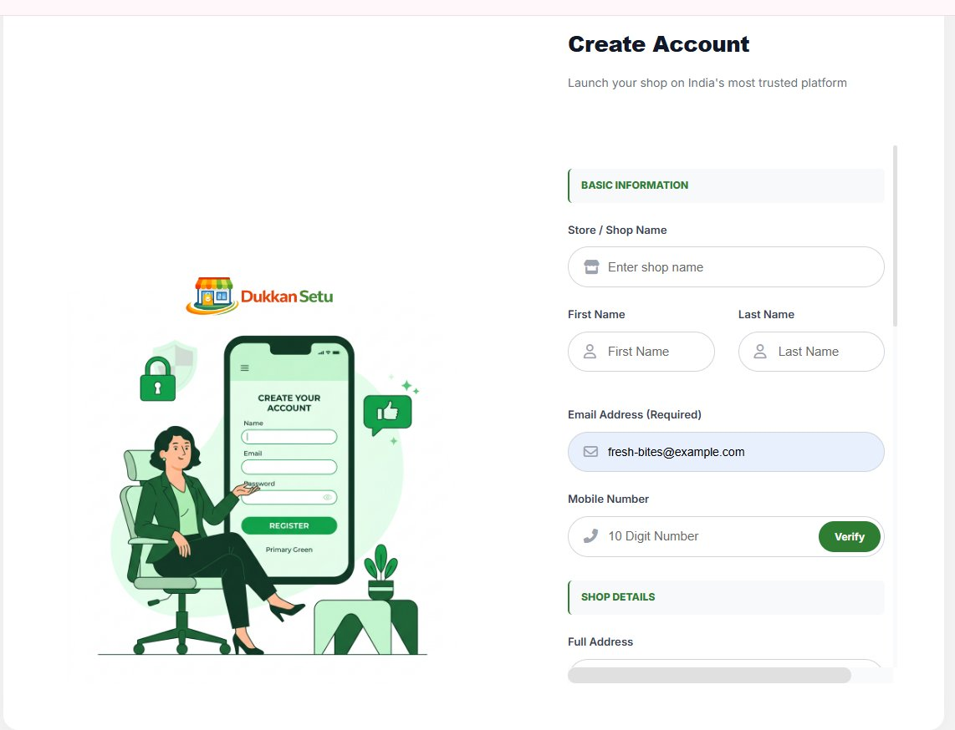
Merchant Onboarding
🔐 Merchant Login
📝 Store Registration
Secure login with Remember Me
and Forgot Password flow
Multi-step onboarding: store info,
live GPS capture, doc uploads

Slide 5
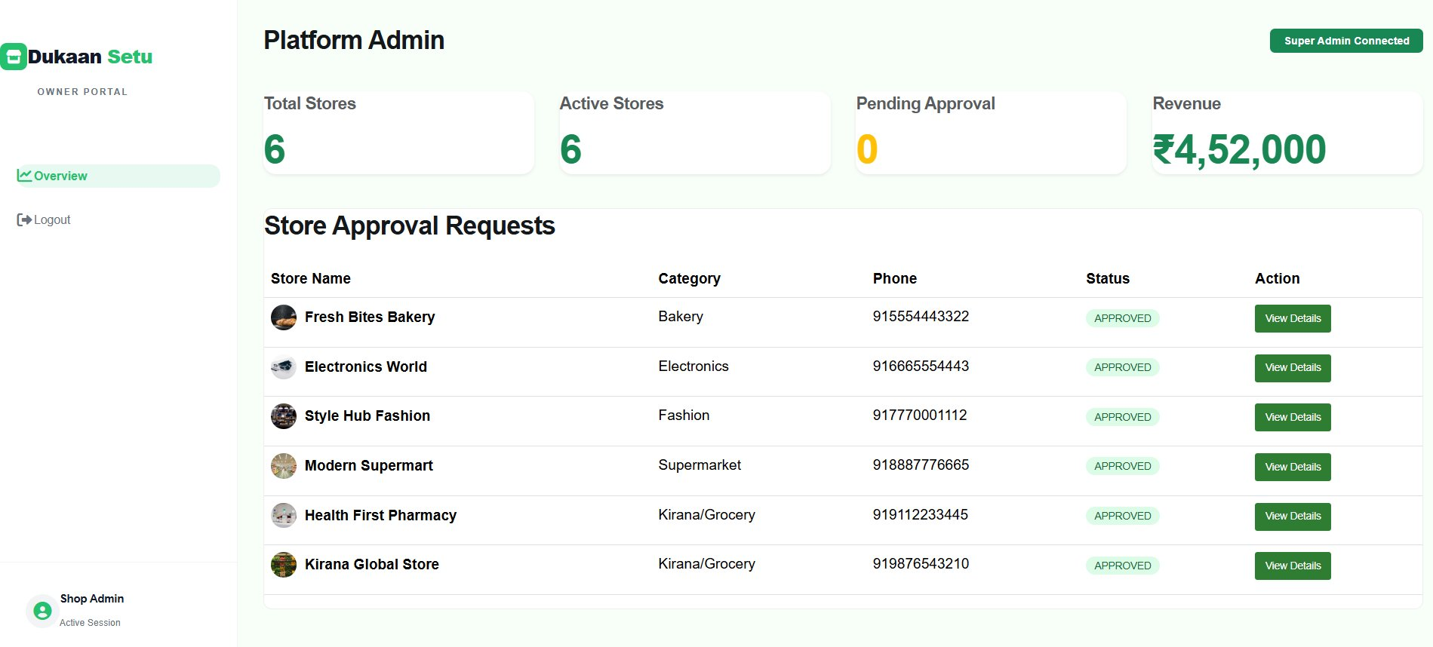
Admin Dashboard
Platform-wide oversight: approve stores, review documents, track revenue
6 Total Stores
6 Active Stores
0 Pending
₹4,52,000 Revenue

Slide 6
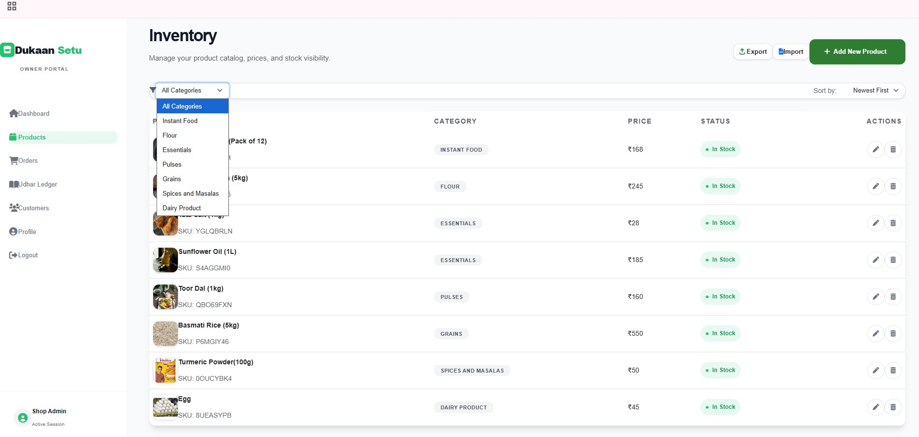
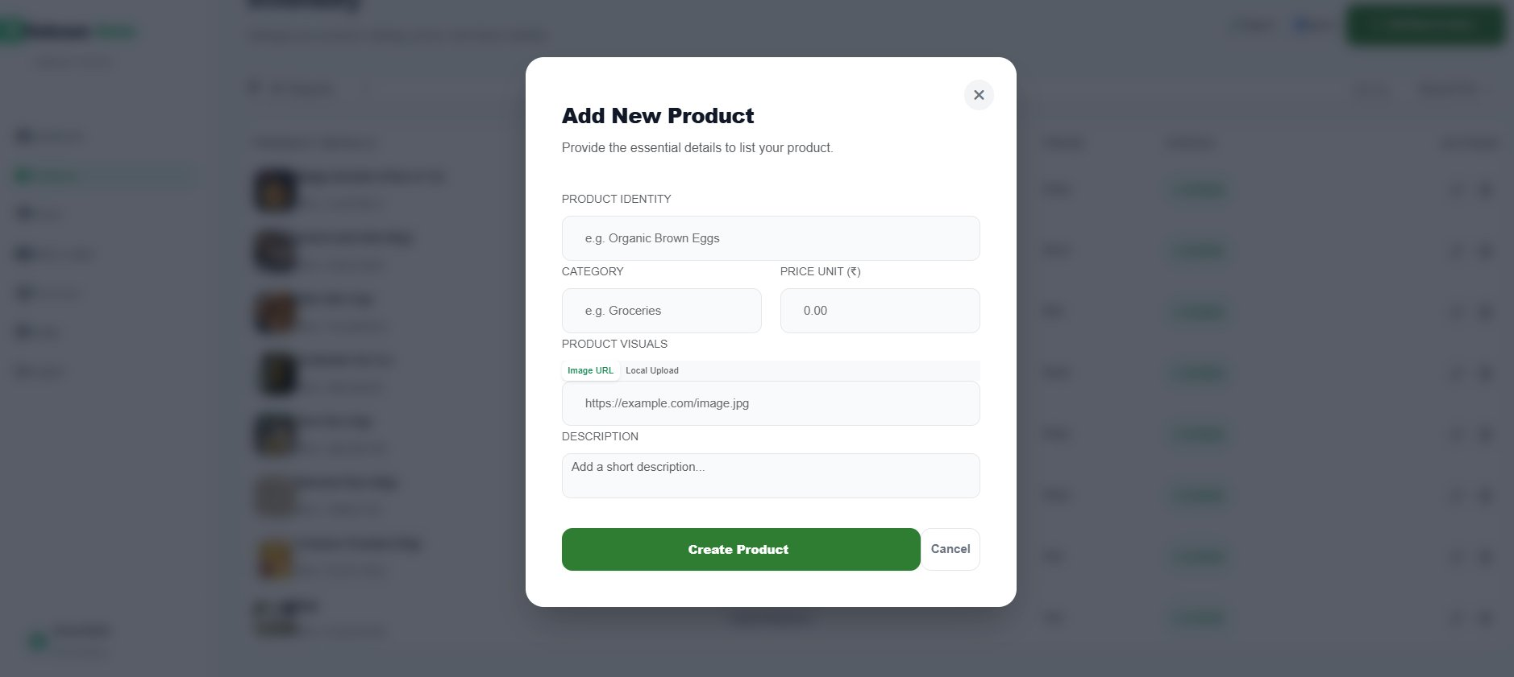
Product Inventory Management
Category filter + sort
CSV Import / Export
Image URL or file upload
SKU auto-generated
Soft-delete (recoverable)

Slide 7
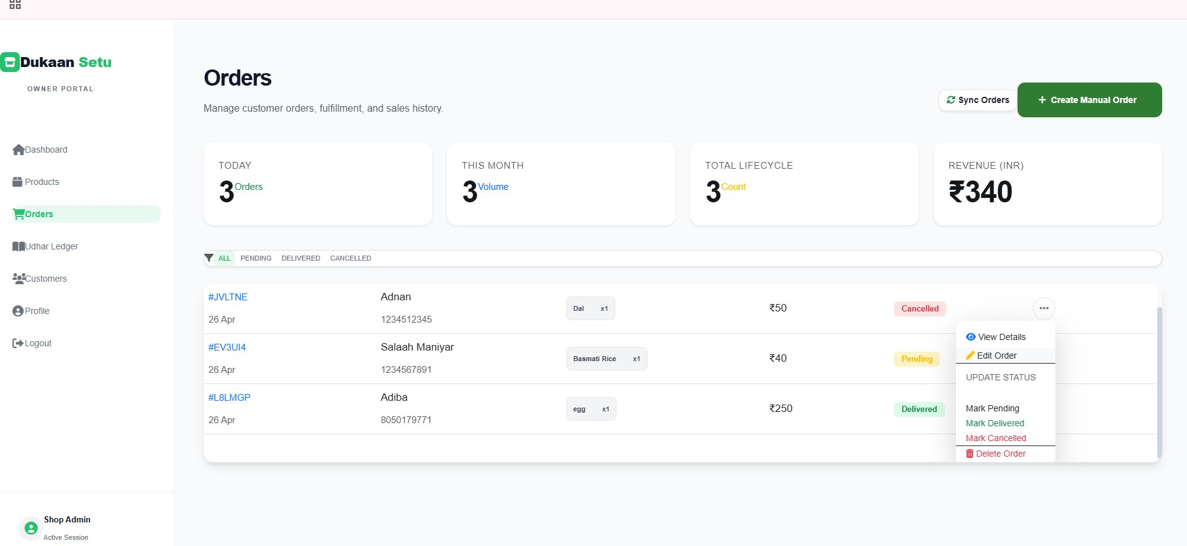
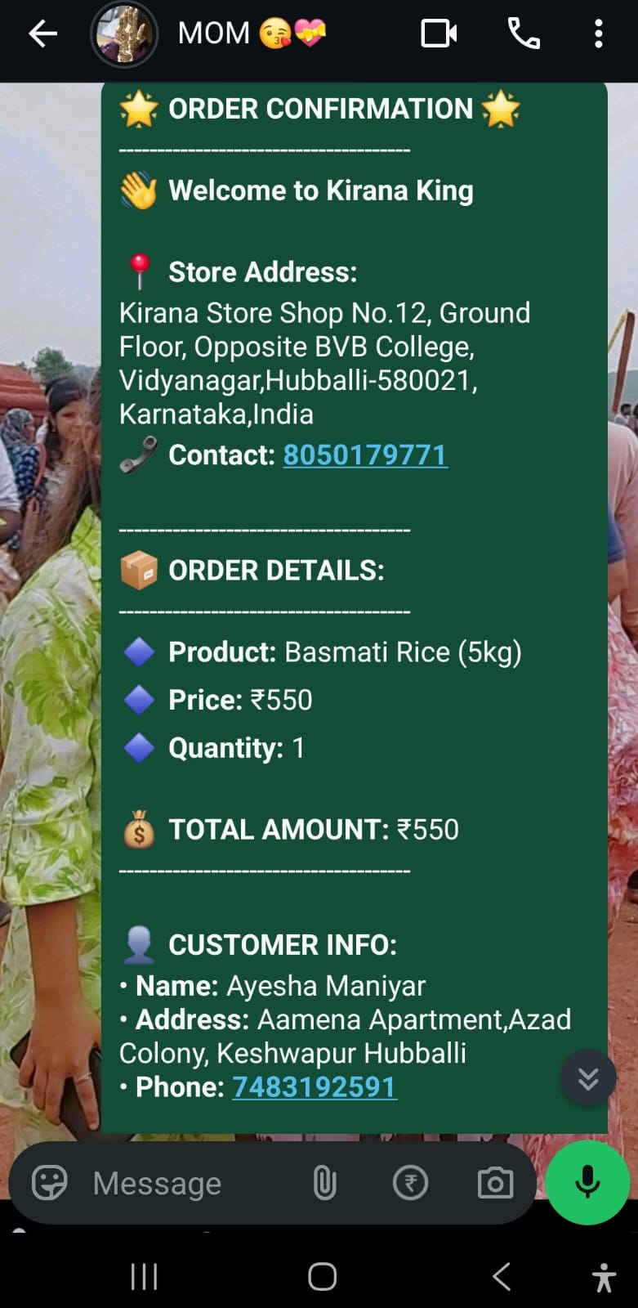
Orders & WhatsApp Commerce
📦 Full Order Lifecycle: PENDING → DELIVERED → CANCELLED + Invoice Print
💬 Real WhatsApp Order Confirmation Message
No payment gateway fees. Orders go straight to merchant WhatsApp — keeping commerce local.

Slide 8
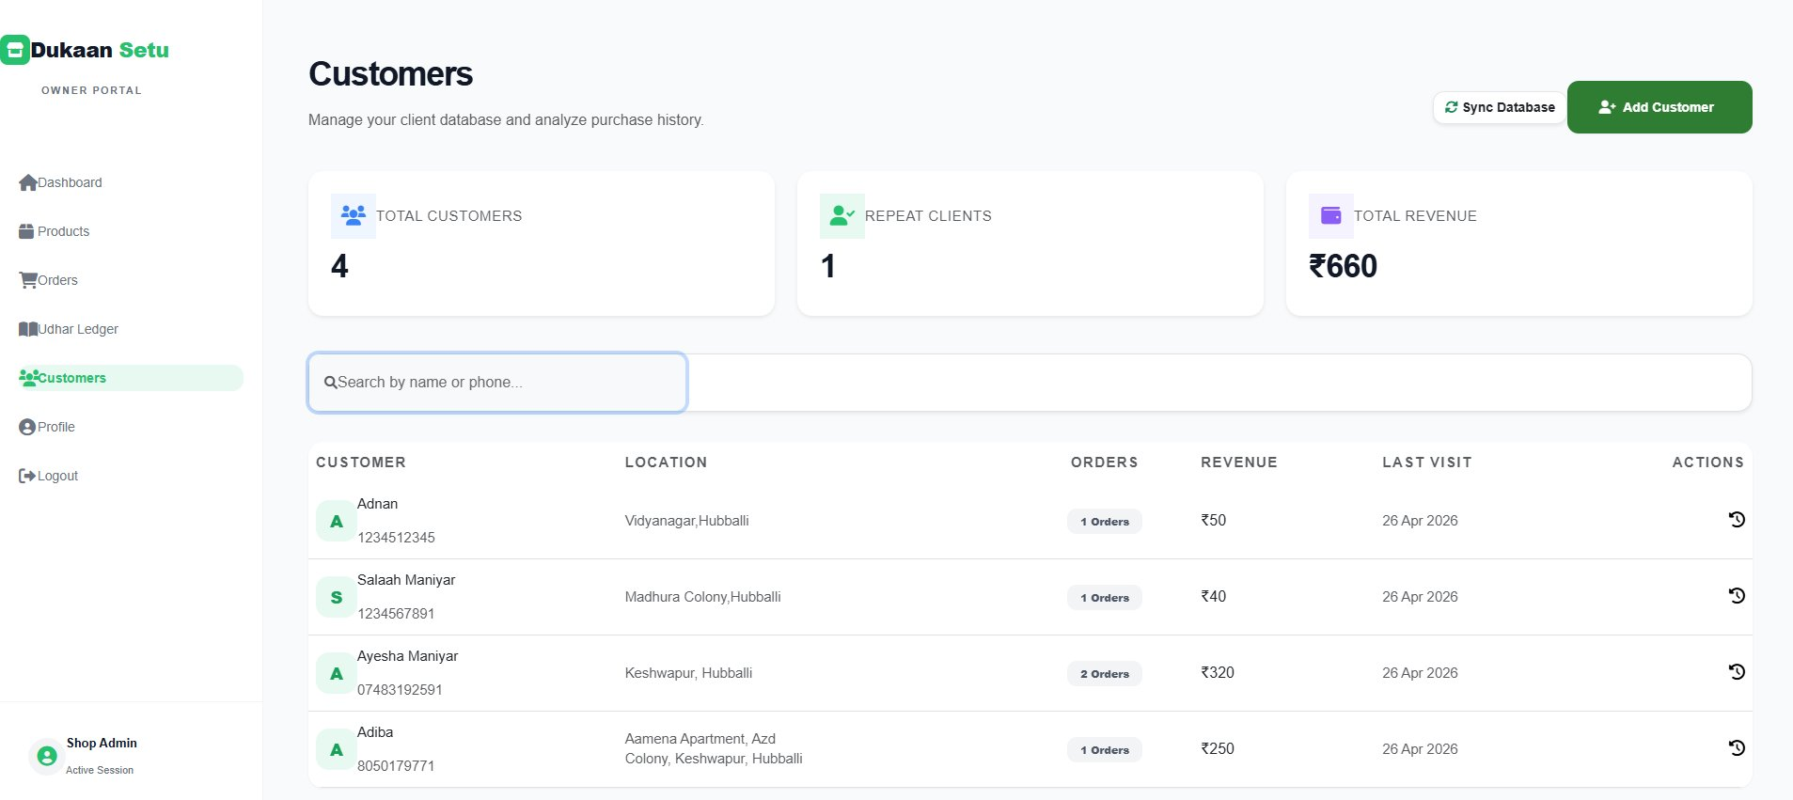
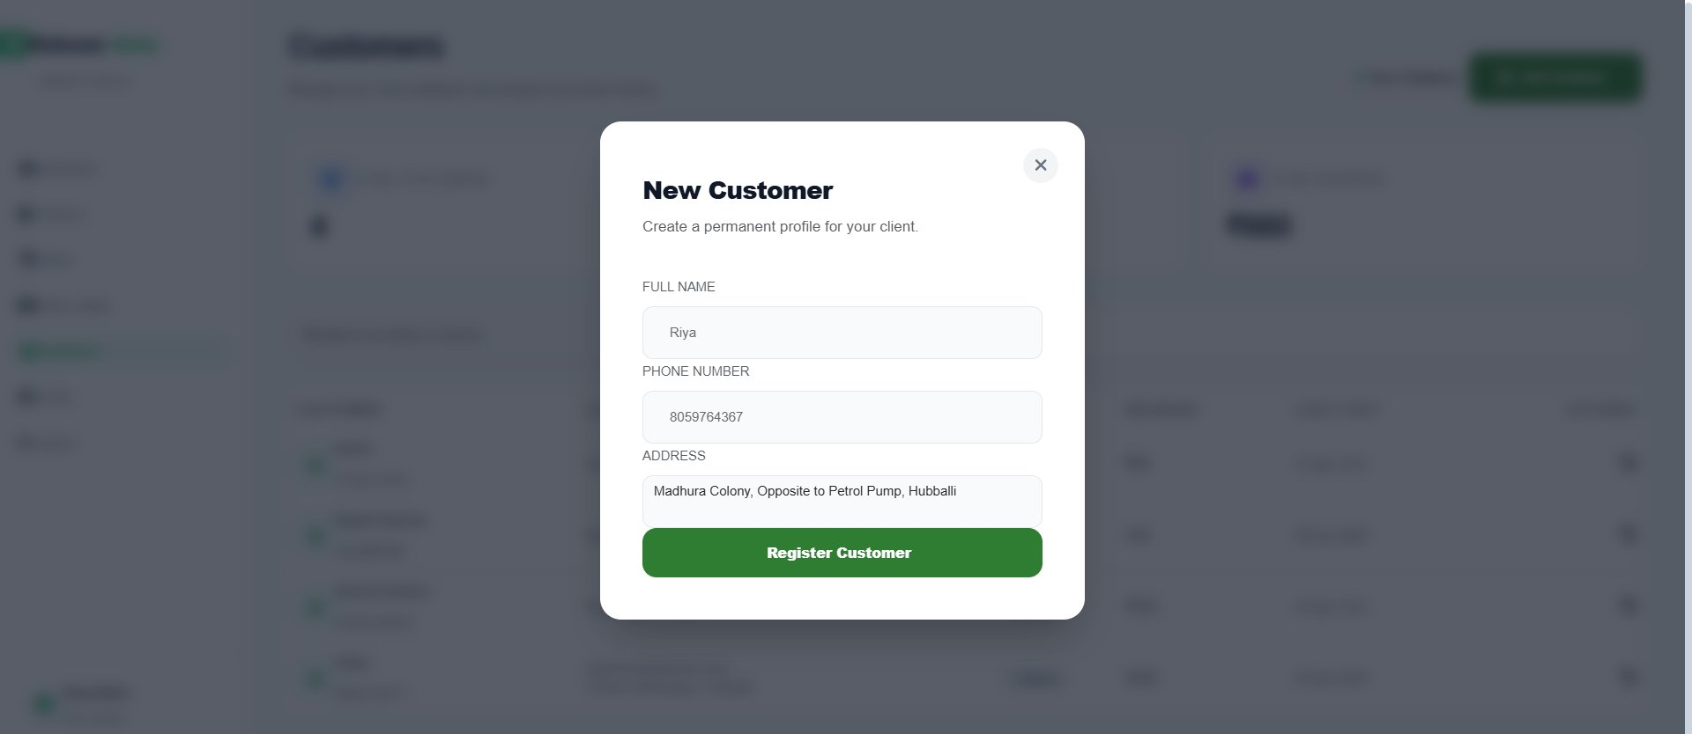
Customer Database & Udhar Ledger
👥 Auto-aggregated
📒 Udhar Tracking
🔍 Search & Filter
📊 Revenue per Customer
Customers auto-built from order history
CREDIT/DEBIT ledger — digital khata
Name/phone search in real-time
Orders + total spend at a glance

Slide 9
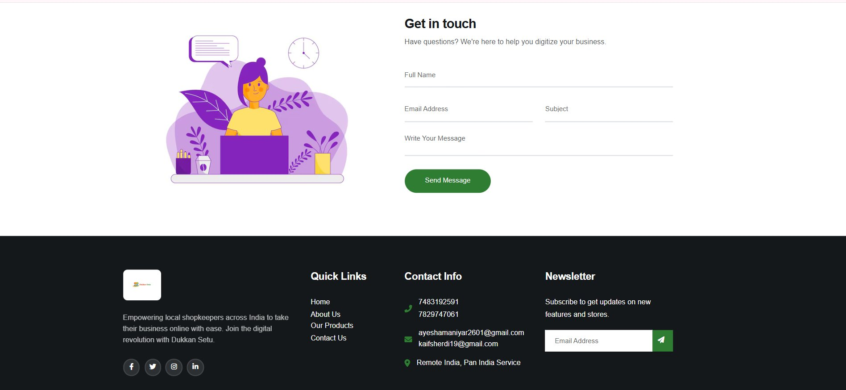
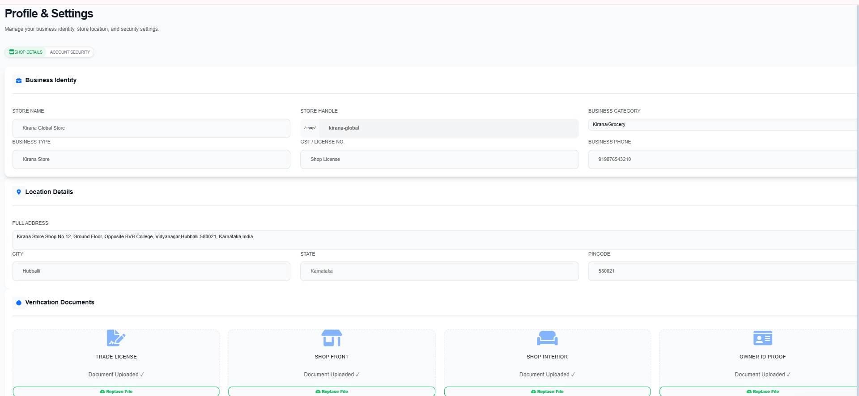
Store Profile & Contact
Complete business identity management — from GST to GPS coordinates
🏪 Business Identity (name, slug, category)
📍 Location Details (address, city, state, pincode)
📄 Verification Documents (trade license, shop front, ID)
🔒 Account Security (email, password change)
📧 Newsletter + Contact Inquiry System

Slide 10
Tech Stack & Workflow
Built with modern full-stack tooling, deployed as PaaS on Vercel
Next.js 16
React 19
Prisma ORM
Vercel
SweetAlert2
App Router + Server Actions
UI Components
DB Schema + Queries
PaaS Deployment
Modals + Alerts
1️⃣ Register Store
2️⃣ Admin Approves
3️⃣ Add Products
4️⃣ Customers Order
via WhatsApp
5️⃣ Manage Orders
& Ledger
Database Models:
Store
User
Product
Order
Ledger
Customer
Inquiry
🌐 Live at: dukaansetu-xi.vercel.app · GitHub: github.com/ayeshamaniyar26/DUKAANSETU · Built by Ayesha Maniyar

