Slide 1


HCL Intern Nexus
AI-Powered Internship & Learning Platform
HCLTech Internship · Weekly Engineering Progress & Architecture Review
GITHUB.COM/AYESHAMEHREENTECH/HCL_INTERN_NEXUS

Slide 2


The Problem — Fragmented Internship Operations
The Cost
📱 WhatsApp
📧 Email
Constant context-switching, repeated search effort, and lost information create friction for interns and mentors alike.
Notices, learning resources, and announcements buried in chat history
Meeting links, schedules, and follow-ups scattered across threads
The Goal
Bring internship operations, communication, learning, and AI assistance under one roof — with structured role-based workspaces.
🗂️ Separate Tools
📋 Manual Records
Learning content, coding exercises, and doubt resolution across disconnected platforms
Mentors track observations and performance in fragmented notes with no continuity

Slide 3
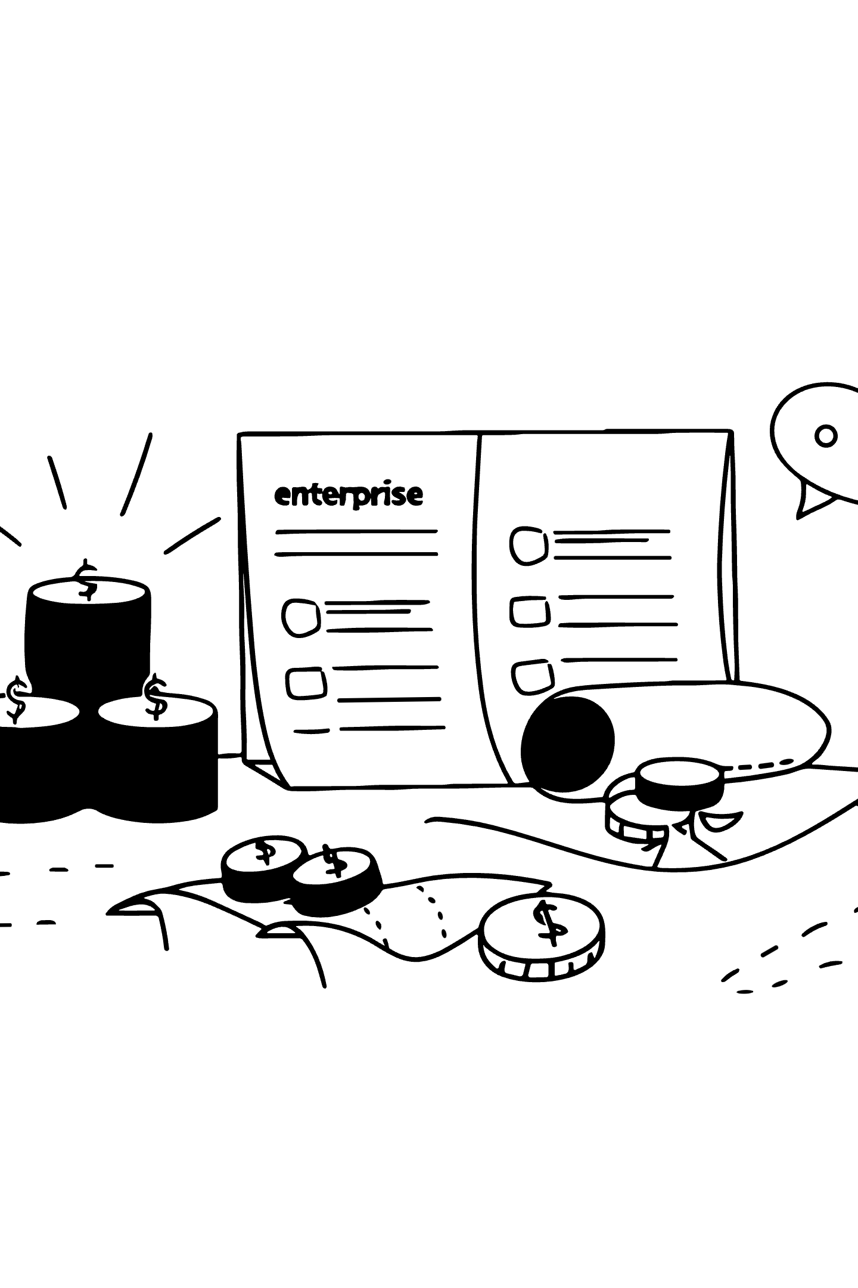
Solution & Differentiation — The Three-Role Nexus
Intern Nexus is designed to combine internship-management workflows with an AI-powered learning environment — not simply a portal, but an integrated operational system.
🎓 Student
🧑‍🏫 Mentor
Notices · Meetings · Resources · Doubts · Learning Plans · Helping Bot · PyQuest / Coding Lab · Progress Tracking
Post Notices & Resources · Meeting Management · Student Support · Evidence-based AI Performance Analysis & PDF Reporting
⚙️ Admin
Account Lifecycle · User Management · Deletion Requests · Administrative Workflows

Slide 4
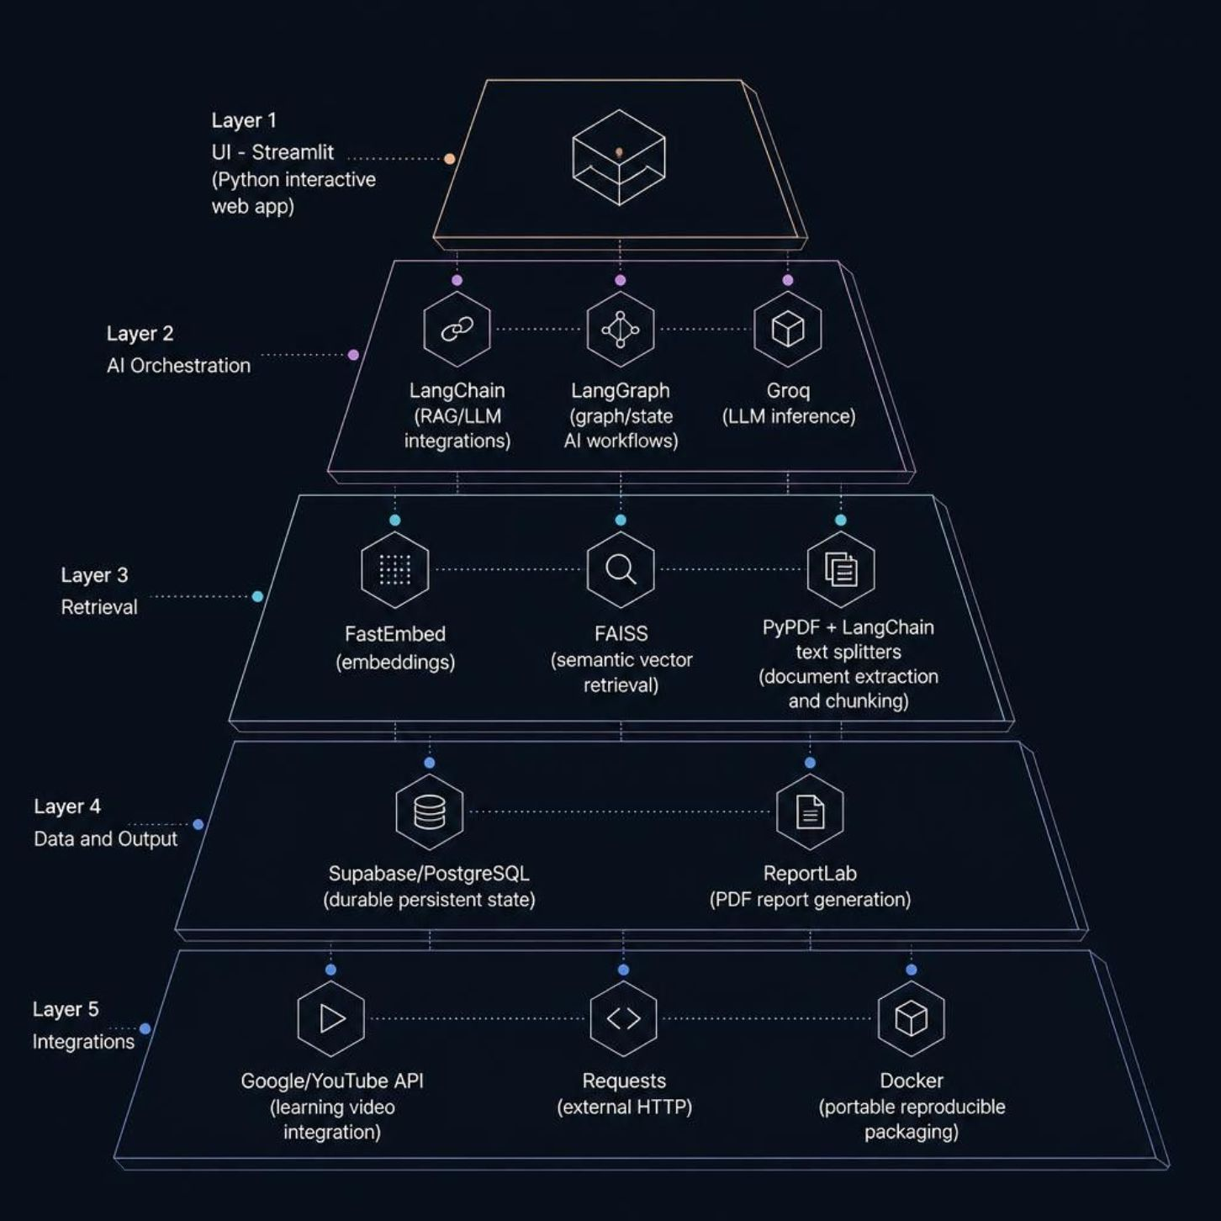


Technology Stack & Libraries
Streamlit
LangChain + LangGraph
Python-first interactive web application framework — entire UI layer
RAG pipelines and graph-oriented stateful AI workflow orchestration
Groq
FastEmbed + FAISS
High-speed LLM inference endpoint when configured
Embedding generation and semantic vector retrieval for RAG
Supabase / PostgreSQL
ReportLab · PyPDF · Google API · Docker
Durable persistent state — source of truth for all verified data
PDF reports · Document parsing · YouTube integration · Container packaging

Slide 5

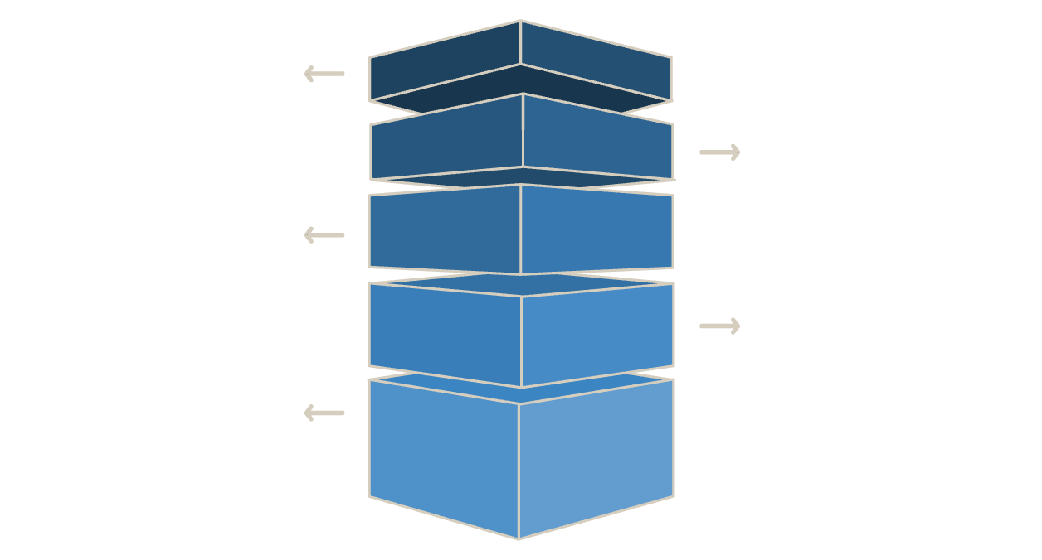



GitHub Code Architecture — Separation of Concerns
Runtime Flow
Student / Mentor / Admin
Role-authenticated Streamlit UI
Entry Point
app.py initializes application and routing.
LangChain · LangGraph · Groq · YouTube API
Auth Layer
authentication.py handles auth and role access control.
Role Dashboards
AI helpers and external integrations
dashboards/ Student, Mentor, Admin UIs.
AI Modules
ai/ PyQuest agents, orchestrator, RAG, utilities.
Supabase Data API → PostgreSQL
Infrastructure
database/, assets/, Dockerfile, requirements, README.
Durable persistent state — verified source of truth
Each concern lives in its own module — not one monolithic Python file.

Slide 6

PyQuest — Main Development Focus
CURRENT SPRINT
CODING LAB
Run & Evaluate
Sandbox validates then routes result
Generate Challenge
Storyteller creates contextual task
Coordinate & Plan
Coordinator and Syllabus plan
Open Lab
Student enters Coding Lab
🟦 DETERMINISTIC
🟣 AI-ASSISTED
Curriculum Mastery Progression
Coordinator · Syllabus Architect · Evaluator · Unlock/Mastery logic
Storyteller · Remediation Camp · Adaptive explanation and language
1
🏰 Castle Kingdom
Unlocks at Stage 9
🟢 PERSISTED
🏬 Mall Mission
Verified attempts and progress → Supabase. Coordinator does NOT write DB.
2
Unlocks at Stage 6
3
🏘️ Python Village
Start · Stage 0

Slide 7
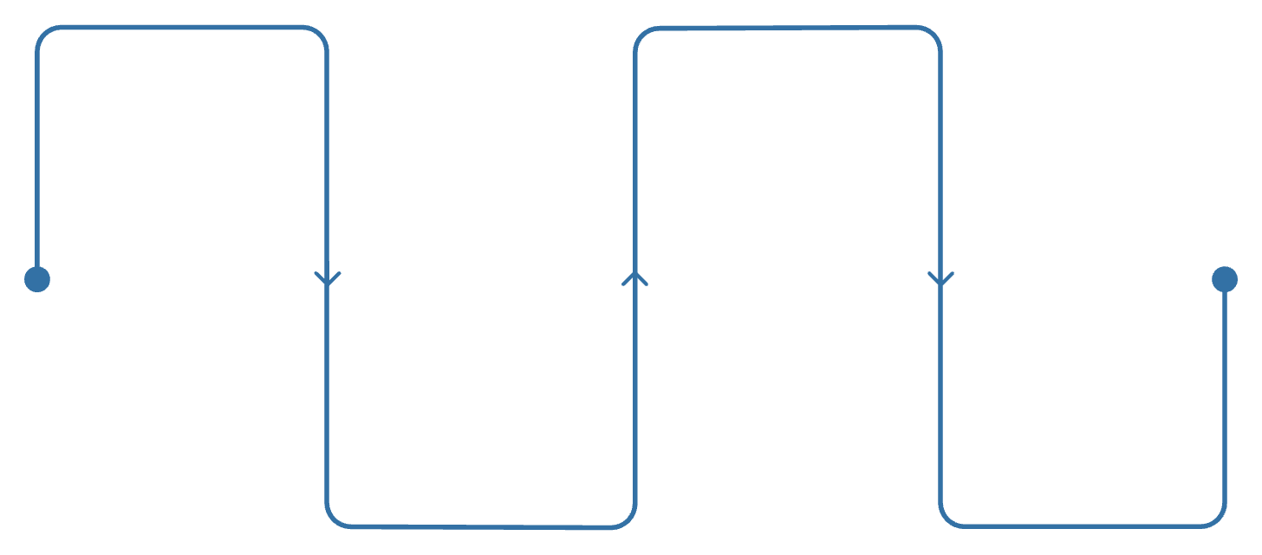



PyQuest Design Principle & Safe Execution
Restricted Executor Pipeline
AST Validation
Child Process
Parse and inspect syntax tree; block imports, file/network, reflection, dunders, unsupported syntax
Spawn isolated multiprocessing child process for execution
Core Engineering Principle
Not everything should be agentic. Use deterministic logic where correctness and reproducibility are required; generative AI where explanation, adaptation, and natural language add genuine value.
Stages: print → input → variables → conditions → loops → functions. 3 verified correct answers required per stage.
Allowlist Check
Timeout & Output
Restrict to safe builtins; max code 8000 chars; max range 10000
Default 1.5s timeout; max output 4000 chars; normalized result to Evaluator
Restricted educational executor — NOT a production hostile-code sandbox.
Deterministic
AI-Assisted
Mastery checks · unlock thresholds · stage progression · attempt verification
Story generation · remediation explanation · adaptive language and context

Slide 8
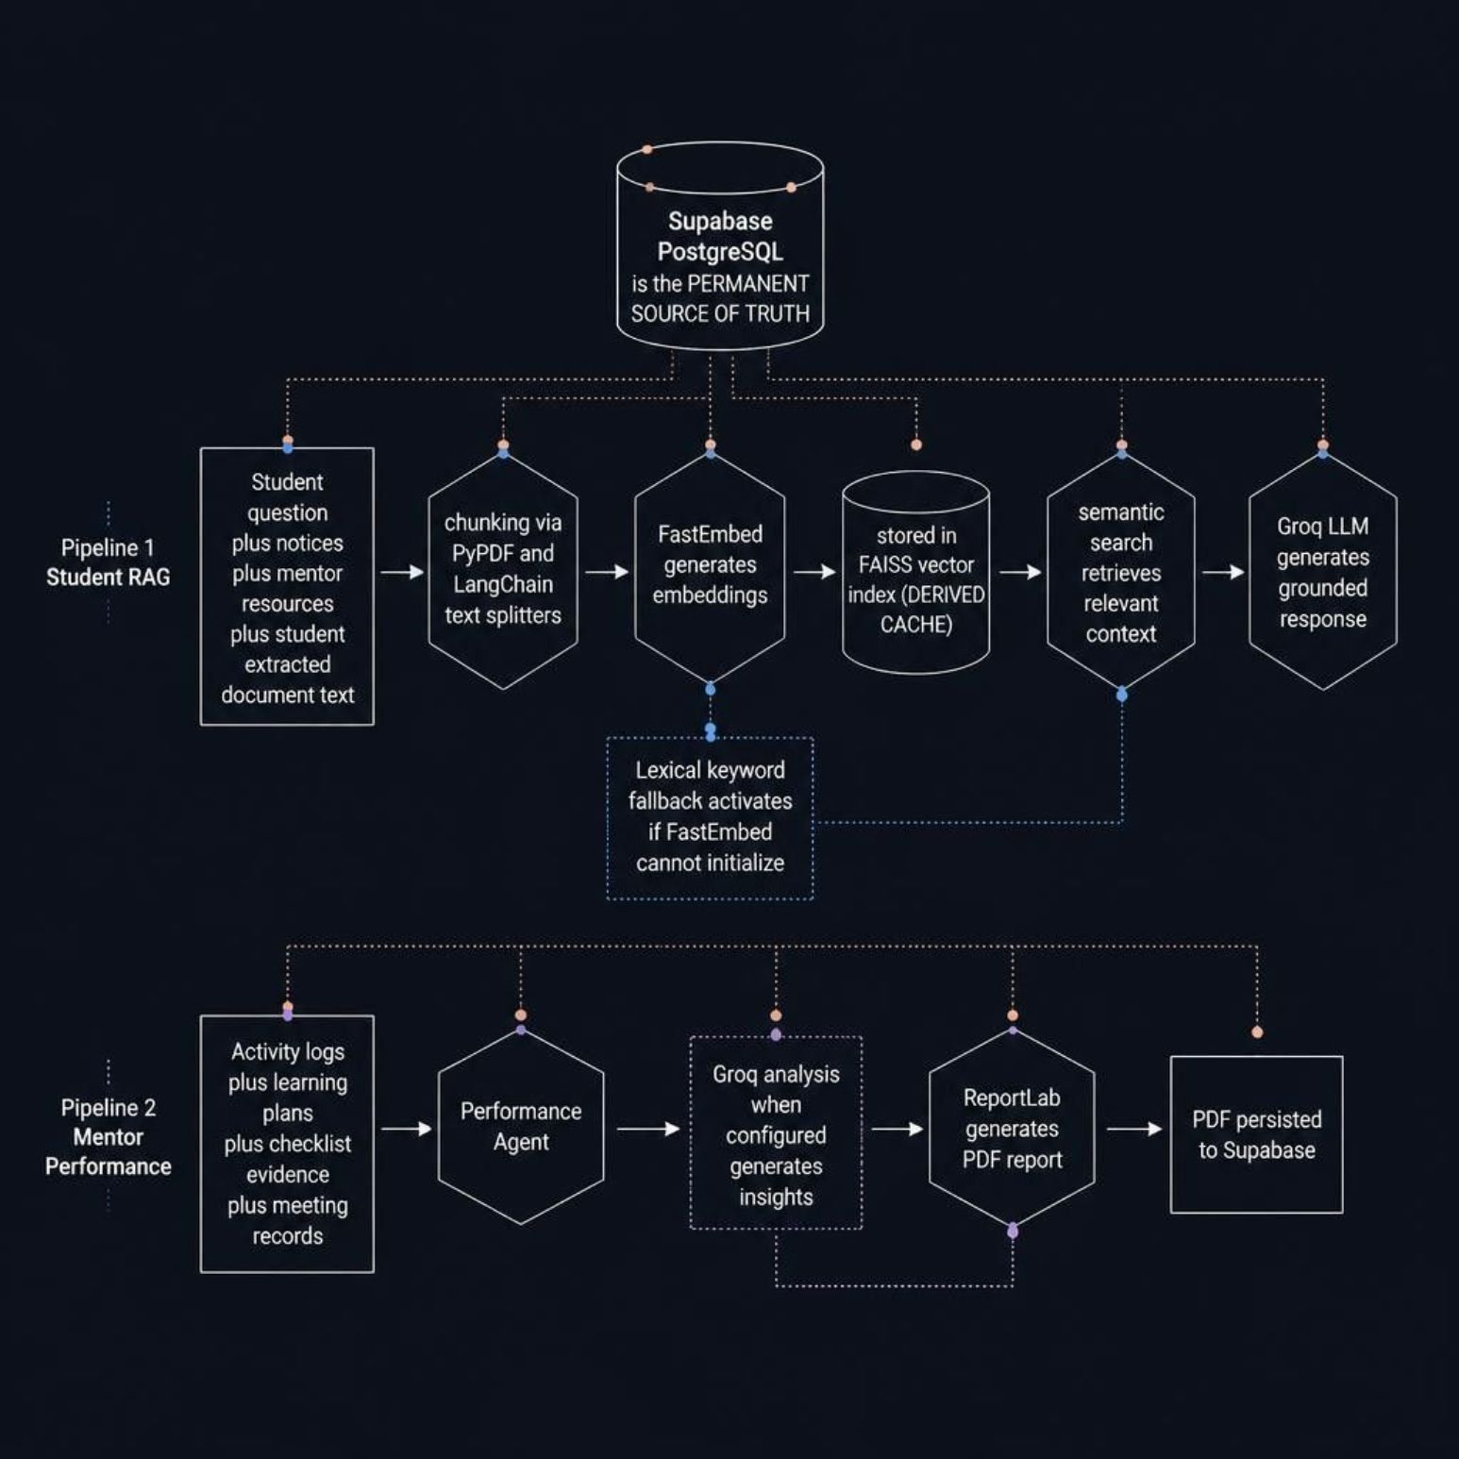


Private RAG & Mentor Intelligence Pipeline
Supabase / PostgreSQL
FAISS Index
Derived retrieval cache. Rebuilt from Supabase content; not an independent data store.
Permanent source of truth. All notices, resources, and verified attempts live here.
Lexical Fallback
Mentor PDF Report
Keyword-based retrieval activates automatically if FastEmbed cannot initialise.
Evidence-driven analysis via Groq → ReportLab PDF → persisted. No invented scores.

Slide 9


Reliability, Docker & Deployment Learning
FUTURE
API / Service separation
Job queue + isolated Docker workers
CURRENT
Decouple Streamlit UI from backend execution services
Student code runs in isolated containers — hardened execution boundary
Supabase persistence
All verified attempt and progress data durably stored
Provider fallbacks
OS limits · RLS · Observability
Lexical retrieval fallback if embedding service unavailable
Syscall restrictions, row-level security, structured logging and testing
Bounded executor
INDEPENDENT DEPLOYMENT LEARNING · NEXT STEP
Timeout, output, and syntax limits on all student code runs
Repo
Domain
GitHub source code and Dockerfiles
Register via GitHub Student Pack
Docker config present
Dockerfile + docker-compose.yml in repository for portable packaging
Deploy
DNS & TLS
Streamlit Cloud publishes the app
Map domain, enable HTTPS for users

Slide 10




This Week → Next Week
THIS WEEK
NEXT WEEK GOAL
01
Working LangGraph Project Demonstration
Architecture refinement
Results will be demonstrated next week — not claimed as complete today.
Intern Nexus module separation and repository organisation
02
"Understand why each architectural decision is made — not only how to make the feature work."
PyQuest development
Agent flow, restricted executor, curriculum mastery logic — current primary focus
03
RAG & agent understanding
Embedding pipeline, FAISS retrieval, LangChain/LangGraph concepts
04
Docker & deployment research
DNS, TLS/HTTPS, containerisation — independent learning following mentor feedback
StateGraph · Nodes · Edges
Conditional Routing · Agent Loop
Defined graph topology with typed state schemas and reducers
Live state transitions, tool calls, and observable routing decisions

