Slide 1


Slide 2


EMBERNET
Offline Emergency Mesh Networking
NO INTERNET • NO CELL SIGNAL • NO BOUNDARIES

Slide 3
PART I
THE CONNECTIVITY GAP

Slide 4


INFRASTRUCTURE FAILURE
When Disaster Strikes
During catastrophic events like the 2022 Pakistan Floods, traditional infrastructure fails immediately. Cell towers are submerged or lose power, leaving millions isolated.
Towers go offline within hours.
Internet-based apps (WhatsApp, Maps) fail.
Rescuers lose the "Golden Hour" to locate victims.

Slide 5

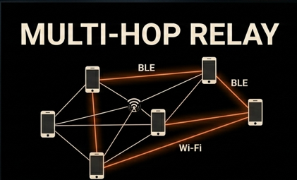

THE MESH SOLUTION
Multi-Hop Relay
EmberNet transforms every Android phone into a network node. Messages hop from device to device, extending communication range far beyond the point of origin without any central server.

Slide 6



CORE CAPABILITIES
Smart SOS
Offline Maps
BLE Mesh
One-tap broadcast of GPS coordinates, battery level, and device ID. Sent every 4 seconds automatically.
Uses pre-cached OSM tiles. Shows safe zones and pulsing red pins for victims with zero data.
Bluetooth Low Energy provides multi-hop delivery reaching up to 50m per hop with minimal power drain.

Slide 7
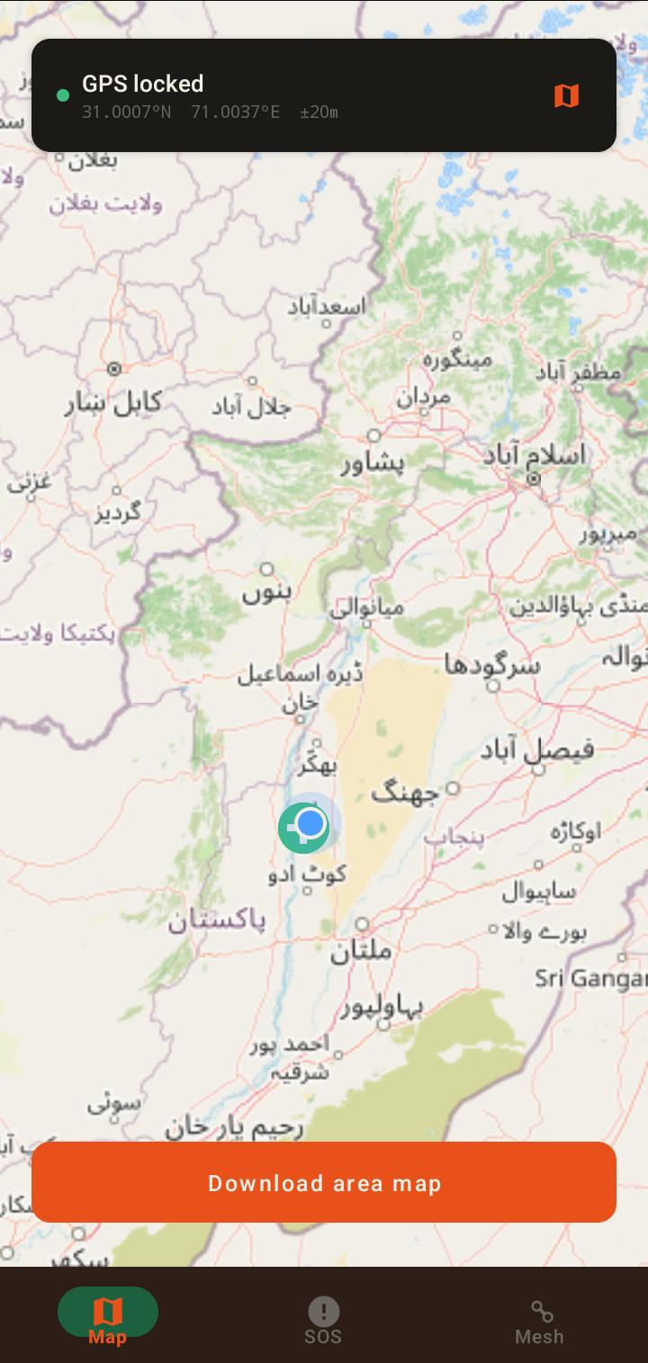
App Screens
MAP Tab
Offline city map
Blue GPS dot
Green safe zone markers
Red SOS alert pins
Download map for offline use

Slide 8
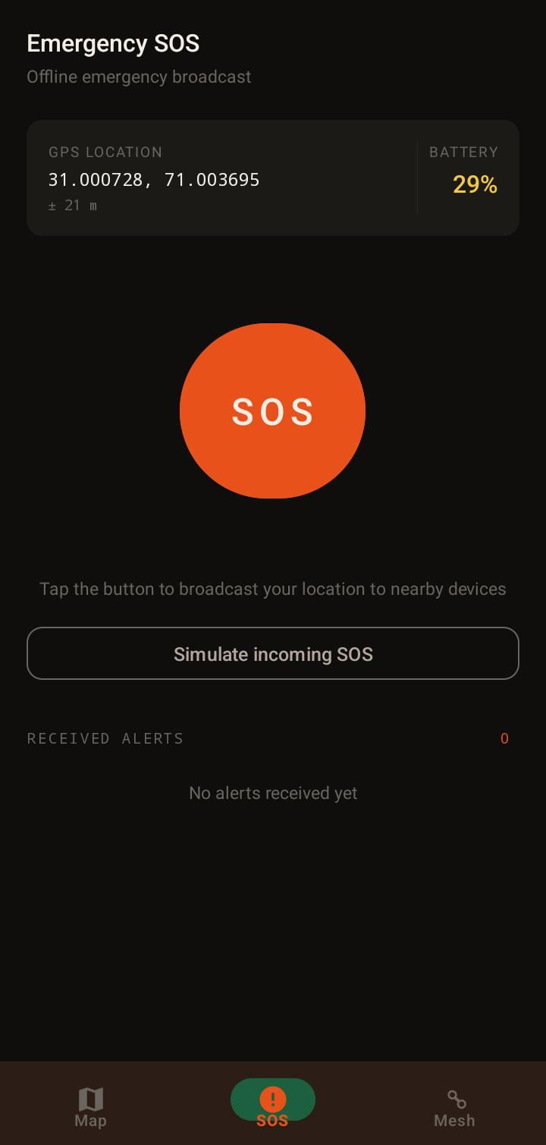
App Screens
SOS Tab
Big orange SOS button
Live GPS coordinates
Battery level display
Broadcast counter

Slide 9
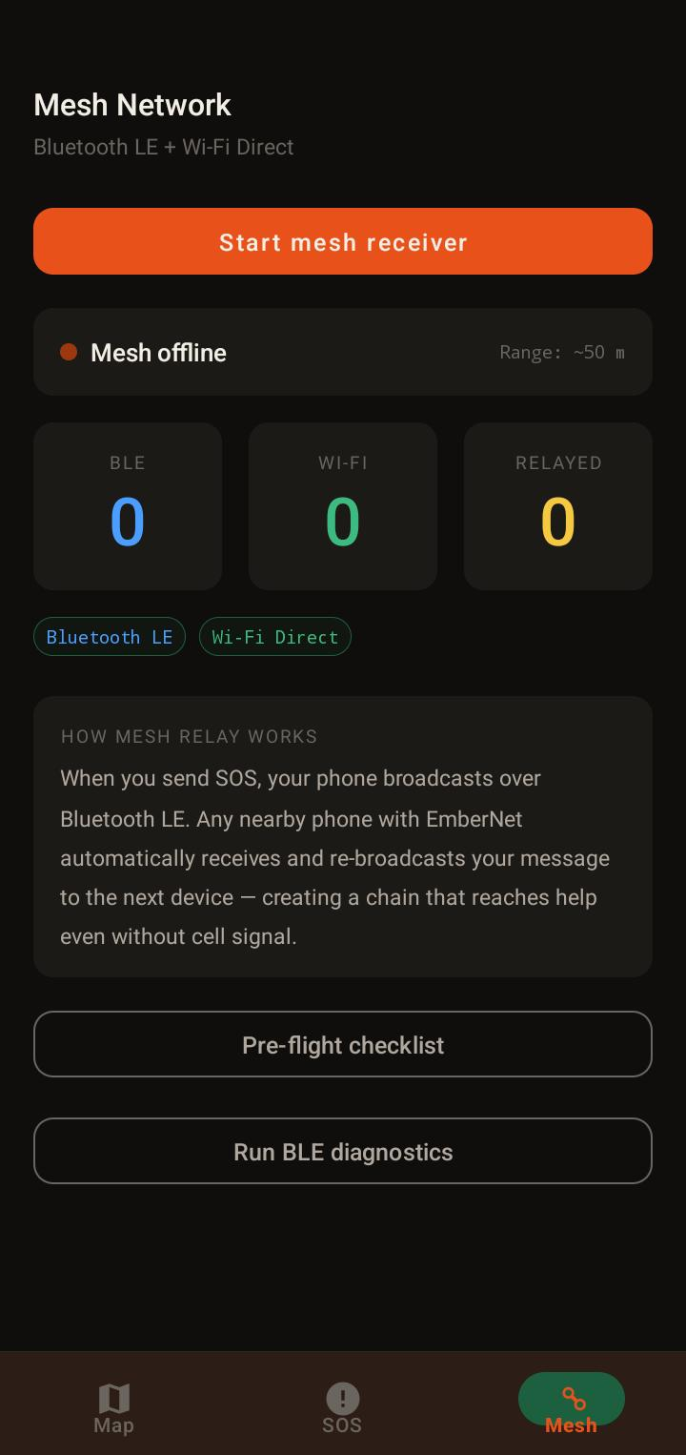
App Screens
MESH Tab
BLE peer count
Wi-Fi Direct peer count
Messages relayed count
Pre-flight checklist
BLE diagnostics

Slide 10
OPERATIONAL WORKFLOW
1. Initiation
2. Broadcast
3. Propagation
4. Reception
5. Visualization
User activates SOS button; app grabs current GPS.
Foreground Service starts BLE advertising payload.
Nearby nodes receive and increment hop count.
Rescuer device triggers vibration and alert card.
Pulsing pin drops on map at exact victim location.

Slide 11
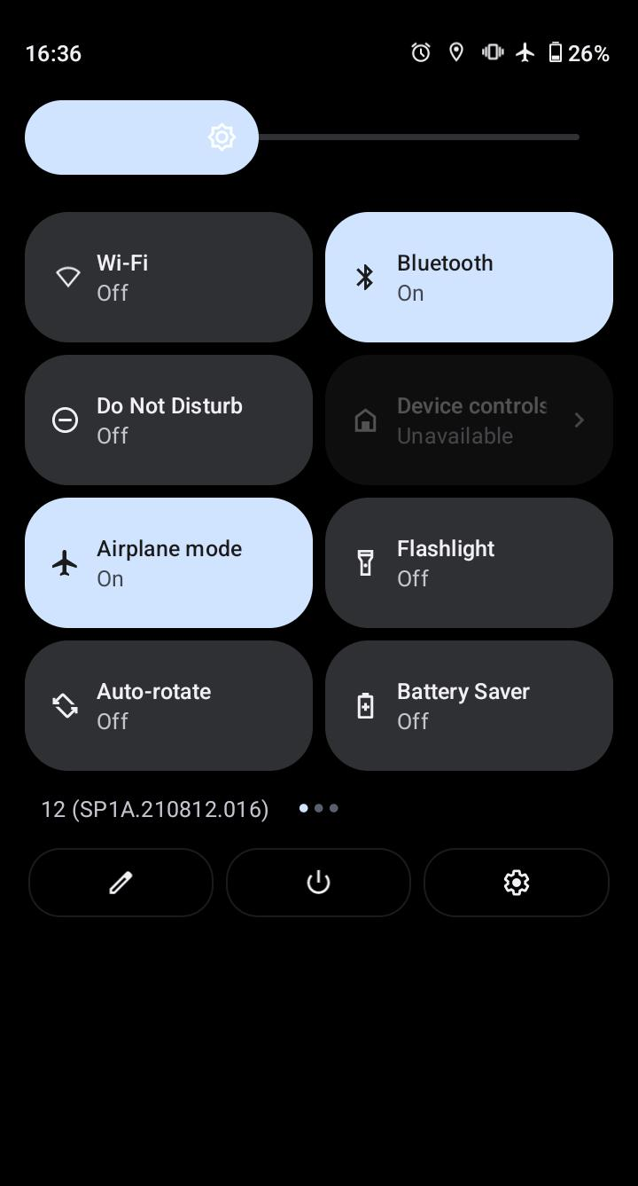
AIRPLANE MODE PROOF
The ultimate test of resilience. EmberNet operates in total isolation.
Internet disabled via Airplane Mode
Bluetooth enabled for P2P only
Real-time location sync between devices

Slide 12
PROJECT IMPACT
0
Efficiency in Numbers
EmberNet was built to maximize survival odds with minimal resources. The system is designed to be lightweight, power-efficient, and universally compatible.
INTERNET NEEDED
25+
200m
4s
JAVA FILES
WIFI DIRECT RANGE
SOS INTERVAL

Slide 13
TECHNOLOGY STACK
Component | Technology | Purpose
Language & IDE | Java | Android Studio | Native performance and reliability
Networking | BLE | Wi-Fi Direct | P2P transmission (Airplane Mode Proof)
Mapping | OSMDroid | OpenStreetMap | Full offline geographic intelligence
Interface | Material 3 | Lottie | Professional UX and high visibility

Slide 14
"When everything goes wrong — EmberNet keeps you connected."
— The Vision Behind the Project

Slide 15
THANK YOU…

