Slide 1
Airbnb NYC
Supply-Demand BI Dashboard
New York City Airbnb Open Data Analysis
Team: Ayesha Salahuddin (29157) | Narin Nadeem (29167)
Dataset: NYC Airbnb Open Data from Kaggle
Supply-Demand
At-Risk & Quality
Pricing & Revenue

Slide 2
Domain Expert Interview
Interviewee
Key Pain Points Identified
Name
Mohammad Shahmeer
01
Data Arrives Too Late
Weekly reports mean demand surges are identified days after they begin, too late to act on host recruitment or pricing.
Role
Asst. Manager
Business Excellence
02
No Automated Alerts
No system flags when supply-demand gap crosses a critical threshold in a neighbourhood, all monitoring is manual.
Company
Livedin
03
Supply Cannot Scale Quickly
Industry
Short-Term Rental
(Pakistan)
Getting a new property live takes several days minimum, the team can't respond to demand spikes in real time.
LinkedIn
linkedin.com/in/mshahr
04
Dashboards Lack Granularity
Current tools (QuickSight + PriceLabs) provide market-level data but don't go deep enough into the customer journey.
"By the time I see the data, it's too late."

Slide 3
Empathy Map - Regional Operations Manager
THINK & FEEL
SEE
Frustrated data arrives too late to act on
Anxious about sudden demand surges
Pressured to recruit hosts faster than tools allow
Motivated to leverage AI and automation
Amazon QuickSight dashboards with lagging data
PriceLabs market pricing data
On-ground property audit reports
Competitors reacting faster to market shifts
HEAR
SAY & DO
Business heads requesting efficiency improvements
Guest feedback via integrated chat systems
Sales team concerns about lead conversion rates
Manually cross-references event calendars with booking data
Conducts regular property audits with on-ground teams
Actively building AI agents to automate guest communication
PAINS
No real-time alerts • Lagging data • No granular customer journey data
GAINS
Real-time demand alerts • Early at-risk warning system • AI-powered automation

Slide 4
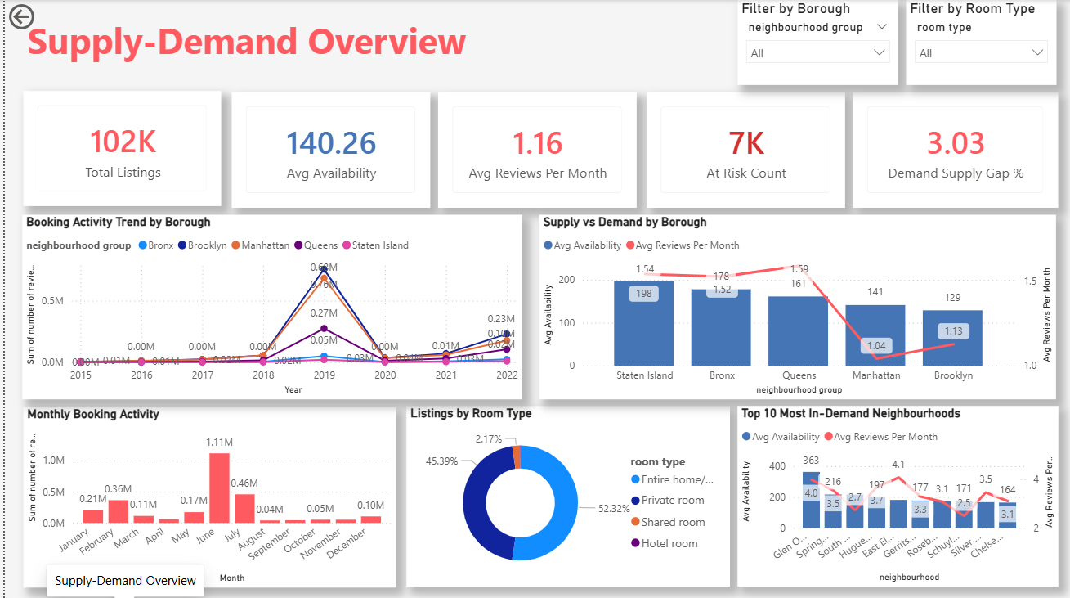
Dashboard 1 - Supply-Demand Overview
Key Insights
102K
Total listings across all 5 NYC boroughs
140
Average availability days per year (supply)
1.16
Avg reviews/month; our demand proxy
7K
At-risk listings needing urgent action
3.03
Demand-supply gap score; market undersupplied
2019
Booking activity peaked; COVID crash in 2020
July
Peak booking month (1.11M reviews)
Glen Oaks
Top priority neighbourhood for host recruitment

Slide 5
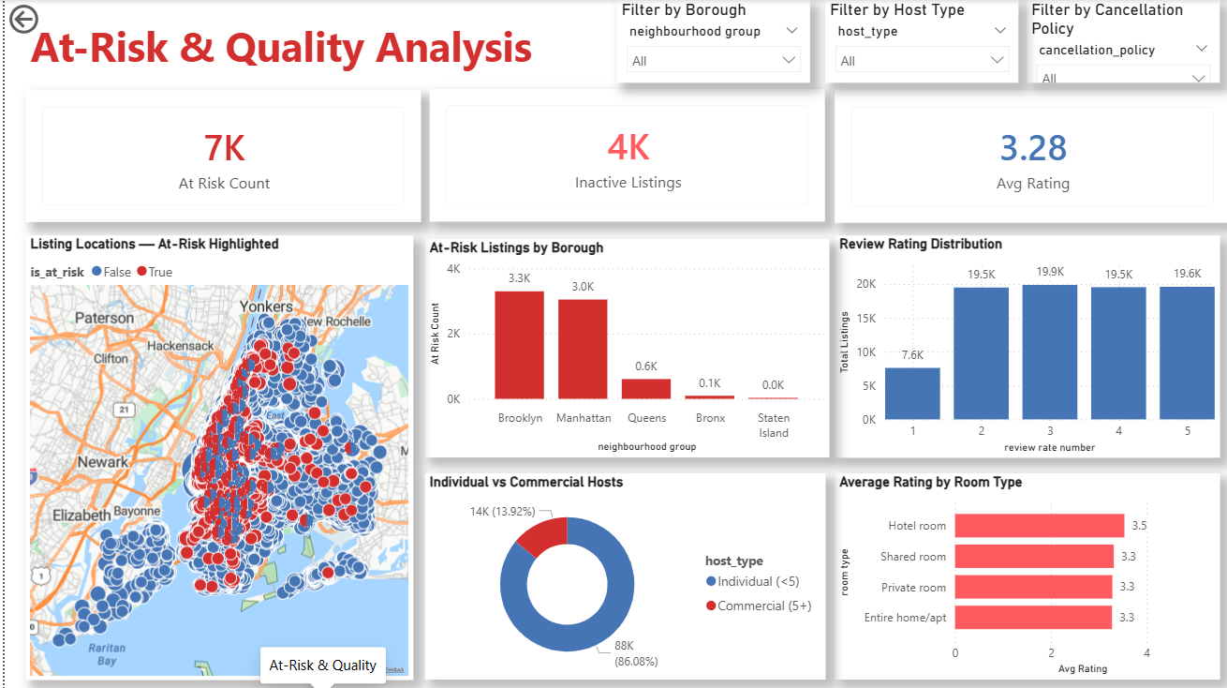
Dashboard 2 - At-Risk & Quality Analysis
Key Insights
7K
At-risk listings showing quality decline signals
4K
Completely inactive listings (0 reviews, high avail)
3.28
Average review rating across all NYC listings
3,300
At-risk listings in Brooklyn — highest borough
3,000
At-risk listings in Manhattan — second highest
86%
Listings managed by individual hosts (<5 listings)
3.5
Hotel rooms have the highest avg rating by type
Map
At-risk listings concentrated in Manhattan & Brooklyn

Slide 6
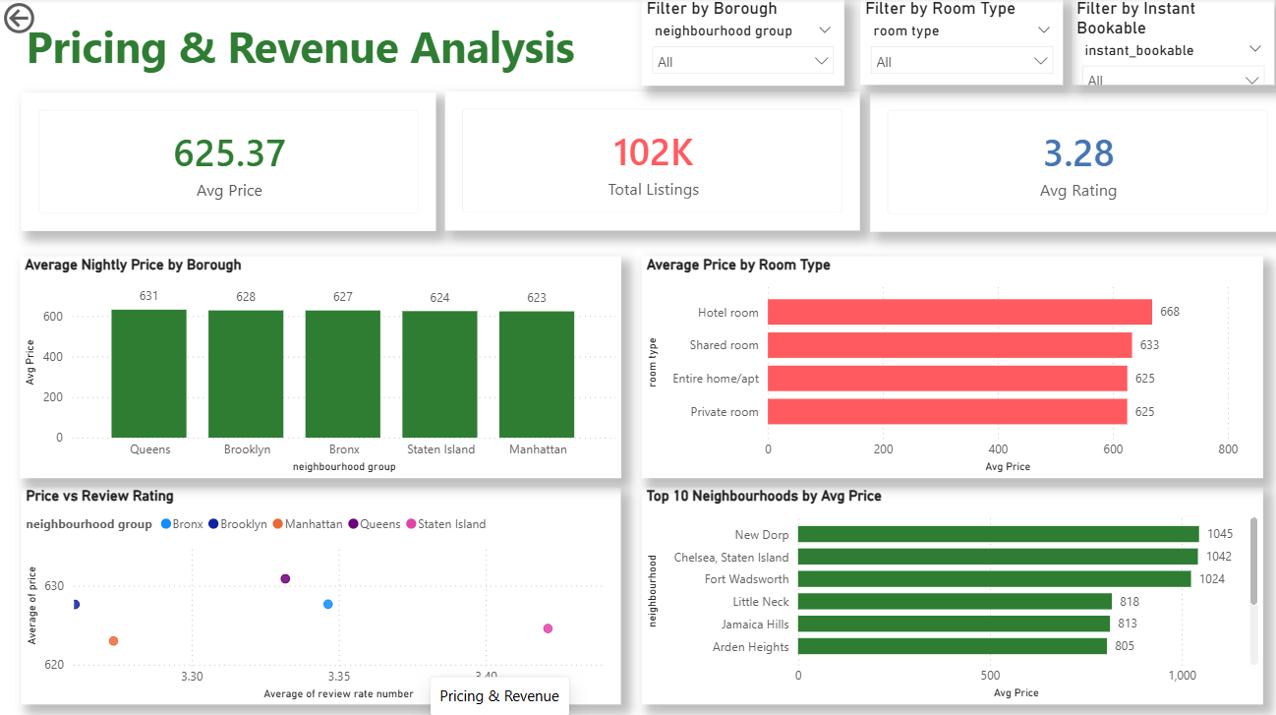
Dashboard 3 - Pricing & Revenue Analysis
Key Insights
$625
Average nightly price — uniform across all boroughs
$8
Difference between cheapest & most expensive borough
$668
Hotel rooms — highest avg price by room type
≈0
Correlation between price and rating (near zero)
$1,045
New Dorp, Staten Island — most expensive neighbourhood
Staten I.
Top 10 most expensive areas — all in Staten Island
$631
Queens — highest avg price borough
$623
Manhattan — lowest avg price borough (surprising!)

Slide 7
The NYC Airbnb Supply-Demand Story
01
THE PROBLEM
02
THE EVIDENCE
03
THE RISK
04
THE SOLUTION
102K listings but 7K are at-risk
4K are completely inactive
Operations team is REACTIVE —
acts only after demand has passed
Booking peaked in 2019
COVID crash in 2020
Manhattan & Brooklyn: lowest
availability, highest demand
Brooklyn: 3,300 at-risk listings
Manhattan: 3,000 at-risk listings
Declining reviews + low ratings =
market quality degradation
Recruit hosts in Glen Oaks &
Spring Creek (highest gap areas)
Prioritize hotel rooms ($668 avg)
Real-time alerts = act in hours
This dashboard moves the operations team from REACTIVE to PROACTIVE decision-making; identifying gaps before revenue is lost.

