Slide 1

Ayesha Salahuddin 29157 · Narin Nadeem 29167
Business Intelligence | April 28, 2026

Slide 2
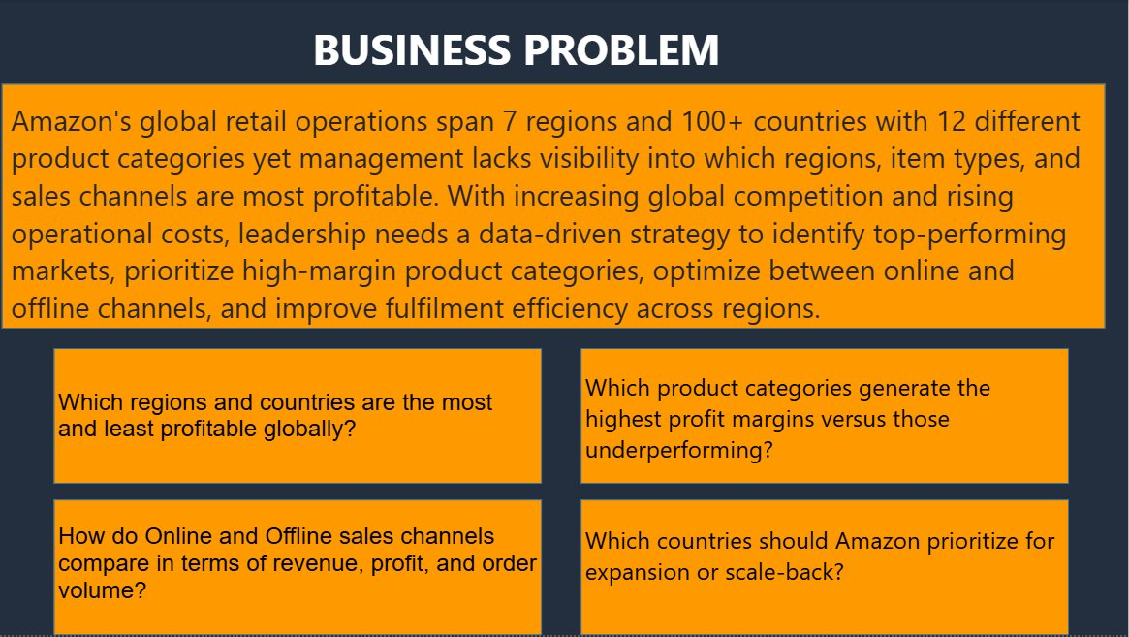
BUSINESS PROBLEM
KEY INSIGHTS
🌍
Operations span 7 regions & 100+ countries
📉
Management lacks profitability visibility
🏆
Goal: identify top markets & categories
⚡
Need to optimize Online vs Offline channels
4 key questions guided our analysis — each answered through a dedicated Power BI report page.
2 / 8

Slide 3
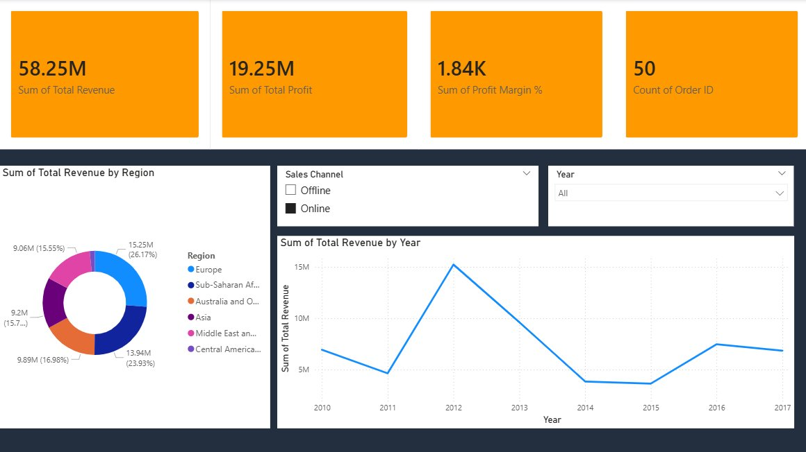
EXECUTIVE SUMMARY
$58.25M
$19.25M
50 Orders
Total Revenue
Total Profit
Captured in dataset
💡 Europe leads revenue at 26.17% share — with a clear sales dip in 2014 followed by gradual recovery through 2017.
3 / 8

Slide 4
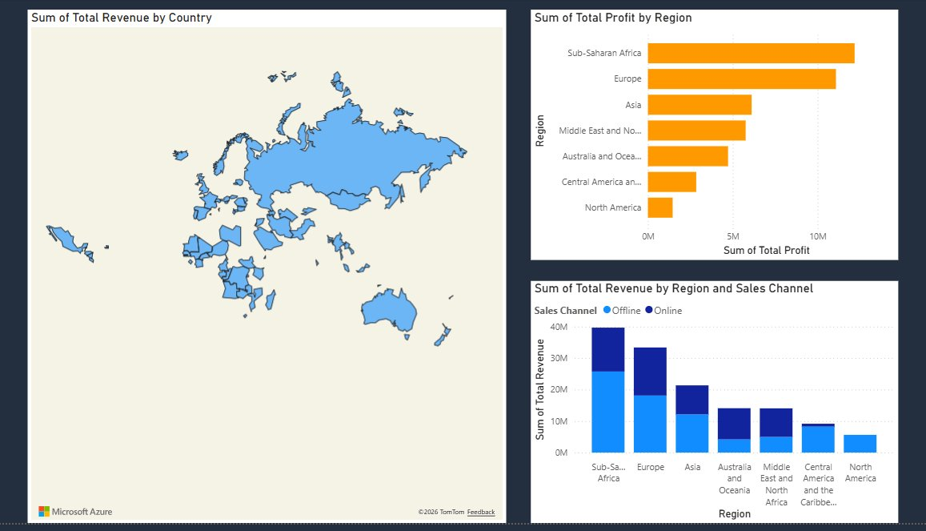
REGIONAL ANALYSIS
🥇 Sub-Saharan Africa
🥈 Europe
⚠️ North America
Highest profit region — challenges the Western dominance assumption
Strong #2 with consistent Online & Offline split
Lowest profit region — needs strategic review
4 / 8

Slide 5
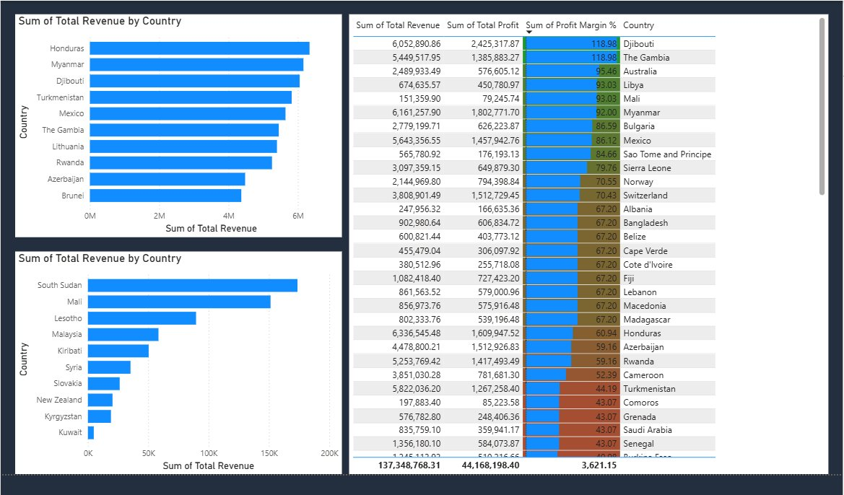
COUNTRY PERFORMANCE
🏆
Honduras & Myanmar top revenue — emerging markets outperform
💰
Djibouti & The Gambia lead profit margin at 118.98%
📉
Kuwait & Kyrgyzstan are the lowest revenue contributors
5 / 8

Slide 6
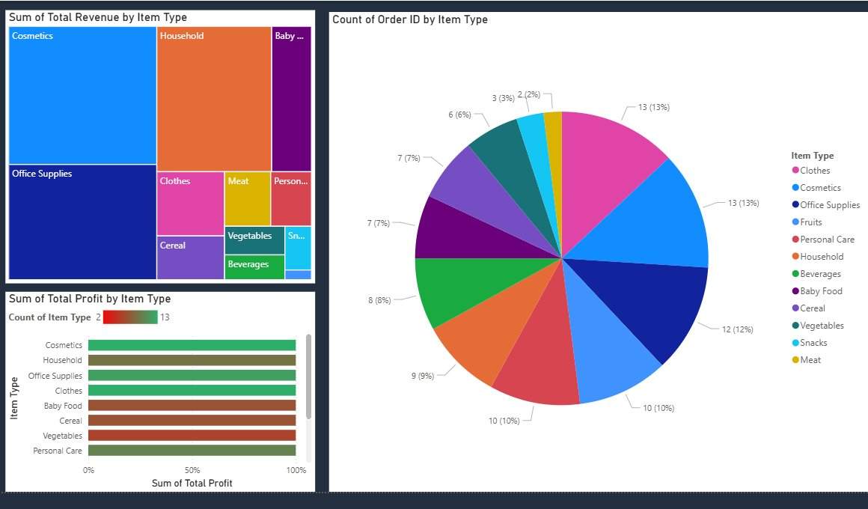
CATEGORY PERFORMANCE
Cosmetics #1
Office Supplies
Balanced Orders
Largest revenue share in treemap — dominant category
Top profit performer with the highest margins
Clothes & Cosmetics tied at 13% of total order count
6 / 8

Slide 7
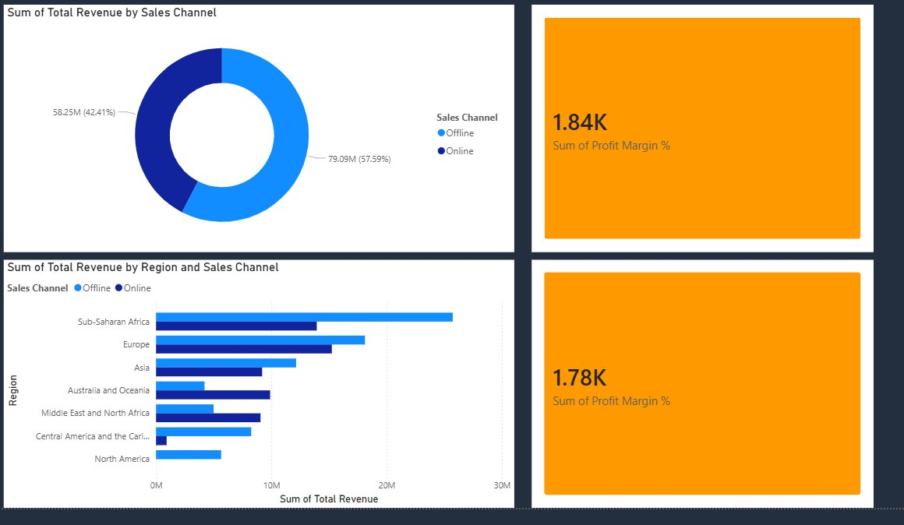
SALES CHANNEL COMPARISON
Offline Dominates
Africa Leads Both Channels
Offline revenue ($79.09M / 57.6%) outperforms Online.
Sub-Saharan Africa tops revenue in both Online and Offline — confirming its position as the #1 global market.
7 / 8

Slide 8
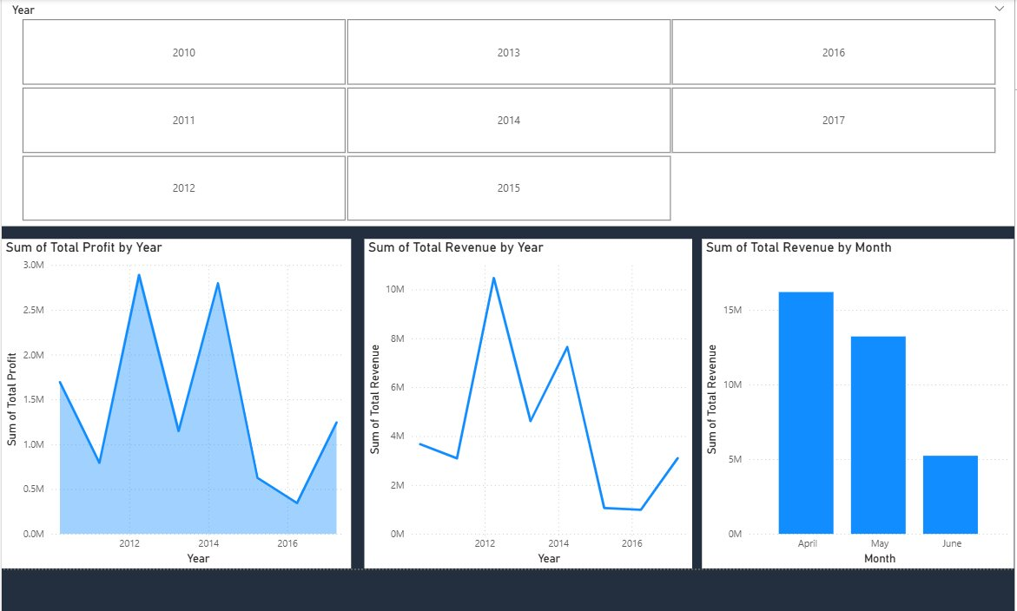
TIME SERIES ANALYSIS
📈 2012 Peak
📉 2014 Crash
📅 Apr is Best
Highest revenue & profit year across the entire period
Revenue and profit both collapsed — needs investigation
April is the strongest single month by total revenue
8 / 8

Slide 9
RECOMMENDATIONS
01
Fix the 2014 Crash
02
Invest in Africa
Investigate the sharp dip — was it market saturation, competition, or supply chain? Prevent recurrence.
Sub-Saharan Africa is the #1 revenue and profit region. Increase fulfilment capacity and local marketing.
03
Grow Online Channel
04
Prioritize Cosmetics & Office Supplies
Offline (57.6%) outperforms Offline in revenue. Shift marketing budget toward digital for higher returns.
These two categories dominate both revenue and profit. Expand SKUs and negotiate better supplier terms.
THANK YOU
Questions? · Amazon Global Sales Analysis · BI Assignment · April 28, 2026

