Slide 1
Data Retrieval - I
Database Sessional
Department of CSE, BUET

Slide 2
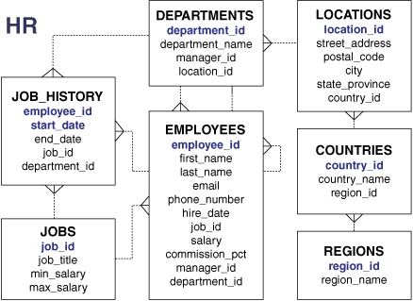
Sample query
Find first names of all employees.
SELECT FIRST_NAME
FROM EMPLOYEES;

Slide 3
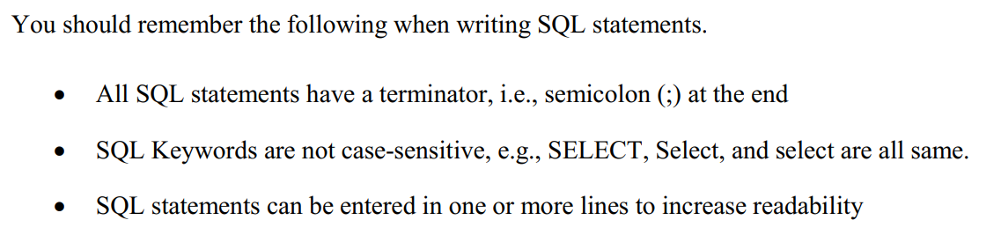
SQL
SELECT FIRST_NAME
FROM EMPLOYEES;
select first_name
from employees;

Slide 4
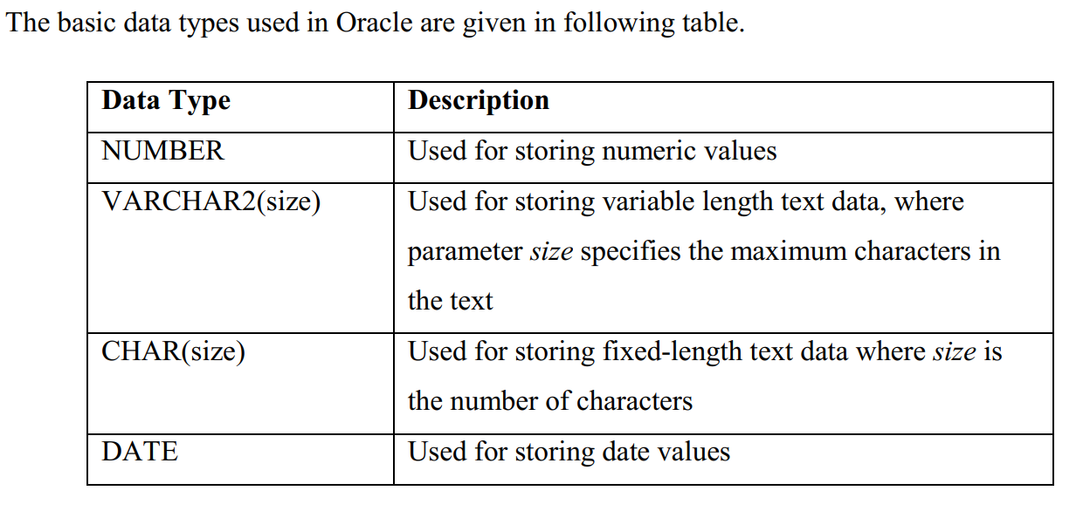
Data Type

Slide 5
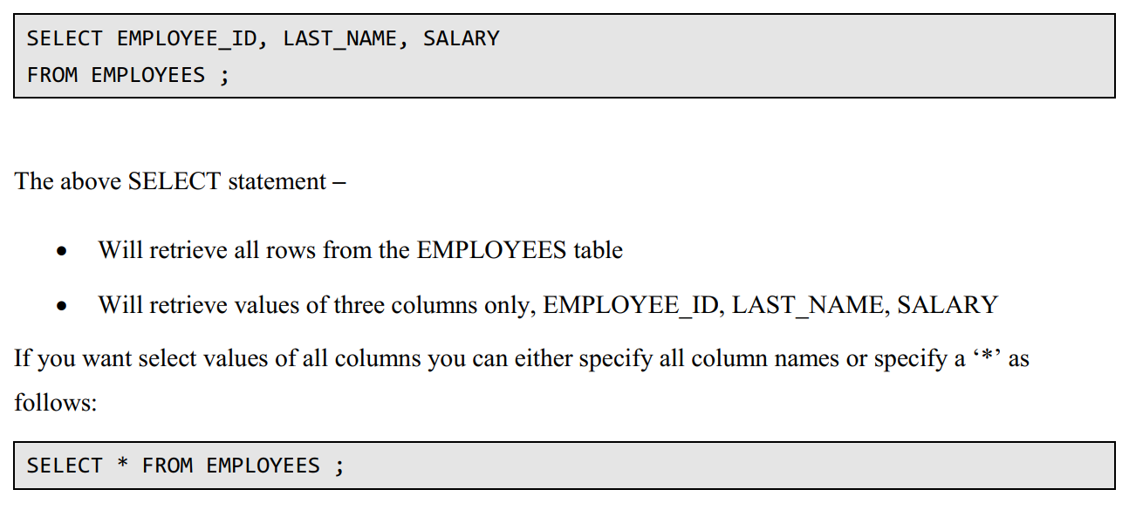
Select Columns

Slide 6
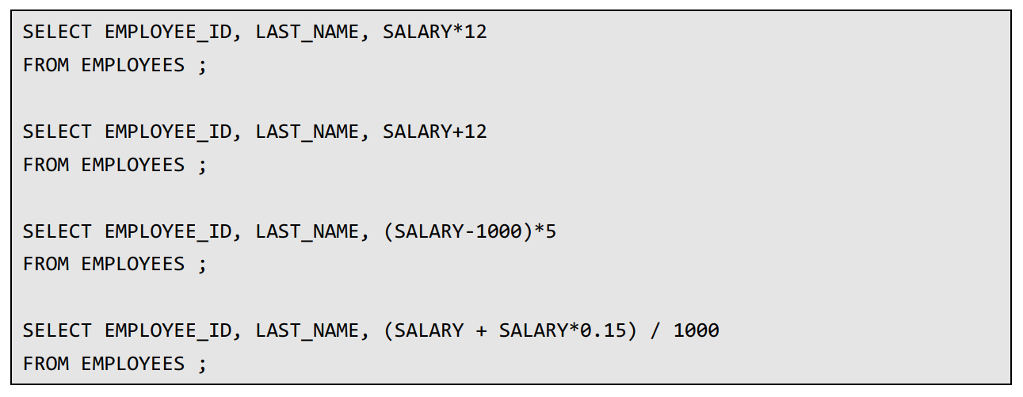
Expression

Slide 7
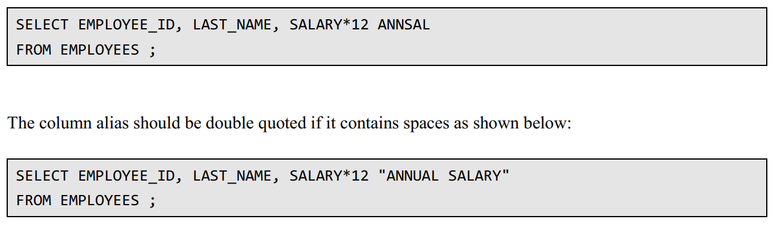
Alias

Slide 8
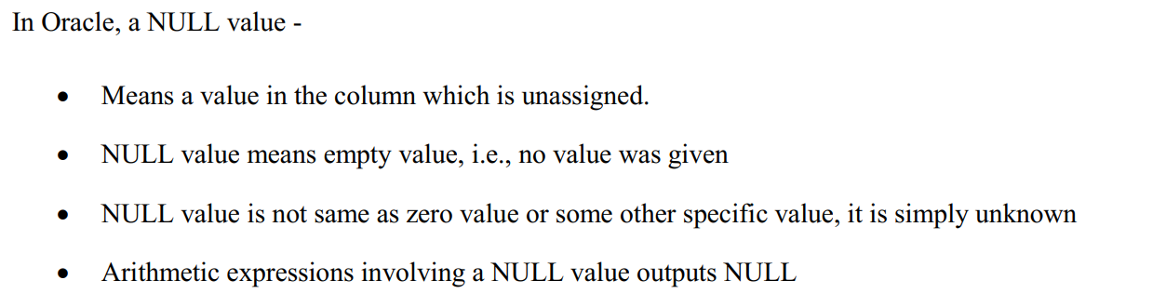
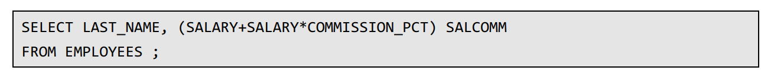
NULL value

Slide 9
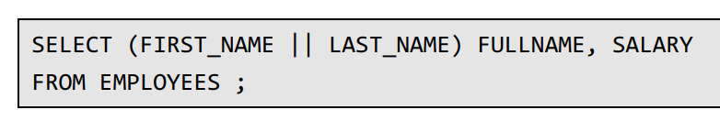
Concatenation

Slide 10
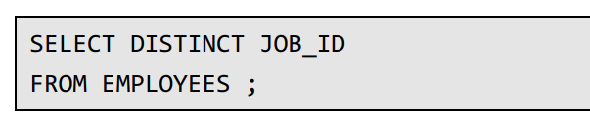
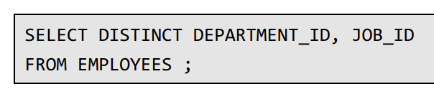
DISTINCT
To remove duplicates

Slide 11

Write an SQL query to retrieve all country names.
Write an SQL query to retrieve all job titles. Remove duplicates.

Slide 12
WHERE clause

Slide 13
Scenario
Find LAST_NAME and SALARY of employee whose EMPLOYEED_ID is 100.

Slide 14
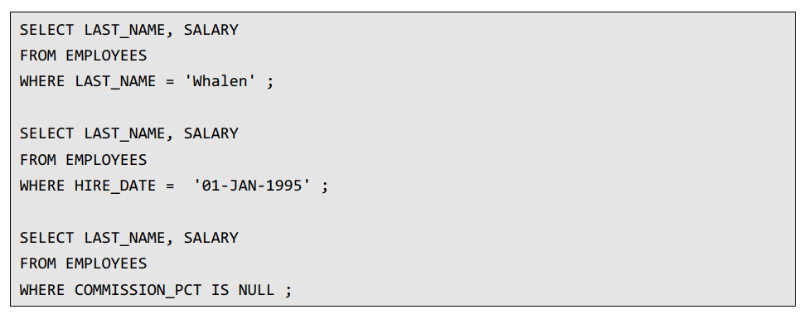

Slide 15
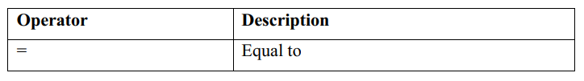
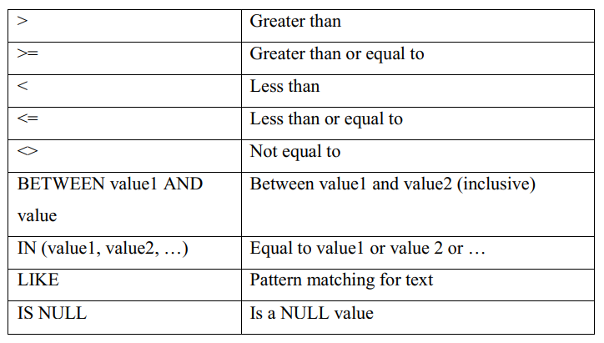
Operator

Slide 16
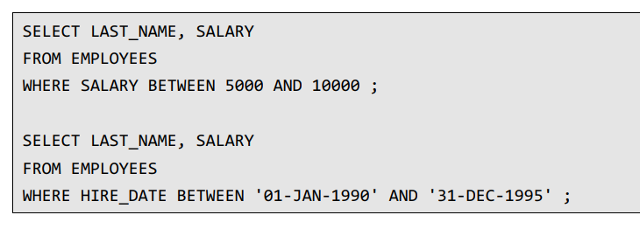
Between

Slide 17
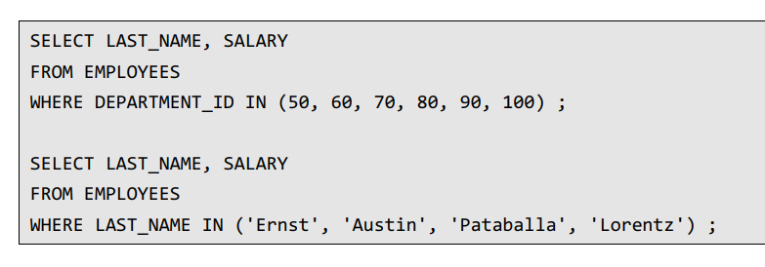
IN

Slide 18
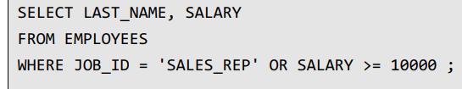
Multiple Condition
Find the employees who are sales representative (SALES_REP) and has salary at least 10000.

Slide 19
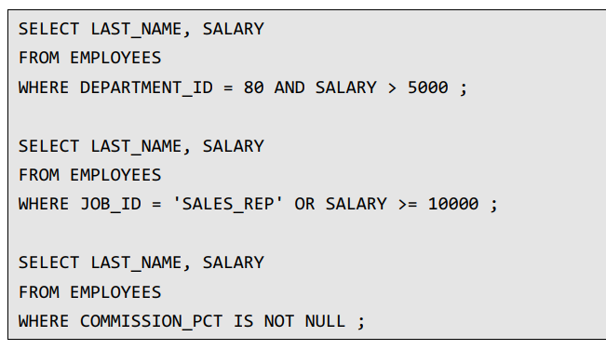
Multiple Condition

Slide 20
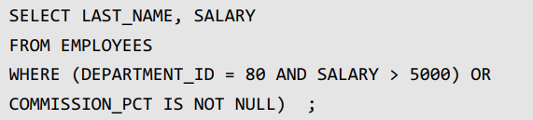
Nested Condition
Find last name and salary of employees who either works at department 80 and has more than 5000 salary or whose commission percentage is not NULL.

Slide 21
Select all department names whose MANAGER_ID is 100
Find full names of all employees who have joined before January 01, 1998.

