Slide 1
Data Retrieval - II
Database Sessional
Department of CSE, BUET

Slide 2
Sorting

Slide 3
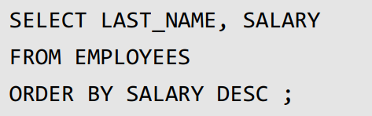
Scenario
Rank employees by their salary
From highest salary to lowest salary

Slide 4
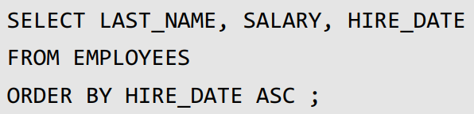
Order by

Slide 5
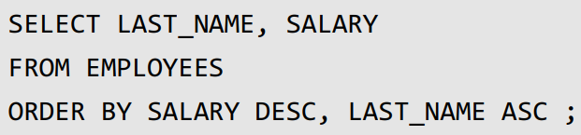
Multiple Order by
Rank by salaries from highest to lowerst
For same salary order by last name alphabetically

Slide 6
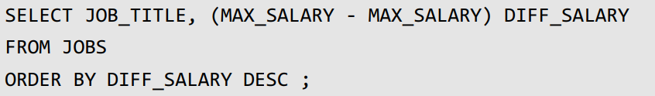
Order by Aliasing
Sort departments by difference in salary.
Departments with higher difference in salary will be placed on top
MIN_SALARY

Slide 7
Order of Execution

Slide 8
Execution so far
FROM
WHERE
SELECT
Order by

Slide 9
Practice
Retrieve all country names in lexicographical ascending order.
Select names, salary, and commissions of all employees of job type ‘SA_REP'. Sort the result in ascending order of commission and then descending order of salary.

Slide 10
Pattern Matching

Slide 11
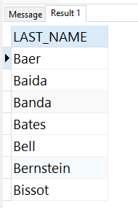
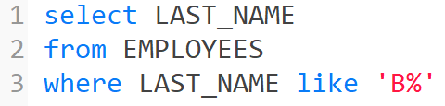
Scenario
Select last names of employees whose last name starts with a ‘B'

Slide 12
% Operator
Means zero or more characters
‘B%’
Bear, Batman, B, Book
Anything that starts with B
‘%b’
Comb, bomb, b
Anything that ends with b

Slide 13
% Operator
Means zero or more characters
‘%b%’
Facebook, b
Anything that has b
‘%oo%’
Google, book, oo
Anything that has oo

Slide 14
_ Operator
Means one character
‘_b’
Ab, ab, yb
Anything that has two characters
And ends with b
‘G__g_e’
Google,

Slide 15
_ Operator
Means one character
‘____’
Abcd, aaaa, dhdh
Anything with four characters

Slide 16
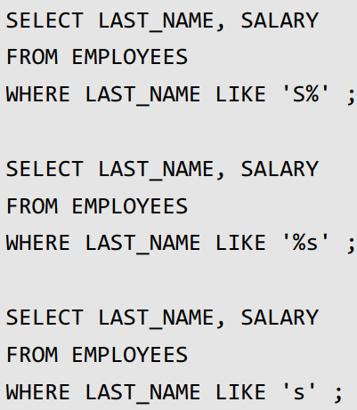
LIKE operator

Slide 17
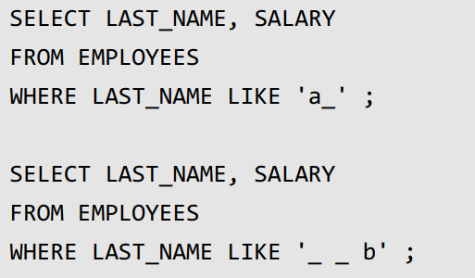
LIKE operator

Slide 18
Practice
Select first names of employees whose last name starts with an ‘A‘
Select first names of employees whose last name starts with an ‘S' and ends with an 'n'

