Slide 1
Data Aggregation
Database Sessional
Department of CSE, BUET

Slide 2

Scenario
Find total salary of all employees

Slide 3


SUM, MAX, MIN, AVG, COUNT
Find total salary of all employees
Find maximum salary of all employees
Find minimum salary of all employees
Find average salary of all employees

Slide 4

Group By
Find the total salary paid by the company to each departments.

Slide 5
Execution Order
FROM
WHERE
GROUP BY
SELECT
Order by

Slide 6
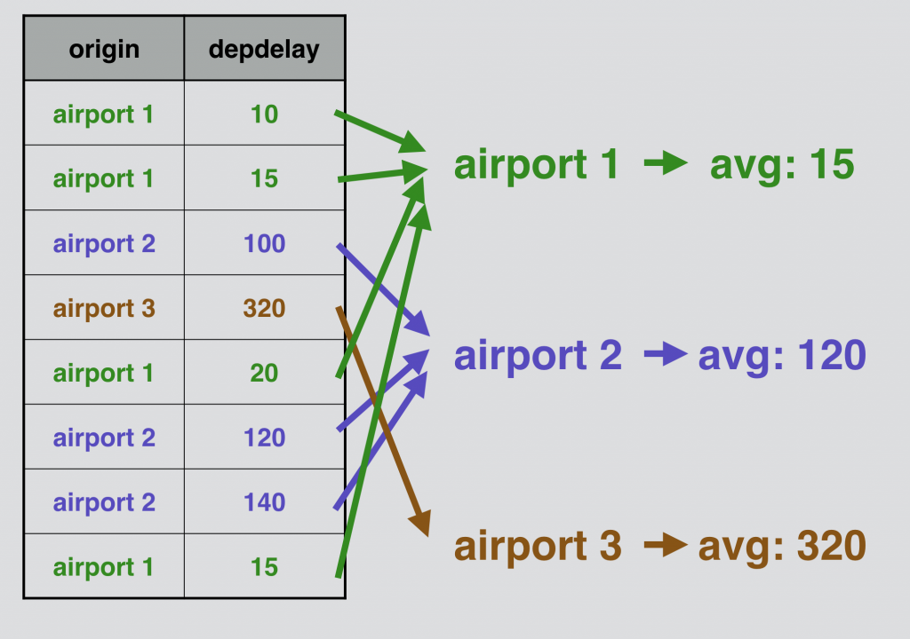
Group by
GROUP BY returns one row for each unique combination of fields

Slide 7
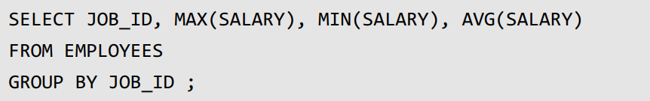
Scenario
Suppose, you want to know the maximum salary, minimum salary and average salary the company pays in different job types.

Slide 8
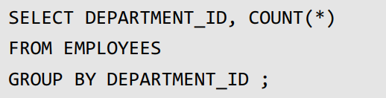
Scenario
Find number of employee in each department.

Slide 9
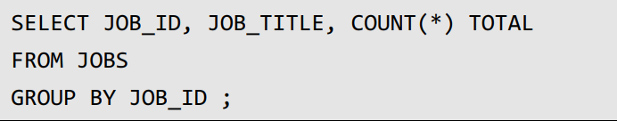
Caution!!!
you cannot select a column that is not present in GROUP BY clause.

Slide 10
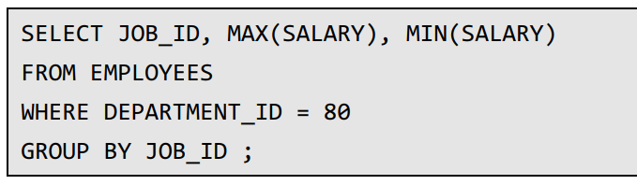
Group by + Where
find the maximum and minimum salary for each job types for only the employees working in the department no. 80.

Slide 11
Group by + Where + Order by
find the maximum and minimum salary for each job types for only the employees working in the department no. 80.

Slide 12
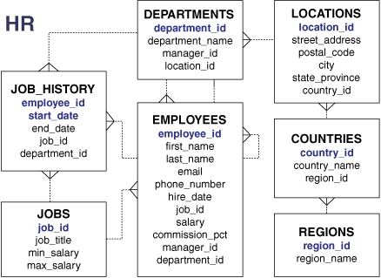
Practice!!!!
For all managers, find the number of employees he/she manages. Print the MANAGER_ID and total number of such employees.
For all departments, find the number of employees who get more than 30k salary. Print the DEPARTMENT_ID and total number of such employees.

Slide 13


Count(*) vs Count(column)

Slide 14
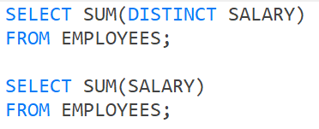
DISTINCT on Aggregation

Slide 15
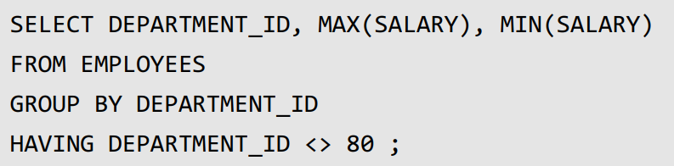
HAVING
Find department wise maximus salary and minimum salary.
But exclude department 80.

Slide 16
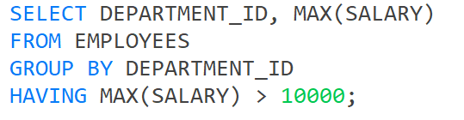
HAVING
Find department wise maximus salary and minimum salary.
Only departments which have maximum salary greater than 10000.

Slide 17
Execution Order
FROM
WHERE
GROUP BY
HAVING
SELECT
ORDER BY

Slide 18
HAVING
FROM
WHERE
GROUP BY
HAVING
SELECT
ORDER BY
HAVING works like WHERE
Except that HAVING works on groups.
HAVING works like WHERE except that HAVING works on groups.

Slide 19
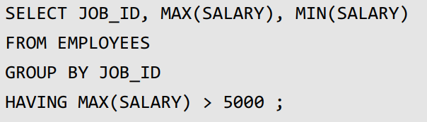
HAVING
Find out maximum and minimum salary for each job types. But only print those jobs which have maximum salary greater than 5000.

Slide 20
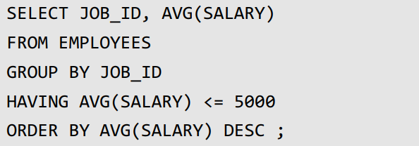
HAVING
Find out average salary for each job types.
But only print those jobs which have average salary less than 5000.
Sort output by descending order of average salary

Slide 21
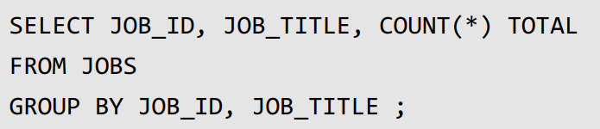
Multiple Column
Find out total number of employees working in each job type. Show job_id, job_title and count.
WRONG!

Slide 22
Multiple Column
Find out total number of employees working in each job type. Show job_id, job_title and count.

Slide 23
Advanced Group By

Slide 24
Problem
Find number of employees in each salary group. Salary groups are considered as follows.
Group 1: 0 to <5000,
Group 2: 5000 to <10000,
Group 3: 10000 to <15000, and so on.

Slide 25

Problem
Find number of employees in each salary group. Salary groups are considered as follows.
Group 1: 0 to <5000,
Group 2: 5000 to <10000,
Group 3: 10000 to <15000, and so on.

