Slide 1
Data Aggregation
Database Management and Administration
Information Access Center
Department of CSE, BUET

Slide 2

Group By
Find the total salary paid by the company to each departments.

Slide 3
Execution Order
FROM
WHERE
GROUP BY
SELECT
Order by

Slide 4
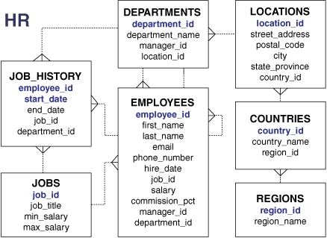
Practice!!!!
For all managers, find the number of employees he/she manages. Print the MANAGER_ID and total number of such employees.
For all departments, find the number of employees who get more than 10k salary. Print the DEPARTMENT_ID and total number of such employees.

Slide 5
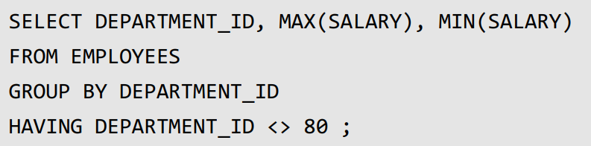
HAVING
Find department wise maximus salary and minimum salary.
But exclude department 80.

Slide 6
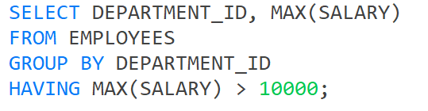
HAVING
Find department wise maximus salary and minimum salary.
Only departments which have maximum salary greater than 10000.

Slide 7
Execution Order
FROM
WHERE
GROUP BY
HAVING
SELECT
ORDER BY

Slide 8
HAVING
FROM
WHERE
GROUP BY
HAVING
SELECT
ORDER BY
HAVING works like WHERE
Except that HAVING works on groups.
HAVING works like WHERE except that HAVING works on groups.

Slide 9
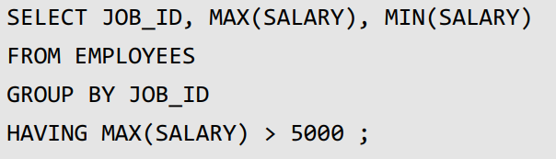
HAVING
Find out maximum and minimum salary for each job types. But only print those jobs which have maximum salary greater than 5000.

Slide 10
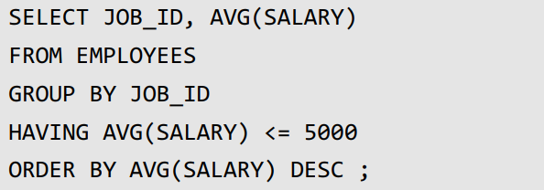
HAVING
Find out average salary for each job types.
But only print those jobs which have average salary less than 5000.
Sort output by descending order of average salary

Slide 11
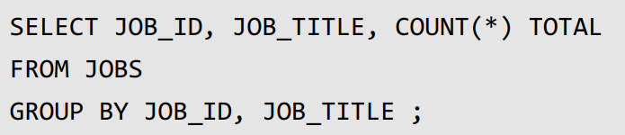
Multiple Column
Find out total number of employees working in each job type. Show job_id, job_title and count.
WRONG!

Slide 12
Multiple Column
Find out total number of employees working in each job type. Show job_id, job_title and count.

Slide 13
Advanced Group By

Slide 14
Problem
Find number of employees in each salary group. Salary groups are considered as follows.
Group 1: 0 to <5000,
Group 2: 5000 to <10000,
Group 3: 10000 to <15000, and so on.

Slide 15

Problem
Find number of employees in each salary group. Salary groups are considered as follows.
Group 1: 0 to <5000,
Group 2: 5000 to <10000,
Group 3: 10000 to <15000, and so on.

Slide 16
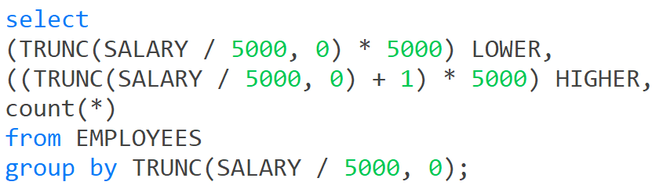
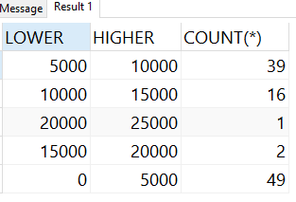
Problem Solution

