Slide 1
Single Row Expression
CSE-216
Department of CSE, BUET

Slide 2
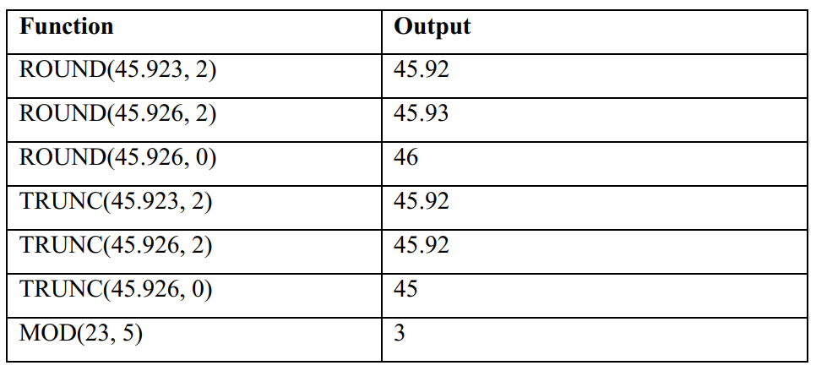
Rounding

Slide 3
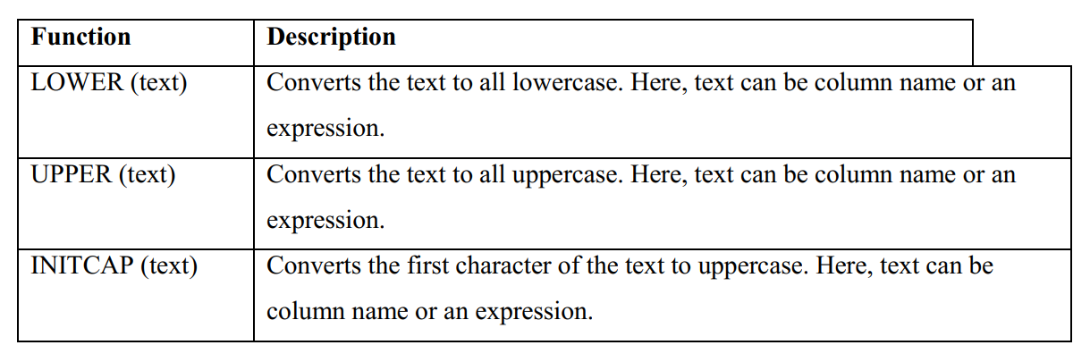
Case Conversion

Slide 4
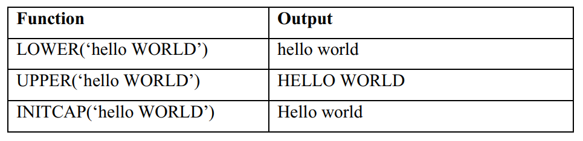
Case Conversion

Slide 5
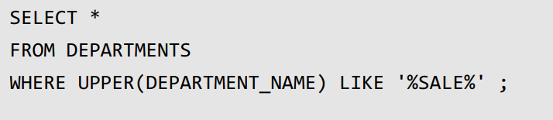
Scenario
Retrieve records of those departments which contain the text SALE in its name.
Name does not have match case.

Slide 6
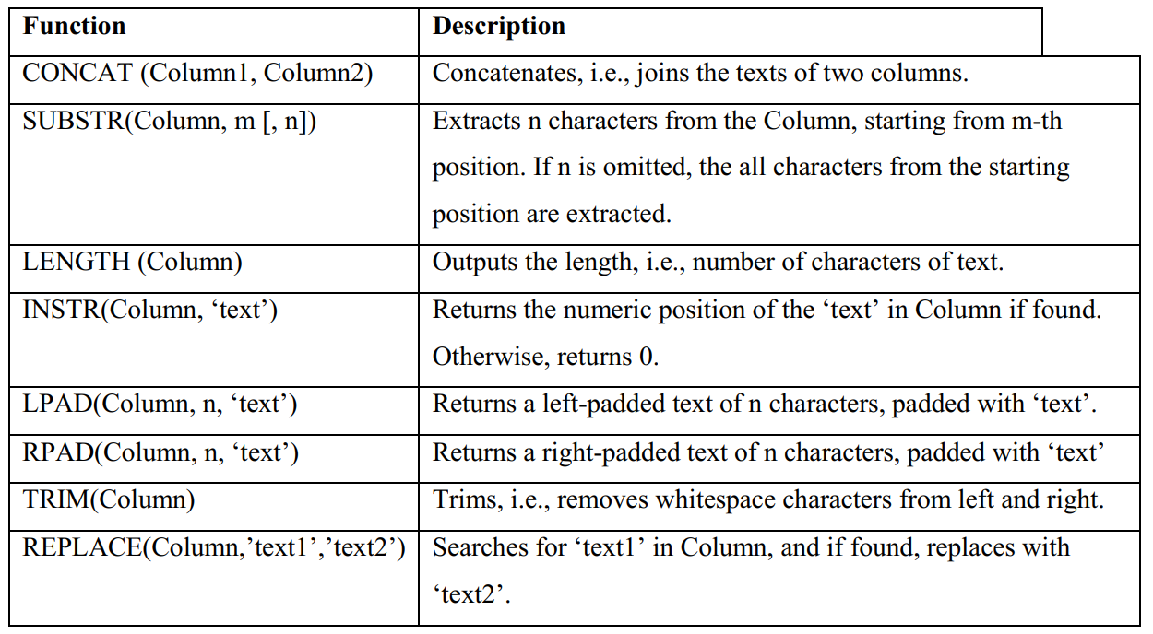

Slide 7
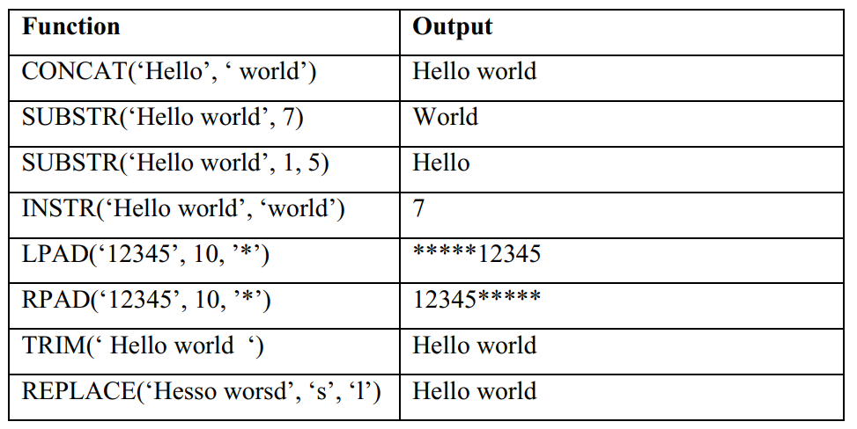
String Operation

Slide 8
Practice
Print the first three characters and last three characters of all country names. Print in capital letters.
Print salaries of all employees in 10 digits.

Slide 9
Current SYSDATE
SELECT SYSDATE
FROM DUAL;

Slide 10
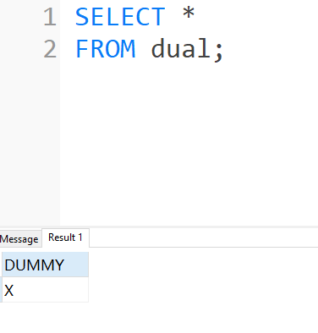
DUAL Table
Dummy table
For execution some queries that don’t require any table

Slide 11
Rounding

Slide 12
How to test the functions?
SELECT ROUND(45.923,2) FROM DUAL;
DUAL is a dummy table

Slide 13
Find number of days each employee has been employeed
Find number of weeks each employee has been employeed

Slide 14
Oracle Data Type

Slide 15
Basic Data
Number
String
Date

Slide 16
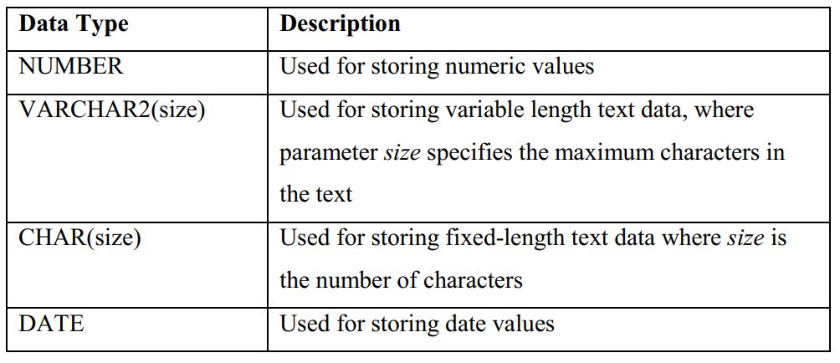
Data Types

Slide 17
Date

Slide 18
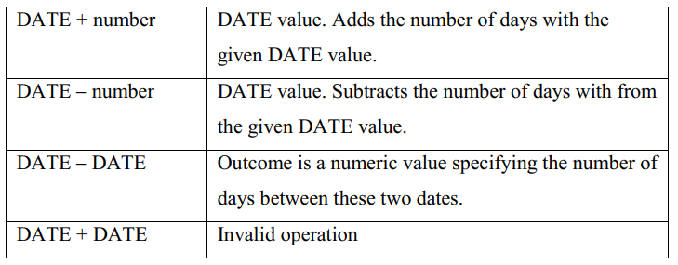

Slide 19
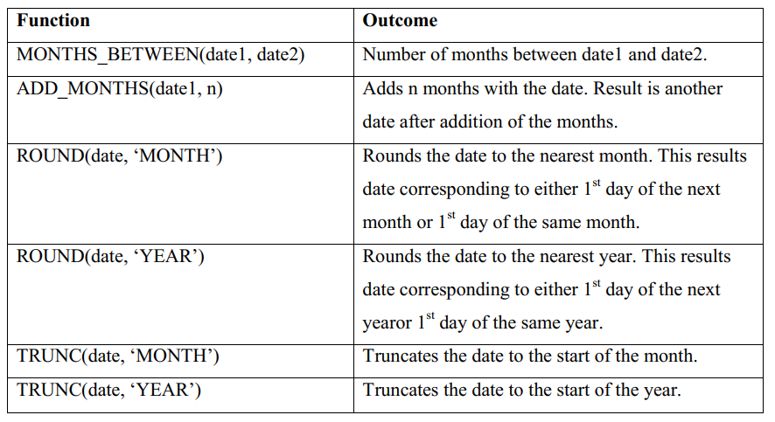
Date Functions

Slide 20
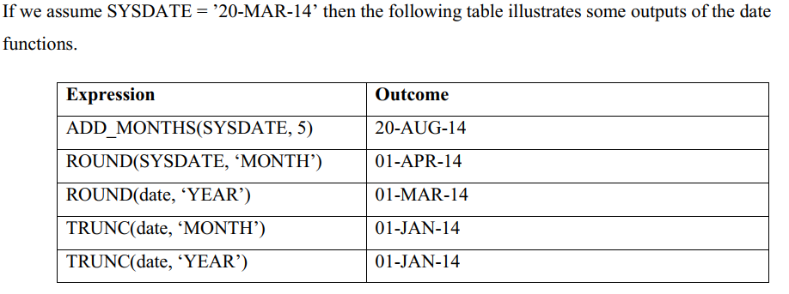
Example

Slide 21
Automatic Type Conversion

Slide 22
Data Types

Slide 23
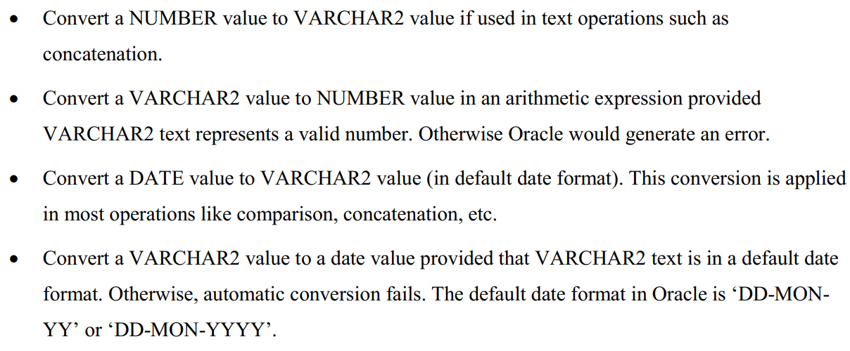
Rules

Slide 24
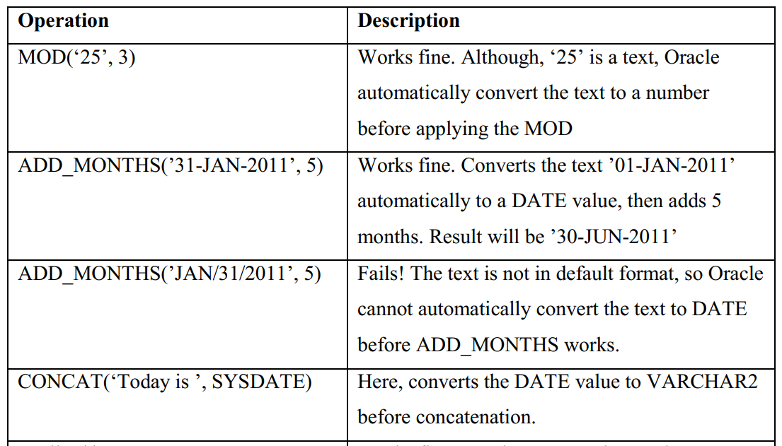
Examples

Slide 25
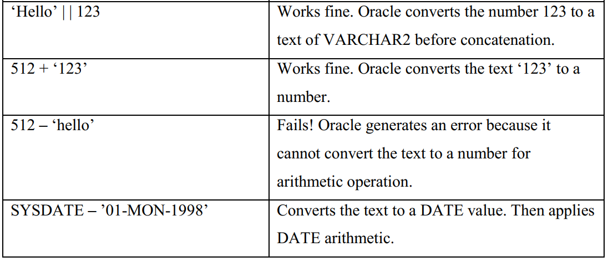
Examples

Slide 26
Type Conversion

Slide 27
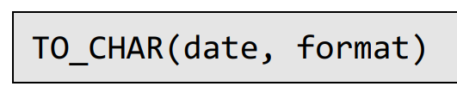
TO_CHAR
Date to String Conversion

Slide 28
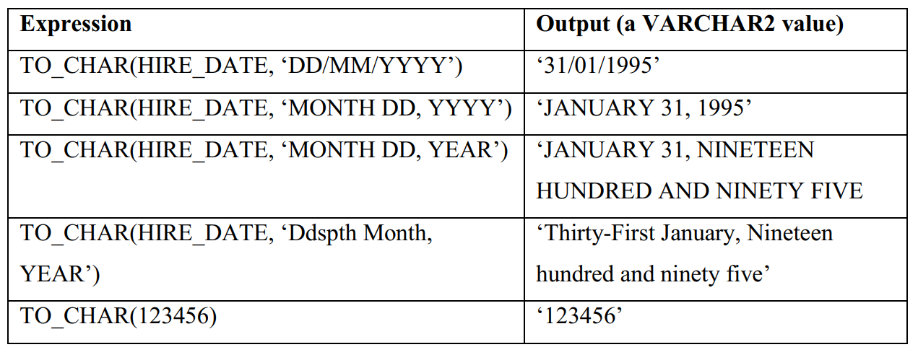
Example
HIRE_DATE is ’31-JAN-1995’.

Slide 29
TO_NUMBER
VARCHAR2 to NUMBER conversion
May not always work
TO_NUMBER(‘123’) => 123
TO_NUMBER(‘a1’) => ERROR!

Slide 30
TO_DATE
VARCHAR2 to DATE conversion
TO_DATE(text, format)

Slide 31
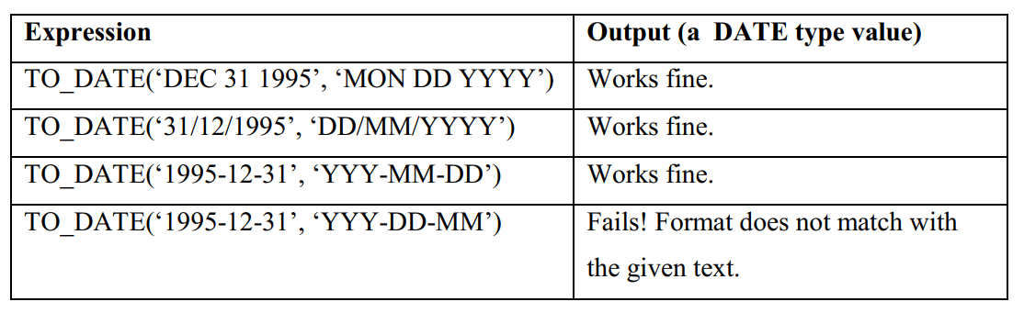
Example
May not always work

Slide 32

NVL
Whenever, COMMISSION_PCT is NULL, the output shows a 0 instead of NULL.

