Slide 1
BSCS-5C
Group Members
Ayesha Urooj SU92-BSCSM-F22-107 Abdul Sami SU92-BSCSM-F22-141
Instructor
Prof. Dr Sohail

Slide 2
Enhanced Disease Detection Using Digital Image Processing for COVID-19, Pneumonia, Brain Tumors, and Alzheimer's Diagnosis

Slide 3
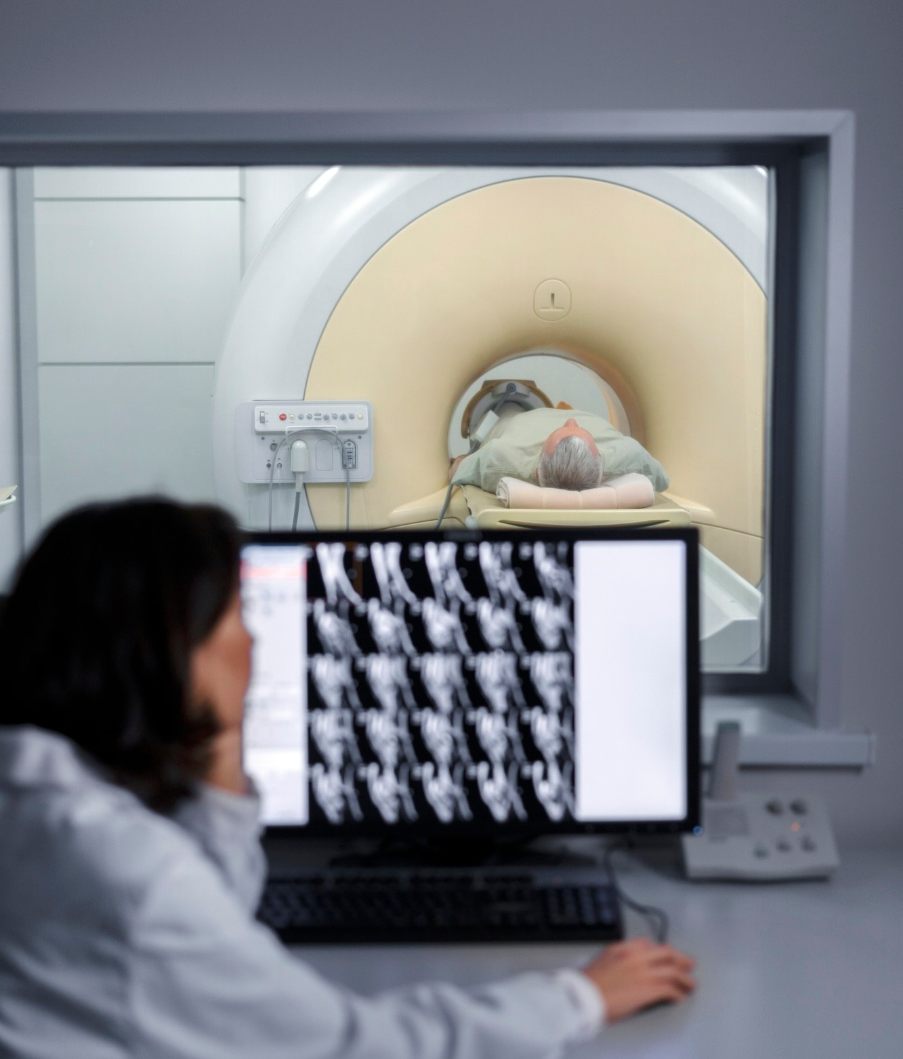
INTRODUCTION TO DISEASE DETECTION
In today's world, digital image processing plays a crucial role in enhancing disease detection. By utilizing advanced techniques, we can achieve more accurate diagnoses for conditions such as COVID-19, brain tumors, Alzheimer's, and pneumonia.

Slide 4
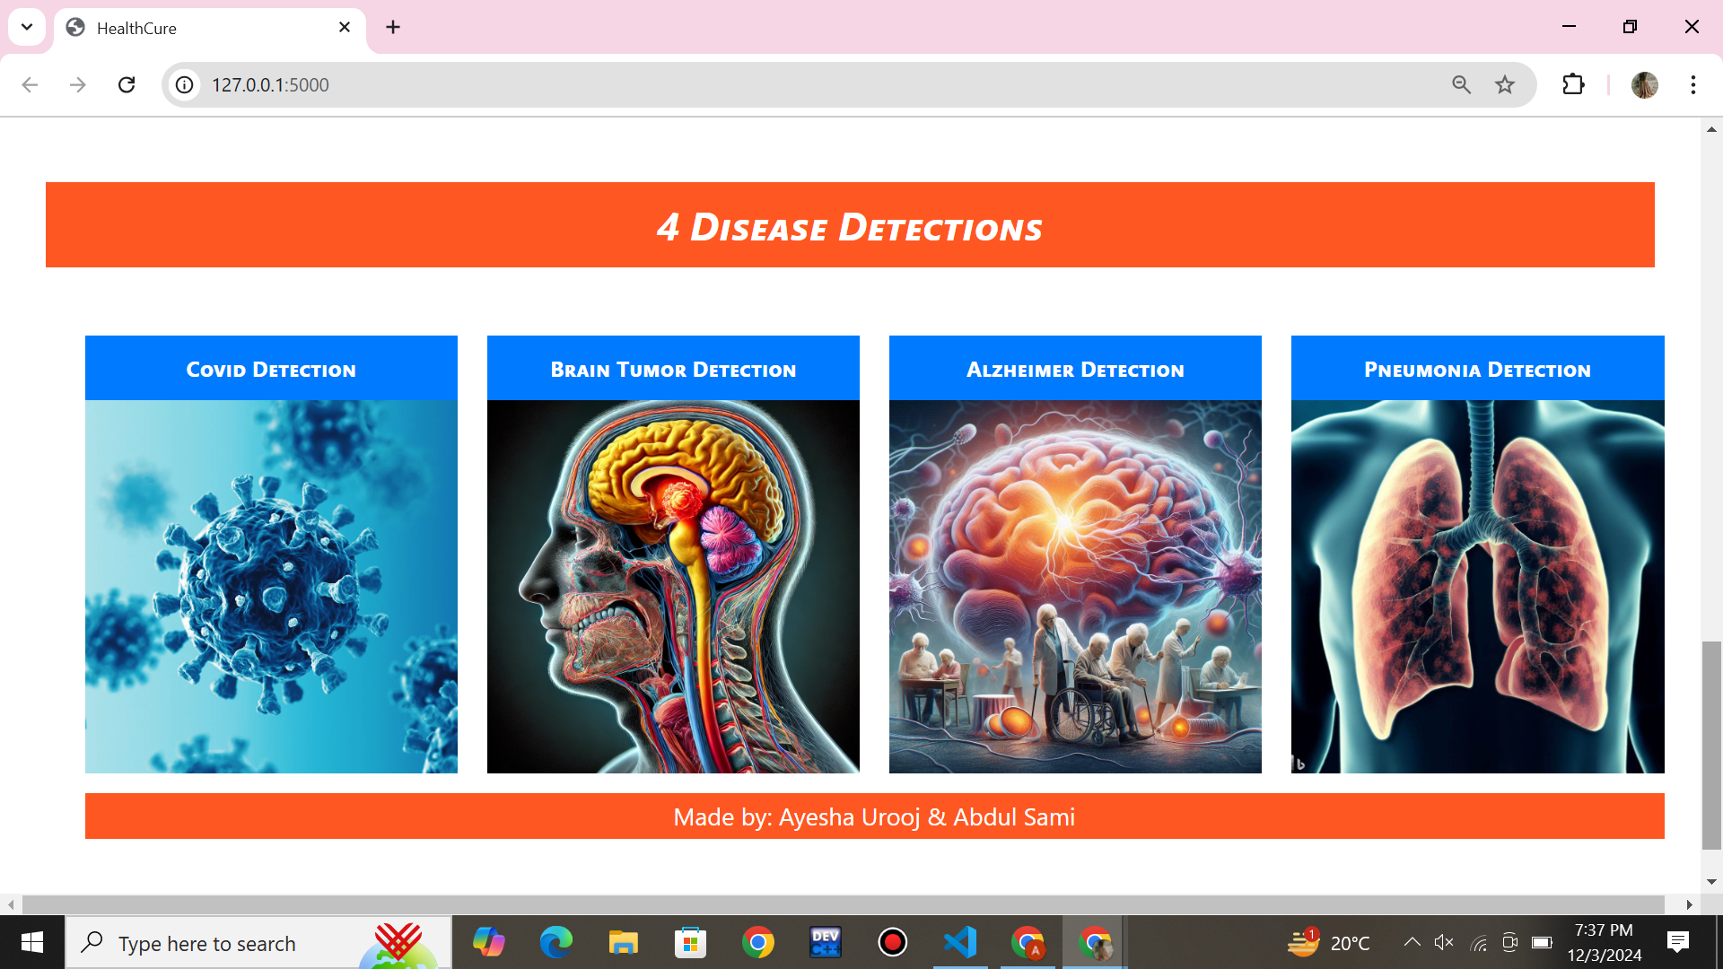

Slide 5
Some Statistics
Pneumonia: Around 1.5 million deaths annually, especially among children and the elderly, are preventable with earlier diagnosis and treatment. Delayed treatment is responsible for up to 50% of pneumonia-related deaths globally​.
COVID-19: During the pandemic, delayed detection significantly increased mortality rates, especially among vulnerable populations. Studies suggest that late diagnosis led to approximately 20–30% higher mortality rates in severe cases​.

Slide 6
Some Statistics
Alzheimer's Disease: Many patients are diagnosed late, often in moderate to severe stages, which limits the effectiveness of treatment and accelerates progression. Specific mortality due to delayed detection isn't quantified, but early detection could slow disease progression in up to 50% of cases
Brain Tumors: Approximately 60% of brain tumor diagnoses occur at later stages, leading to significantly reduced survival rates. Early-stage detection provides a 5-year survival rate of 75%, while late-stage drops to around 22%

Slide 7
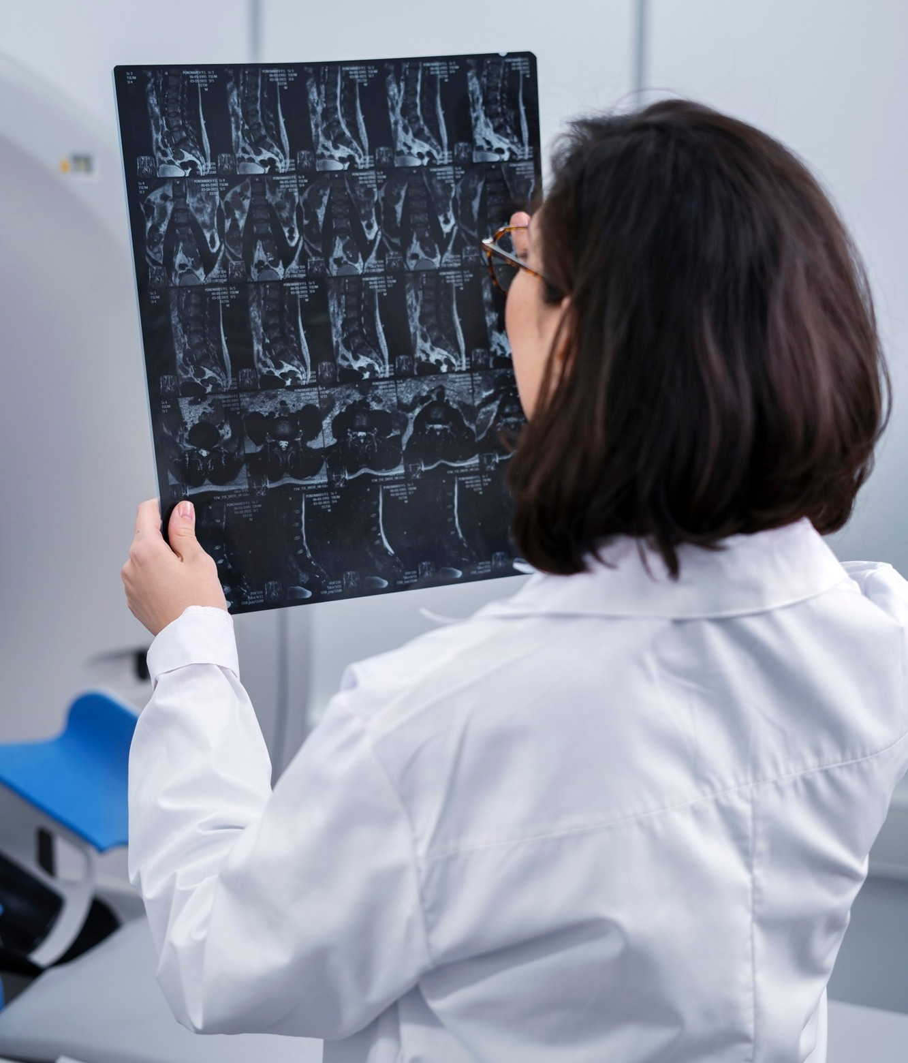
PNEUMONIA DETECTION TECHNIQUES
Digital image processing enhances pneumonia detection by analyzing chest radiographs. Techniques such as image ﬁltering and pattern recognition help identify inﬁltrates, enabling timely treatment and better patient management.

Slide 8
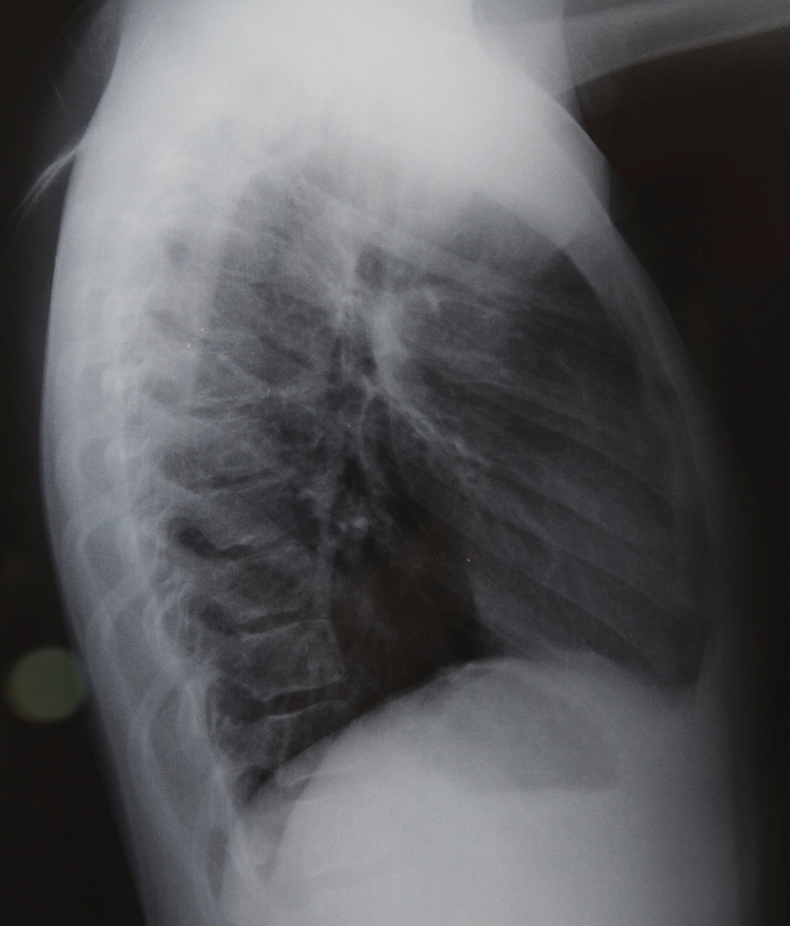
COVID-19 DETECTION METHODS
For COVID-19, digital image processing aids in analyzing chest X-rays and CT scans. By detecting pneumonic patterns, we can facilitate quicker diagnosis and treatment, ultimately improving patient outcomes and reducing the spread of the virus.

Slide 9
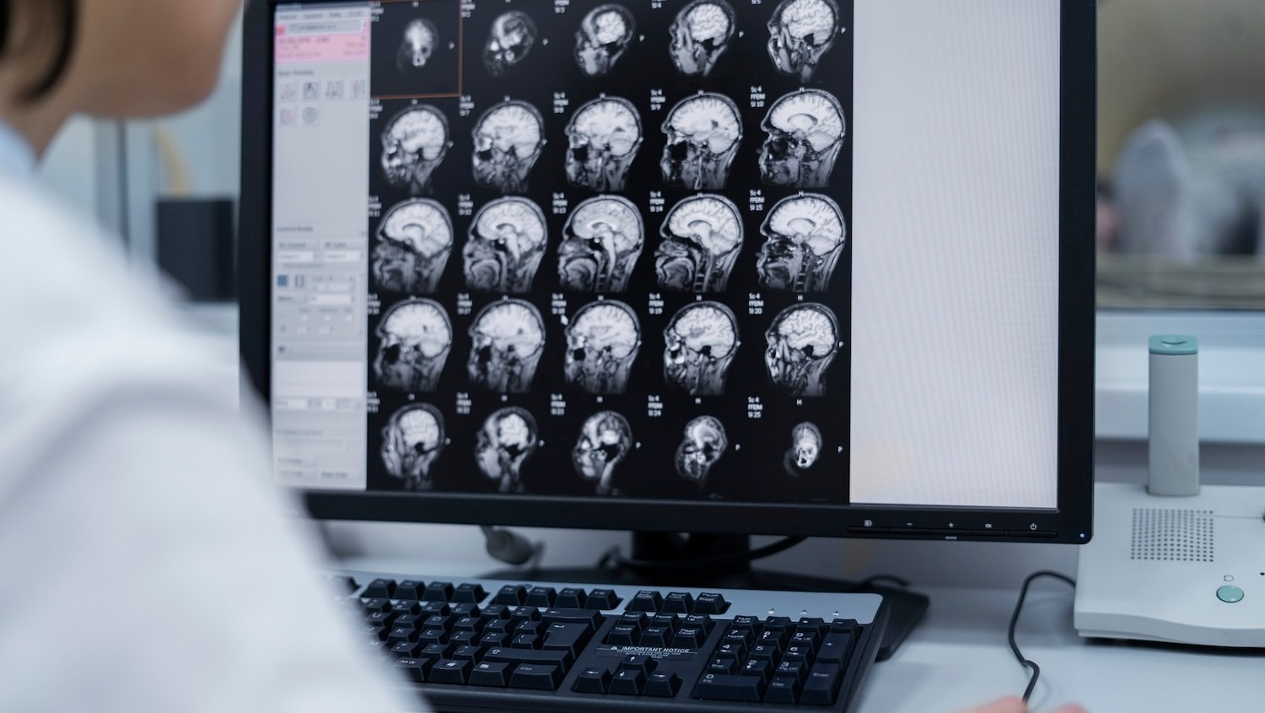
Brain Tumor Identiﬁcation
Detecting brain tumors through MRI scans is enhanced by digital image processing. Techniques like edge detection and template matching help in identifying tumor boundaries, leading to more precise surgical planning and effective treatment strategies.

Slide 10
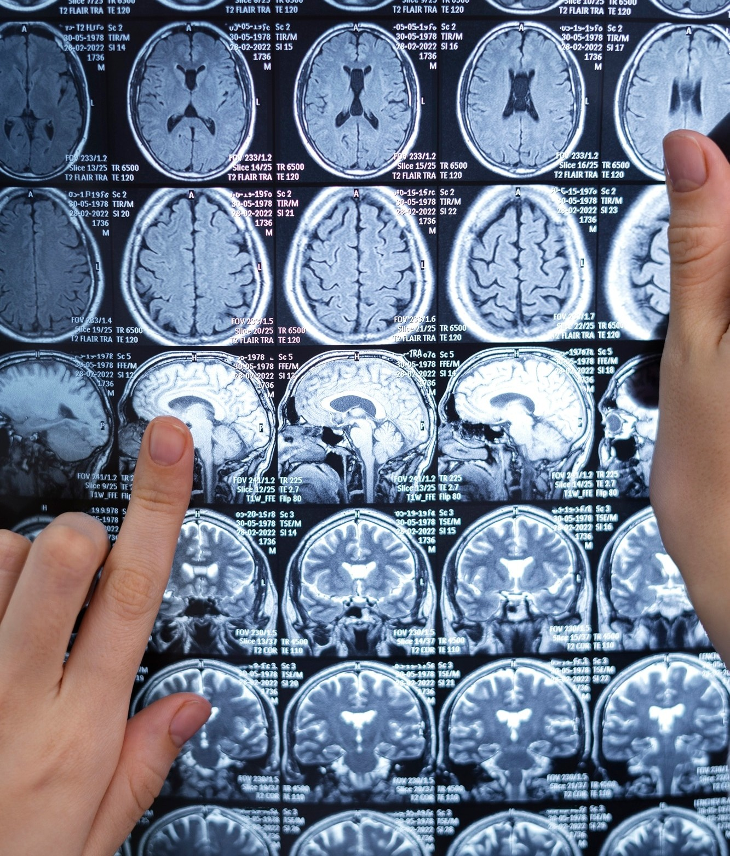
ALZHEIMER'S DISEASE DIAGNOSIS
In diagnosing Alzheimer's, digital image processing can analyze brain scans to detect early signs of atrophy. By evaluating cortical thickness and volume changes, we can improve early intervention and patient care.

Slide 11
Accuracies
Disease | Accuracy
Brain Tumor | 99.5%
Covid-19 | 96.8%
Pneumonia | 98.2%
Alzheimer’s | 99.2%
Average Accuracy of Project | 98.4%

Slide 12
Thanks!

