Slide 1
TripAdvisor Restaurants Review in Major Euro-Cities
Sky Liu

Slide 2
Overview
This project took European restaurant data from TripAdvisor as the main data sourse and conducted analysis on restaurant ratings and reviews.
Major techniques applied in the analysis:
data cleaning using dplyr
Benford's Law analysis using benford.analysis
text mining using tidytext and wordcloud
mapping using leaflet
data visualization using plotly

Slide 3
Data Cleaning
Datasets
Kaggle: Ratings and reviews for restaurants across 31 European cities from TripAdvisor[1]
Simplemaps: World Cities Database[2] .
Original data: 125527 records of restaurants from 31 European cities.
After cleaning: 108178 records

Slide 4
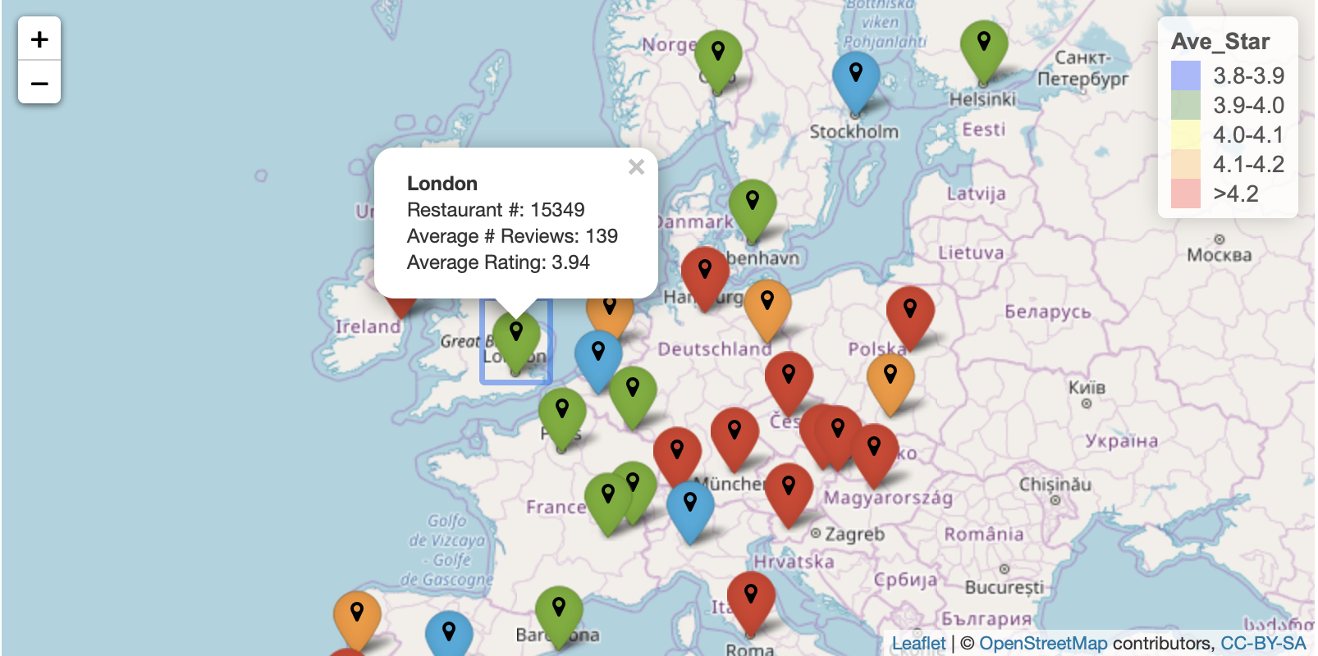
Data Cleaning
Geographically information of the cities from the dataset
Interaction to view:
the total number of restaurant
average rating
average number of reviews.

Slide 5
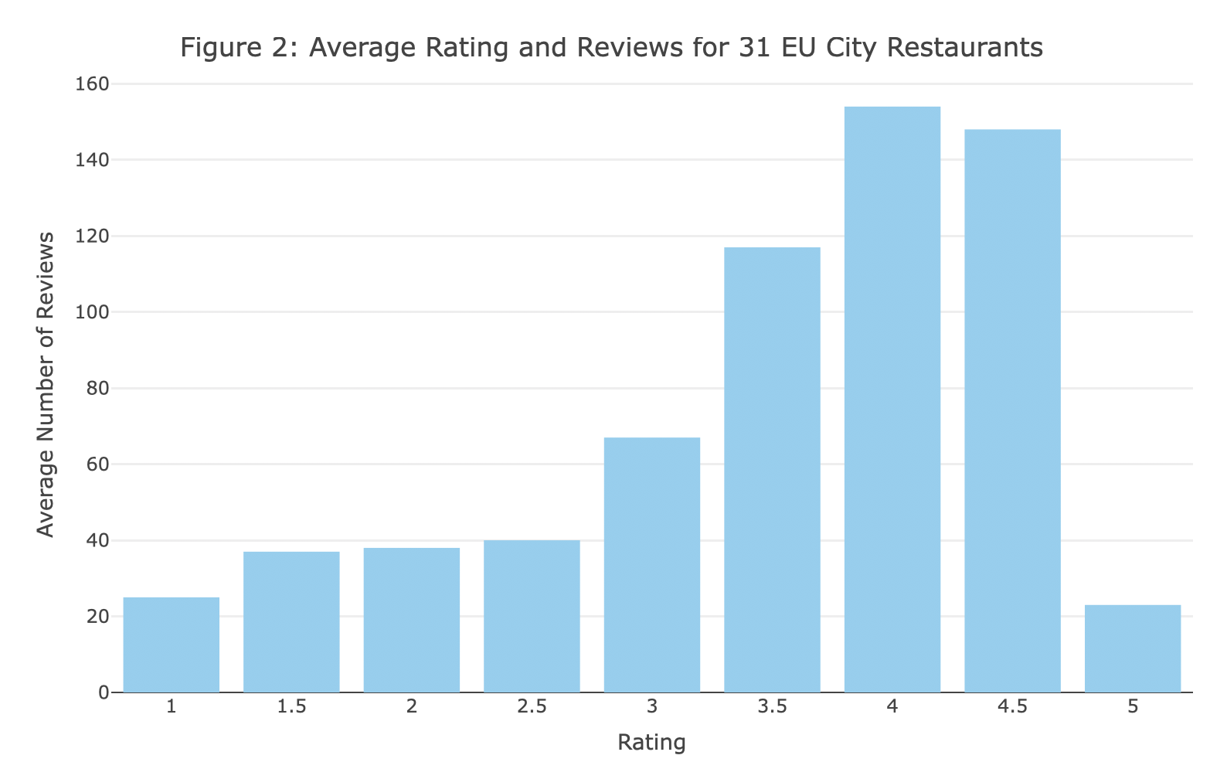
Benford's Law Analysis
Motives behind Benford's Law Analysis: detect fake reviews
Higher ratings are associated with higher number of reviews.
Businesses might generate fake reviews to increase overall number of reviews.

Slide 6
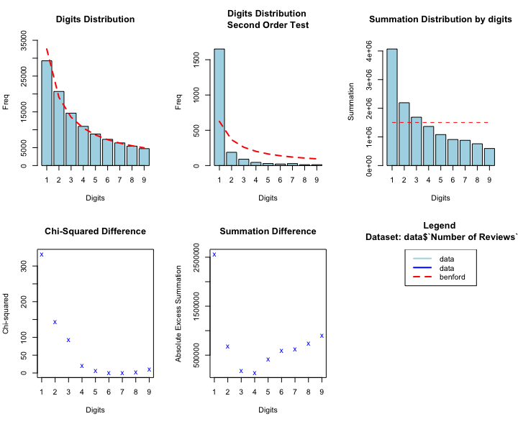
Benford's Law Analysis
The number of reviews follows One-Digit Benfords Law distribution
No obvious susbicious reviews are detected

Slide 7
Text Analysis on Reviews
The most frequently used word in reviews of each star level.
Non-characters, common stopwords and customized stopwords deleted.
Customized stopwords: food, service, restaurant, dinner, lunch, etc.
Summary
1-star restaurants: mostly strongly negative words like,'terrible', 'horrible','worst'
2-star restaurants: slightly less negative though, 'bad', 'poor' and etc commonly used
3-star restaurants: more than half of most frequently used words are positive
4-star restaurants: mostly positive
5-star restaurants: very similar to 4-star restaurants reviews.

Slide 8
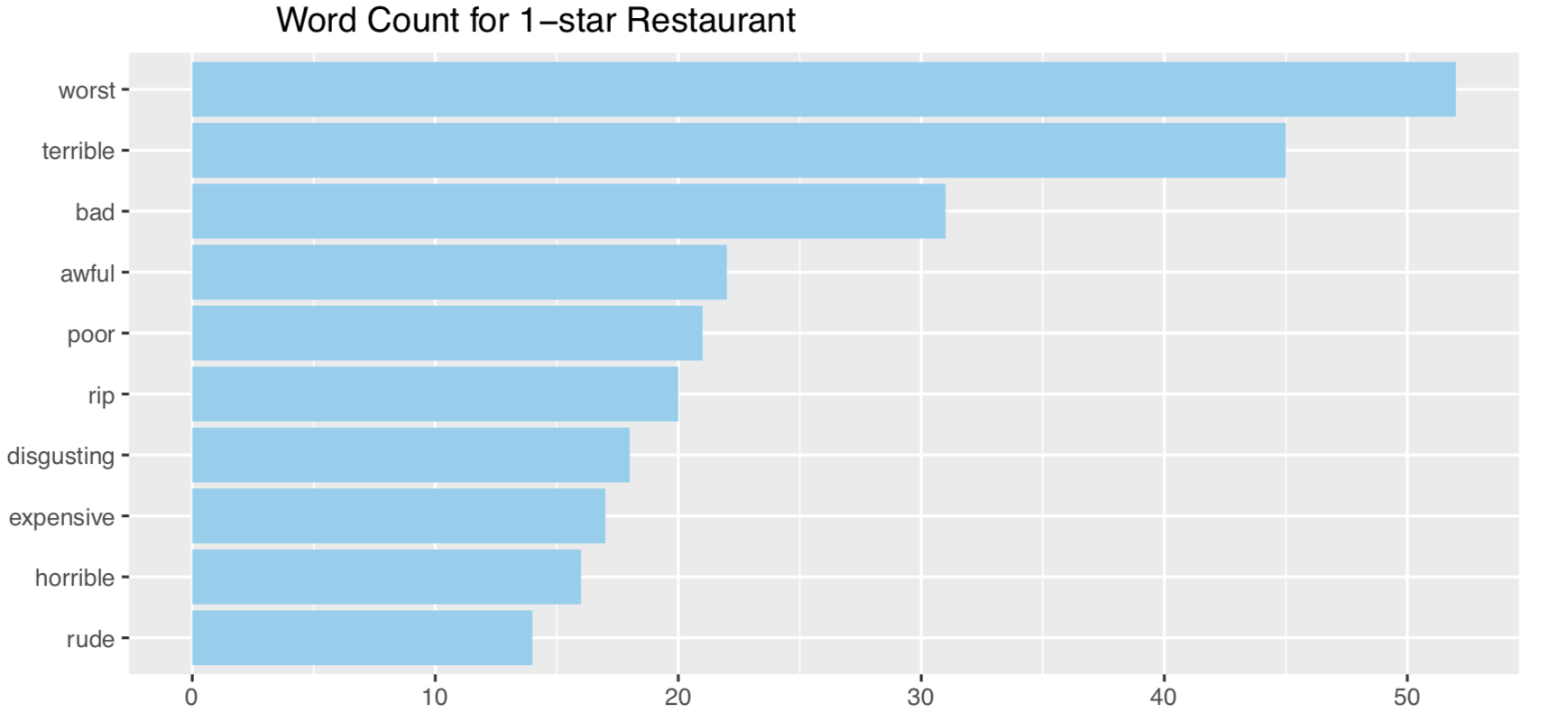
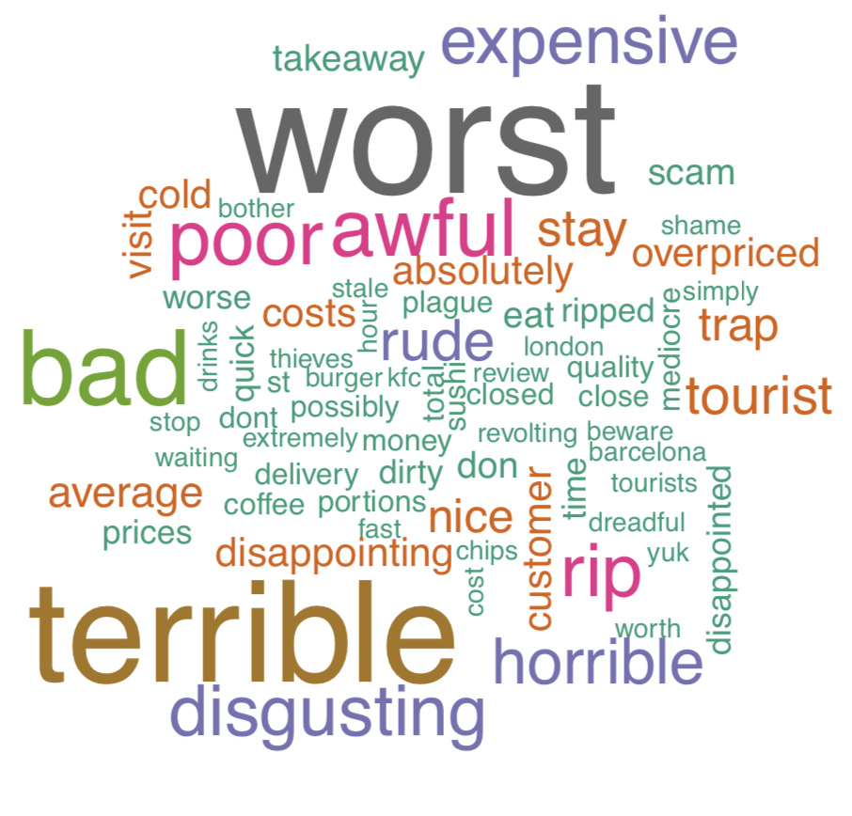
Reviews for 1-star Restaurants

Slide 9
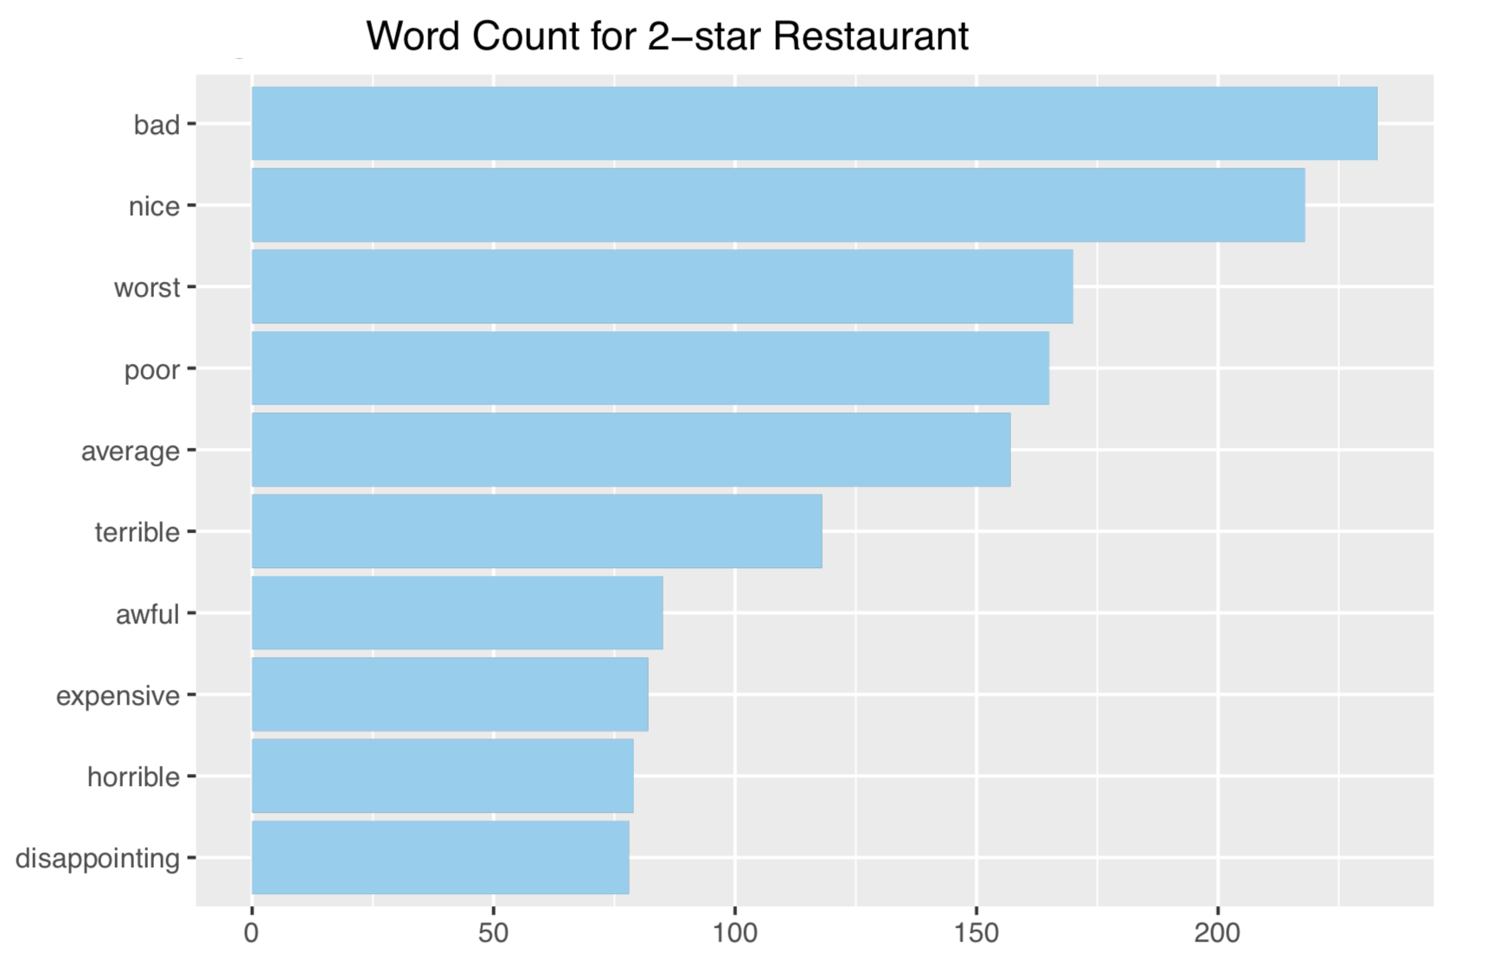
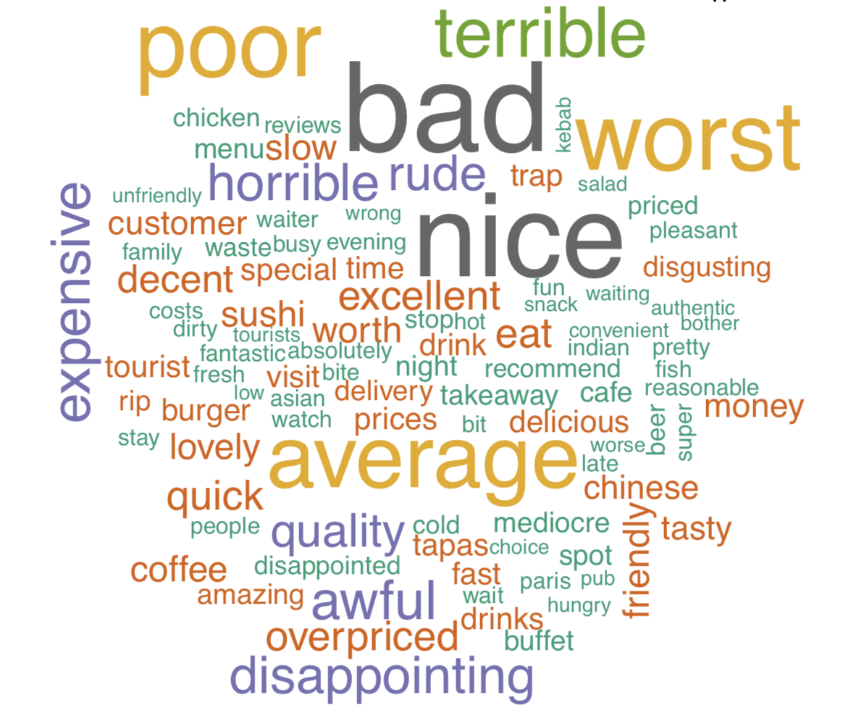
Reviews for 2-star Restaurants

Slide 10
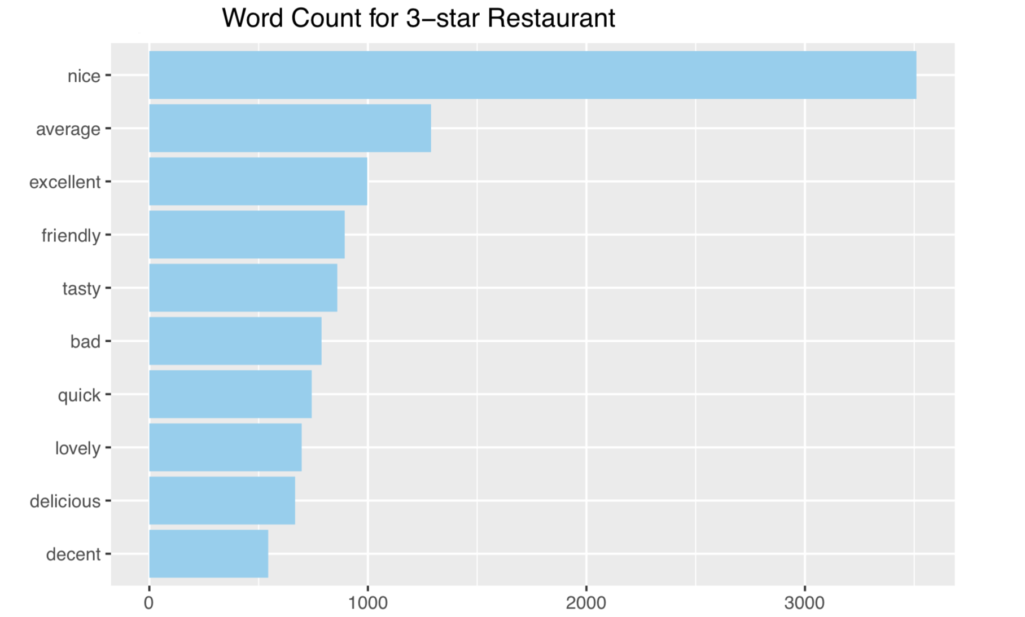
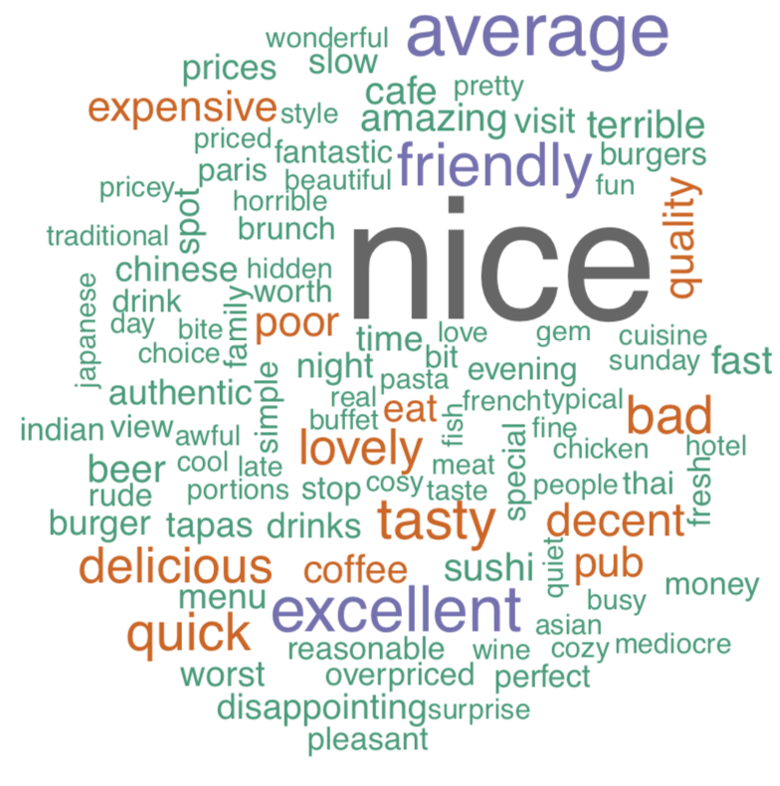
Reviews for 3-star Restaurants

Slide 11
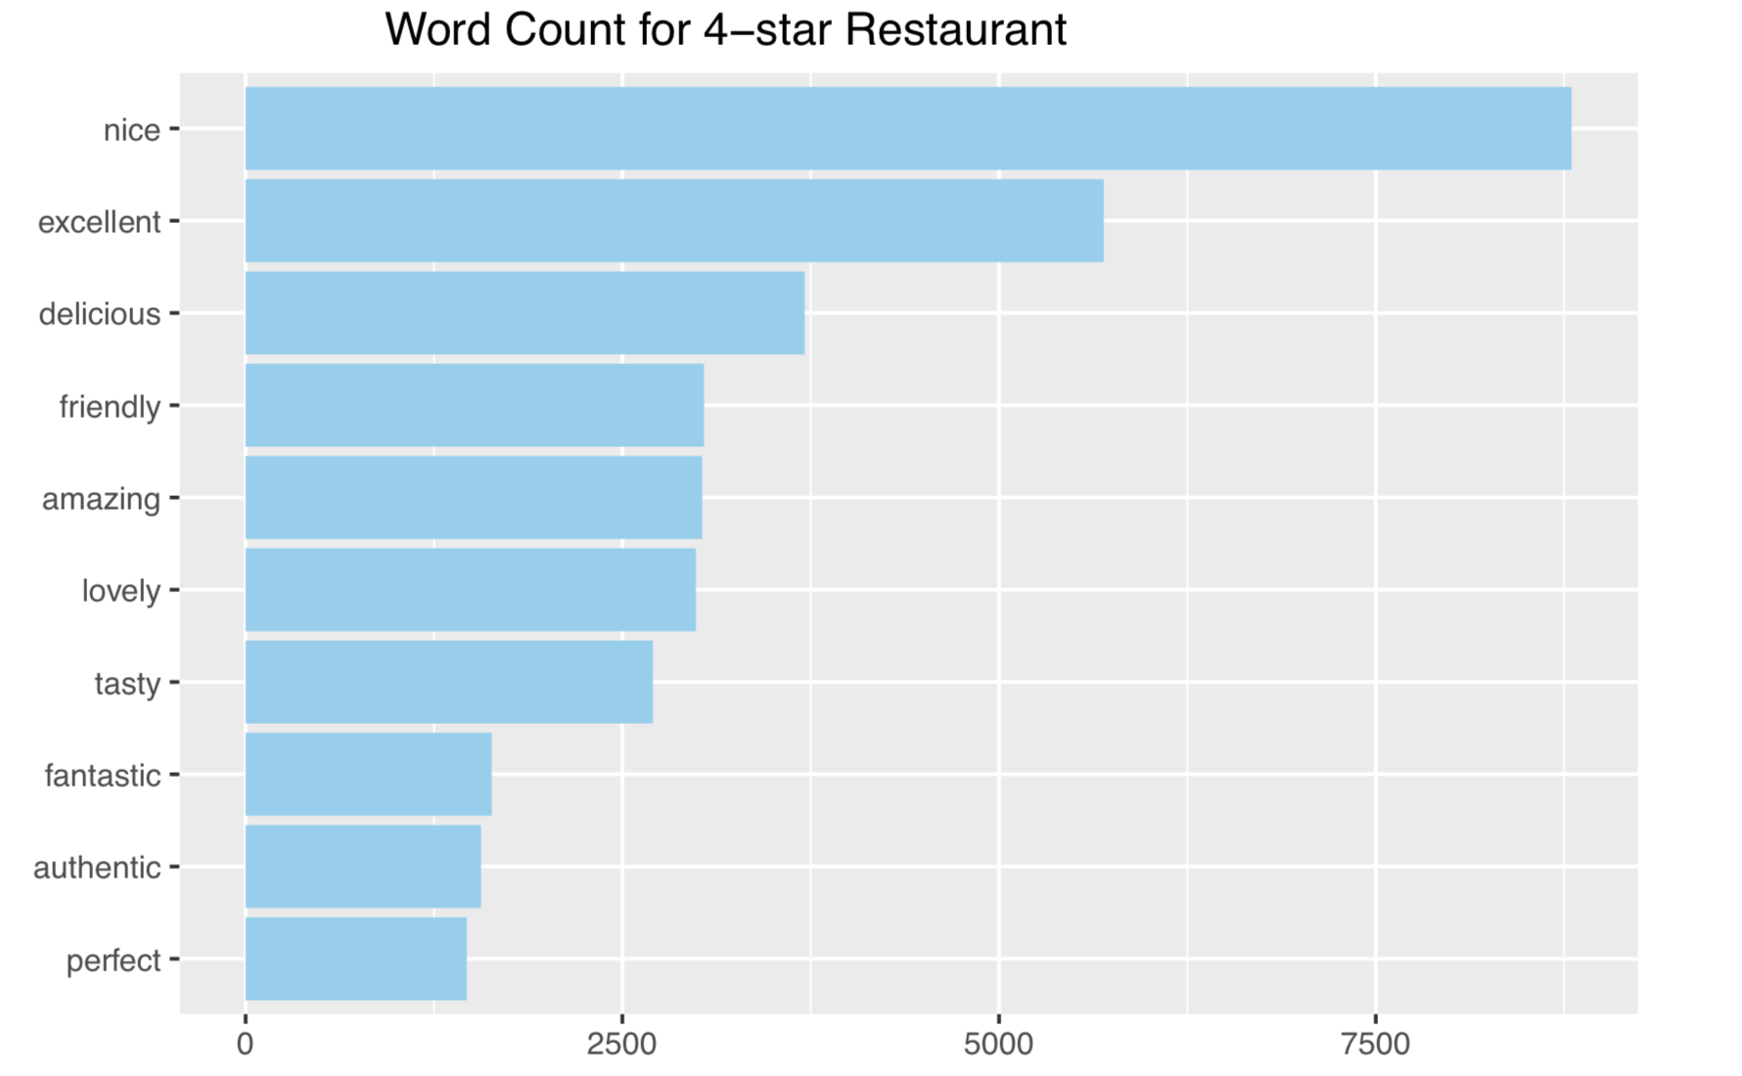
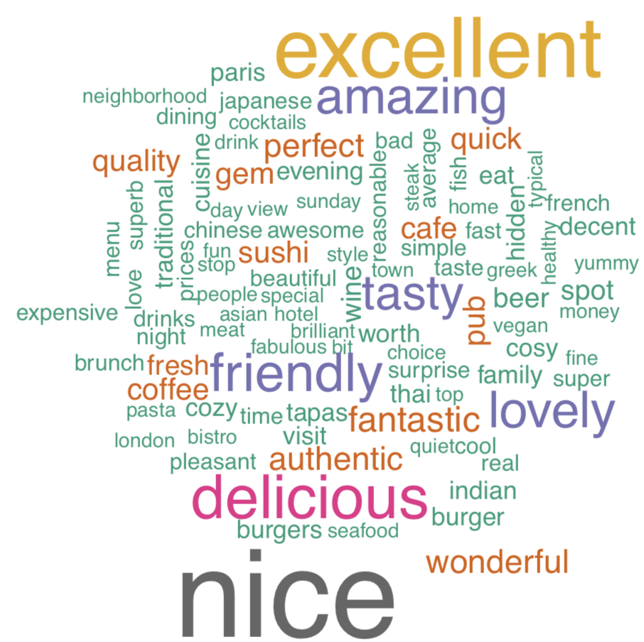
Reviews for 4-star restaurants

Slide 12
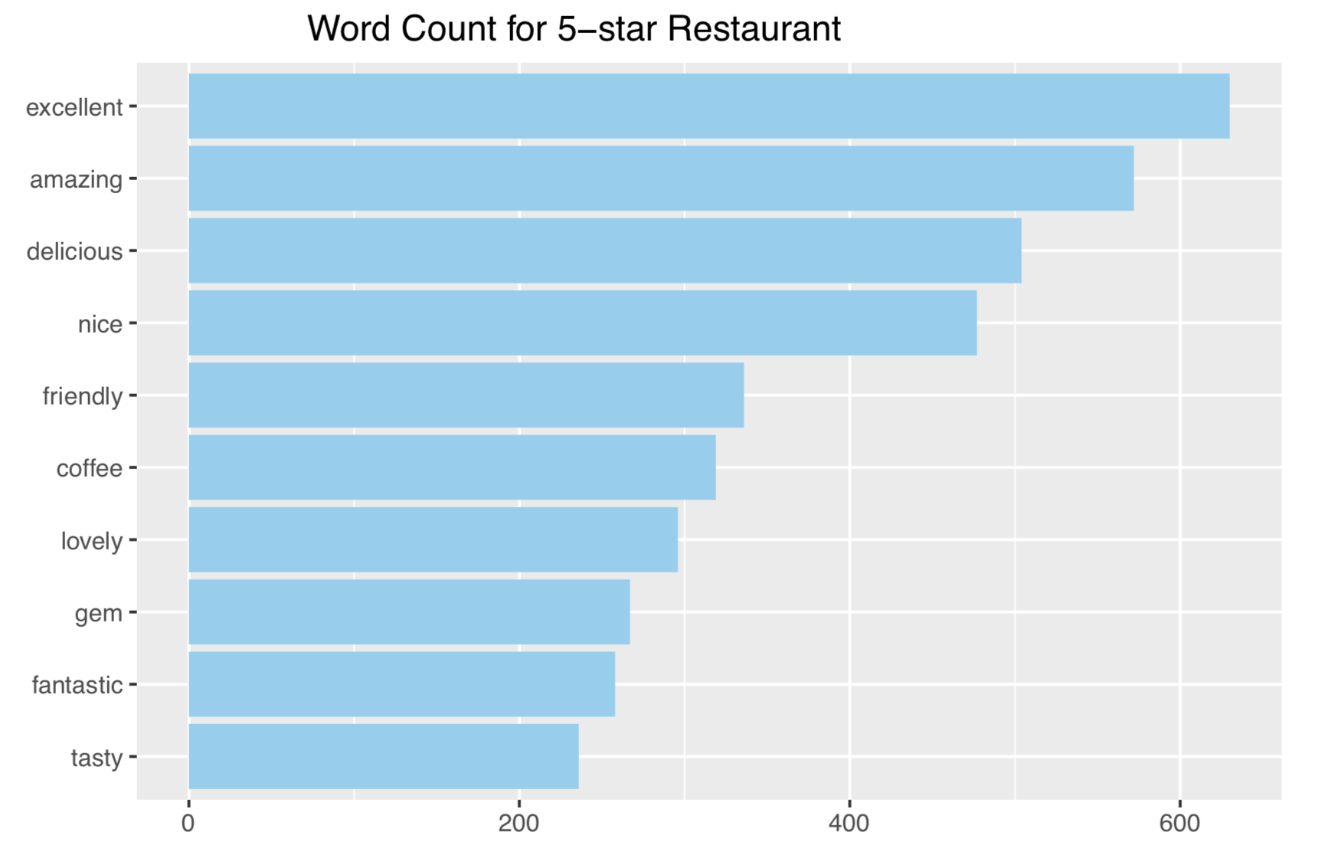
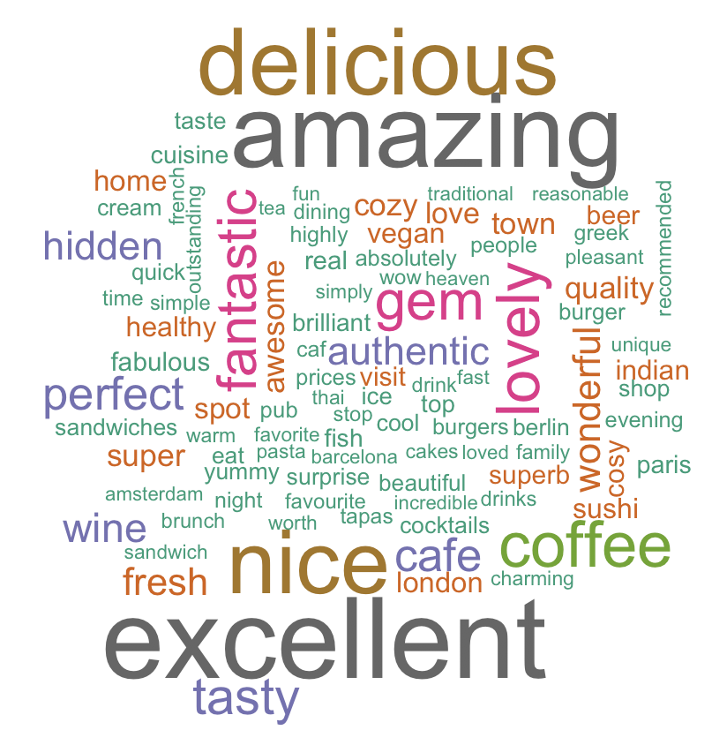
Reviews for 5-star Restaurants

Slide 13
Conclusion
The ratings and reviews of the restaurants from the major 31 European cities look fair.
No susbicious reviews detected by using Benford's Law analysis
The review contents are consistant with ratings
Higher rating restaurants are mostly in South East Europe.

Slide 14
Thank You

Slide 15
Citation
[1] TripAdvisor Restaurants Info for 31 Euro-Cities.
https://www.kaggle.com/damienbeneschi/krakow-ta-restaurans-data-raw
[2] Simplemaps World Cities Database.
https://simplemaps.com/data/world-cities

