Slide 1

Education spending and literacy in rural Khyber Pakhtunkhwa
ECO346 Assignment 1 · Ayesha Abbas · FA24-BEDS-084 · Section B
Variant 4
KP rural (prov_code 1, urban_rural 1)
13,200
persons aged 10–64 with a literacy answer
4,912
students with education spending above zero
Source: PSLM 2019–20. Every statistic is weighted by hhweight.
ECO346 · Assignment 1 · FA24-BEDS-084
Notes:
Introduce yourself and the variant. My registration number ends in 084, 84 = 10 x 8 + 4, so variant 4: rural Khyber Pakhtunkhwa. I use the PSLM 2019-20 person file with household weights attached by hhid. Two samples: 13,200 persons aged 10-64 for literacy, and 4,912 students with education spending above zero. Everything is weighted by hhweight. Today: the makeover, the main finding, then how spending is distributed.
1

Slide 2
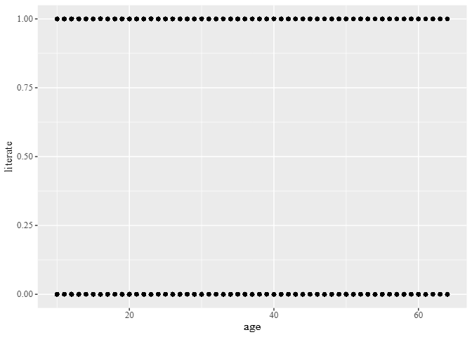
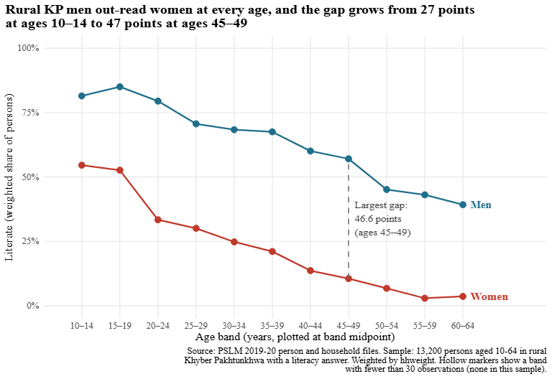
Makeover: from 13,200 dots to two lines
Default (ggplot + geom_point)
Redesign
Dots stack on 0 and 1. No sexes, no trend, no weights.
Weighted literacy rate by age band, women and men, labelled directly.
Three changes: conditional means, position on a common scale, data–ink (direct labels, quiet grid)
ECO346 · Assignment 1 · FA24-BEDS-084
2
Notes:
Left is R's default: ggplot with geom_point and nothing else. Literate is 0 or 1, so 13,200 points sit on two stripes and overplot completely; you cannot see women versus men or any trend. The redesign fixes that in three ways. One, conditional means: the weighted literacy rate in each five-year band. Two, position on a common 0 to 100 percent scale, the channel the eye reads best, with a line per sex. Three, data-ink: direct labels instead of a legend, no grey panel, a title that states the finding. What the default shows that the redesign hides: single years of age and how many people are at each; a thin band would look as solid as a thick one, which is why the rule uses hollow markers for cells under 30 (none here).
2

Slide 3
Rural KP women fall far behind men, and the gap widens with age
Ages 15–19
85.1%
men
52.6%
women
Largest gap, ages 45–49
46.6 points
Up from 26.9 points at ages 10–14. The 35–49 bands are nearly tied, so it is a plateau.
Ages 55–59
43.0%
men
2.9%
women
What it cannot tell us: whether literacy changes as people age or differs by birth cohort (one cross-section)
ECO346 · Assignment 1 · FA24-BEDS-084
3
Notes:
This is the finding I think matters most. Among girls and boys aged 15-19, 52.6 percent of women are literate against 85.1 percent of men. By ages 55-59 it is 2.9 percent of women against 43.0 percent of men. The gap grows from 26.9 points at ages 10-14 to a peak of 46.6 points at 45-49. Be honest: 35-39, 40-44 and 45-49 are within 0.05 points of each other, so the peak is really a plateau. It fits expanding schooling for younger cohorts, especially girls. But this is one cross-section of the 2019-20 survey, so it cannot separate an age effect from a cohort effect.
3

Slide 4
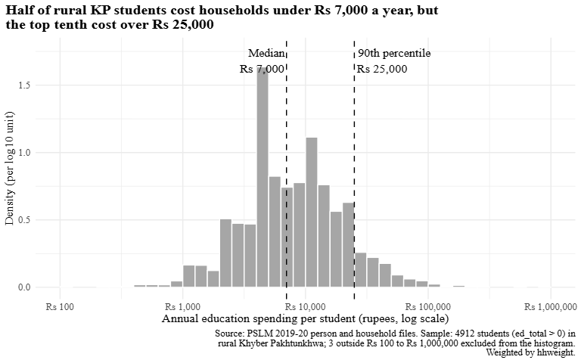
Spending per student is right-skewed, with a tenfold spread
Rs 7,000
median, weighted and unweighted
Rs 2,500–25,000
10th to 90th percentile (ratio 10.00)
4,912
students; 3 outside Rs 100–1,000,000 left out of the histogram
Python rebuild matches R: women aged 15–19 = 52.6% in both; band tables agree to one decimal.
ECO346 · Assignment 1 · FA24-BEDS-084
4
Notes:
Second view: how much households spend per student. Histogram on a log10 scale, bins 0.1 wide, density per log10 unit. Weighted median is Rs 7,000, the same as the unweighted median: both cross 50 percent exactly at Rs 7,000, where 134 students report that exact amount, and the weights hardly correlate with spending. The 10th and 90th percentiles are Rs 2,500 and Rs 25,000, a ratio of 10.00. Three students fall outside Rs 100 to Rs 1,000,000 and are left out of the histogram. Last, I recomputed the literacy band table in Python and the two tables agree to one decimal, women 15-19 is 52.6 percent in both. The one default that differed was how matplotlib saves SVG text (as outlines), which I changed to keep text as text.
4

