Slide 1
Data Detectives
Aye Thuzar

Slide 2
What comes to your mind when you hear: Data Detectives
Using Python (and a little AI help) to uncover the stories hiding in real data

Slide 3
The DIKW Pyramid
From raw data to wisdom (Source: https://en.wikipedia.org/wiki/DIKW_pyramid)

Slide 4
The DIKW Pyramid
WISDOM Knowledge applied with judgment
KNOWLEDGE Information applied and understood
INFORMATION Data with context and structure
DATA Raw facts and numbers

Slide 5
Every spreadsheet is hiding a story.
Let’s find it today!

Slide 6
3 Rules for AI-Assisted Coding
1
Read and predict before you run it.
2
You're the detective, not the AI.
3
If you don't understand a line, ask what it does.

Slide 7
The Process
Read
→
Predict
→
Run
→
Chart/Verdict

Slide 8
Finding Your Own Dataset
You can choose from various online data sources such as:
Kaggle
data.gov
Our World in Data
Wide variety of datasets
U.S. government data
Global development data
GitHub
Google Dataset Search
Any other source
Curated datasets
Search for datasets
Any other reliable data source you find interesting

Slide 9
Common File Formats
XLS
Excel spreadsheet files (most common for Education Dept. data)
TEXT
Plain text files
Comma-separated values (universal format)
Resource Description Framework (semantic web data)
CSV
recommended
RDF
JSON
JavaScript Object Notation (machine-readable)
API
Application Programming Interface (programmatic access)
XML
Extensible Markup Language (structured data)
ZIP
Compressed archive files (mentioned for download)
HTML
Web page format

Slide 10
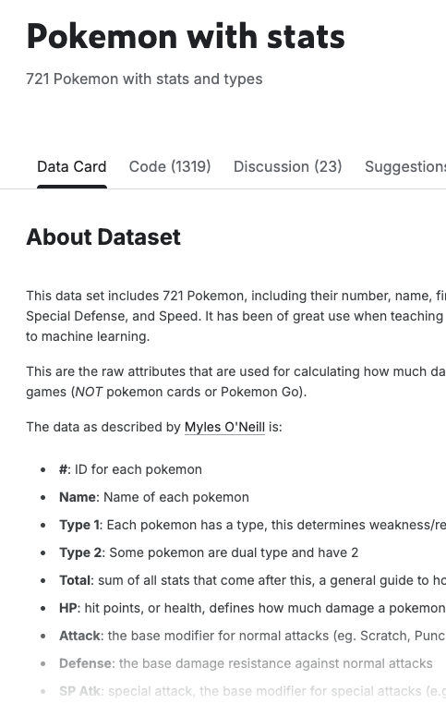
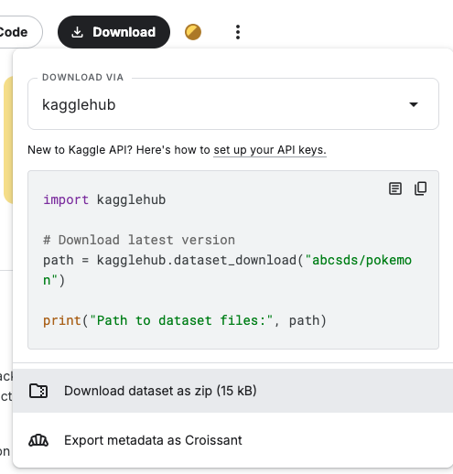
How to Use Kaggle Datasets

Slide 11
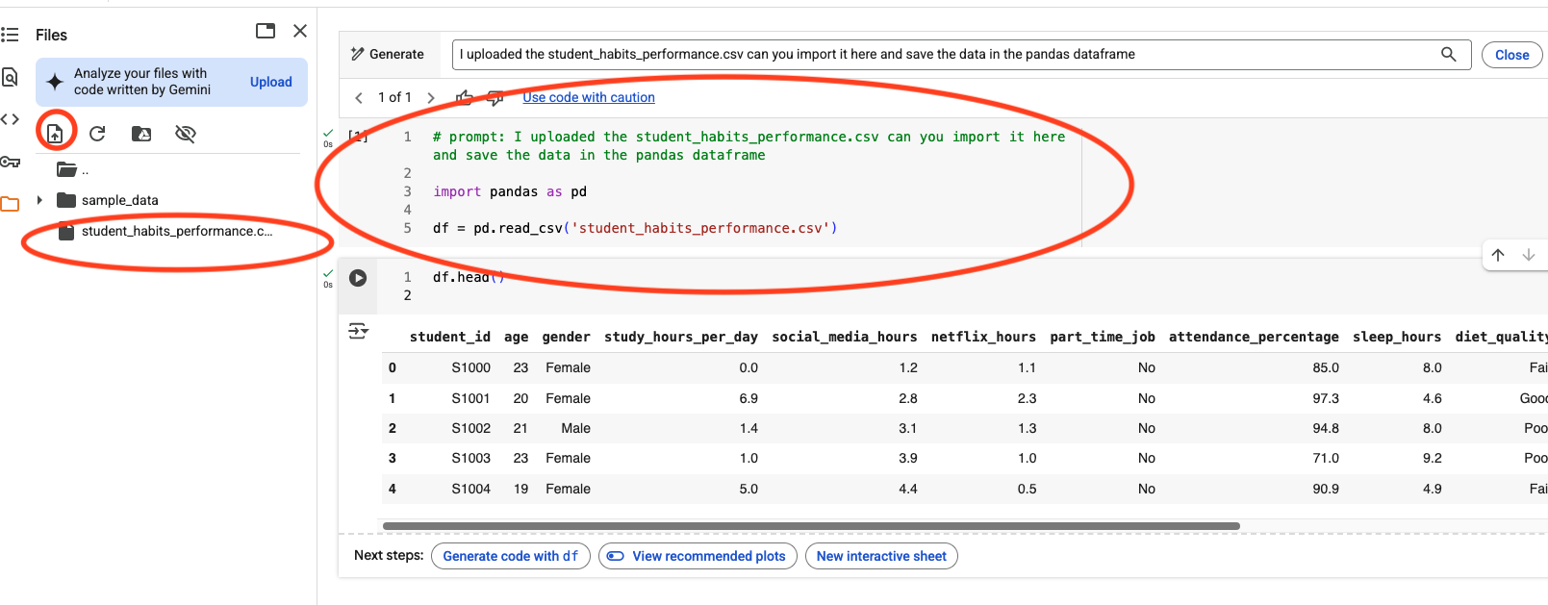
How to Use the Downloaded .csv Files

Slide 12
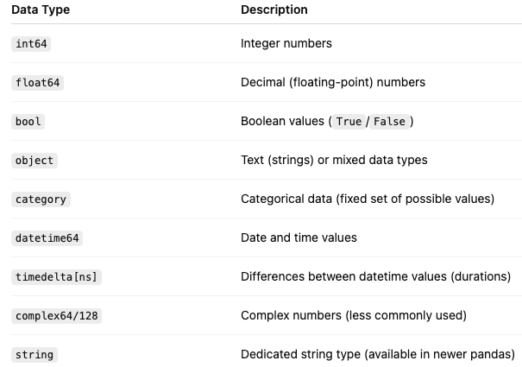
Data Types in Pandas DataFrame Columns or Series
Series
Can only hold one data type (homogeneous), but it can be “object” if it has mixed types.
DataFrame
Can have different types in different columns (heterogeneous).

Slide 13
Today's Case Files
Pokémon Stats
Netflix Titles
World Happiness
Spotify Tracks
Which type is strongest?
What's changed over time?
Does money buy happiness?
What makes a song a hit?
Please work with a partner. You are welcome to explore other topics.
https://ayethuzaruo.github.io/DataDetectives/

Slide 14
What's one line of code you can now explain?

