Slide 1

Conditional Probability

Slide 2
What is Conditional Probability?
Conditional probability is defined as the likelihood of an event or outcome occurring, based on the occurrence of a previous event or outcome.
Conditional probability is calculated by multiplying the probability of the preceding event by the updated probability of the succeeding, or conditional, event.

Slide 3
For Example
Event A is that an individual applying for college will be accepted. There is an 80% chance that this individual will be accepted to college.
Event B is that this individual will be given dormitory housing. Dormitory housing will only be provided for 60% of all of the accepted students.
P (Accepted and dormitory housing) = P (Dormitory Housing | Accepted) P (Accepted) = (0.60)*(0.80) = 0.48.

Slide 4

A conditional probability would look at these two events in relationship with one another, such as the probability that you are both accepted to college, and you are provided with dormitory housing.
Conditional probability can be contrasted with unconditional probability. Unconditional probability refers to the likelihood that an event will take place irrespective of whether any other events have taken place or any other conditions are present.

Slide 5
KEY TAKEAWAYS
Conditional probability refers to the chances that some outcome occurs given that another event has also occurred.
It is often stated as the probability of B given A and is written as P(B|A), where the probability of B depends on that of A happening.
Conditional probability can be contrasted with unconditional probability.

Slide 6
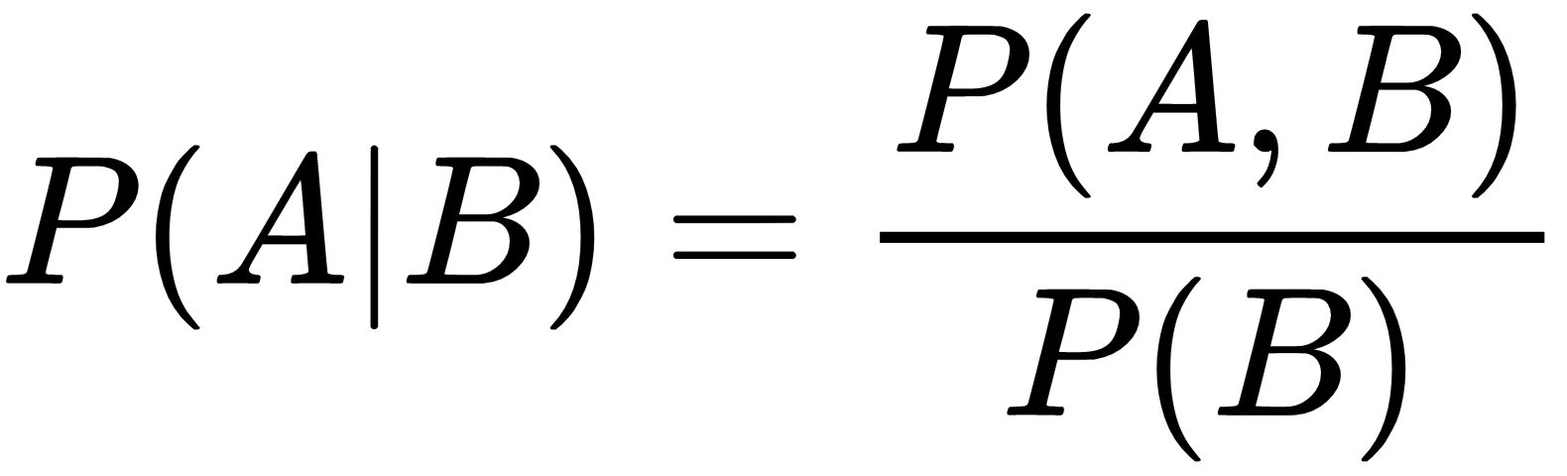
Notation
Formula:
1
2
P(B) means "Probability Of Event B"
3
P(A|B) means "Event A given Event B"
4

Slide 7

Example: Tossing a coin
Each toss of a coin is a perfect isolated thing.
What it did in the past will not affect the current toss.
The chance is simply 1-in-2, or 50%, just like ANY toss of the coin.
So each toss is an Independent Event.

Slide 8

Example: Marbles in a Bag
But events can also be "dependent" ... which means they can be affected by previous events ...
2 blue and 3 red marbles are in a bag. What are the chances of getting a blue marble?
The chance is 2 in 5
But after taking one out the chances change! So next time:
if we got a red marble before, then the chance of a blue marble next is 2 in 4
if we got a blue marble before, then the chance of a blue marble next is 1 in 4

Slide 9
Bayes' Theorem
Bayes' theorem, named after 18th-century British mathematician Thomas Bayes, is a mathematical formula for determining conditional probability. The theorem provides a way to revise existing predictions or theories (update probabilities) given new or additional evidence. In finance, Bayes' theorem can be used to rate the risk of lending money to potential borrowers.
Bayes' theorem is also called Bayes' Rule or Bayes' Law and is the foundation of the field of Bayesian statistics. This set of rules of probability allows one to update their predictions of events occurring based on new information that has been received, making for better and more dynamic estimates.

Slide 10
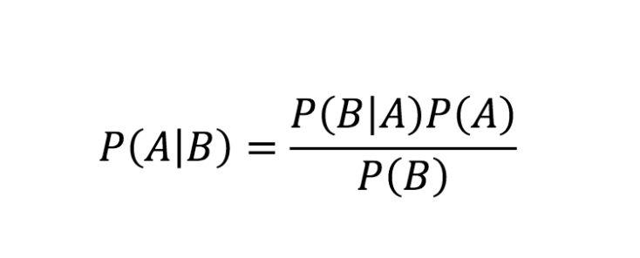
Bayes Theorem Formula
Which tells us: how often A happens given that B happens, written P(A|B),
When we know: how often B happens given that A happens, written P(B|A)
and how likely A is on its own, written P(A)
and how likely B is on its own, written P(B)

Slide 11

References
THANK YOU FOR LISTENING
https://www.investopedia.com/terms/c/conditional_probability.asp
Aygün BAYIR 161044119
https://www.mathsisfun.com/data/probability-events-conditional.html

