Slide 1
CAPSTONE-1 PROJECT REPORT Can Air Accidents/Incidents be Predicted?
Adnan Aygunduz
Springboard DS Track

Slide 2
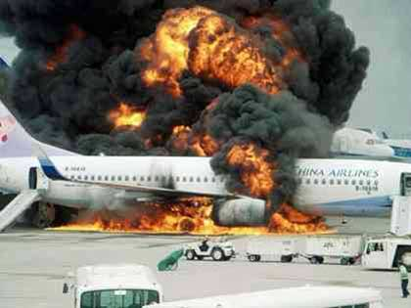
Problem
Air accidents and incidents can cost lives and huge resources.
Understanding the factors behind them based on the previous data we have can help authorities to take preventative measures in advance and save lives and valuable assets.
Is there a Pattern?

Slide 3
Problem
Accident is defined as "An occurrence associated with the operation of an aircraft which takes place between the time any person boards the aircraft with the intention of flight until such time as all such persons have disembarked, in which a person is fatally or seriously injured."
Incident is defined as "An occurrence, other than an accident, associated with the operation of an aircraft which affects or could affect the safety of operation."

Slide 4
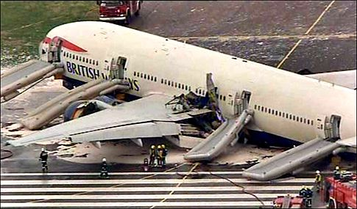
Data
The NTSB aviation accident database contains information from 1962 and later about civil aviation accidents and selected incidents within the United States, its territories and possessions, and in international waters.
Data Set: ntsb-aviation-accident-dataset

Slide 5
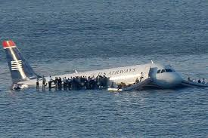
Data
Since the Data was containing around 162.000 records including all air assets, only airliner data filtered out to be able to maintain same parameters.
Final dataset shape was 2189x13

Slide 6
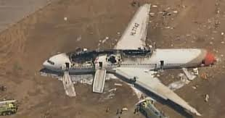
Wrangling
Steps Taken
Cleaning Duplicates
Cleaning White Spaces
Handling Missing Values
Standardization and Formatting
Creating New Columns

Slide 7
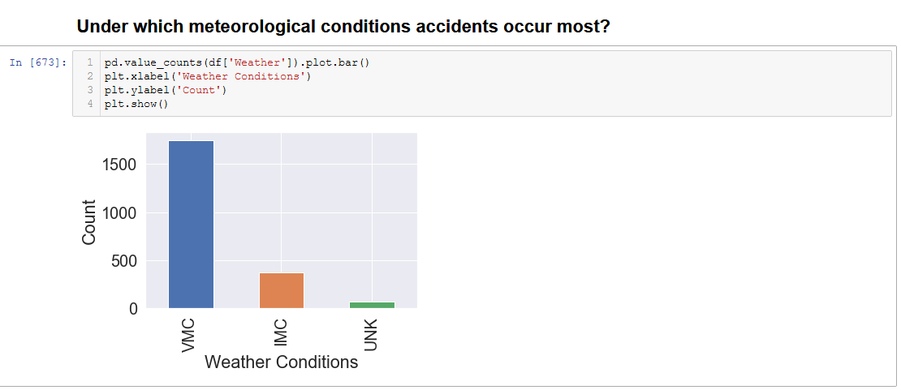
EDA

Slide 8
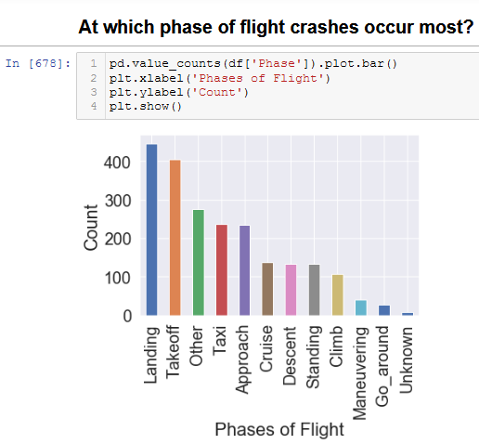
EDA

Slide 9
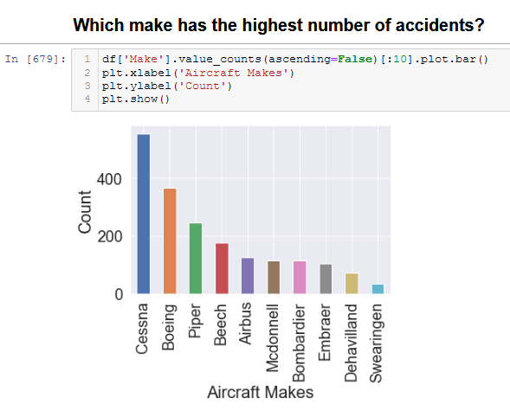
EDA

Slide 10
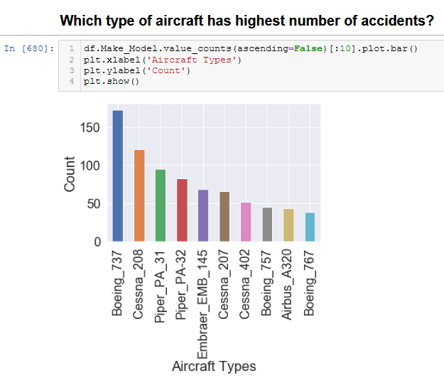
EDA

Slide 11
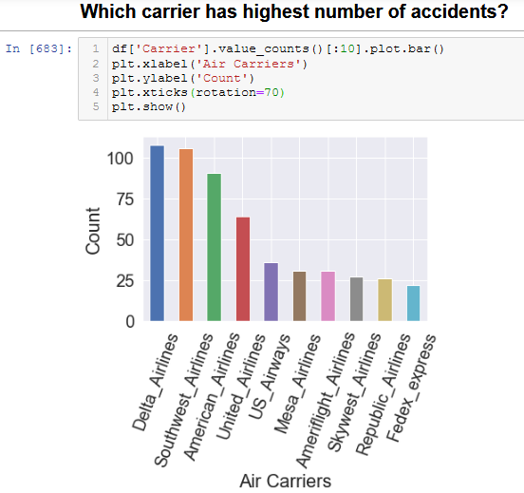
EDA

Slide 12
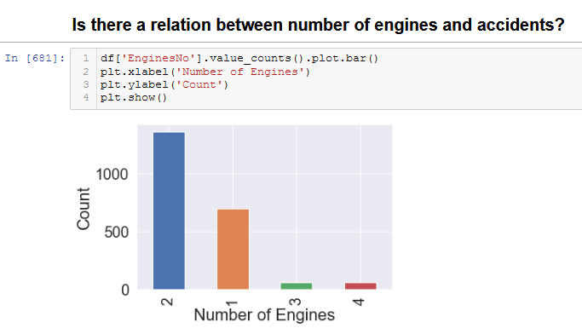
EDA

Slide 13
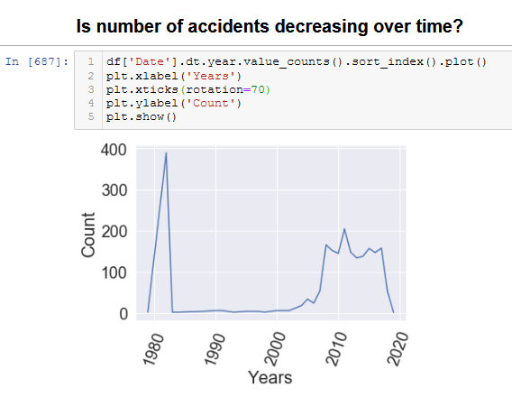
EDA

Slide 14
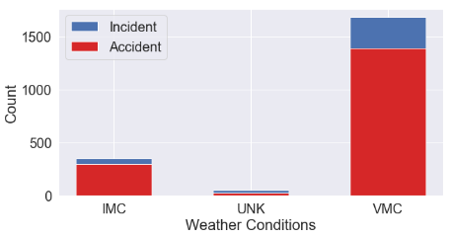
Hypotesis
The Null and Alternate Hypothesis
H0:There is no statistically significant relationship between weather conditions and investigation type.
Ha:There is a statistically significant relationship between weather conditions and investigation type.

Slide 15


Hypotesis
The Chi-Squared Test for Independence - Calculation with Numpy
Conclusion:
The X**2 = ~49, p-value = ~0 and degrees of freedom = 2.
With a p-value < 0.05 , we can reject the null hypothesis. There is definitely some sort of relationship between Accident and the Incident column. We don't know what this relationship is, but we do know that these two variables are not independent of each other.

Slide 16
Machine Learning (Classification)
Steps:
Categorical to numerical conversion
Defining X and y data
Splitting Data
Model Selection (Logistic Regression)
Prediction
Evaluation and confusion matrix

Slide 17
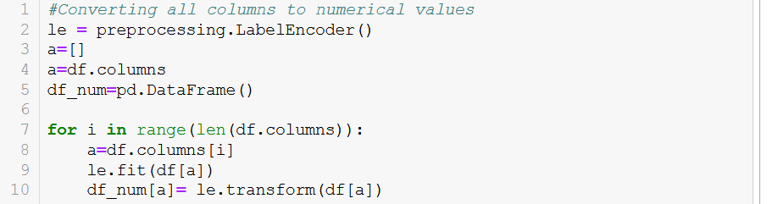
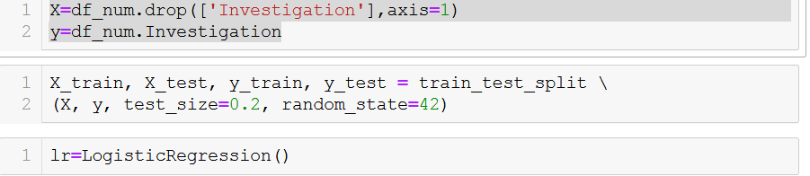
Machine Learning (Classification- Logistic R.)
Steps:
Categorical to numerical conversion
Defining X and y data
Splitting Data
Model Selection (Logistic Regression)

Slide 18
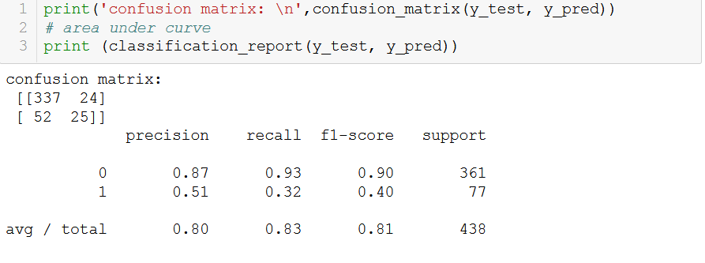
Machine Learning (Classification- Logistic R.)
Steps:
Prediction
Evaluation and confusion matrix

Slide 19
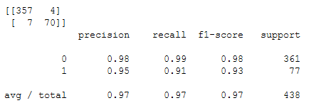
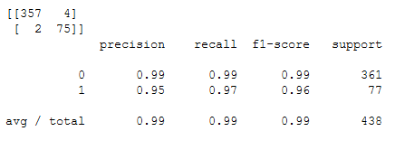
Machine Learning (Random Forest)
Machine Learning (Decision Tree)

Slide 20
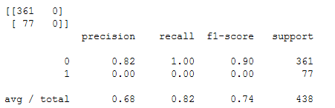
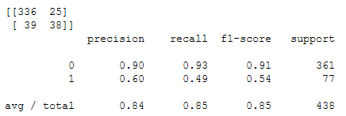
Machine Learning (SVM)
Machine Learning (K-NN)

Slide 21
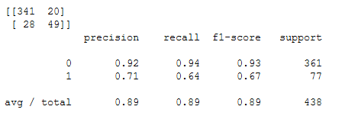
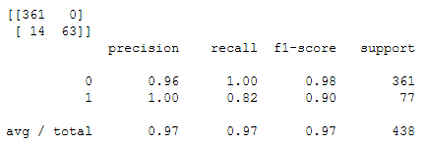
Machine Learning (Naïve Bayes)
Machine Learning (Kernel SVM)

Slide 22
Conclusion
Successful prediction
Currently this model is not capable of predicting possible future air accidents.
Dataset can be enriched with total flight hours of
each aircraft model,
engine, and
pilots during the accident in addition to
annual and total flight hours of each air carrier.

